Slide 1
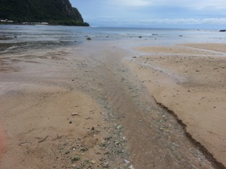
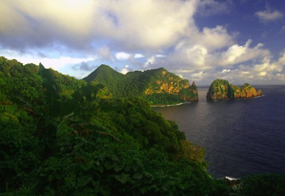
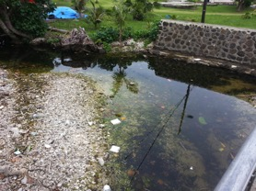
Effect of Stream Nutrients on Benthic Algal Overgrowth in Vatia Bay
By: Gabrielle Langkilde
Mentored by: Visa Vaivai-Tapusoa

Slide 2
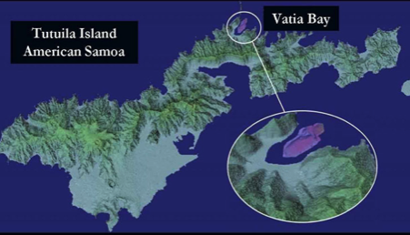
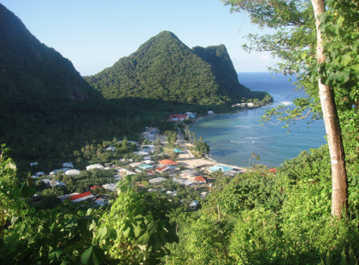
Vatia Bay, American Samoa
Vatia Bay is located on the island of Tutuila, American Samoa’s largest Island. The bay is isolated on the north side of the island, away from the majority of the population.

Slide 3
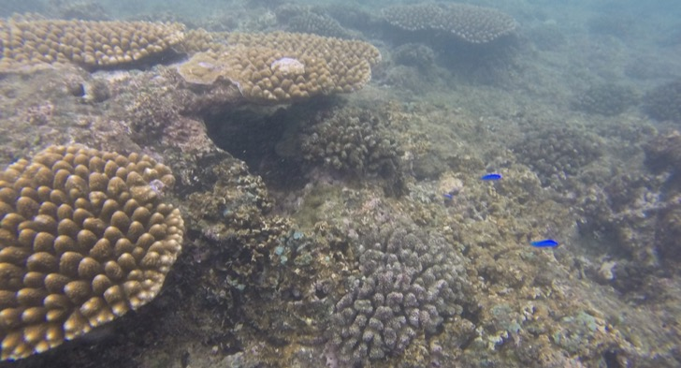
Vatia Bay, American Samoa
Vatia Bay is home to various coral species, which a recent NOAA study has found to be in danger due to harmful algae blooms.

Slide 4
Problem
Vatia Bay is experiencing an unusual overgrowth of benthic algae.
An overgrowth of benthic algae can be caused by excess nutrients in the ocean, specifically nitrogen and phosphorus. These algal blooms threaten to outcompete coral reefs, which are unique, economically-valuable ecosystems.
Notes:
Source: https://coastalscience.noaa.gov/projects/detail?key=245

Slide 5
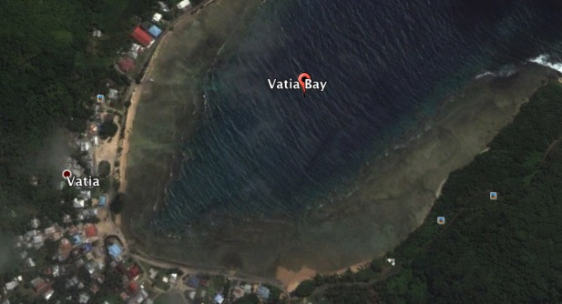
Streams Feeding Vatia Bay
✖
✖
Vatia Bay is fed by several streams, that run down through the village of Vatia.

Slide 6
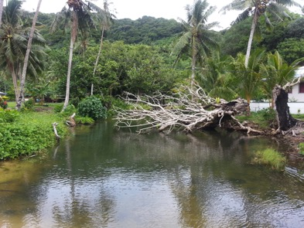
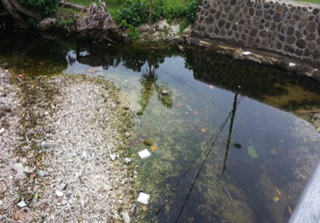
Streams Feeding Vatia Bay
Inventory and Monitoring Pacific Island Network (PACN ) water quality data on the streams feeding Vatia Bay indicates high nutrient levels.

Slide 7
Purpose
This project is aimed at examining whether there may be a relationship between high nutrient levels coming from the streams and the overgrowth of algae in the Bay.

Slide 8
Stream Nutrients- Nitrogen
Inventory and Monitoring PACN water quality data shows a median increase in levels of nitrogen from 2012 to 2014. Data for 2016 was unavailable for purposes of this study.
This data shown was collected from three different sites along the streams at different distances from the Bay.

Slide 9
Stream Nutrients- Phosphorus
Inventory and Monitoring PACN water quality data shows a median increase in levels of phosphorus from 2012 to 2014. Data for 2016 was unavailable for purposes of this study.
This data shown was collected from three different sites along the streams at different from the Bay.

Slide 10

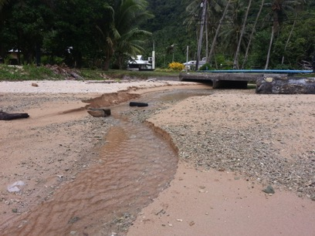
Stream Mouths
Stream 1
Stream 2
Two streams feeding the Bay, shown as Stream 1 and Stream 2, were identified for this project.

Slide 11
Stream Mouth Nutrients (2015)
According to NOAA data collected from the mouth of these two streams, levels of nitrogen far exceeded American Samoa Water Quality Standards (ASWQS).

Slide 12

Vatia Bay Nutrients (2015)
According to NOAA data collected from Vatia Bay, levels of nitrogen and phosphorus exceeded American Samoa Water Quality Standards (ASWQS).

Slide 13
Hypothesis
In examining whether there may be a relationship between the feeding stream nutrients and benthic algal growth, we hypothesized that the percentage of benthic algae on the ocean floor would decrease as the distance from the mouths of the streams increased.

Slide 14
Procedure
Three transects, extending from each stream mouth to the edge of the reef at 45, 90, and 135 degree angles were mapped, with points 20m apart.
135°
45 ° 90°
45 ° 90° 135°
Stream 1
Stream 2

Slide 15
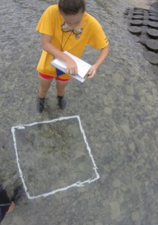
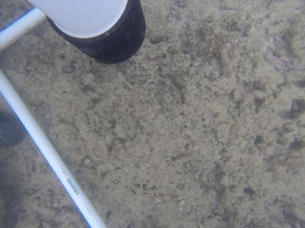
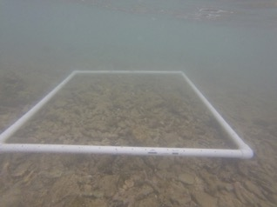
Procedure
At each of these points, a 1m by 1m quadrat was laid on the ocean floor. Using an aqua-scope to view the material, the percentage of algae, coral, sand, and other material was estimated.

Slide 16
Procedure
The data collected was graphed to show the relationship between the amount of algae and coral vs. the distance from the stream.
From the data, a linear line of best fit was graphed to show the general trend/slope of the data.

Slide 17
45°
Stream 1

Slide 18
90°
Stream 1

Slide 19
135°
Stream 1

Slide 20
45°
Stream 2

Slide 21
90°
Stream 2

Slide 22
135°
Stream 2

Slide 23
Overall Results- Algae
Percentage of Benthic Algal Cover vs. Distance from Stream
    Stream 1:
        45 degree transect = -0.1179
        90 degree transect = -0.1529
        135 degree transect = -0.0607
    Stream 2:
        45 degree transect = -0.0167
        90 degree transect = -0.0011
        135 degree transect = -0.0077
    The average slope of the six transects = -0.0595

Slide 24
Overall Results- Coral
Percentage of Coral vs. Distance from Stream
    Stream 1:
        45 degree transect = 0.1339
        90 degree transect = 0.1814
        135 degree transect = 0.0905
    Stream 2:
        45 degree transect = 0.0800
        90 degree transect = 0.0464
        135 degree transect = 0.0038
    The average slope of the six transects ≈ 0.0893

Slide 25
Conclusion- Algae
The overall average slope of the “Percentage of Benthic Algal Cover vs. Distance from Stream” for both streams was negative.
A negative slope supports our hypothesis, indicating that as the distance from the streams increases, the percentage of algae generally decreases.

Slide 26
Conclusion- Coral
The overall average slope of the “Percentage of Coral vs. Distance from Stream” for both of the streams was positive.
A positive slope shows that, as the distance from the streams increases, the percentage of coral generally increases.

Slide 27
Management Implications
Land-based pollution sites- piggeries, septic tanks, and agricultural fertilizers- are most likely the source of these high nutrient levels in the streams, possibly causing this algal overgrowth in the Vatia Bay.
A solution to this problem would be to enforce and implement ASEPA and other governmental policies, reducing nutrient pollution in the Bay’s feeding streams.

Slide 28
References
Curtis, Meagan- Department of Marine and Wildlife Resources American Samoa- (2016) “Nutrient Dynamics of Vatia Bay, American Samoa” (unpublished).
Inventory and Monitoring Pacific Island Network (PACN) Water Quality Data (2009-2014).
Whitall, David & Piniak, Greg (2015) “Nutrient Dynamics and Changes to Benthic Communities in Vatia, American Samoa”. https://coastalscience.noaa.gov/projects/detail?key=245

Slide 29
Acknowledgements
Visa Vaivai-Tapusoa, NPSA
Dr. Mark Schmaedick, American Samoa Land Grant
Dr. David Whitall, NOAA
Dr. Greg Piniak, NOAA
Meagan Curtis, American Samoa Department of Marine and Wildlife
Victor Kalei Groberg, NPSA intern (2016)
STEP-UP Program
American Samoa National Park Service

Slide 30
Thank You!

