Slide 1
Knowledge, Attitude, And Practice on Hygiene and Sanitation Among Households in Pohnpei, Federated States of Micronesia June and July 2019
Nick Raifmai, Robert Spegal, MPH
Our Lady of Mercy Catholic High School, College of Micronesia-FSM
Pohnpei, Federated States of Micronesia

Slide 2
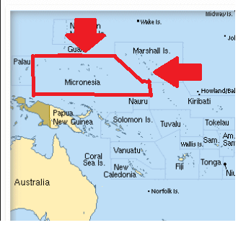
Federated States of Micronesia
Pohnpei is one of the four states of the Federated States of Micronesia. The capital of the FSM, Palikir, is located in Pohnpei.
Population : 36,196 (2010)
Fun Fact: In the name
Pohnpei, Pohn means
“Upon” and Pei means “altar”
Notes:
Name is Nick and I am from the FSM. Big bulk of land is aus

Slide 3
Introduction
Pacific Island Countries and Territories (PICT) experience some of the lowest levels of improved water, sanitation, and hygiene (WASH) on Earth (WHO 2016).
Low levels of improved water, sanitation, and hygiene are often directly related to experiences of poverty and/or conflict.
PICT, only one-third of people have access to basic sanitation facilities and basic water sources (WHO & UNICEF 2017)

Slide 4
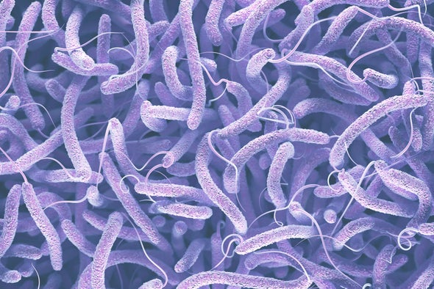
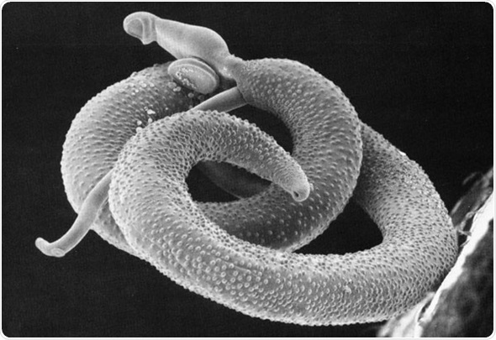
Consequences
Limited access to proper water, sanitation, and hygiene result in negative health outcomes.
Negative health outcomes include:
Diarrhea
Helminthes ( Parasitic Worms)
Cholera
Cholera
Helminth

Slide 5
Objective & Method
Improve sanitation practices through targeted behavioral change communication.
Demand the creation of and access to drinking water, sanitation marketing, solid waste, waste water, and drainage.
A survey was done in Kolonia Town and Kitti Municipal using a questionnaire by United Nations International Children’s Emergency Fund (UNICEF).
Recreation of survey that was done in the Phillippines.

Slide 6
Kolonia Town & Kitti Municipal
People were interviewed from these places because of the big differences in development in these two areas.
Kolonia Town is more developed than Kitti. There are a lot of buildings and cars in Kolonia. Kitti Municipal, on the other hand, is more rural and mostly trees fill the area

Slide 7
Survey
n=26 people took the survey: 11 males and 15 females
What is the survey asking?
Type of water source
How water is stored
Opinion on hygiene
How were people selected?
They were randomly selected.

Slide 8
Results
More than 50% had access to improved water sources while the other used unprotected springs, surface water, and piped water into their yard.
Out of the 26, only 14 of them treated their water by boiling, using water filter, letting it stand and settle, or straining it through cloth.
22 of them store their drinking water in covered containers, 1 stores in a tank, and 3 do not know.

Slide 9
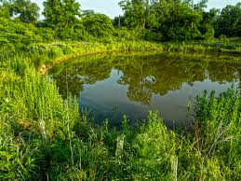
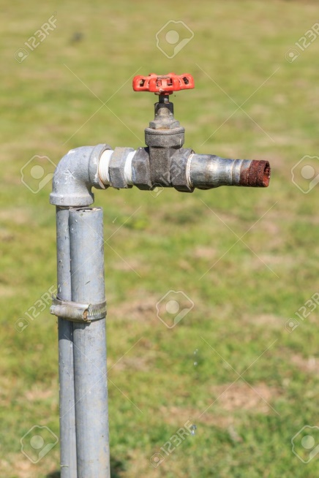
Unprotected Spring
Surface water
Piped Water into Yard

Slide 10
Results
8 of the people pay for their drinking water
Average price: $31/month.
All agreed that washing hands is important prior to feeding children and hand sanitation in general.
21 had flush/pour toilets, 1 had pit latrine with slab and 4 had composting toilets.
16 of them own the toilets that they use and 10 do not own toilets but would like to own one.
A majority of them said that people practice open defecation because there are no toilets within the area.

Slide 11
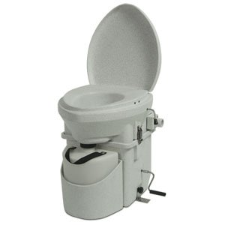
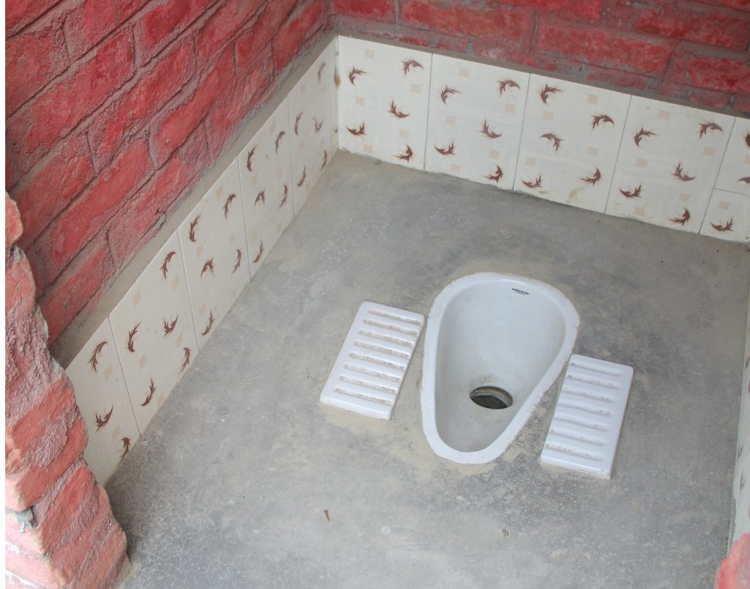
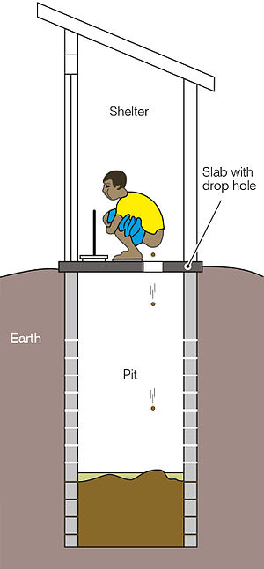
Composting Toilet
Pit Latrine with slab

Slide 12
Results
Open Defecation:
3 usually,
4 sometimes; and
5 rarely.
Of the 12, 2 said that all the household members defecate openly and 10 said some household members defecate openly.
A majority of the participants interviewed believe that defecating openly is not acceptable along with people in their community.

Slide 13
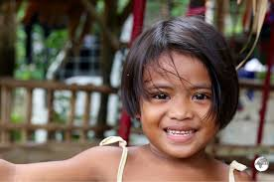
Conclusion
Shows improvements in basic water coverage, improved sanitation, and improved water source are needed.
Show how many of the interviewed people had access to adequate water sources and sanitation facilities.
Notes:
To conclude, a lot of information was gathered in the survey that

Slide 14
Recommendations
The FSM government is making efforts in promoting hygiene and spreading awareness and is well on their way to improving hygiene and sanitation for people in the FSM.
People should take steps to better their hygiene so that they can live a good and healthy lifestyle. Good hygiene means less probability of getting sick.

