Slide 1


Determining Total Phenolic and Anthocyanin Content in Varieties of Capsicum annuum (Hot Pepper) in Guam
Nathan Grant Sala, Stanford University
Mentor: Mari Marutani PhD, University of Guam
Coordinating Center: University of Hawaii at Manoa

Slide 2
What are Phenolics?
A type of phytochemical (”plant chemical”) that are commonly found in fruits and vegetables.
Commonly associated with the antioxidant activity of plants.
Notes:
Name “phenolics” refers to the chemical structure of the molecules – contains a ring-shaped “phenol” group.
Association with antioxidant activity has lead to research interest on their interactions and effects on human health.

Slide 3
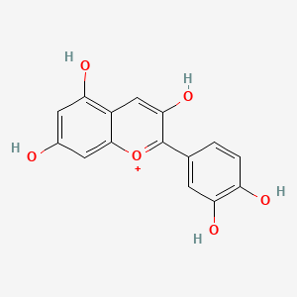
What are Anthocyanins?
A type of flavonoid (subgroup of phenolics) that commonly present as orange, red, or purple color in plants.
Possible use as natural food colorant.
Also associated with antioxidant activity.
Basic Anthocyanin
Structure
Notes:
One topic of current research on anthocyanins is the extraction and use of anthocyanins as a natural food dye. Additionally, as a phenolic compound, the interactions of anthocyanins on human health is another field of research interest.
Fun fact: Anthocyanins are reactive to changes in acidity and can be used as pH indicators.
For our study, we wanted to focus on two anthocyanins. The first anthocyanin, Chrysanthemin (or Cyanidin-3-Glucoside) is the most common anthocyanin found in plants containing anthocyanins. The second, Nasunin, or Delphinidin-3-p-coumaroylrutinoside-5-glucoside, is one that was first found in eggplants and was identified by literature to be found in Mexican cultivars of hot pepper.

Slide 4
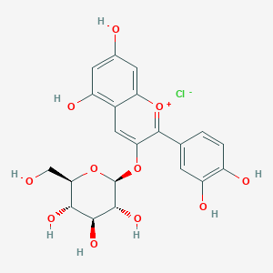
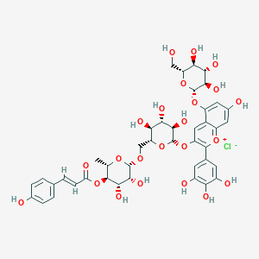
Anthocyanins in Capsicum annuum
Chrysanthemin
(Cyanidin-3-glucoside)
Magenta, Orange, Crimson
  Nasunin
  (Delphidin-3-p-coumaroylrutinoside-5-glucoside)
  Purple
Notes:
Left: Chrysanthemin (Cyanidin-3-Glucoside)
Right: Nasunin (Delphindin-3-p-coumaroylrutinoside-5-glucoside)

Slide 5
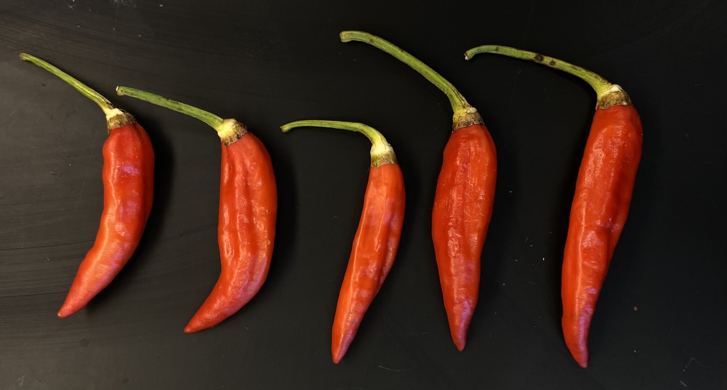
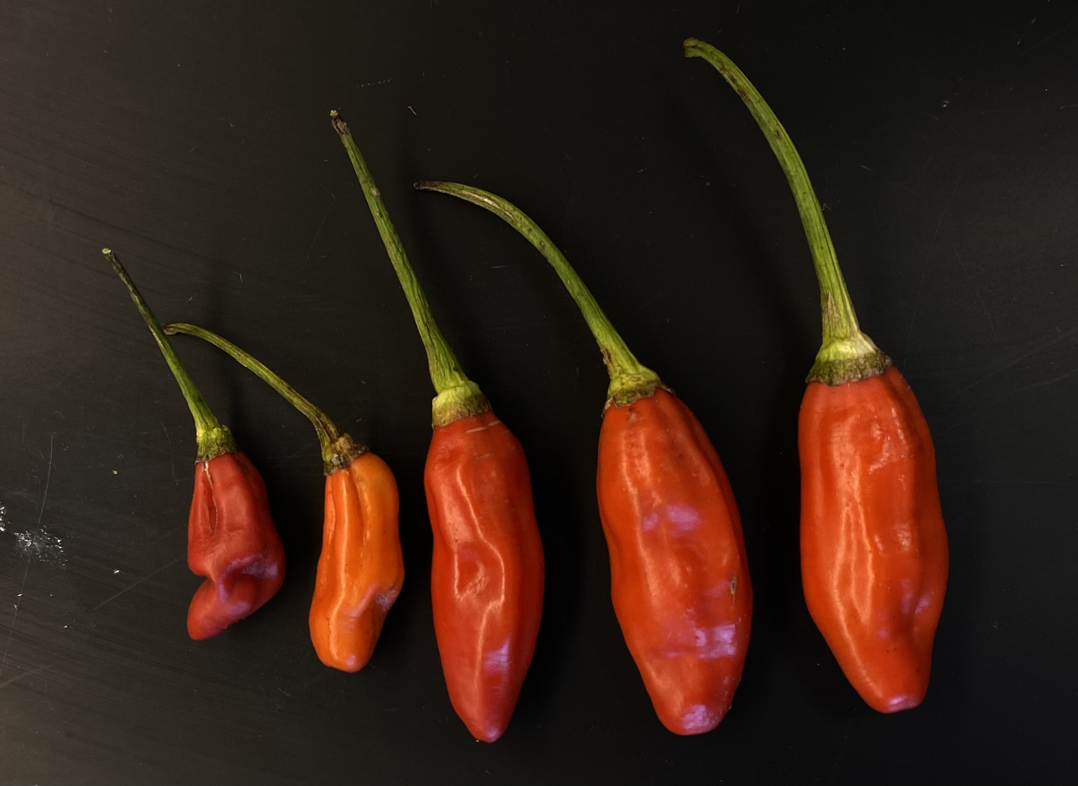
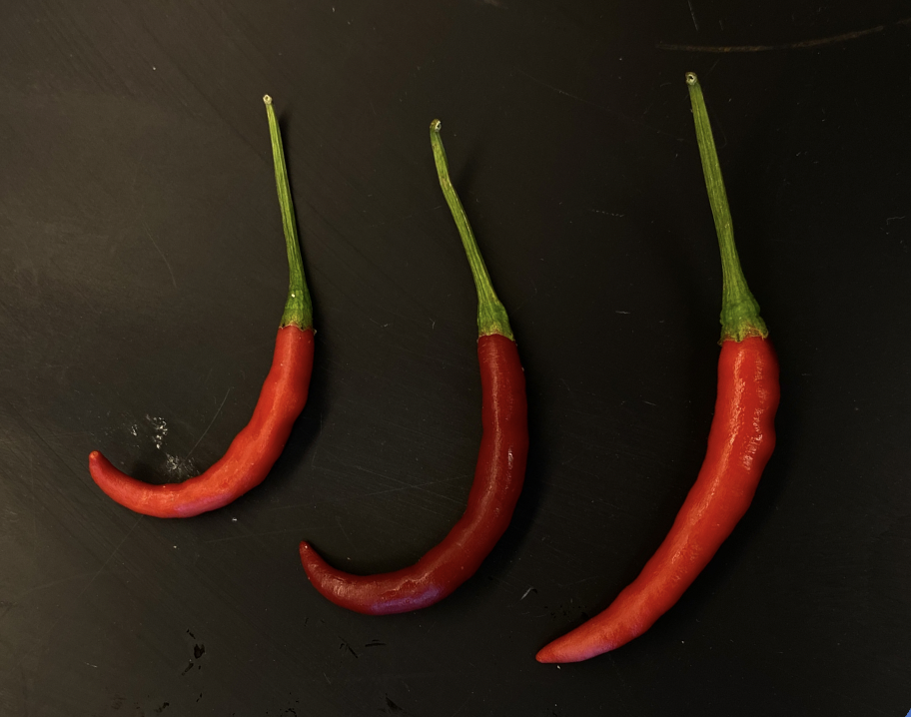
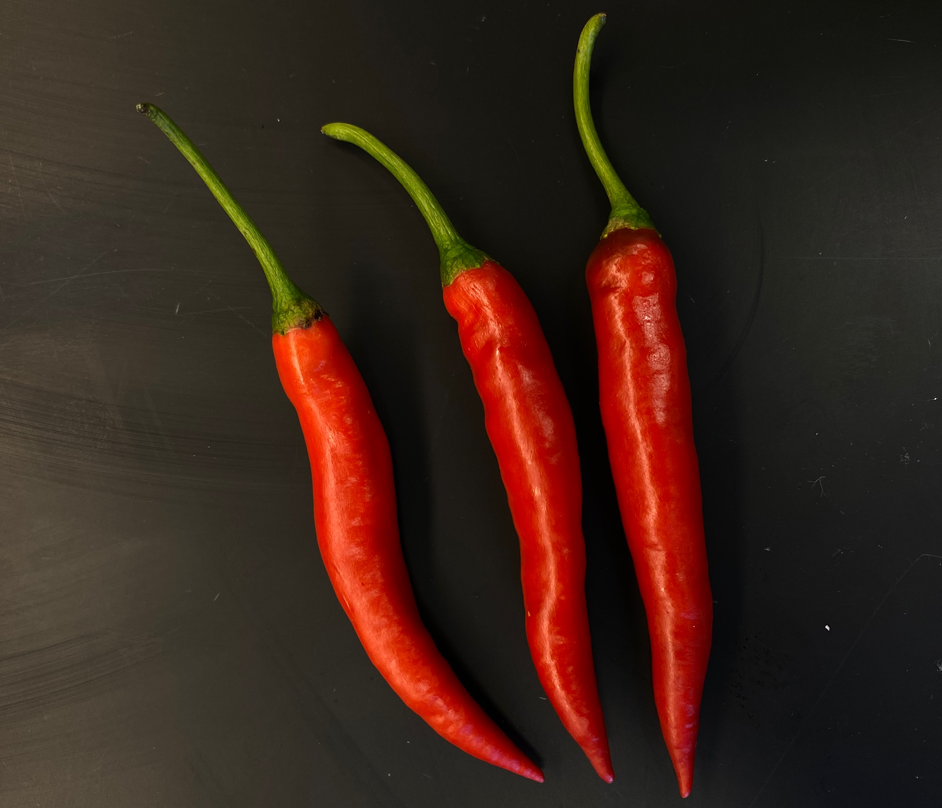
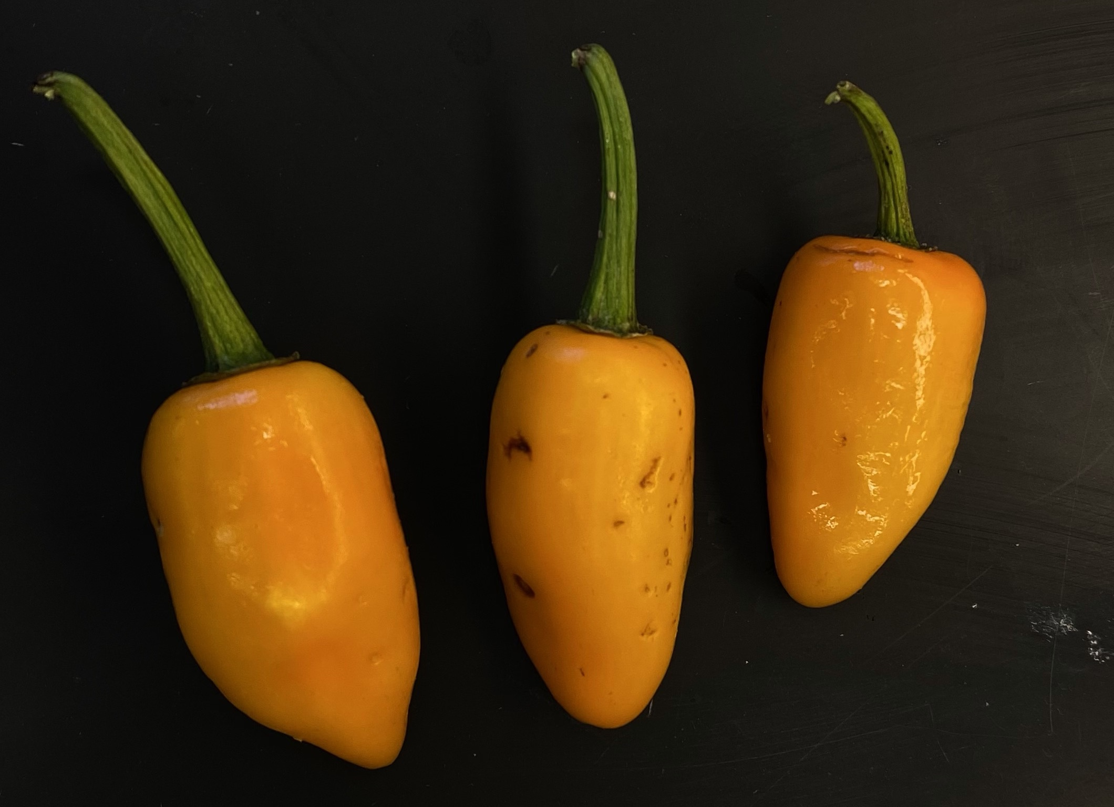
Varieties of Hot Peppers in Guam
Guåfi
Toves
Saipan
Barcinas
Håchon
Notes:
Why hot peppers? Hot Peppers, known in Chamorro as Donne’ are a prominent ingredient in the cuisine of Guam.

Slide 6
Research Questions
How can we numerically characterize differently colored peppers?
Do different colored peppers have different amounts of phenolic compounds and anthocyanins?

Slide 7
Hypothesis
All varieties of pepper have comparable CIELAB L*, a*, b* color space (Lightness, Red/Green, Yellow/Blue) values.
All varieties of pepper have comparable concentrations of total phenolics.
All varieties of pepper have comparable concentrations of anthocyanins.
Notes:
We hypothesized that the red colored varieties of hot pepper Barcinas, Guafi, Saipan, and Toves would have similar concentrations of total phenolics and of anthocyanins, and that the yellow-colored variety of hot pepper Hachon would have a different concentration of phenolics and anthocyanins than the other peppers.
Our basis for this hypothesis was CIELAB L* a* and b* data that was collected from fresh peppers prior to the experimental method using a colorimeter.
Kruskal-Wallis One-Way Analysis of Variance Testing and Dunn multiple-comparison testing for each set of data L*, a*, and b*, Hachon was significantly different than 2 other pepper varieties.
confirmed that Hachon was statistically significantly different than Toves and Saipan for L*, Guafi and Saipan for a*, and Guafi and Barcinas for b*. OR

Slide 8
Objectives
To determine CIELAB Color Space L*, a*, b* values of locally grown hot peppers from Guam.
To determine the concentration of total phenolics in locally grown hot peppers from Guam.
To identify and quantify the concentration of anthocyanins present in locally grown hot peppers from Guam.
Notes:
The objectives for this project were to determine the concentration of total phenolics, to identify the types of anthocyanins present, and determine the concentration anthocyanins in locally grown hot peppers from Guam. This is the first recorded study of its kind conducted on local peppers on Guam.

Slide 9
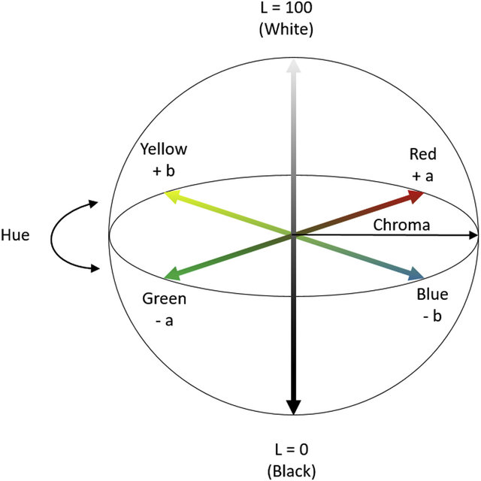
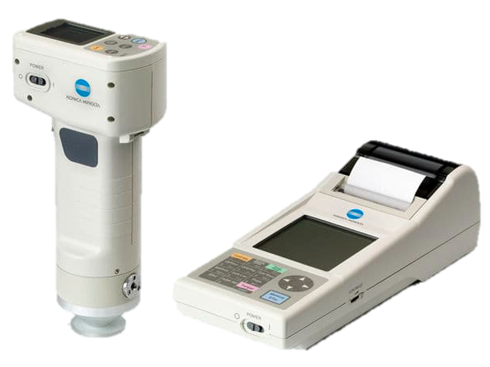
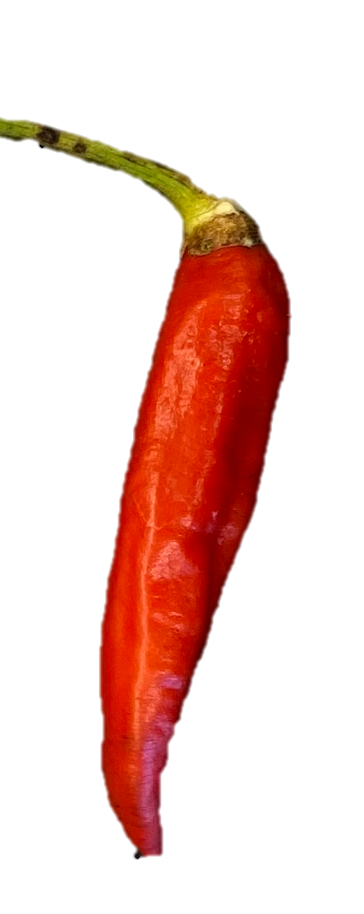
Methods
Objective 1: Determination of CIELAB Values
Colorimeter
CIELAB Color Space
Notes:
Using a colorimeter, the L*, a* and b* values of each pepper was collected from ripe, fresh pepper fruits five times each.

Slide 10
Methods
Objectives 2&3: Preparation of Hot Pepper Samples
Fresh pepper fruits were harvested from the UOG Yigo Research Center.
Pepper fruits were cleaned, cut into small pieces, and freeze-dried.
Freeze-dried pepper was ground into powder and stored in the freezer for later use.
Notes:
To begin preparation of the hot pepper samples, fresh pepper fruits were harvested from the UOG Yigo Field, cleaned, and freeze dried. The freeze dried pepper flesh was then ground into a powder and used to prepare the pepper extracts used for analysis.

Slide 11
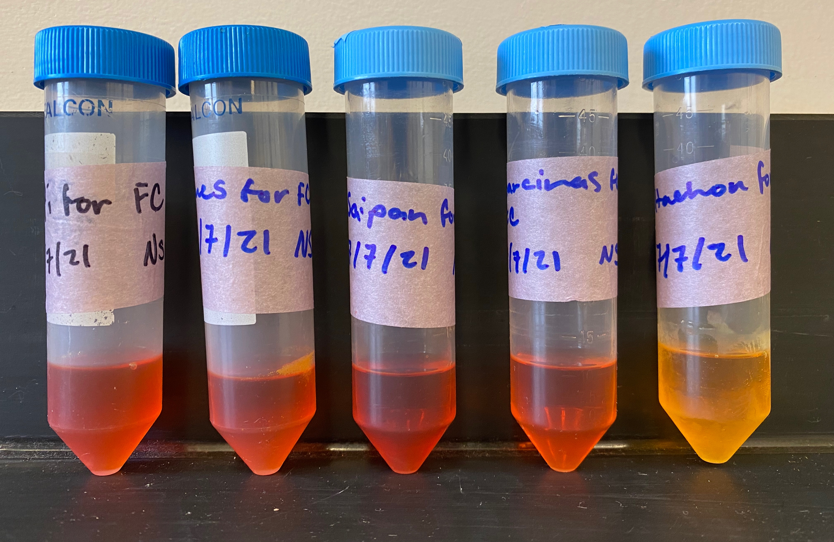
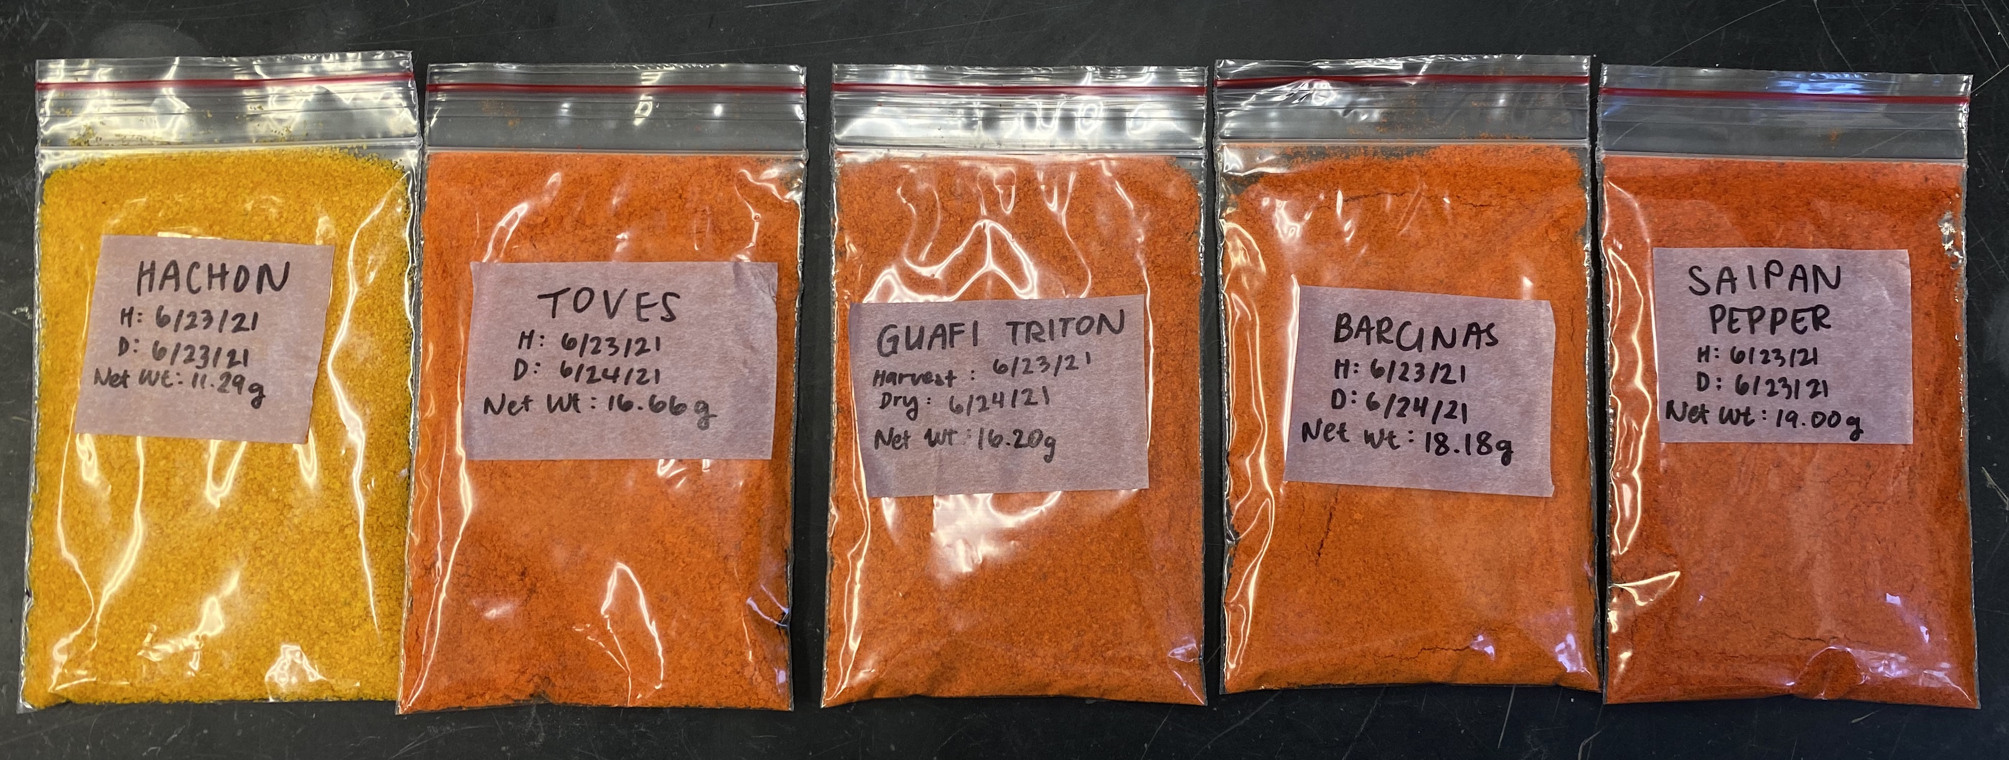
Methods
Objective 2: Preparation of Pepper Extract for Phenolics Analysis
Pepper powder (2g) was mixed with acidified methanol (20 mL 0.005% HCl) and phenolics extracted by magnetic stirring over 15 minutes.
Crude extracts were filtered using filter paper and a 0.2 μm syringe filter.
Notes:
Pepper powders were then combined with acidified methanol and compounds extracted by use of a magnetic stir plate and stir bar. The amounts of pepper powder, concentration of extraction solvents, and extraction time were based on previous literature. For the extraction of anthocyanins, a more acidic extraction solvent was necessary in order to optimize the efficiency of anthocyanins by keeping the anthocyanins in their more stable ionic species.
Before analysis, extracts were filtered through filter paper and through a 0.2 micron syringe membrane filter to remove any solids and particle matter that may affect analysis of the extracts.

Slide 12

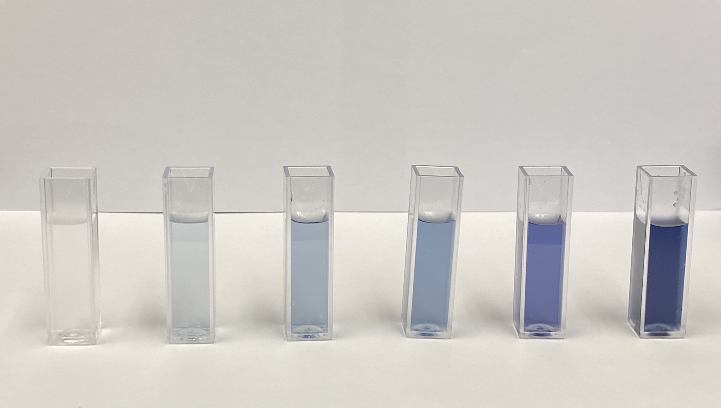
Methods
Objective 2: Analysis of Total Phenolics
For each extract prepared from peppers, samples were prepared for Folin-Ciocalteu analysis as described in literature (Arnnok, 2012).
Notes:
To determine the concentration of phenolics in the local hot peppers, the Folin-Ciocalteu assay was run using pepper extracts. In the FC assay, Folin-Ciocalteu reagent reacts with phenolic componds present in a sample, turning from a yellow color to a distinct blue color.
Using UV-Visible Spectroscopy, differences in the absorbance capacity of samples run using the FC assay were measured and compared to the absorbance capacity of Gallic Acid standard solutions of known concentration treated with the FC assay in order to quantify the concentration of phenolics in the samples.

Slide 13
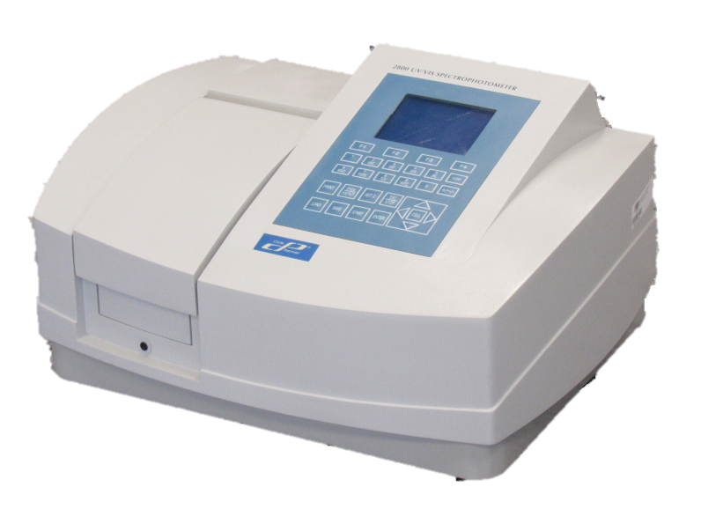
Methods
Objective 2: Analysis of Total Phenolics
Absorbance of each sample at 745 nm was recorded using UV-Visible spectroscopy.
Absorbance values of samples were compared to absorbance values of gallic acid standards of known concentration.
Notes:
To determine the concentration of phenolics in the local hot peppers, the Folin-Ciocalteu assay was run using pepper extracts. In the FC assay, Folin-Ciocalteu reagent reacts with phenolic componds present in a sample, turning from a yellow color to a distinct blue color.
Using UV-Visible Spectroscopy, differences in the absorbance capacity of samples run using the FC assay were measured and compared to the absorbance capacity of Gallic Acid standard solutions of known concentration treated with the FC assay in order to quantify the concentration of phenolics in the samples.

Slide 14
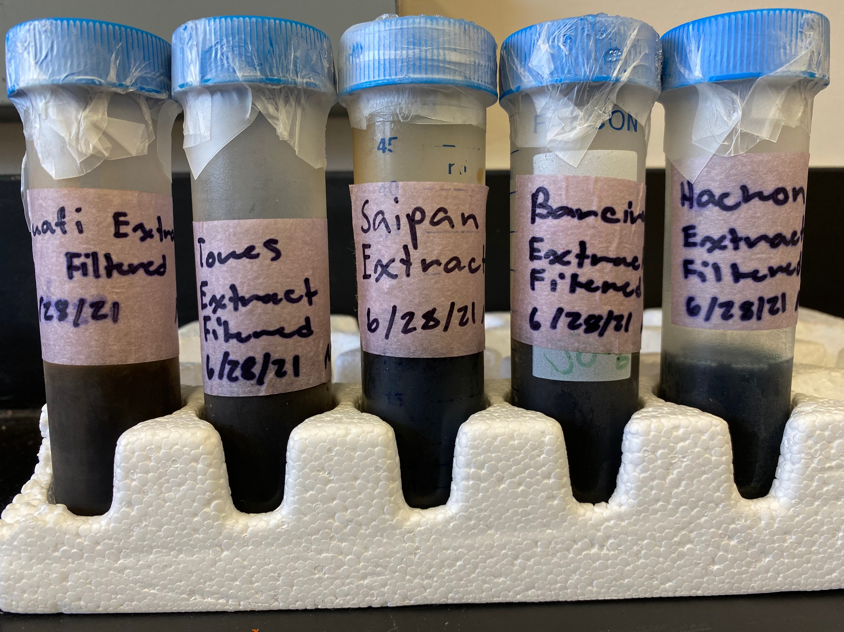
Methods
Objective 3: Preparation of Hot Pepper Samples for Anthocyanin Analysis
Pepper powder (10g) was mixed with acidified methanol (50 mL 2% HCl) and anthocyanins extracted using magnetic stir plate and bar for 15 minutes.
Crude extracts were filtered using filter paper and a 0.2 μm syringe filter.
Notes:
Pepper powders were then combined with acidified methanol and compounds extracted by use of a magnetic stir plate and stir bar. The amounts of pepper powder, concentration of extraction solvents, and extraction time were based on previous literature. For the extraction of anthocyanins, a more acidic extraction solvent was necessary in order to optimize the efficiency of anthocyanins by keeping the anthocyanins in their more stable ionic species.
Before analysis, extracts were filtered through filter paper and through a 0.2 micron syringe membrane filter to remove any solids and particle matter that may affect analysis of the extracts.

Slide 15
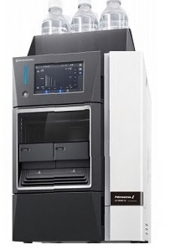
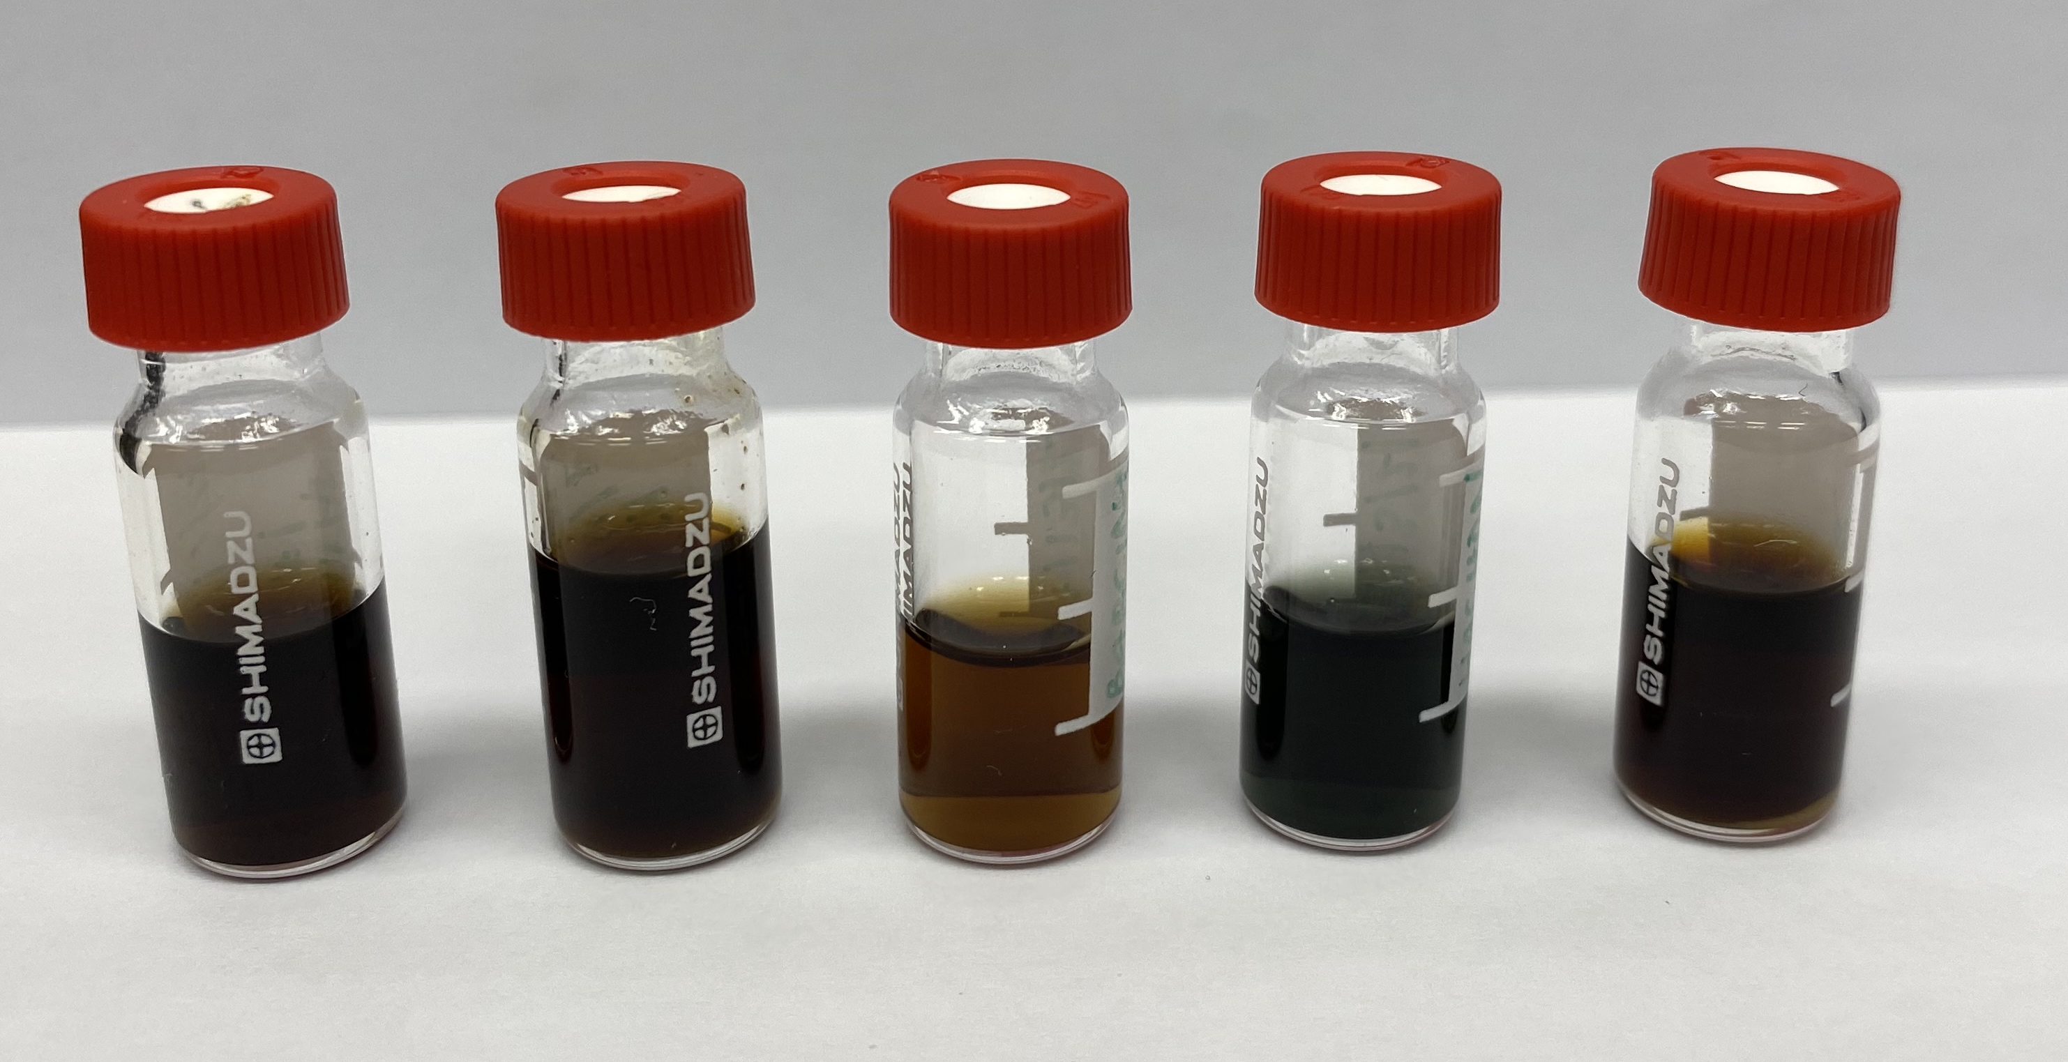
Methods
Objective 3: Analysis of Anthocyanins by HPLC
Extracts were run using High-Performance Liquid Chromatography.
  Wavelength: 520 nm
  Chrysanthemin: Commercial Standard
  Nasunin: Comparison
Notes:
To determine the type and concentration of anthocyanins in the local hot peppers, pepper extracts were run using high-performance liquid chromatography, an instrument used to separate the compounds that make up a given sample.
The pepper extracts were run at 520 nanometers, the wavelength at which anthocyanins are detected using HPLC. To determine the concentraction of Chrysanthemin present in a sample, values collected using HPLC were compared to a commercially-available standard of known concentration.
Because no standard for Nasunin is available commercially, we confirmed the presence of nasunin in our pepper samples by comparing HPLC chromatographs of each pepper to chromatographs of arbol pepper, which was found previously in literature to contain Nasunin following a characteristic chromatograph pattern.

Slide 16
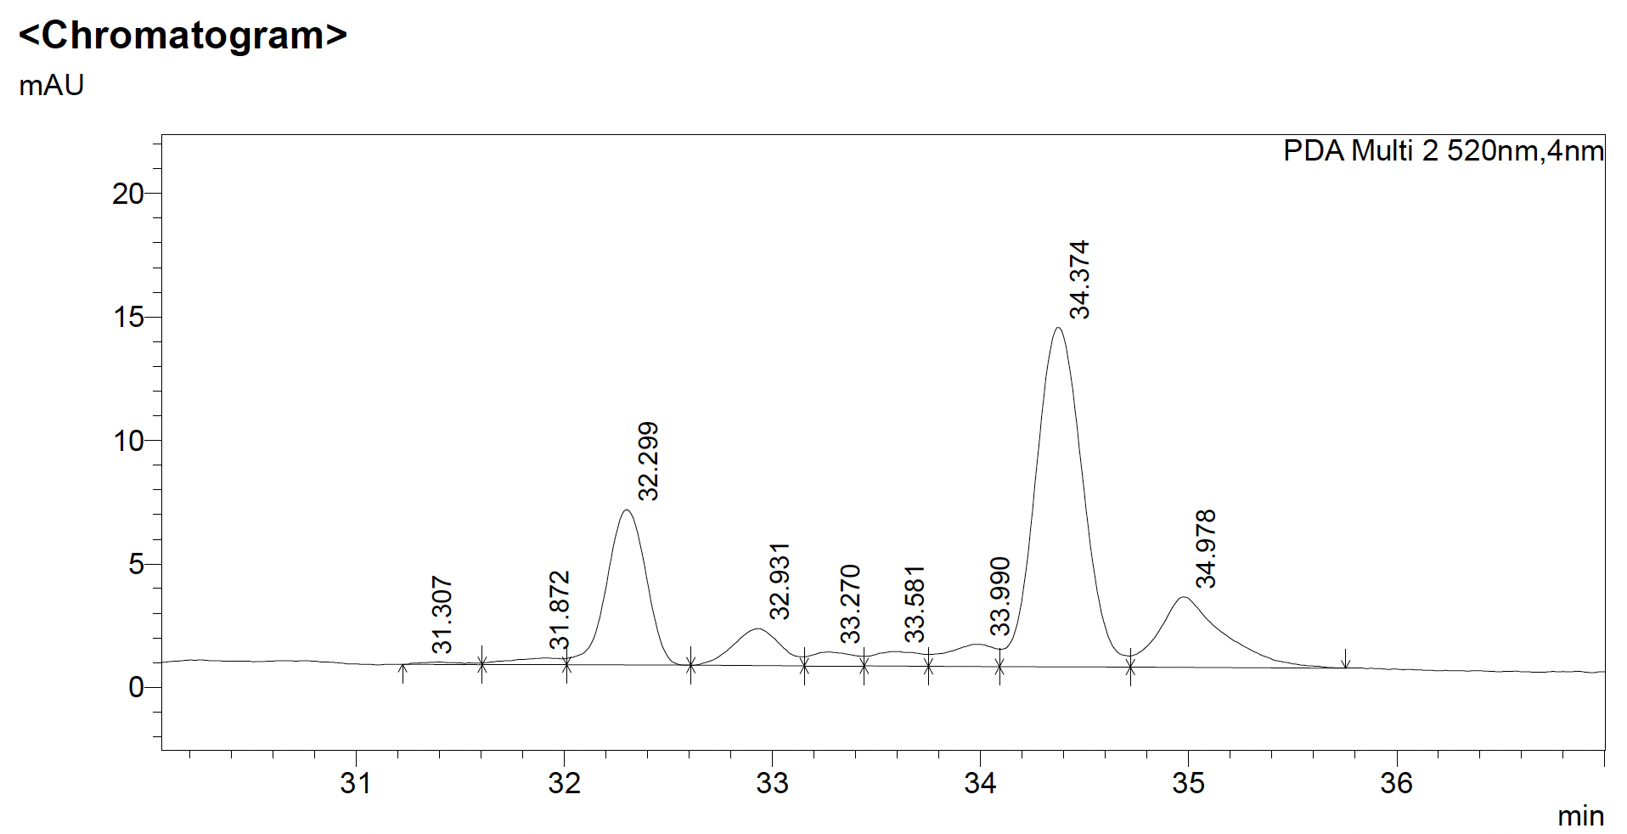
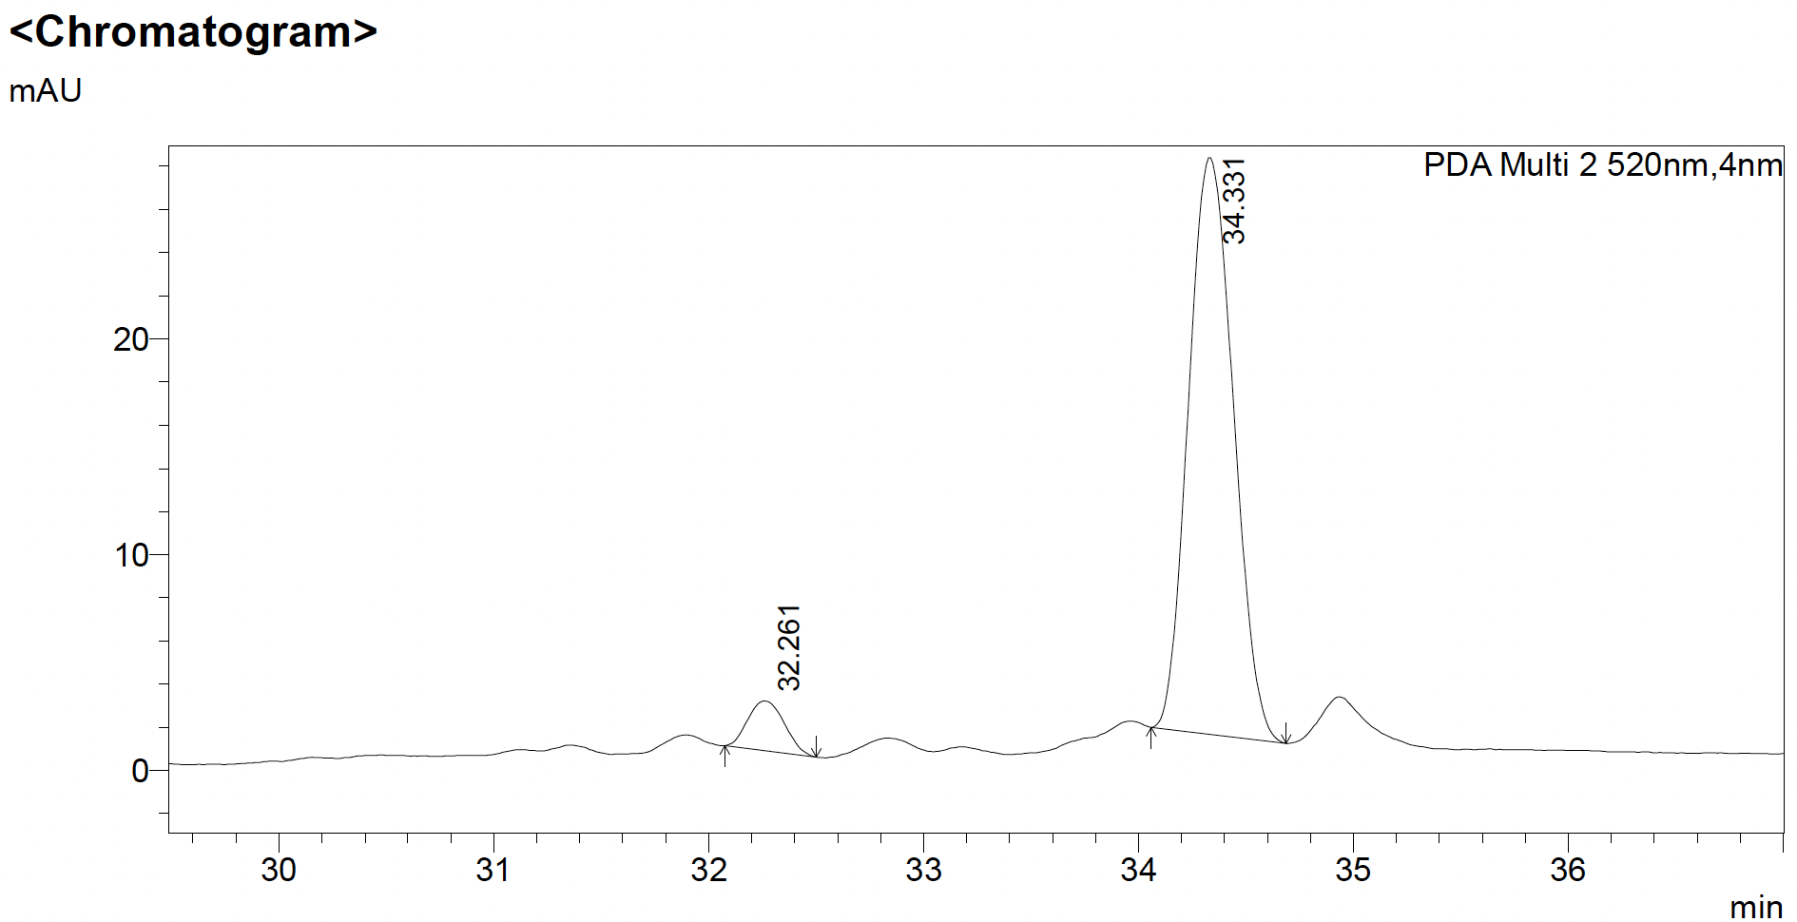
Methods
Objective 4: Identification of Anthocyanins
Cis Isomer
Trans Isomer
Presumptive Nasunin Peaks
(Guam Hot Peppers)
Cis Isomer
Confirmed Nasunin Peaks in Arbol Pepper
(Aza-Gonzalez, 2012)
Trans Isomer
Notes:
To determine the type and concentration of anthocyanins in the local hot peppers, pepper extracts were run using high-performance liquid chromatography, an instrument used to separate the compounds that make up a given sample.
The pepper extracts were run at 520 nanometers, the wavelength at which anthocyanins are detected using HPLC. To determine the concentraction of Chrysanthemin present in a sample, values collected using HPLC were compared to a commercially-available standard of known concentration.
Because no standard for Nasunin is available commercially, we confirmed the presence of nasunin in our pepper samples by comparing HPLC chromatographs of each pepper to chromatographs of arbol pepper, which was found previously in literature to contain Nasunin following a characteristic chromatograph pattern.

Slide 17
Methods
Data Analysis
CIELab (L*a*b*): Five (5) Readings per pepper
Phenolics and Anthocyanins: Three (3) Trials per pepper
One-Way Analysis of Variance (ANOVA) and Tukey’s Multiple Comparison tests performed on data collected.
Graphs constructed using GraphPad Prism.
3-D Scatterplot constructed using Python (Matplotlib)
Notes:
To determine the type and concentration of anthocyanins in the local hot peppers, pepper extracts were run using high-performance liquid chromatography, an instrument used to separate the compounds that make up a given sample.
The pepper extracts were run at 520 nanometers, the wavelength at which anthocyanins are detected using HPLC. To determine the concentraction of Chrysanthemin present in a sample, values collected using HPLC were compared to a commercially-available standard of known concentration.
Because no standard for Nasunin is available commercially, we confirmed the presence of nasunin in our pepper samples by comparing HPLC chromatographs of each pepper to chromatographs of arbol pepper, which was found previously in literature to contain Nasunin following a characteristic chromatograph pattern.

Slide 19
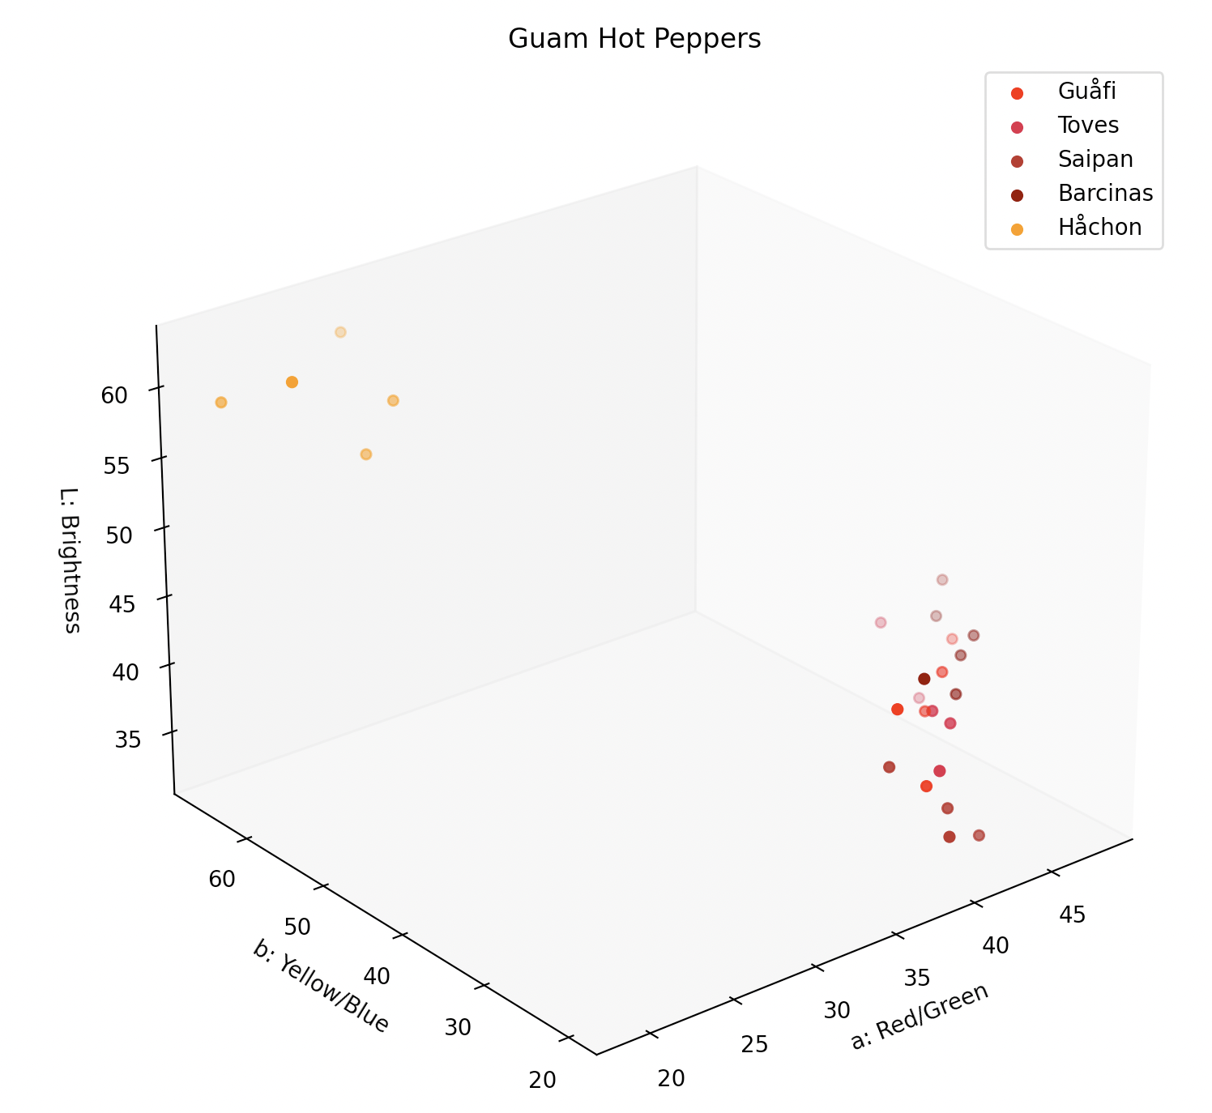

Slide 23
Discussion – Objective 1
L*, a*, b* values were similar for red-colored varieties of peppers from Guam.
L*, a*, b* values of yellow-colored Håchon differed from red-colored varieties of peppers.
Notes:
We found chrysanthemin concentrations in Guam cultivars of hot pepper to be lower in concentration than Thai cultivars of hot pepper as reported by literature. Literature suggested concentrations of 782.07 mg/kg to 4516.2 mg/kg fresh weight of hot peppers; we measured concentrations ranging from 0.037 mg/kg to 0.704 mg/kg fresh weight of hot peppers.

Slide 24
Discussion - Objective 2
Total phenolics concentrations of hot peppers from Guam were within the range reported in literature (Arnnok, 2012).
  Literature: 0.782– 4.516 g/kg (Fresh Weight)
  Guam Peppers: 1.074 – 2.308 g/kg (Fresh Weight)
Notes:
We found chrysanthemin concentrations in Guam cultivars of hot pepper to be lower in concentration than Thai cultivars of hot pepper as reported by literature. Literature suggested concentrations of 782.07 mg/kg to 4516.2 mg/kg fresh weight of hot peppers; we measured concentrations ranging from 0.037 mg/kg to 0.704 mg/kg fresh weight of hot peppers.

Slide 25
Discussion – Objective 3
Chrysanthemin concentrations of hot peppers from Guam were overall lower than reported in literature (Arnnok, 2012).
  Literature: 0.795 – 2.78 mg/kg (Fresh Weight)
  Guam Peppers: 0.056 – 1.134 mg/kg (Fresh Weight)
Nasunin identified in all red-colored varieties.
  Not detected in Håchon.
Notes:
We found chrysanthemin concentrations in Guam cultivars of hot pepper to be lower in concentration than Thai cultivars of hot pepper as reported by literature. Literature suggested concentrations of 782.07 mg/kg to 4516.2 mg/kg fresh weight of hot peppers; we measured concentrations ranging from 0.037 mg/kg to 0.704 mg/kg fresh weight of hot peppers.

Slide 26
Future Study
Quantification of Nasunin concentration in local varieties of hot pepper.
Determining the concentration of other phytochemicals in local varieties of hot pepper.
Determining the antioxidant activity of local varieties of hot pepper by DPPH and TEAC assays.
Notes:
In addition to HPLC, analysis of detected compounds using mass spectrometry could be carried out in order to more definitively identify the anthocyanins present in Guam cultivars of hot pepper.
In addition to anthocyanins, analysis of other phytochemicals, such as carotenoids, in Guam cultivars of hot pepper is of research interest.
While the Folin-Ciocalteu assay may give an indirect evaluation of the antioxidant activity of Guam cultivars of hot pepper by quantifying the total phenolics present, free-radical scavenging assays such as the DPPH ( 2,2-diphenyl-1-picrylhydrazyl) and TEAC (Trolox equivalent antioxidant capacity) could give a better picture of the antioxidant activity of Guam cultivars of hot pepper.

Slide 27
Special Thanks:
NIH/NIDDK STEP-UP (Grant #R25DK07836)
Dr. George Hui, PhD – Pacific STEP-UP Director
Dr. Anita Enriquez– Guam STEP-UP Collaborator
Aneesa Golshan – Pacific STEP-UP Coordinator
Kristina Sayama – Guam STEP-UP Coordinator

Slide 28
Special Thanks:
Dr. Mari Marutani, PhD, University of Guam
Maegan Delfin, BS, University of Guam
Chieriel Desamito, MS, University of Guam
Greciella Mae Valerio, University of Guam
Jester Kyle Calalang, University of Guam

Slide 29
Questions?
Thank you!

