Slide 1
An Island in Crisis:
The Relationship Between Community Disasters and Admissions Into A Psychiatric Ward
By: Ryan Kang
Marianas High School
Saipan, CNMI
Mentors: Johnny Aldan, Bachelor of Science in Nursing, Registered Nurse
Josh Tanghal, Associates of Science in Nursing, Registered Nurse
Coordinating Center: University of Hawai’i at Manoa

Slide 2
Background
Criteria for admission:
Clinician determines psychiatric illness — needs immediate attention
All other restrictive level of care is inappropriate
Imminent danger to self or others, or impaired judgement
Risk Factors:
Biophysical (Genetic / Pregnancy)
Psychosocial (Low Socioeconomic Status / Traumatic Disaster)
Individual (Childhood Abuse )

Slide 3
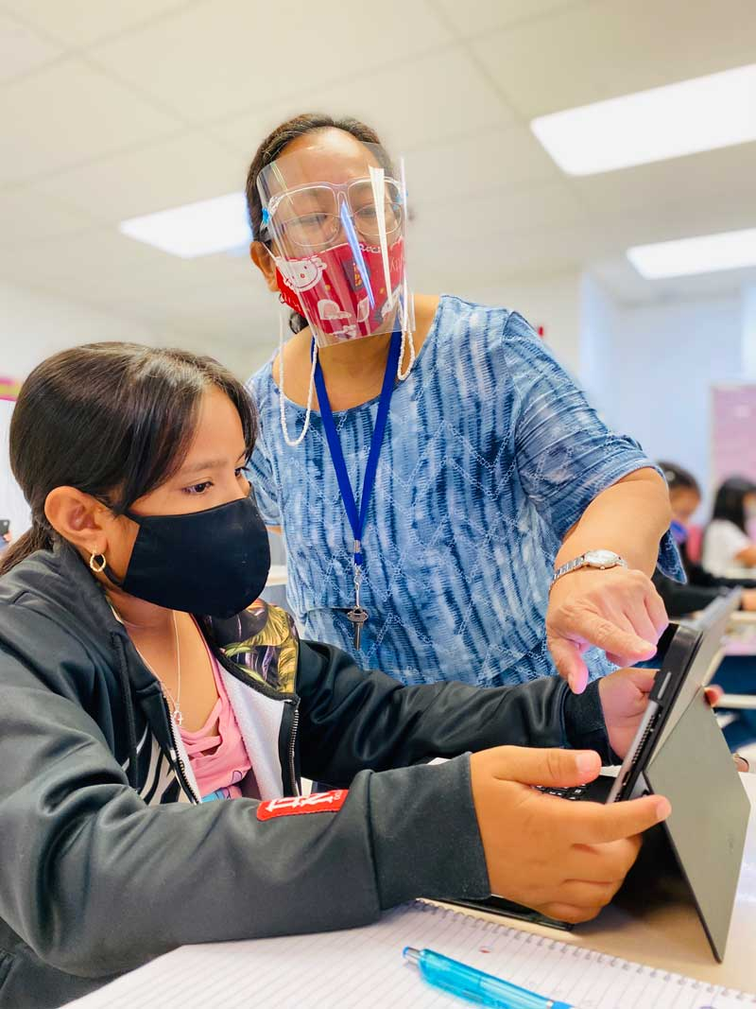
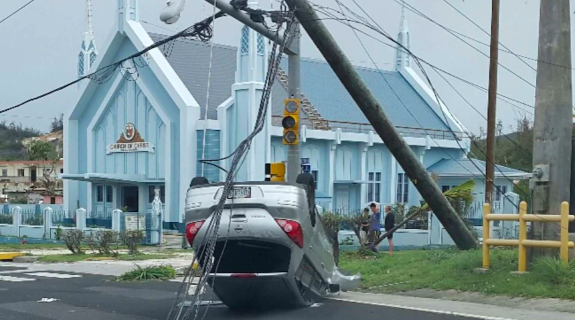
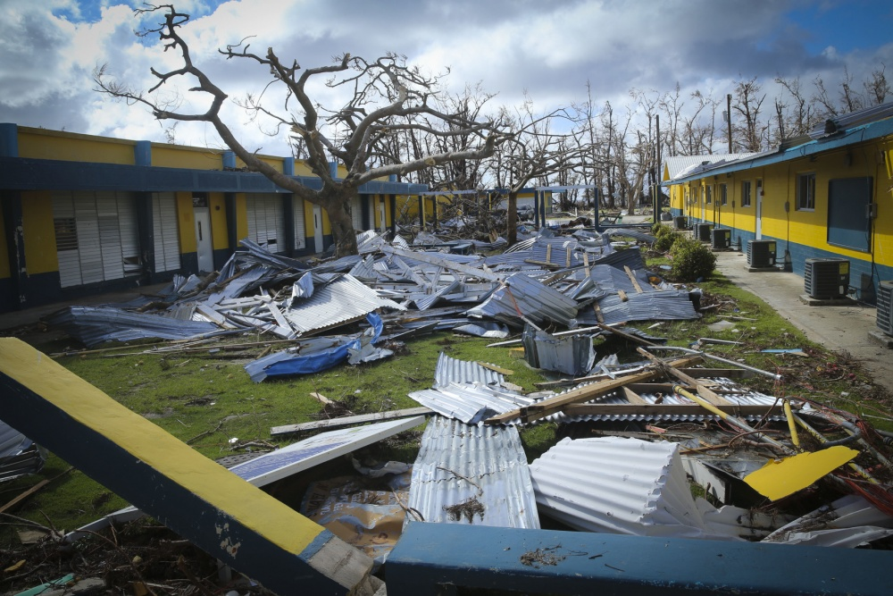
Community Crises
2015
2020
2018
Super Typhoon Soudelor
COVID Pandemic
Super Typhoon YUTU

Slide 4
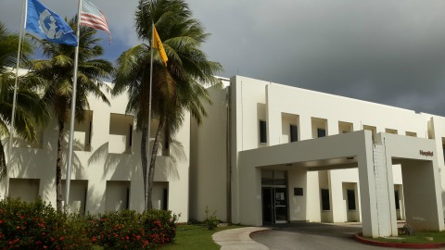
Goals:
Find relationship between psychiatric ward admissions and times of community crises.
Commonwealth Healthcare Center
June 28 - July 20 — Gather Data
July 21 - 28 — Organize Data

Slide 5
Significance
Predictions
Community Outreach
Demographic
Will there be an increase in psychiatric admissions?
When is a good time for community outreach?
Which demographics are most susceptible?

Slide 6
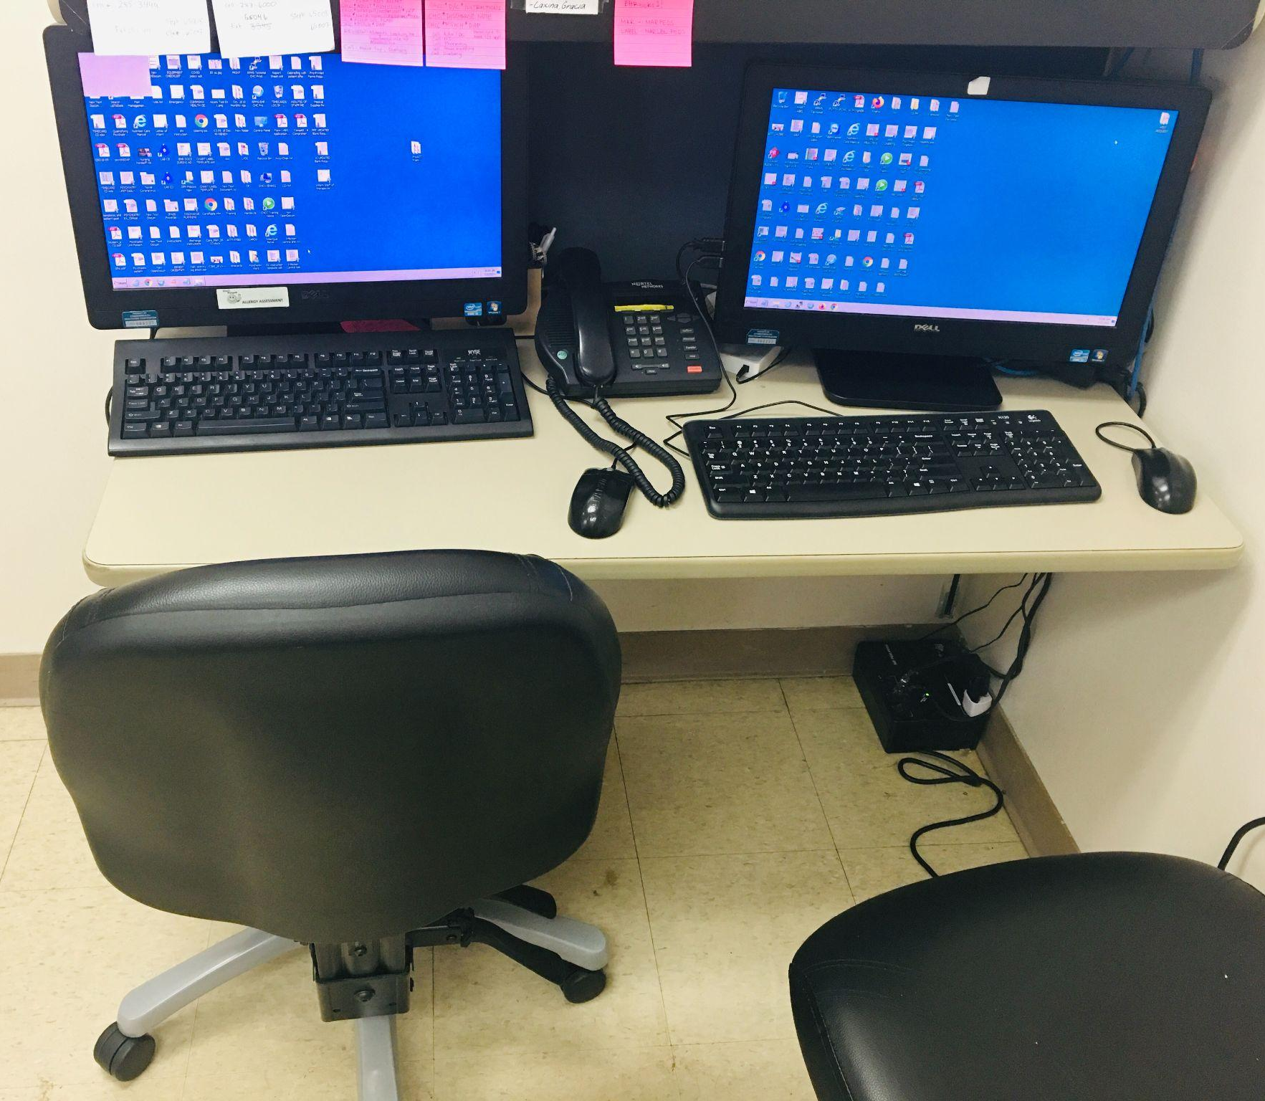
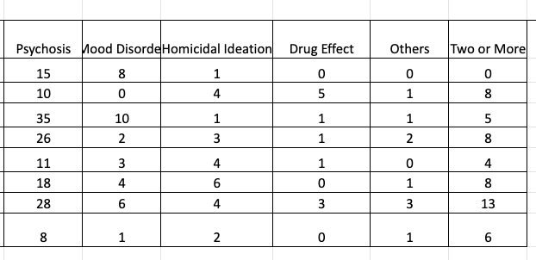
Methods:
Book
Records
Stratify Data
Paper admission and discharge records
Digital Records kept by the hospital
Organization

Slide 7
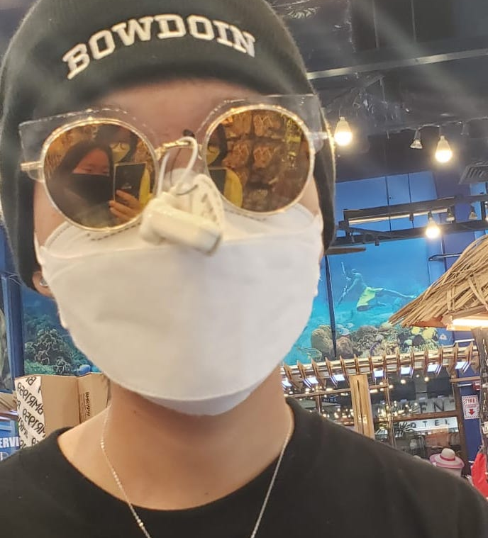
Sample Psychiatry Inpatient Admin Note
ID Data: Ryan, 18 yo male, Korean, full-time student at XYZ high school, 1 sister, lives with mom
Name
Ryan Kang
CC: Pt admitted for increased stressors: family stress + school stress. Suicidal Ideation
Age
18
Sex
Male
S: Denied medicine compliance. Depression lasts for past two weeks after failing exam. Met today to discuss therapy with counselor. Multiple psychosocial stressor
DOB
02/24/2003
O: Appearance: Appropriate, groomed Behavior: Cooperative Speech: Normal Mood: Dysphoria Perception: Normal Cognition: Alert, oriented
Dx: MDD
A: Ryan, 18, has h/o MDD and admitted inpatient for acute feelings of self harm. Cont. hospitalization for safety + observation
P: Keep under supervision, Start back up on medication XYZ, discharge on future date, f/u next week

Slide 8
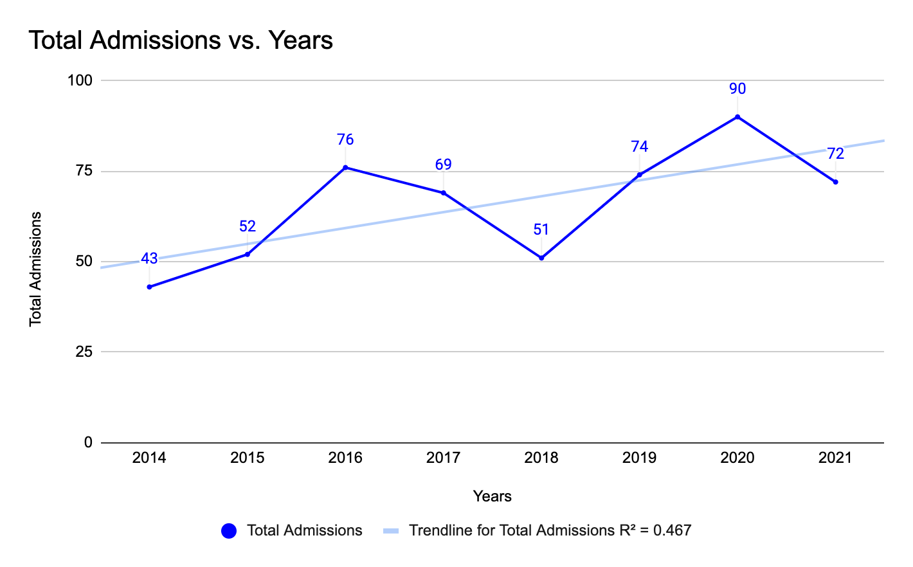
Results:

Slide 9
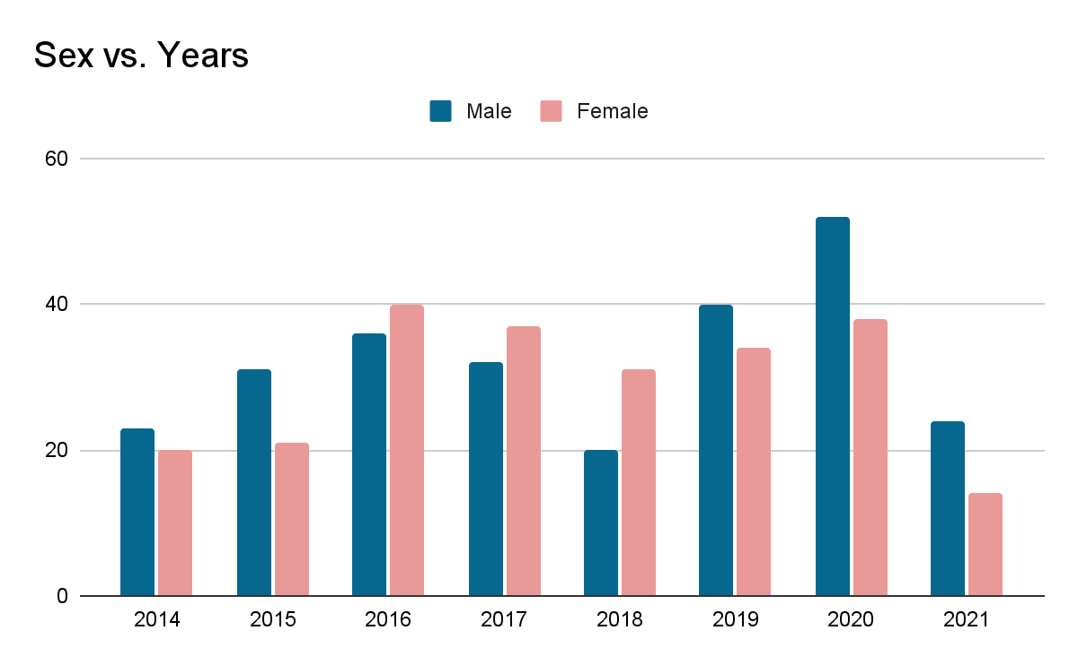
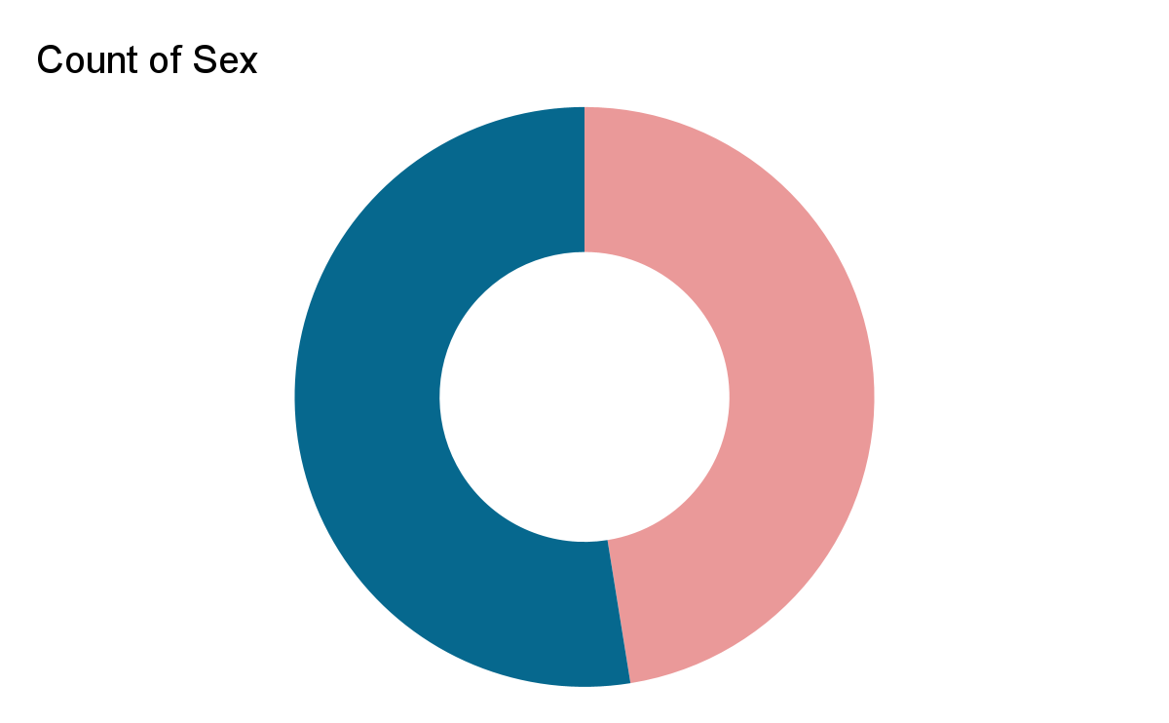
Results - Sex:
52.5%
47.5%
Male
Female

Slide 10
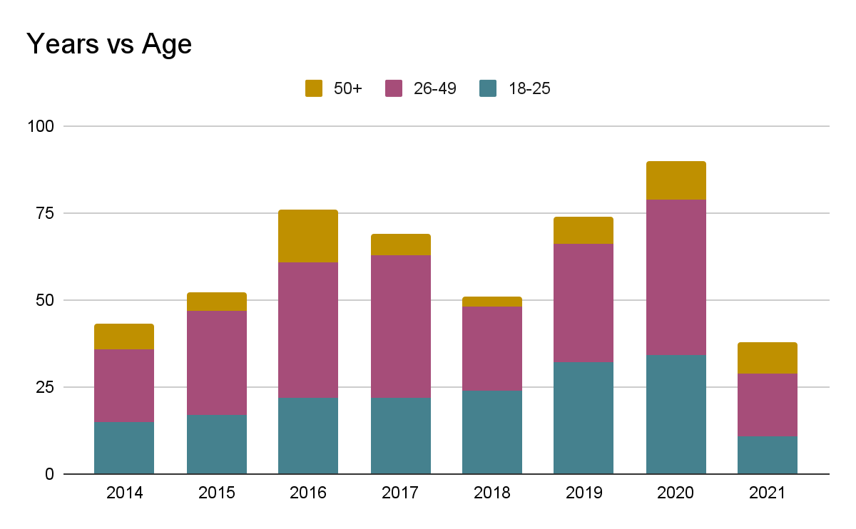
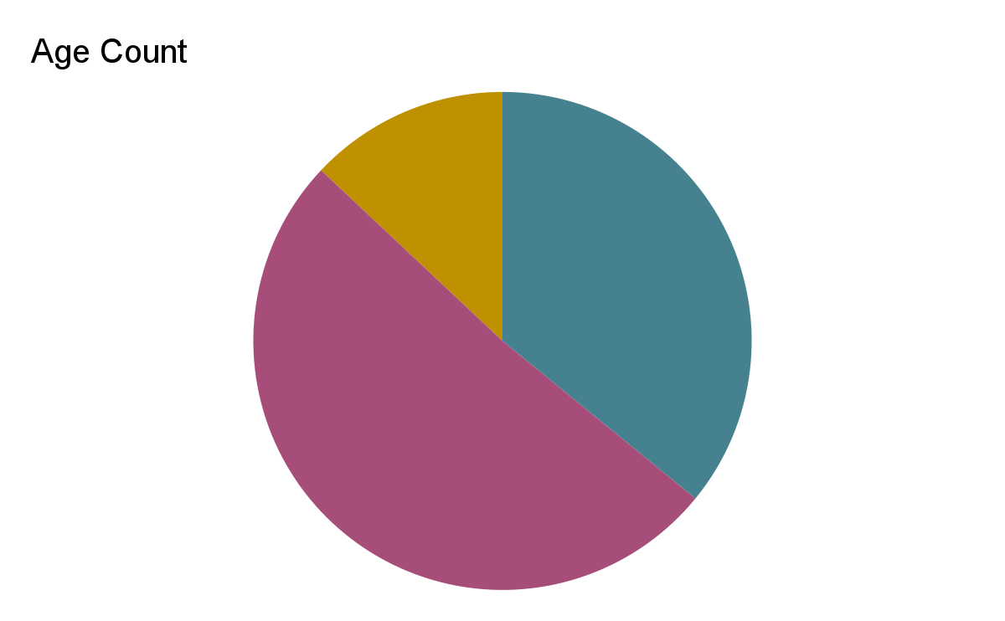
Results - Age:
13%
35.9%
51.1%
50+
18-25
26-49

Slide 11
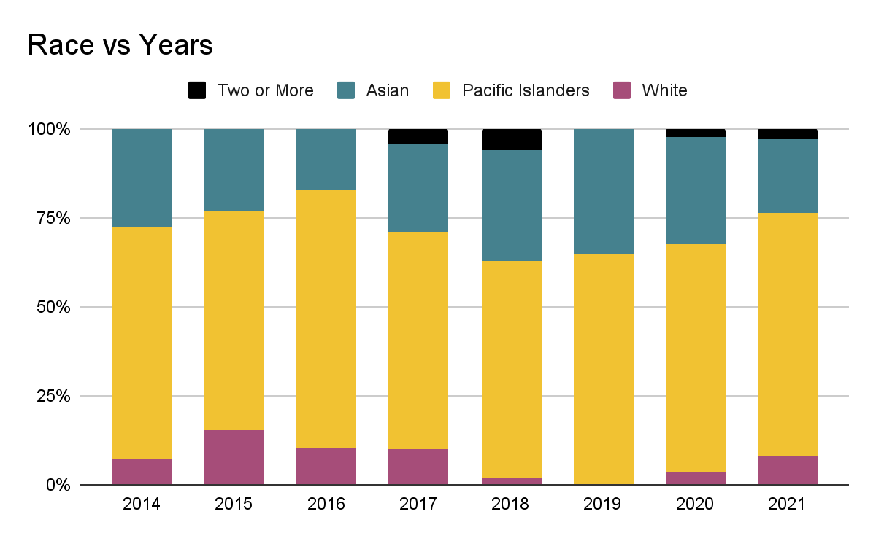
Results - Race:
64.9%
26.6%
6.7%
1.8%

Slide 12
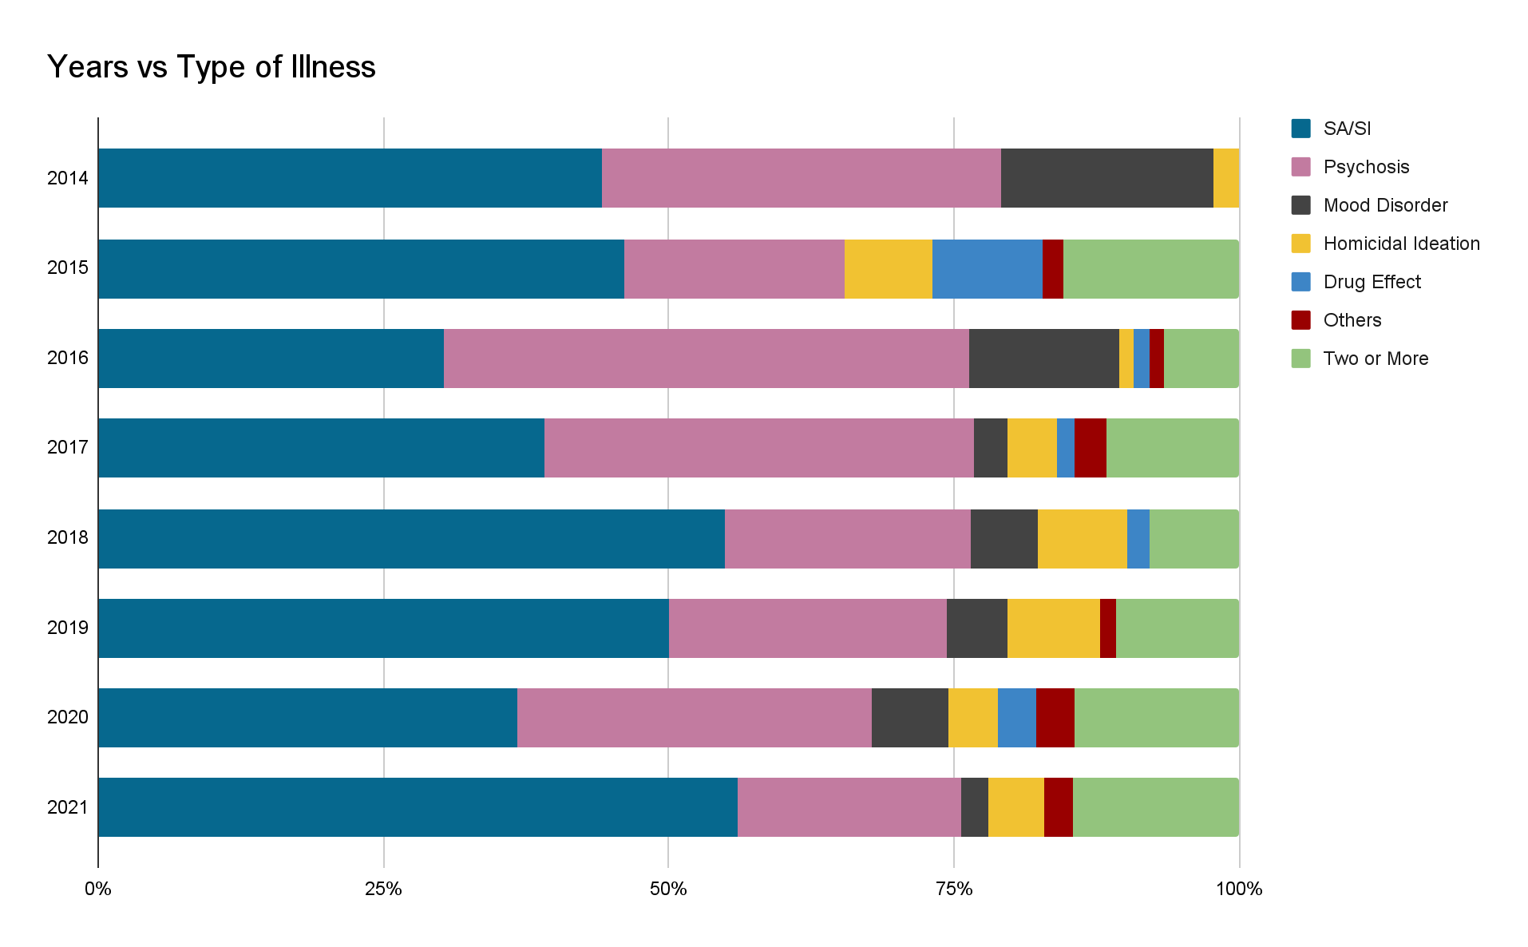
Prevalence:
43.1%
30.4%
6.9%
5%
2.2%
1.8%
10.5%

Slide 13
Significance:
Notes:
Overall slight general increase in admissions
Peaks in admission will occur typically in the year after a community crisis
Peaks in years 2016, 2019, and 2021
Pacific Islanders are susceptible
Crises may only affect certain mental illnesses
Demographics may be underrepresented

Slide 14
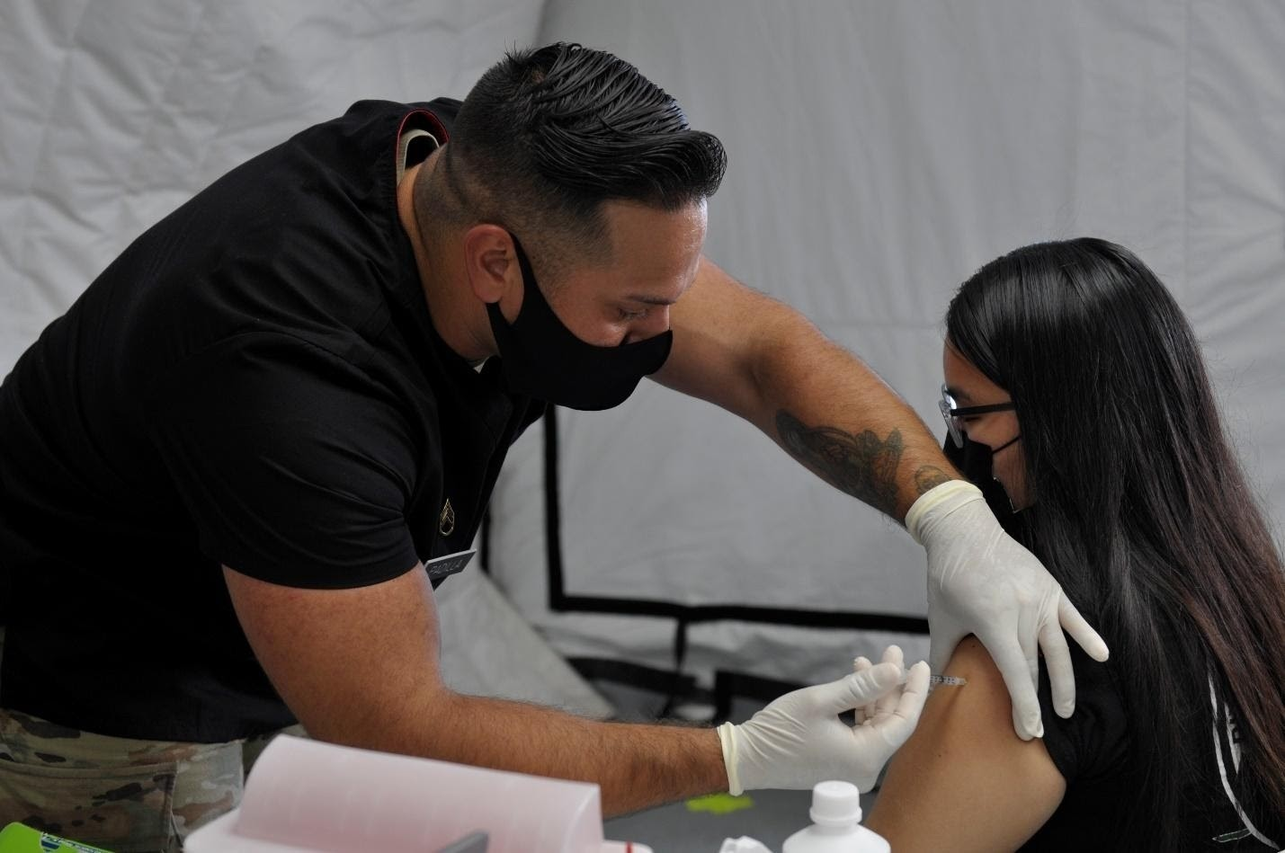
Future Directions:
Predictions
CGC
Outpatients
See if full 2021 data matches
Corroborate data with Community Guidance Center
See if increase is similar in outpatients

Slide 15
Sources
LFP population Characteristics 2017 by ethnic group. Department of Commerce Commonwealth of the Northern Mariana Islands CNMI RSS. (n.d.). https://ver1.cnmicommerce.com/lfp-population-characteristics-2017-by-ethnic-group/.
Institute of Medicine (US) Committee on Prevention of Mental Disorders. (1994, January 1). Risk and protective factors for the onset of mental disorders. Reducing Risks for Mental Disorders: Frontiers for Preventive Intervention Research. https://www.ncbi.nlm.nih.gov/books/NBK236306/.
What causes psychosis? Early Psychosis Intervention. (2019, October 20). https://www.earlypsychosis.ca/what-causes-psychosis/.

Slide 16
Acknowledgements
Northern Marianas College
Johnny Aldan, Bachelor of Science in Nursing, Registered Nurse
Commonwealth Healthcare Corporation
Josh Tanghal, Associates of Science in Nursing, Registered Nurse
University of Hawai’i at Manoa
Aneesa Golshan
Dr. George Hui

