Slide 1
Investigation of Hypothalamic Selenoprotein M in Energy Metabolism
Victoria Kaahaaina
Step-Up Hawaii Research Program

Slide 2
Selenium and Selenoproteins
Notes:
WHAT ARE WHAT ARE NOT IS

Slide 3



Selenium
Selenoproteins
SelM
Selenium (Se) is an essential micronutrient
Important role in maintaining human health
Required for:
    Normal thyroid hormone metabolism
    Brain development
    Immune function
Obtained primarily through diet
Proteins with amino acid Selenocysteine
25 genes in humans and 24 genes in mice encode selenoproteins
A Thioredoxin-like protein
Highly expressed in the brain
Protects against oxidative stress
Notes:
The Optimum amount of selenium has a narrow range
What makes a selenoprotein is seleno protein is selenocysteine

Slide 4
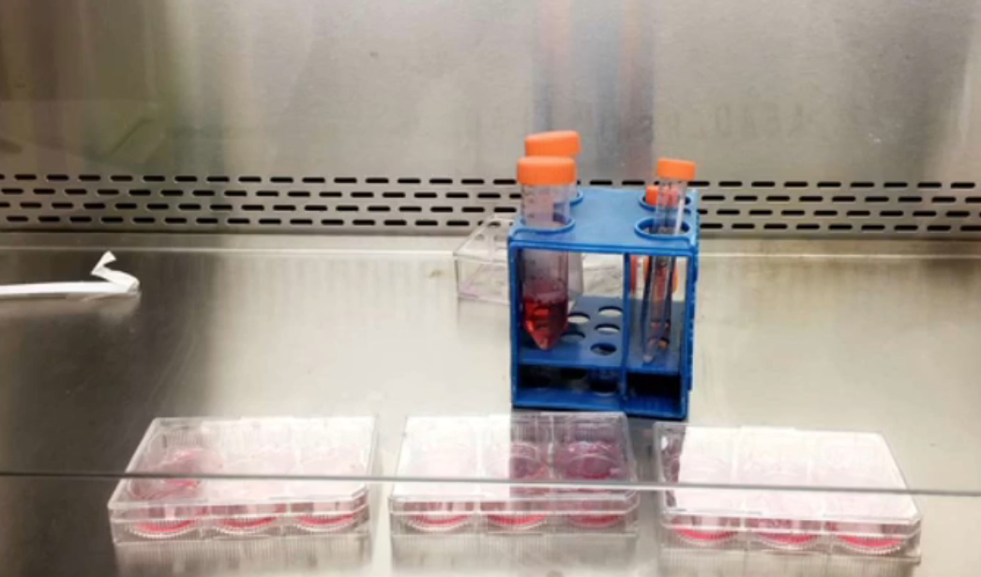
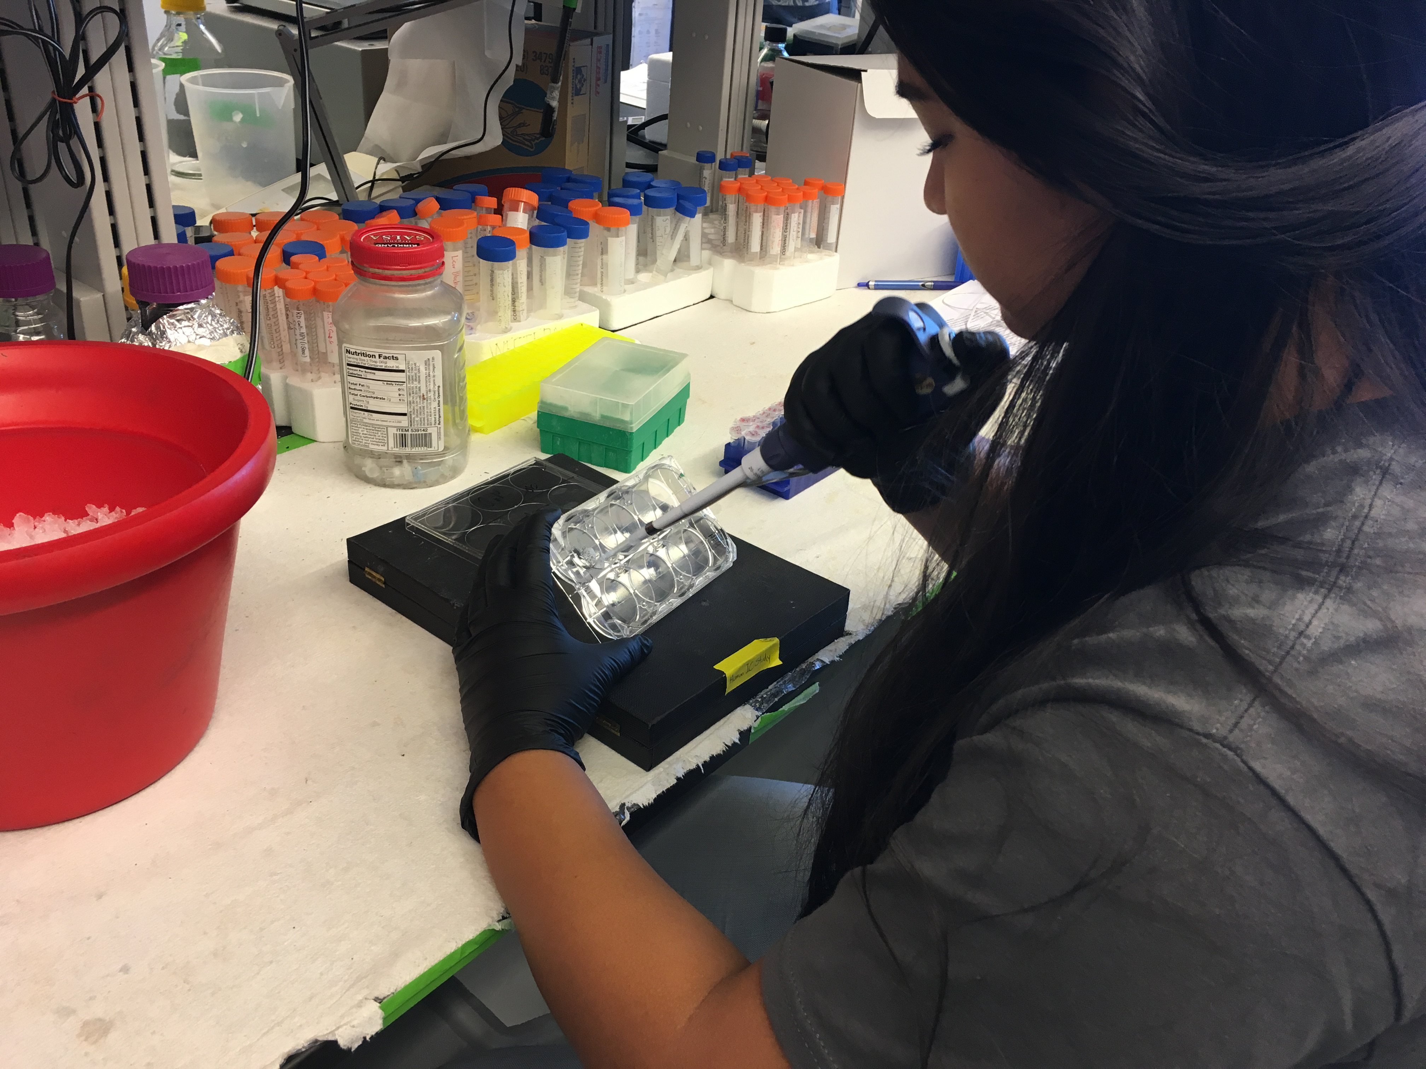
Last Yearʻs Research
The Role of Selenium in Hypothalamic leptin signaling
  Leptin- Hormone released from fat that regulates energy homeostasis
  Leptin Resistance- Failure of leptin to stimulate cell signaling pathways that promote energy metabolism
Hypothesis- Selenium deficiency promotes hypothalamic leptin resistance
Experiment timeline
  Transfected cells, treated with Leptin, collected protein and analyzed by western blotting
Results were inconclusive
  SelM was significantly affected by the selenium treatment
Notes:
Selenium wsa involved in the signaling pathway for leptin signaling

Slide 5
Experiment

Slide 6
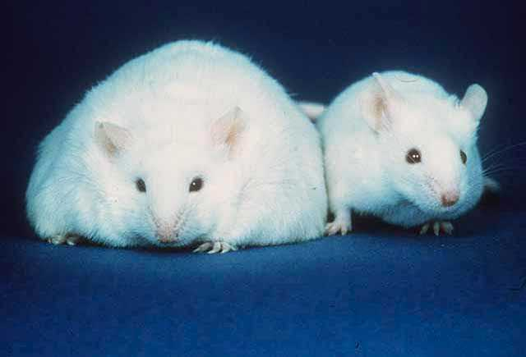
SelM KO Mice
Lack a functional SelM gene sequence
SelM KO Mice developed leptin resistance and obesity at 18-20 weeks old when raised on a standard diet
Mice used in Hypothalamic Microarray Study
10- week-old males
Similar body weight
Notes:
10 week old WT and KO mice with similar body weights before signs of other metabolic problems

Slide 7

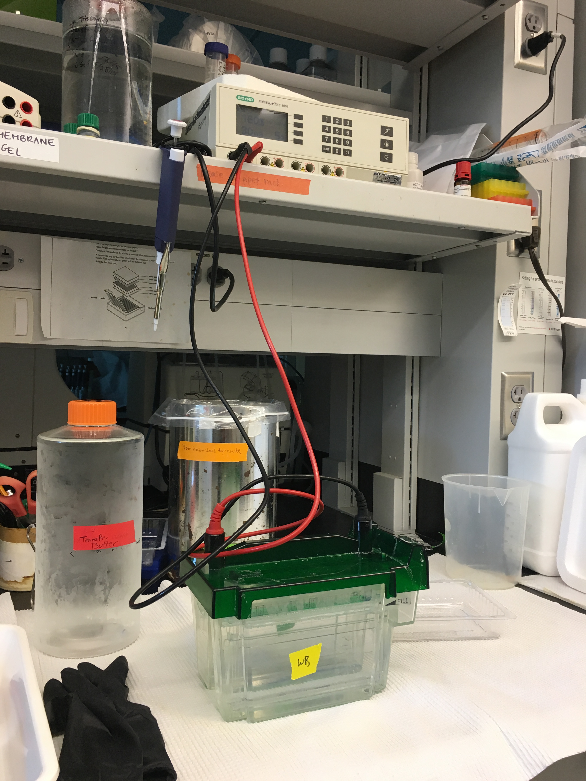
Experimental Design
qPCR
Verify specific identified genes
p21
PGC1𝛼
TXNIP
UCP2
Western Blotting
Probe for genes verified in qPCR
PGC1𝛼
TXNIP
Microarray
Identify genes affected by SelM deletion
Notes:
Important interacing genes showed up in the microarray that we wanted to furthe test an verify by qPCR
Criteria
P21- or cdkn1a, cell cycle control, cancer related
PGC1a- mitochondrial biogenesis
TXNIP- Oxidative stress, negative regulator of thioredoxin
UCP2- Oxidative stress, energy metabolism, calcium signaling

Slide 8
qPCR Data:
Hypothalamic Tissue
Notes:
All results showed ot follow what was found in the microarray but PGC1a and TXNIP were signifigcant

Slide 9
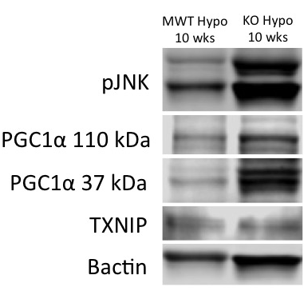
Western Blot Data:
Hypothalamic Tissue
Notes:
pJNK-
JNK cell signaling pathway for stress and the p means that it is being phosphorylated:
The KO is understress causing that increase of protein expression
TXNIP-
Neuropotective properties and reduce oxidative stress
PGC1a antibody
110- full
Meaning that it is the full protein length of 797 amino acids
37- NT
Meaning it is only a portion of the protein 267 amino acids the front portion

Slide 10
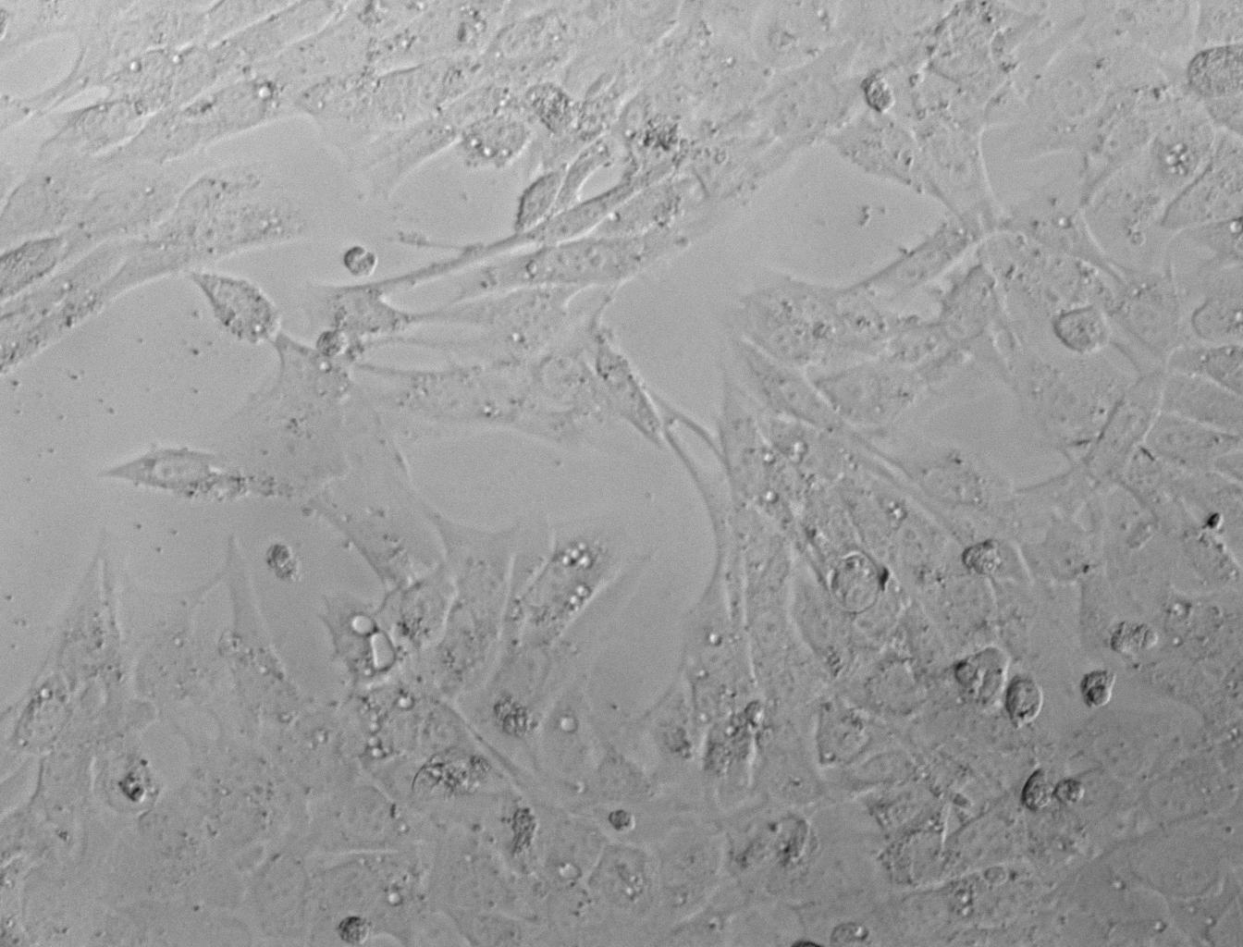
Cell line= mHypoE44
Immortalized cell line derived from embryonic mouse hypothalamic neurons

Slide 11
qPCR N44 Immortalized Cell Line
Notes:
Opposite of the microarray

Slide 12
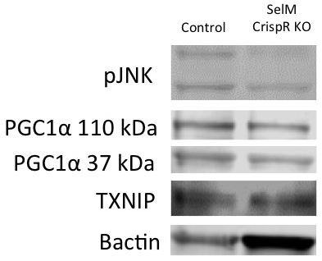
Western Blot Data:
N44 Immortalized Cell Line
Notes:
Dashed line represesnts the control
All are down but arenʻt signifigcant because there was only an N of 1

Slide 13
Conclusions
SelM deletion significantly affects expression of p21, PGC1α, and TXNIP
Increased hypothalamic ER stress (pJNK levels) precedes disturbances in energy homeostasis previously reported in SelM KO mice

Slide 14




Acknowledgements
Mentor- Dr. Matthew Pitts
  The Berry Lab
PI- Dr. Marla Berry
Dr. Ashley Ogawa-Wong
Dr. Lucia Seale
Ann Hashimoto
Herena Ha
Ting Gong
Dr. George Hui
University of Hawaii John A. Burns School of Medicine
NIH/NIDDK Step-Up Program 2017
Dedicated to Dioniso Domingo 1931-2017

