Slide 1
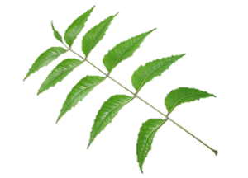
THE EFFECTS OF NEEM LEAF-BASED ORGANIC INSECTICIDE TO APHIDS
DIANA LOPERA
STEP-UP PROGRAM
MENTOR: MR. ARNOLD ROUTE, B.S.
NORTHERN MARIANA COLLEGE, SAIPAN, CNMI

Slide 2
GOAL
The goal of this experiment is to examine the effects of a neem leaf-based organic insecticide on three specific aphids: Aphis craccivora, Aphis gossipii, and Myzus persicae.

Slide 3
Azadirachta indica
Commonly known as the neem plant
Native to India
Known for its diverse number of applications
Insecticide (Focus)
Medicinal uses
Other uses

Slide 4
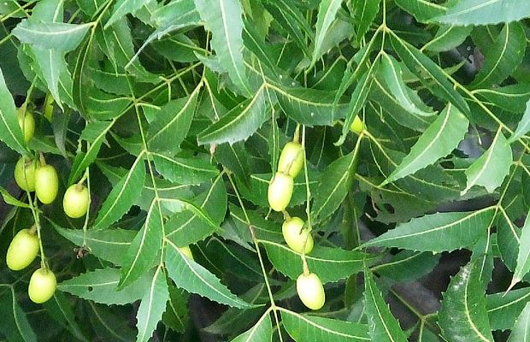
AZADIRACHTIN
Active ingredient azadirachtin in A. indica are similar to hormones called ecdysones found in insects
Acts as an antifeedant as well as and ecdysone “blocker”, disrupting reproduction cycle
Does not kill instantaneously
Has low toxicity levels to non-target animals
Biodegradable

Slide 5
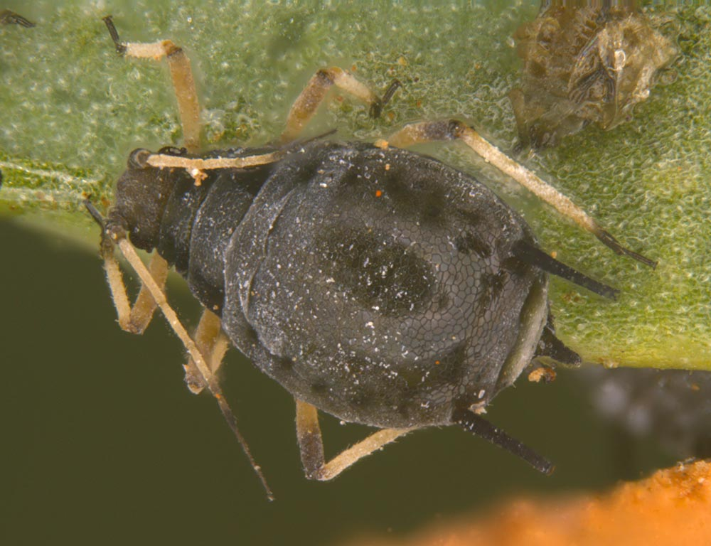
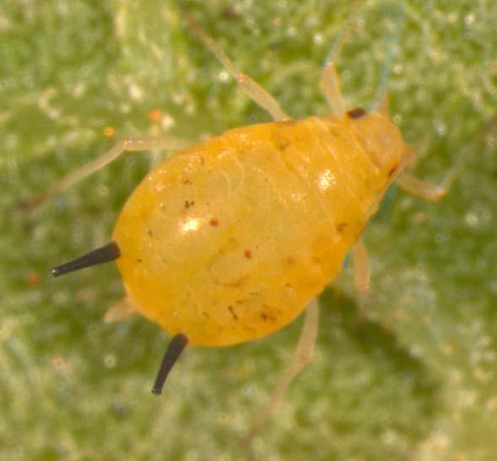
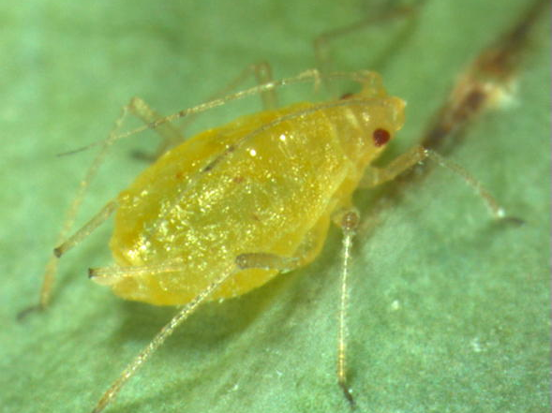
APHIDS
Aphis craccivora
(Cowpea Aphid)
Soft-bodied insects
Over 4,400 species
Highly successful in a zoological standpoint
One of the most destructive pests on cultivated plants
Aphis gossipii
(Melon Aphid)
Myzus persicae
(Green Peach Aphid)

Slide 6
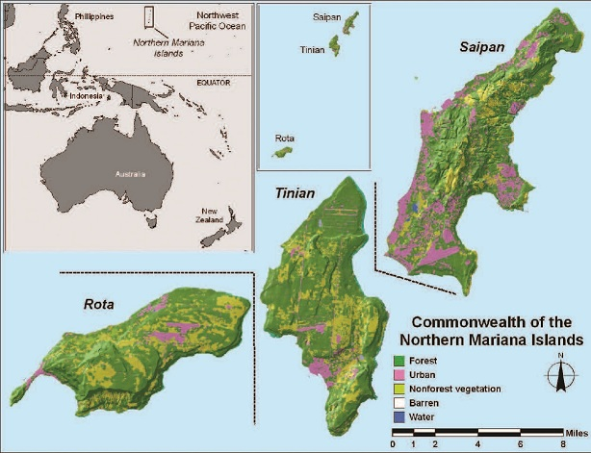
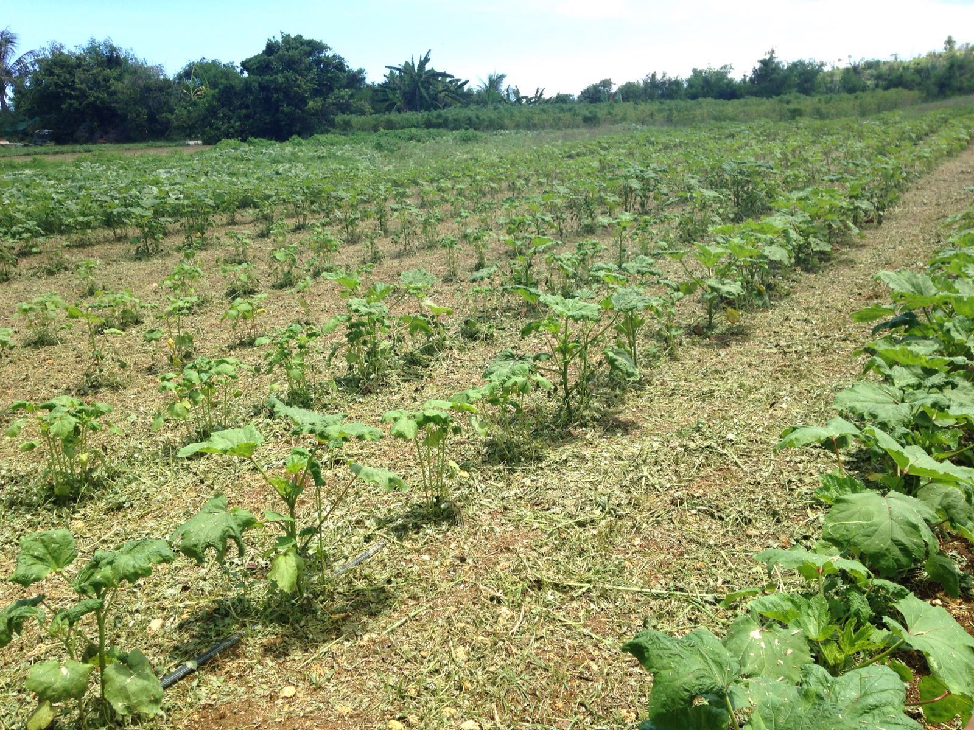
IMPORTANCE
Agricultural production is prominent within the Commonwealth of the Northern Mariana Islands (CNMI)
CNMI is not immune to the destructive nature of aphids

Slide 7
HYPOTHESIS
We hypothesize that the organic insecticide based on the neem leaves will significantly reduce the population of our aphid samples.
NULL HYPOTHESIS
We hypothesize that the organic insecticide based on the neem leaves will NOT significantly reduce the population of our aphid samples.

Slide 8
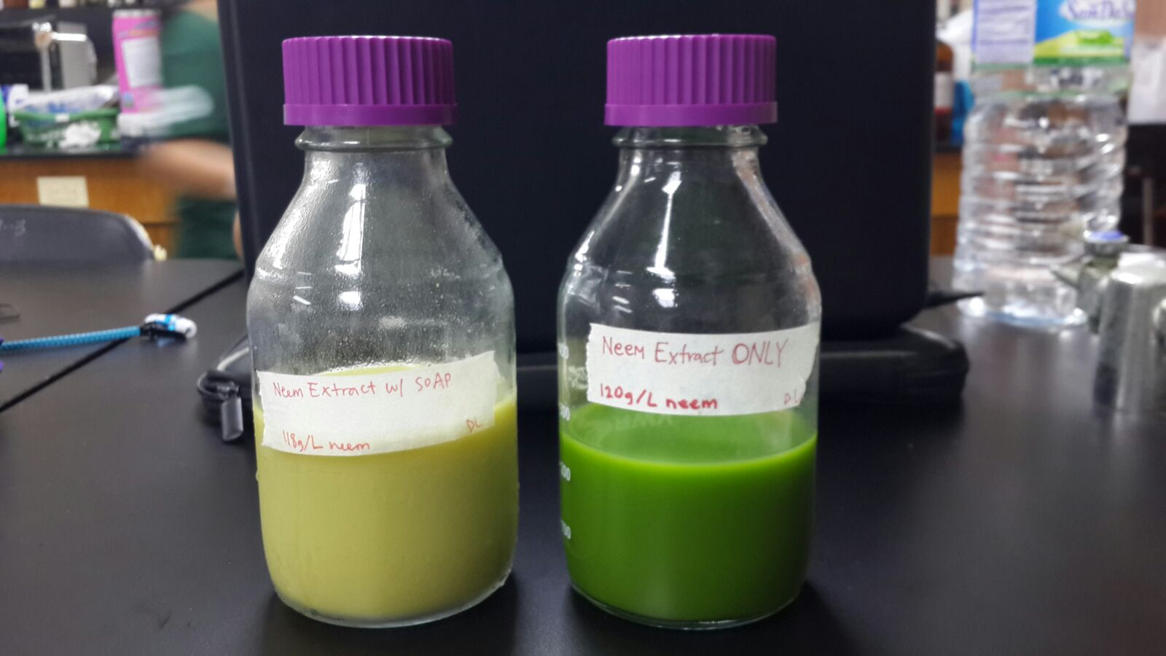
PART I: ORGANIC INSECTICIDE
Neem Insecticide WITH Soap
Neem Insecticide WITHOUT Soap
Neem leaves
Distilled Water
Neem leaves
Distilled Water
Dr. Bronner’s Peppermint Pure-Castile Liquid Soap™*
* Soap acts as a spreader-sticker.

Slide 9
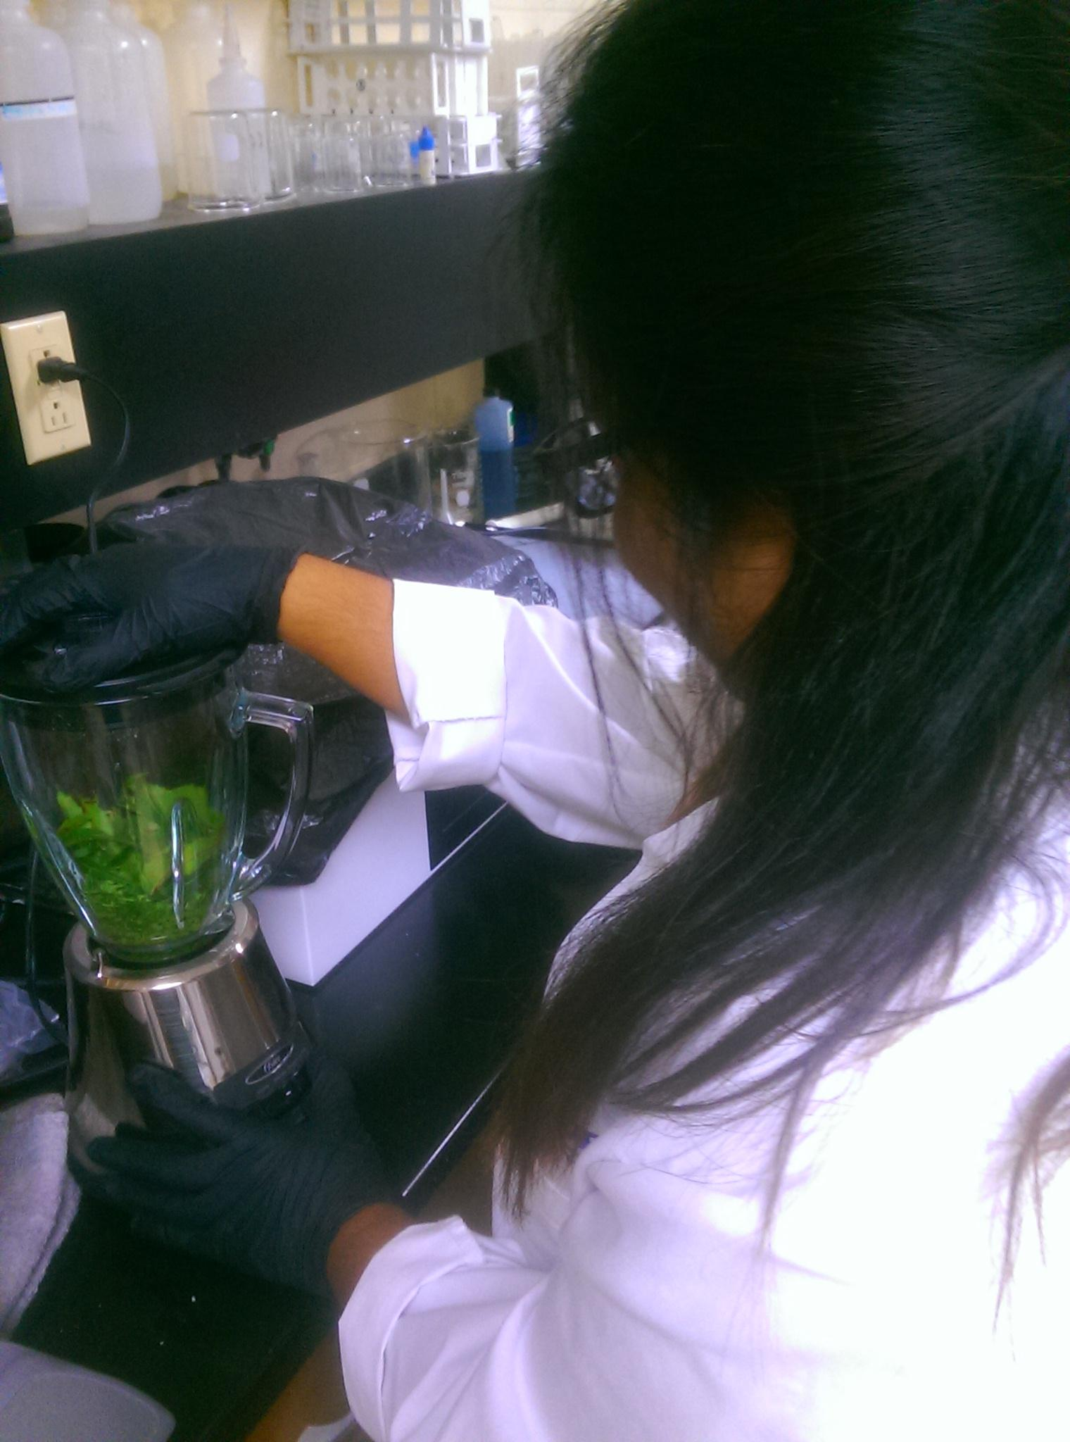
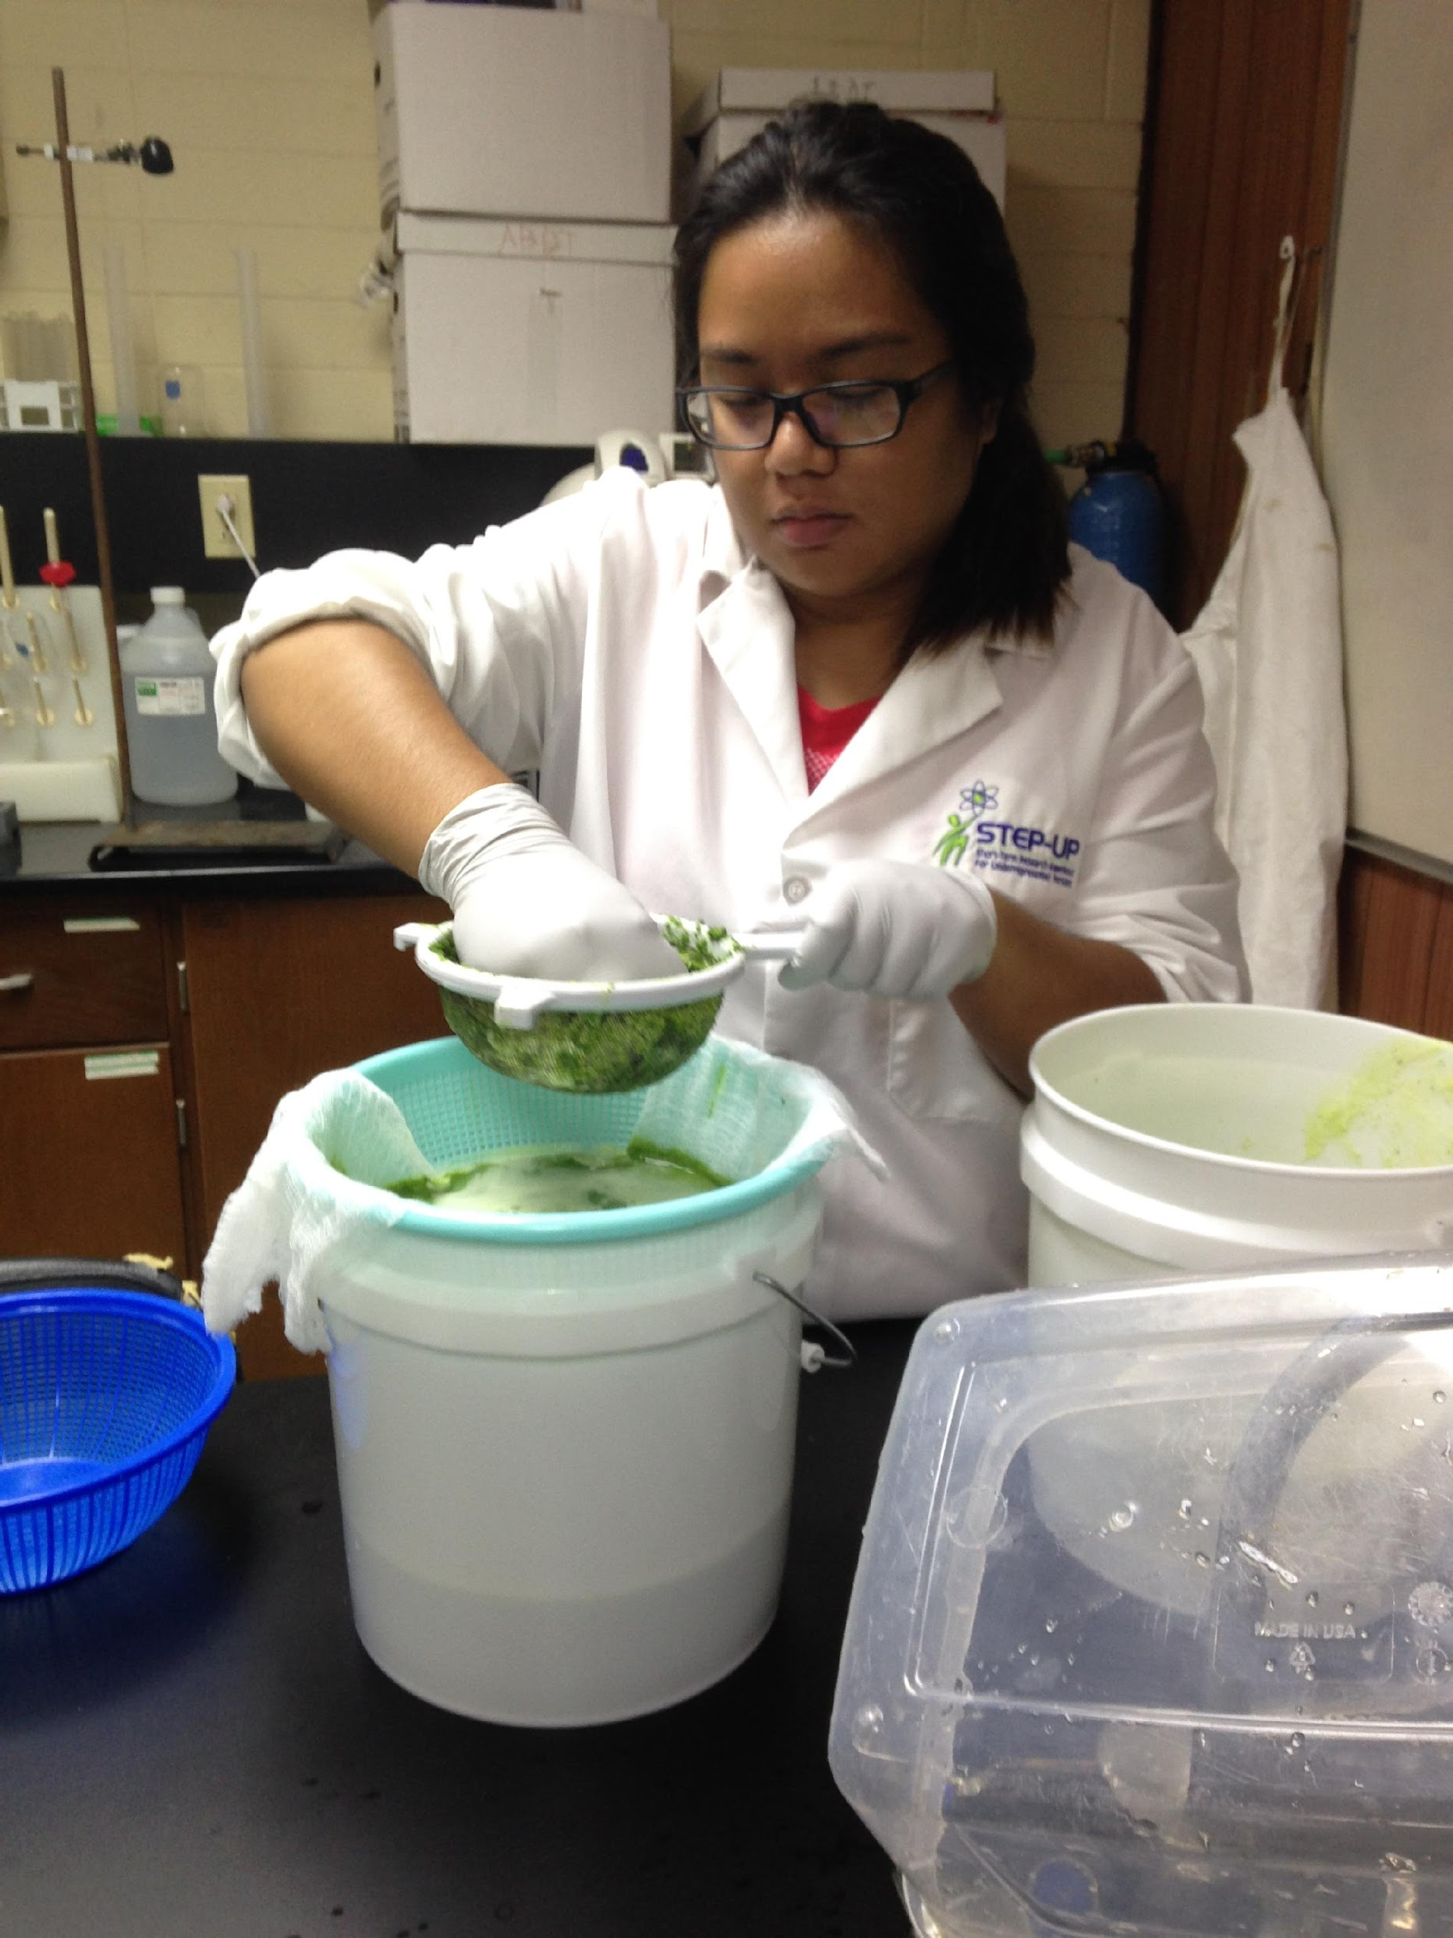
MAKING THE INSECTICIDE (WITHOUT SOAP)
Blend 453.592g (~1 lb.) neem leaves with 3785.41mL (~1 gal.) of distilled water in blender and break down leaves.
Strain mixture twice through a strainer and a layer of cheesecloth.
Cover mixture with plastic wrap and let sit for three days.
After letting it set for three days, strain twice with strainer and cheesecloth.
Neem leaves and distilled water are incorporated in a blender.
Mixture is strained to get rid of leaf residue.

Slide 10
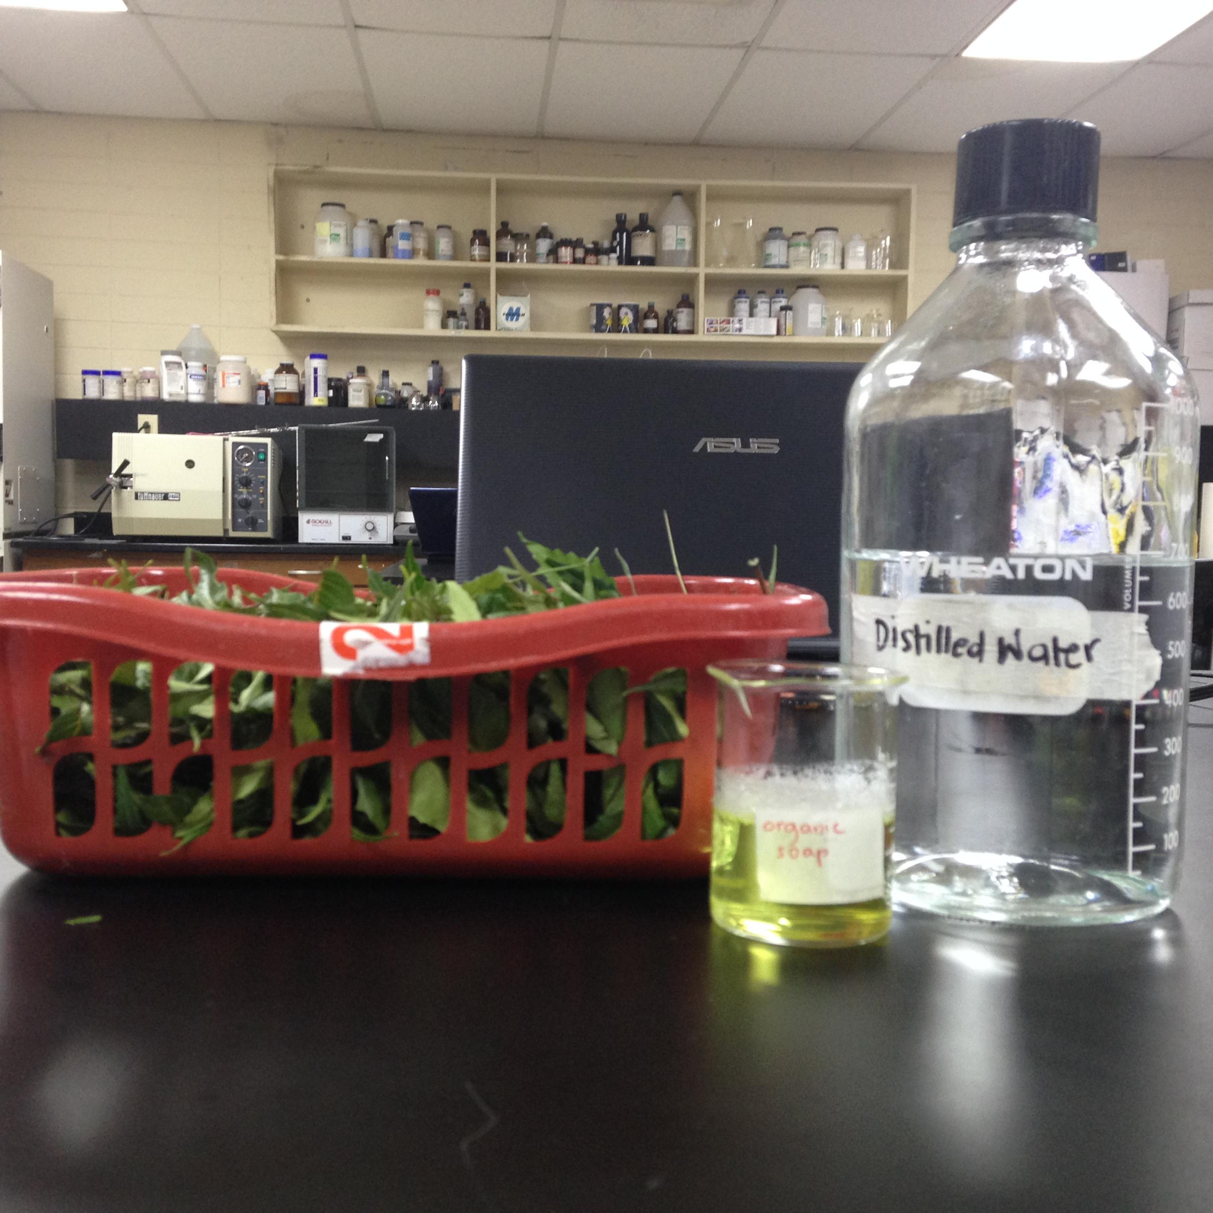
MAKING THE INSECTICIDE (WITH SOAP)
Follow steps on making insecticide (without soap).
Add 59.147mL (~2 fl. Oz) of Dr. Bronner’s Peppermint Pure-Castile Liquid Soap™ to solution, mixing well.

Slide 11
Both solutions are stored in containers and placed in refrigerator until needed for use.

Slide 12
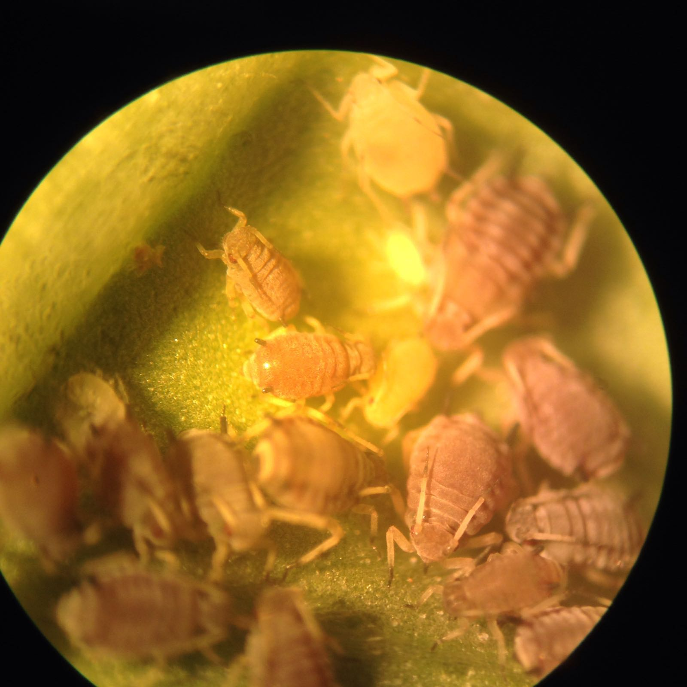
PART II: COLLECTION
Aphid-infected leaves were collected at a local farm in Kagman, Saipan.
Specimen were never exposed to insecticides, organic or chemical.
Samples were placed in paper bags and brought to the lab located the Northern Marianas College, Saipan.
Okra crops at Kagman Farm
Close up of A. craccivora

Slide 13
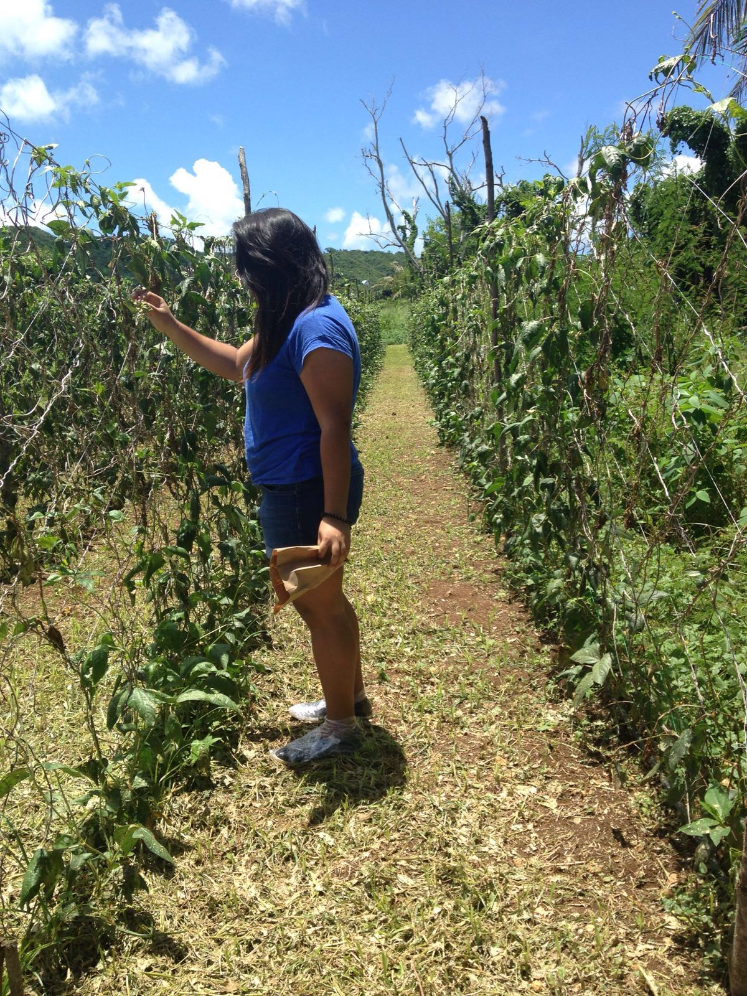
A. gossipii on pumpkin leaves
A. craccivora on string bean crops

Slide 14
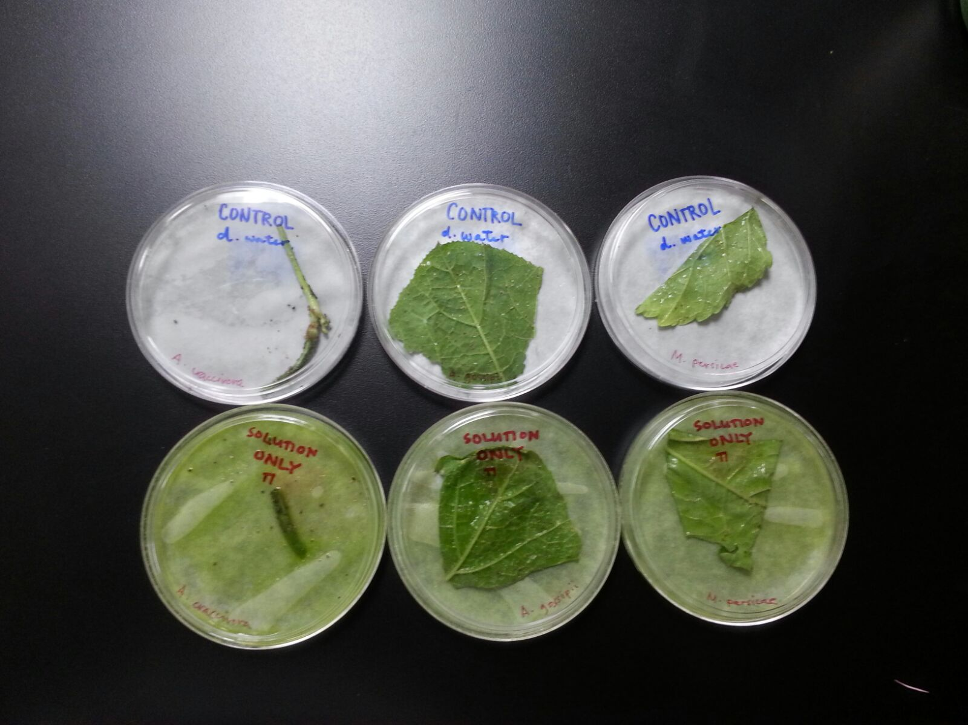
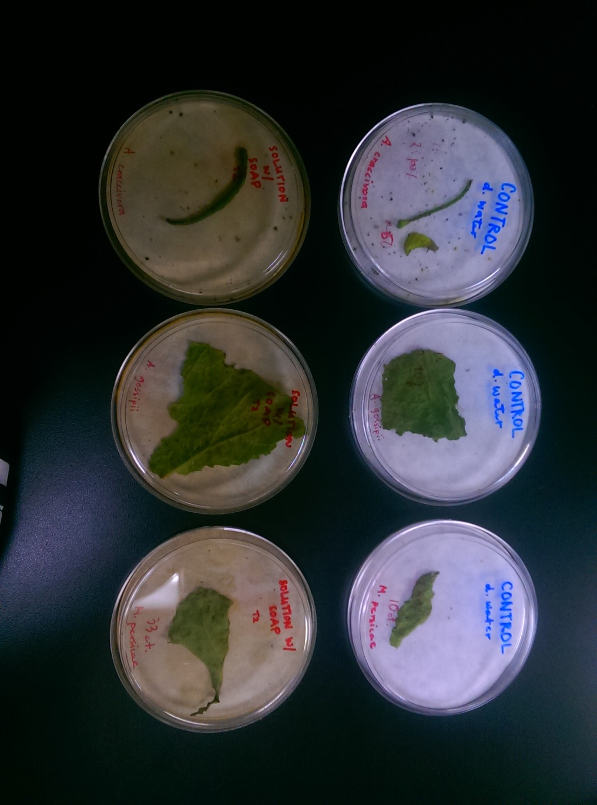
PART III: EXPERIMENT
ONE TRIAL:
1.) Three sets of three petri dishes (Control, Solution Only, and Solution with Soap) were lined with filler paper.
2.) Infected leaves were cut to 2-3 in. samples.
Each sample has ~50 aphids.
3.) Aphids were placed in corresponding plates.
4.) Both neem solutions and distilled water (control) were poured into spray bottles.

Slide 15
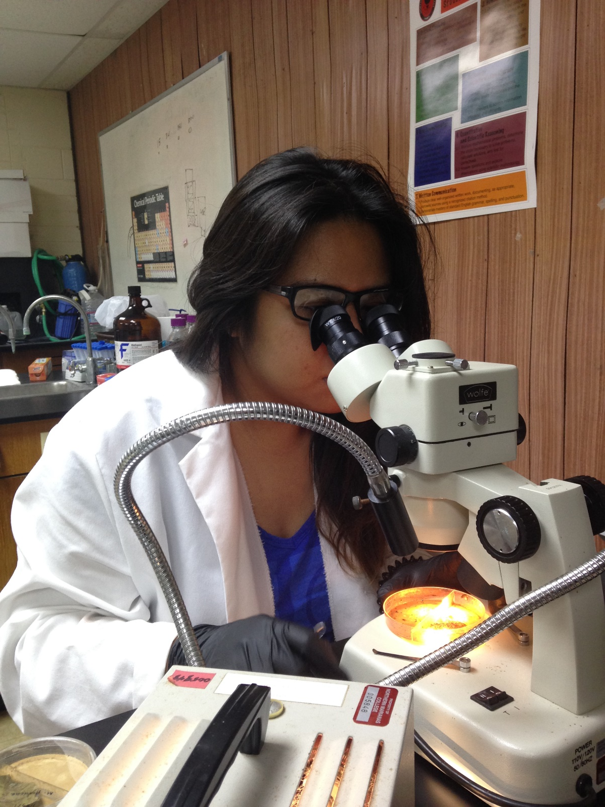
5.) Control were sprayed three times each (~5mL).
6.) Solution Only were sprayed three times each (~5mL).
7.) Solution with Soap were sprayed three times each (~5mL).
8.) Observe mortality of aphids through a stereo microscope every 24 hours for two days.
Plates are observed to see the effects of the neem solutions on selected aphids.

Slide 16
RESULTS
**Percentages are estimations based on aphid populations of 50.

Slide 17
CONCLUSION
Exposure to the insecticide did significantly reduce aphid sample population, as compared to control group
Null hypothesis rejected

Slide 18
ACKNOWLEDGEMENTS
Mr. Arnold Route, Mentor
CNMI STEP-UP Interns 2016
Ms. Annette Pladevega
Mr. Lieto (Aphid provider)
CNMI Public School System

Slide 20
BIBLIOGRAPHY
Route, A. & Bier, C. (2014). Neem Extract: An Organic Pesticide [Brochure]. NMC Crees. Retrieved June, 2016, from http://crees.org/resources/files/forms/35.pdf
Santos, T. M., Costa, N. P., Torres, A. L., & Júnior, A. L. (2004). Effect of neem extract on the cotton aphid. Pesq. Agropec. Bras. Pesquisa Agropecuária Brasileira, 39(11), 1071-1076. doi:10.1590/s0100-204x2004001100003
Pataky, N. (2002). Spreader--Stickers. Retrieved June 24, 2016, from http://hyg.ipm.illinois.edu/pastpest/200220c.html
Mordue(Luntz), A. J., & Nisbet, A. J. (2000). Azadirachtin from the neem tree Azadirachta indica: Its action against insects. An. Soc. Entomol. Bras. Anais Da Sociedade Entomológica Do Brasil, 29(4), 615-632. doi:10.1590/s0301-80592000000400001

Slide 21
Thank you!
Any questions?

