Slide 1
Assessment of Coconut Rhinoceros Beetle Damage in Palau 2021
Presenter: Kesiil Thomas
Mentors: Christopher Kitalong, PhD, PCC-CRE/Pacific Academic Institute for Research (PAIR)
Marinca Faimau , Mentor
Sid Aimie Oilouch, Former STEP-UP student
Leah Marie Bukurou, Former STEP-UP student

Slide 2
Table of Contents
Abstract
Importance of Coconut trees
CRB and their impact on coconut trees
Materials and Methods
Results
Discussion
Conclusion
Acknowledgements

Slide 3
Abstract
Kesiil Pohai Thomas
Christopher Kitalong PhD, Pacific Academic Institute for Research
Coordinating Center: University of Hawaii at Manoa
Assessment of Coconut Rhinoceros Beetle Damage 2021
The Coconut Rhinoceros Beetle (CRB), also known as Oryctes Rhinoceros, is an invasive insect that kills coconut trees and other palm species by feeding on the plant’s crown. There is a confirmed presence of at least two biotypes of the CRB in Palau, Nudivirus (OrNV) resistant CRB-G versus all other types. These invasive insects have caused devastating damage to many coconut/palm trees in the Pacific.
The study of these invasive species has been an ongoing process in which damage assessment surveys and beetle collections have been done. Damage assessments surveys were administered in representative sites throughout all states of Palau in the years of 2016-2021. To collect beetle and larvae samples, specialized traps were used along with manual searches through debris. To determine distribution of CRB-G and occurrence of Nudivirus infection in each sample, DNA analysis was conducted.
In 2018 , damage assessment results have shown slow recovery and reduced damage in tree fronds. Results from the analysis of biotypes and viral infection show a very high rate of infection of all CRB with the Nudivirus, and damage assessment and sample assessment will help determine virus types/variants as well as heterozygosity in CRB population. Comparing results from past damage assessments to the results of this year will show reduction in impact of CRB.
Key Words: CRB, Coconut Rhinoceros Beetle, Tree Damage Assessment

Slide 4
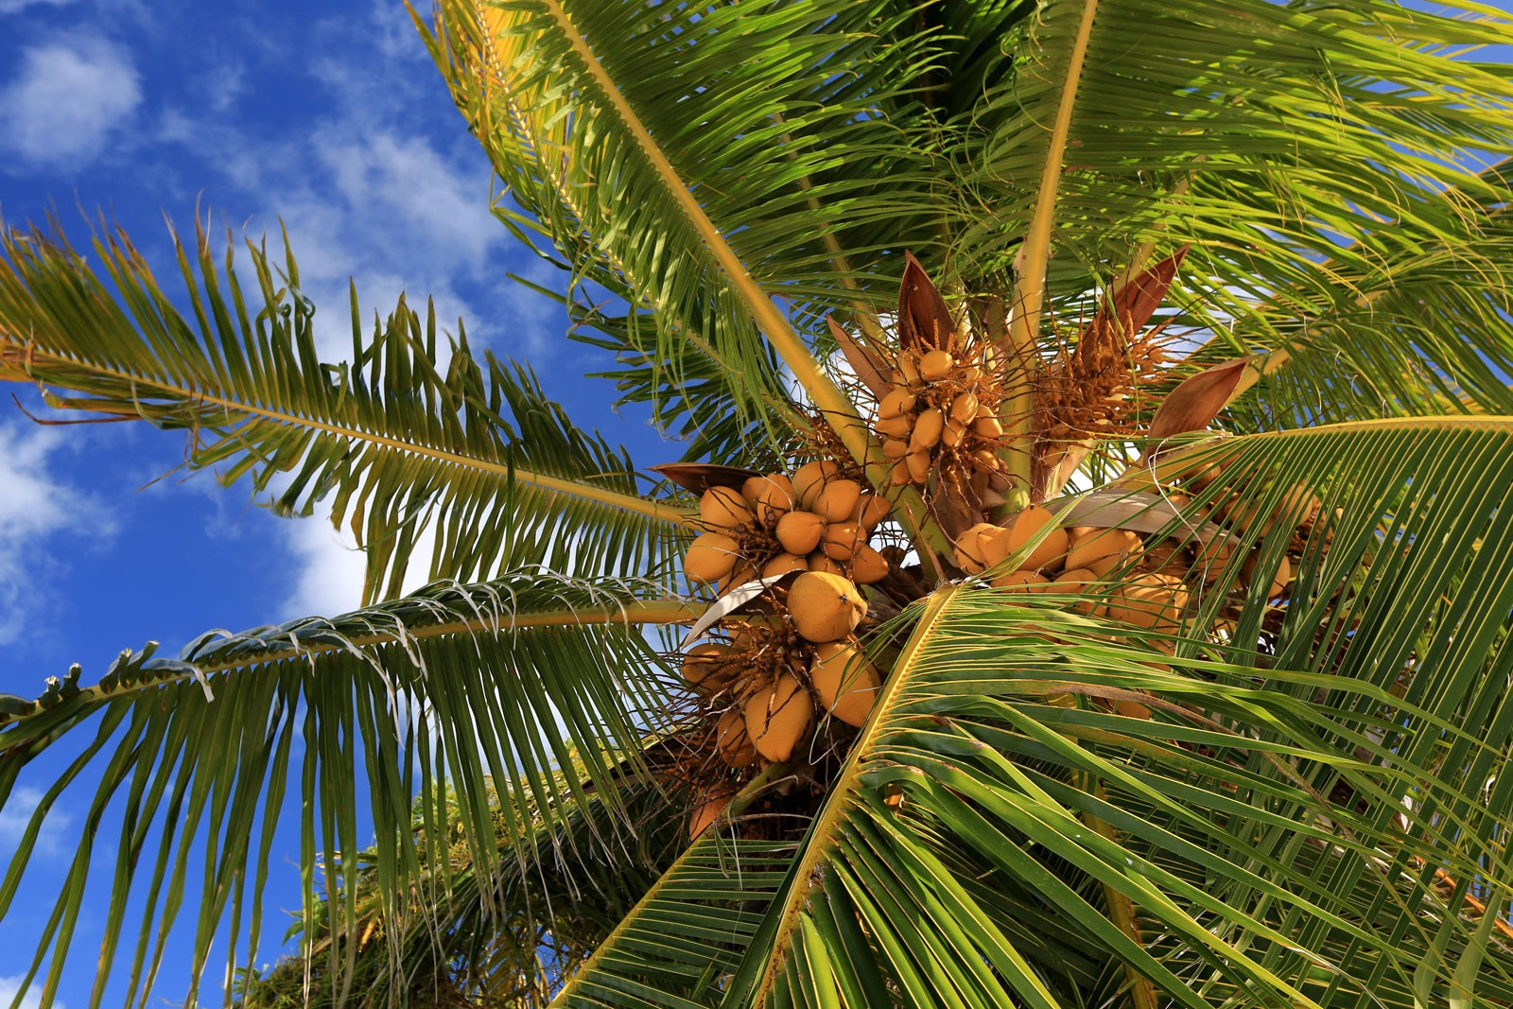
Importance of Coconut Trees
Important source of food and drink
Significant part of Palauan Culture
Tourist Attraction
Used in the production of oil, baskets, and brooms

Slide 5
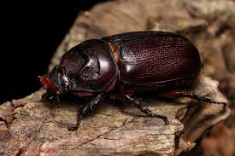
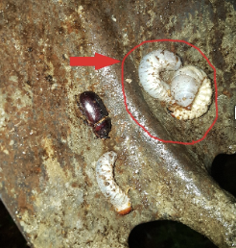
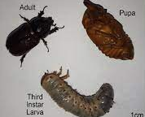
Coconut Rhinoceros Beetle (CRB)
- Invasive species from Southeast Asia
- First discovered in Palau in the 1950s
- Lifespan of adult male and female beetles

Slide 6
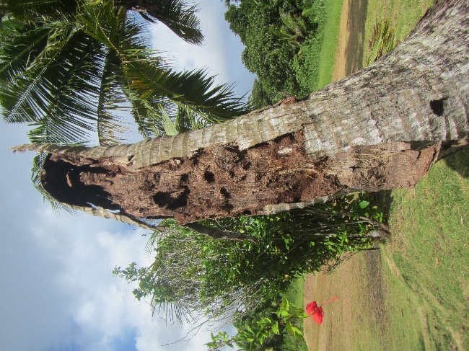
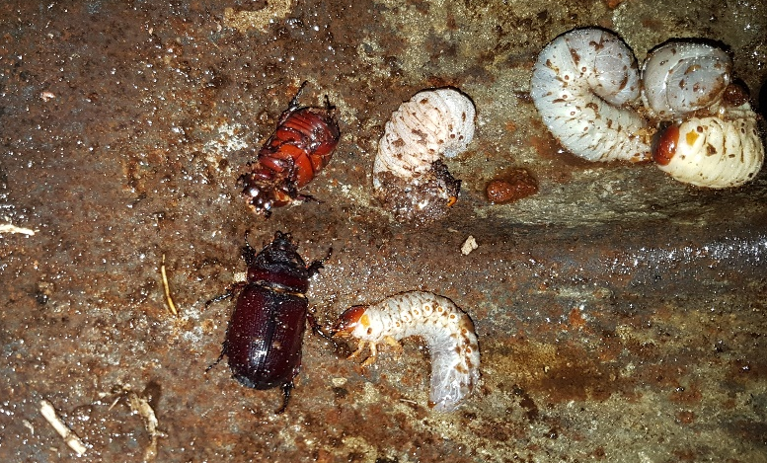
Breeding sites of CRB
- Compost piles
- Mulch
- Rotten Coconut Trees
- Old piles of leaves and fronds

Slide 7
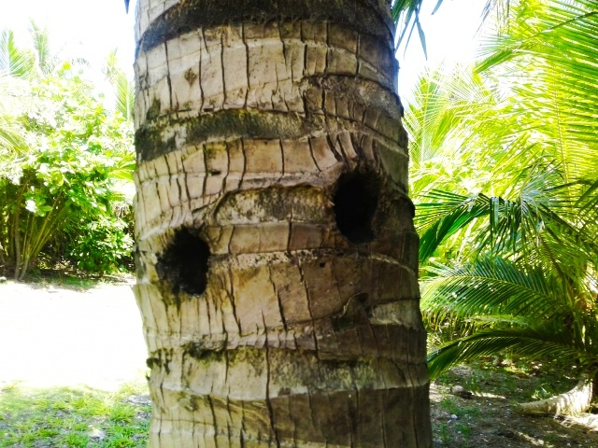
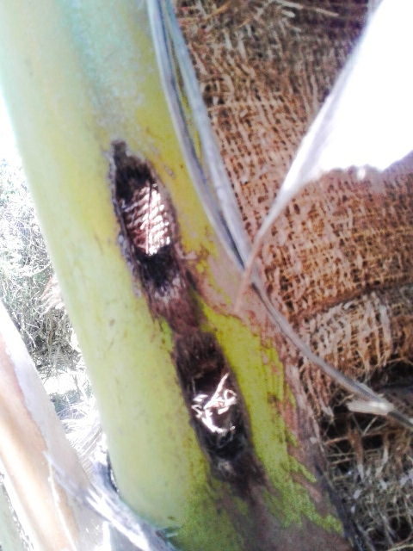
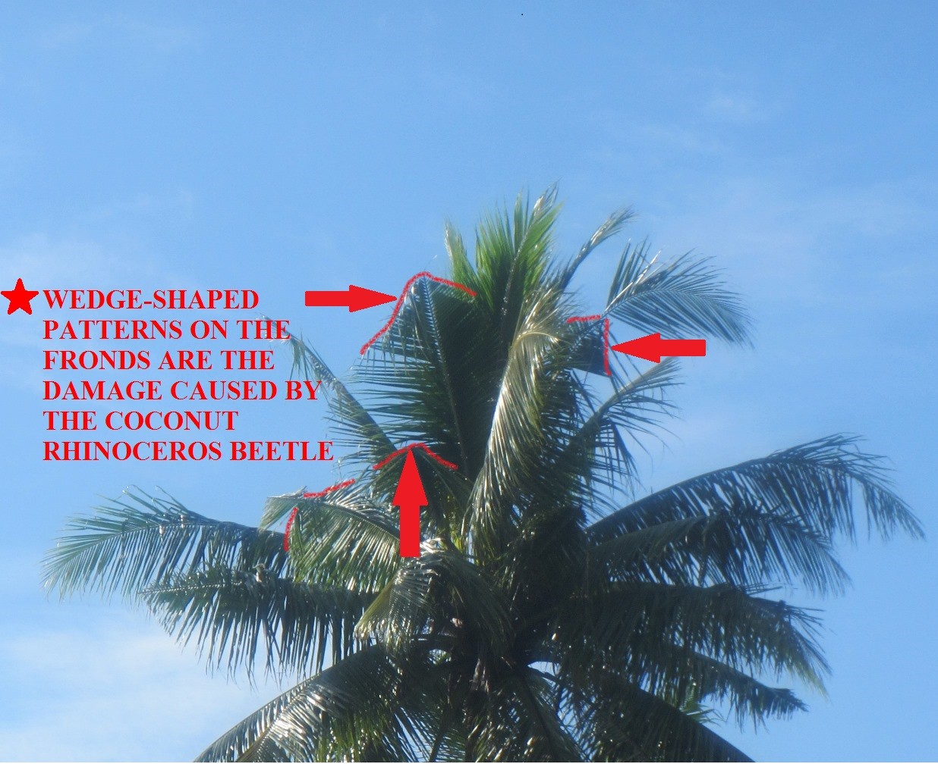
CRB Damage to Coconut Trees
The CRB drills holes into the coconut when the coconut tree is still young Gand makes its way to the crown or “heart” of the tree where it feeds on the inside. Damage to the leaves is later indicated by wedge shaped cuts on the fronds.

Slide 8
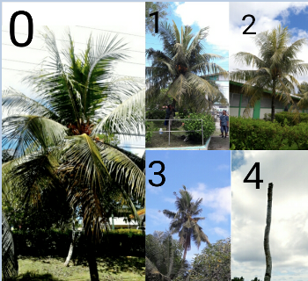
Tree Damage
CRB Damage Assessments, A scale of 0-4, developed by SPC ( Secretariat of the Pacific Community ), is being used to rate the amount of damage on coconut trees in numerous sites around Palau.
0 = No damage (0% of leaves are removed)
1 = light damage ( 1%- 29% of leaves are removed)
2 = Moderate damage ( 30%- 49% of leaves are removed)
3 = Severe damage ( 50% of leaves are removed)
4 = Dead tree ( 100% of leaves are removed)

Slide 9
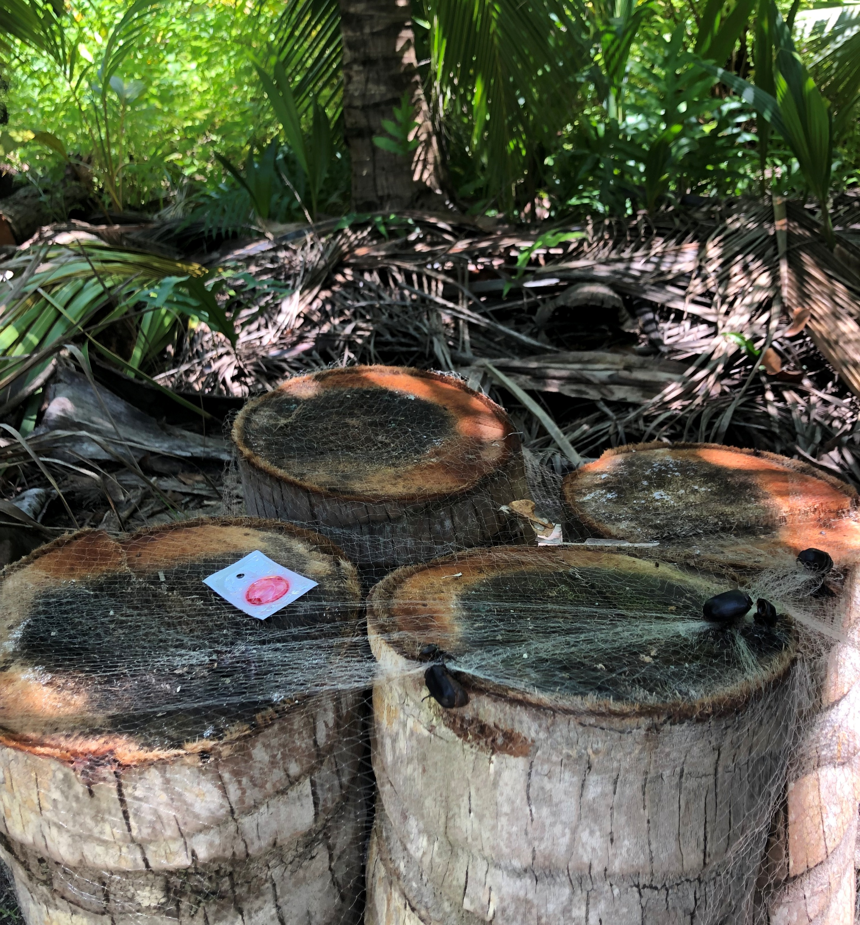
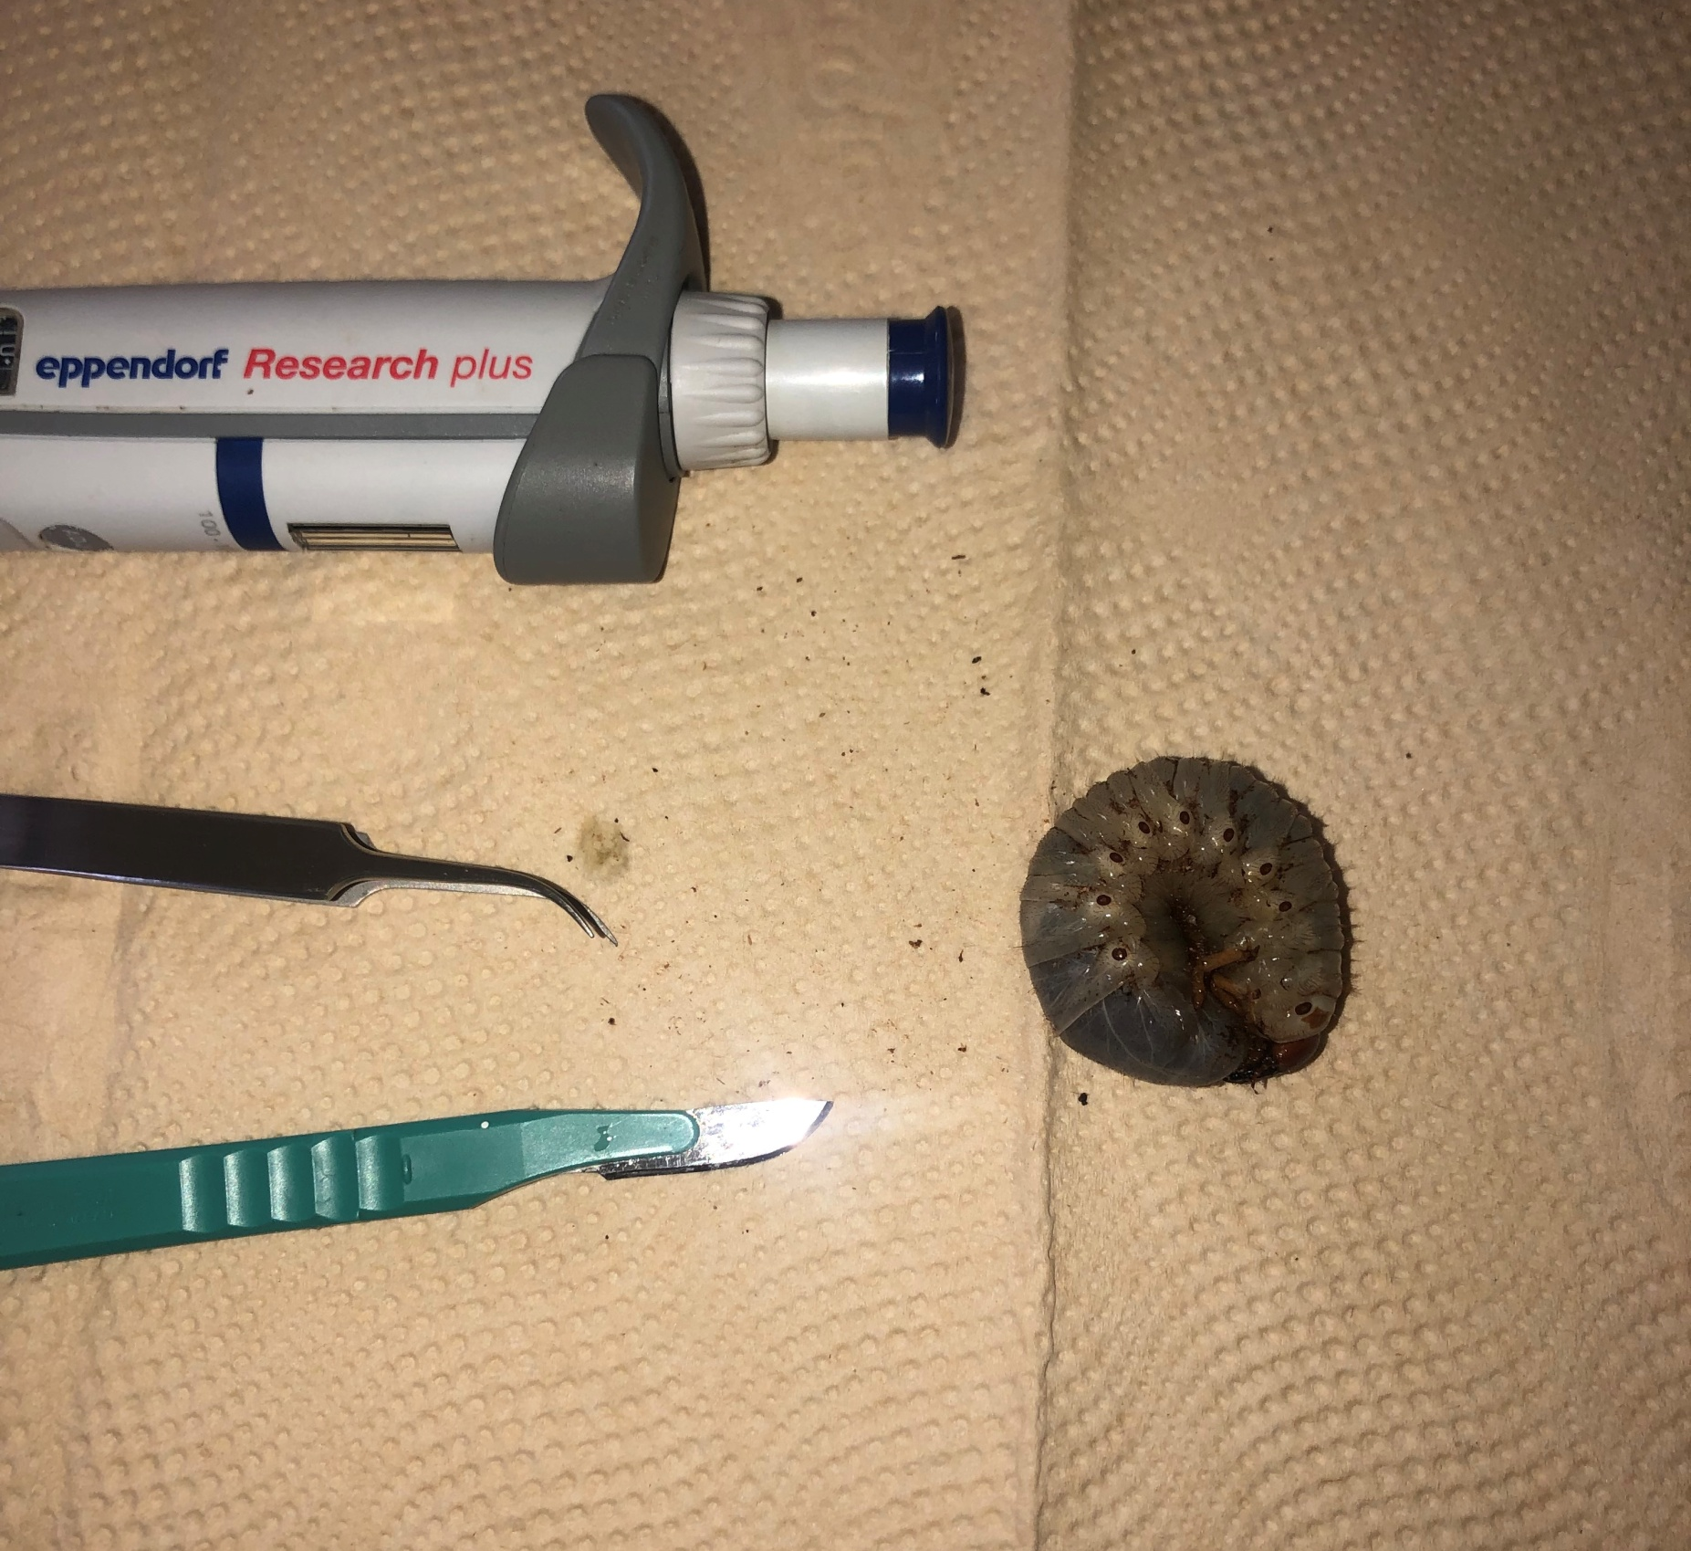
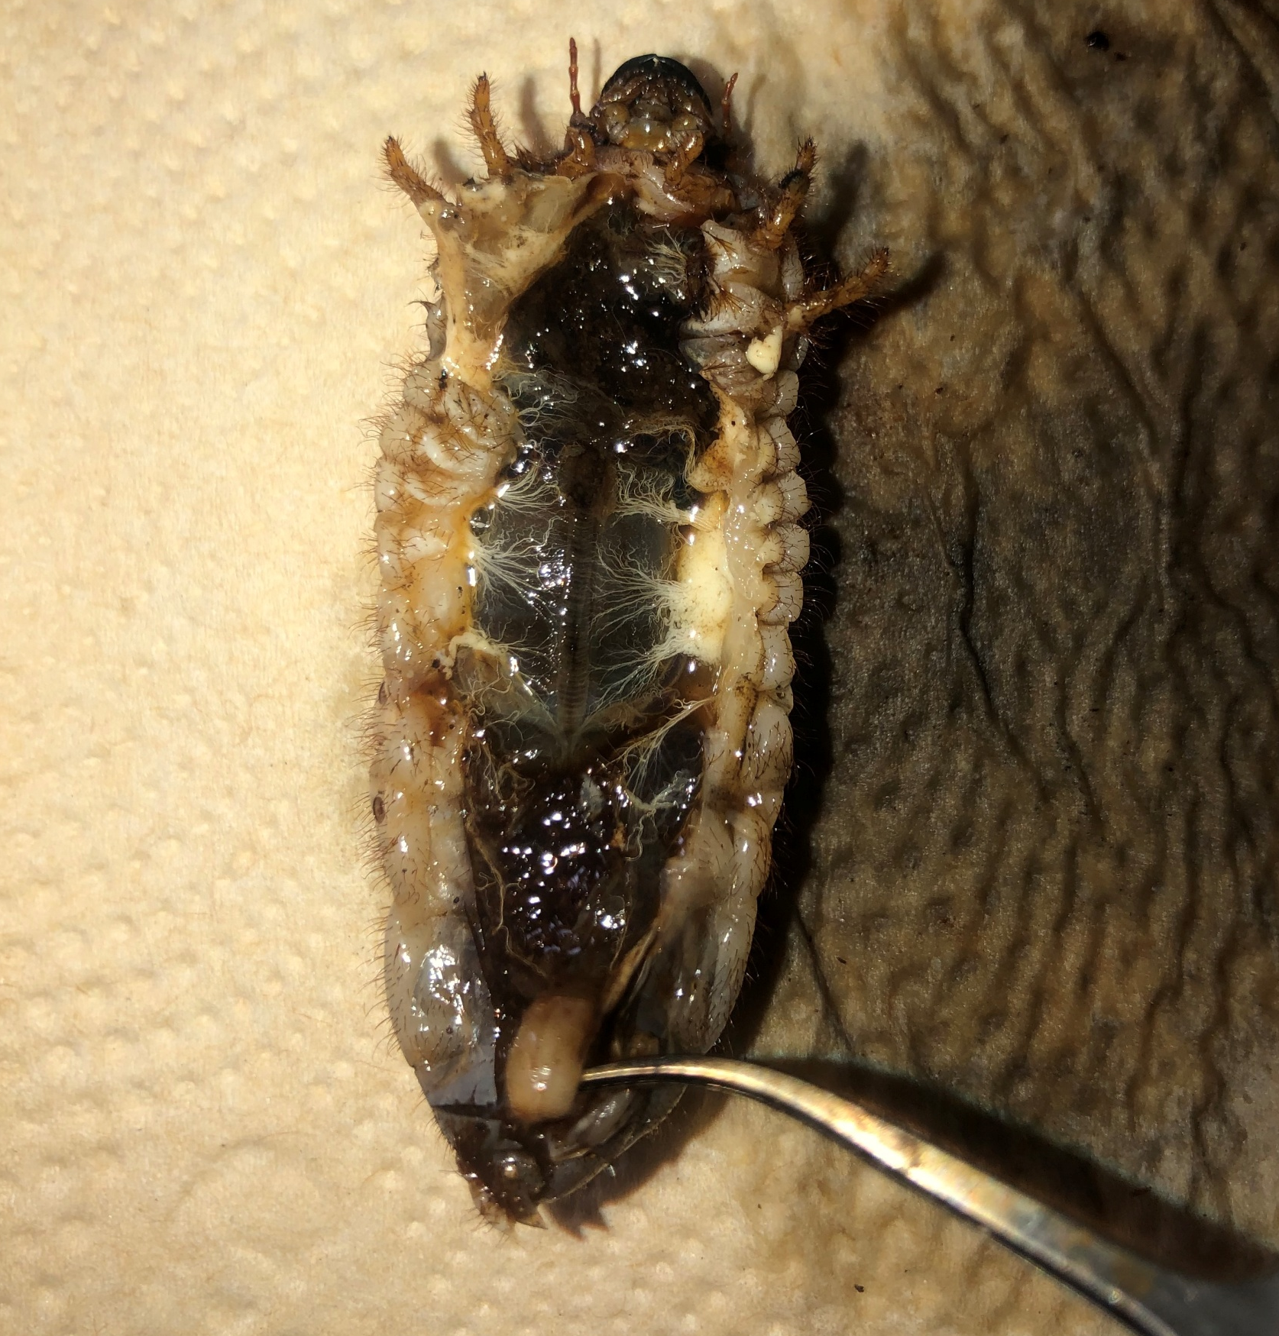
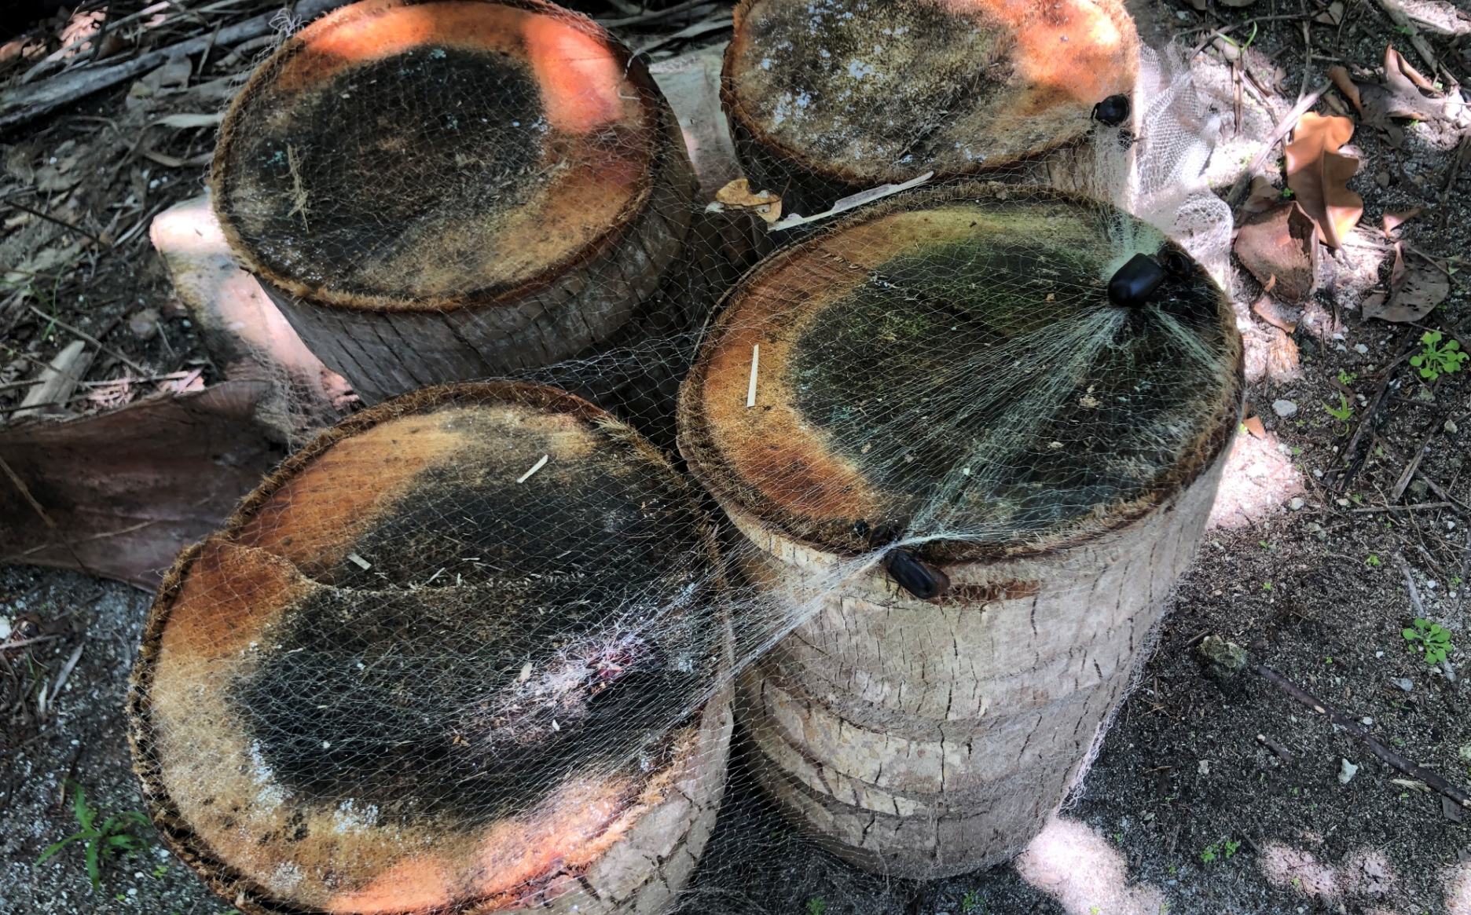
Methods & Materials
Recording damage assessment data at survey sites
Analyzed assessment data in R version 3.5.1 via Anova
Collecting adult CRB with specialized netting traps and specialized pheromone traps from previous project were used to catch adult beetles
Used gloves, machetes, picks, & shovels to break up rotten coconut logs, mulch, compost piles to collect the CRB larvae inside.
Dissectected samples and put samples in to RNA protect

Slide 10
Results
Mean for 2018 Overall Fronds = 1.24
Mean for 2021 Overall Fronds = 1.49
P- Value = 0.120, for 2018 vs. 2021 Overall Fronds
Mean for 2018 Top 4 Fronds = 0.91
Mean for 2021 Top 4 Fronds = 1.45
P- Value = 0. 23, for 2018 vs. 2021 Top 4 Fronds

Slide 11
Discussion
Aimeliik, Kayangel, & Ngeremelengui show significant difference of damage from 2018 to 2021
Based on surveys conducted this year, coconut trees show slight decrease in damage
Although data has shown decrease in damage, CRB impact is still a great issue.

Slide 12
Conclusion
Based on surveys conducted this year have shown slight increase in tree damage from 2018.
Although damage has increased, it hasn’t increased to the levels consistent with heavy infestation like other countries suffering from CRB impact. This is consistent with the theory of cross-breeding resistant and variable virus types.

Slide 13
Acknowledgements
Christopher Kitalong, PhD, PCC-CRE/ Pacific Academic Institute of Research
STEP-UP
The University of Hawaii
Palau Community College

