Slide 1
Fruit Fly Management in Palau
Mederang Takeo
Mentor: Christopher Kitalong PhD

Slide 2
Overview
Abstract
Importance of fruit trees
Objectives
Methods and materials
Results
Discussion
Conclusions

Slide 3
ABSTRACT
Mederang Takeo
Mentors: Christopher Kitalong PhD, Palau Community College, Pacific Academic Institute for Research, Jesse Ramarui, Pacific Academic Institute for Research
Institutions: University of Hawaii, Palau Community College, Pacific Academic Institute for Research
Control of Fruit Fly Population in Palau
Fruit flies have caused major damage in fruit trees across the pacific and in Palau. They have caused 90% of fruit loss on the island. There are four known species of fruit flies; mango fruit fly (Bactrocera Frauenfeldi), oriental fruit flies (Bactrocera Dorsalis), breadfruit flies (Bactrocera Umbrosa), and Bactrocera Calophylli. The female flies damage unripened fruits by injecting their larvae into the fruits by their stinger. As the larvae grow they devour the fruit from the inside out. Catching female fruit flies with existing methods have been proven difficult, but a new cost-effective method is being tested and has produced promising results. Implementation of traps made of yeast waste, crushed papaya leaves and isopropyl carried out in small bottles hung on trees have proved effective in trapping 40 female B. dorsalis, 12 D. melanogaster, as well as 3 unidentified female flies. Future plans in expanding the methods and traps used are under way to trap and control fruit flies on a larger scale.
Key Words: B. Dorsalis, B. Umbrosa, B. Frauenfeldi, B. Calophylli, Palau, yeast, papaya

Slide 4
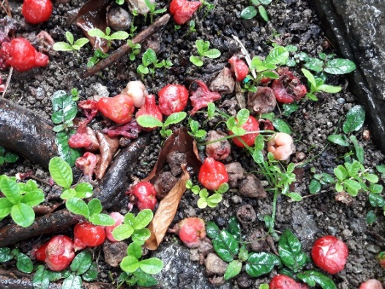
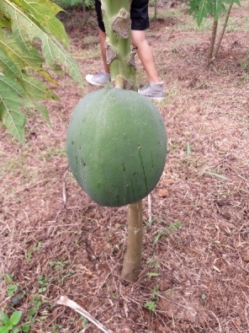
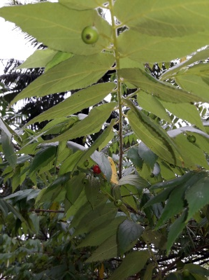
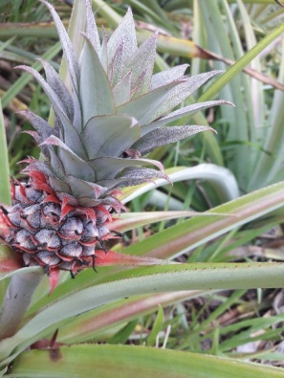
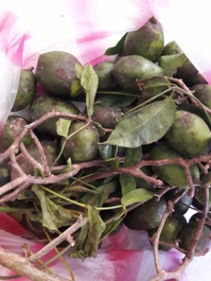
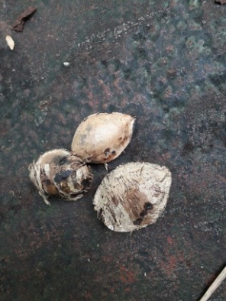
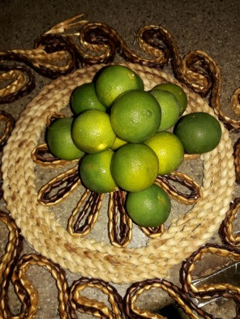
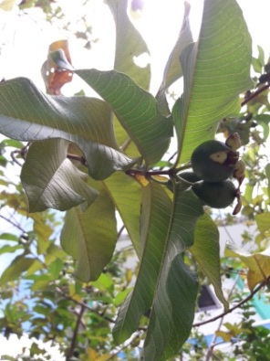
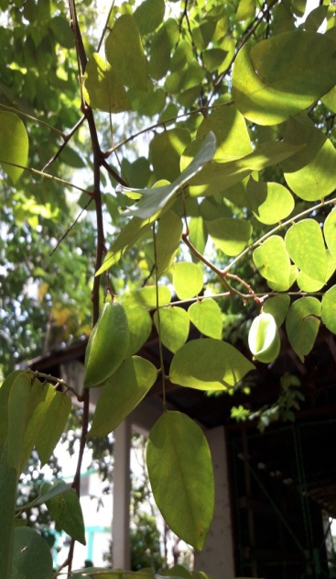
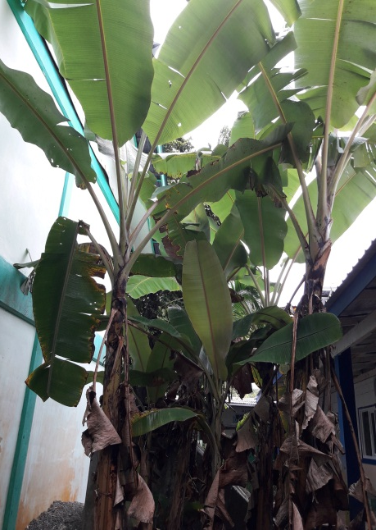
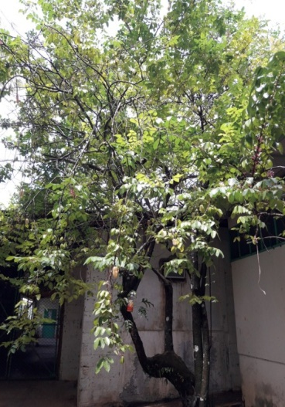
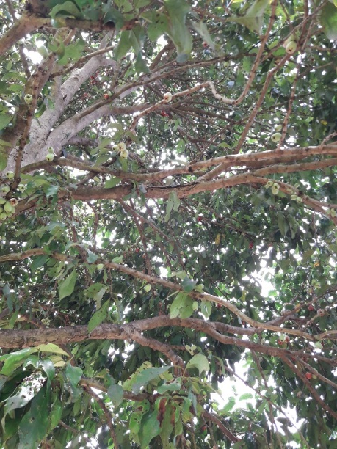
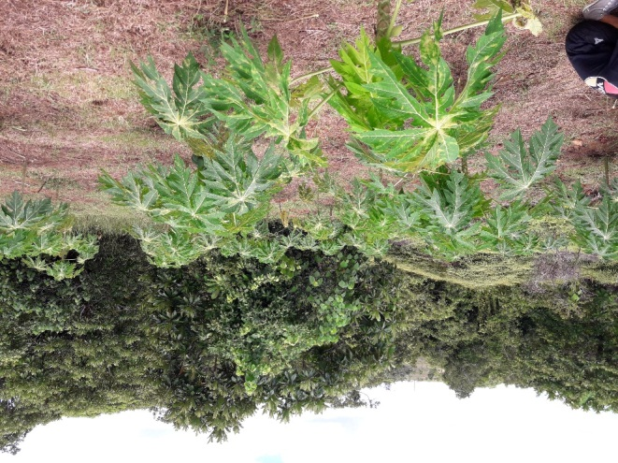
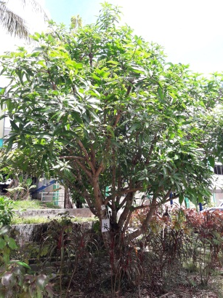
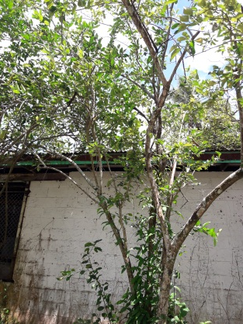
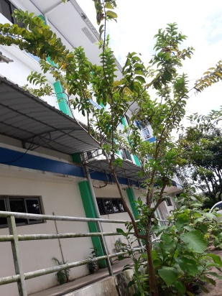
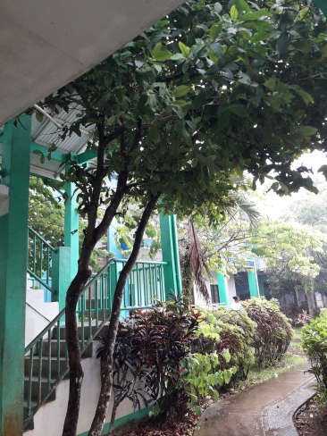
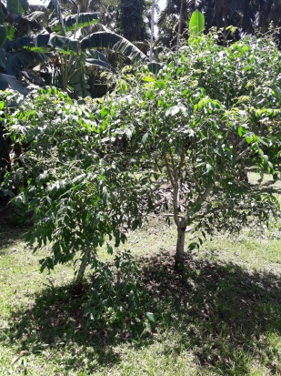
Importance of Fruit Trees
Source of food and drink
Used for medicinal purposes
Used in making tools and other specific materials
Source of sustainable economy (local/tourist)

Slide 5
Fruit flies of the family Tephritidae are considered to be the most problematic insect pest species of cultivated fruit in the world.
There are over 4500 fruit fly species in the world and more than 50 of them are classified as major pests.
Palau is known to have 4 fruit fly species.

Slide 6
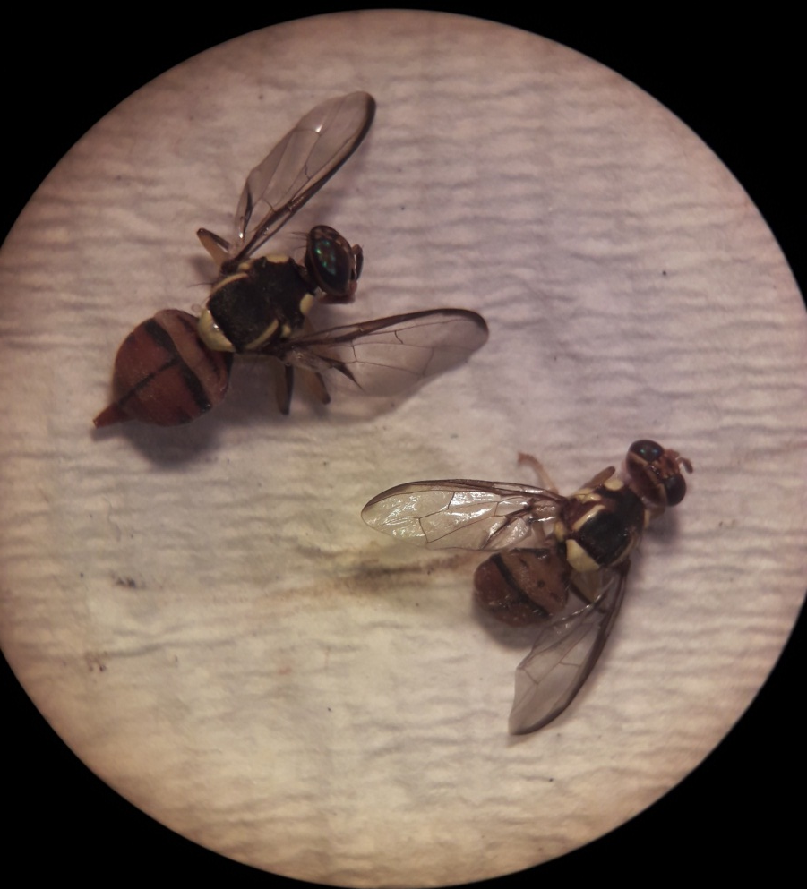
Oriental Fruit Fly
Bactrocera dorsalis
First discovered in Palau in 1999, thought to have been accidentally introduced from the Philippines.
Host fruit:
Starfruit (Averrhoa carambola)
Kalamansi (Citrus microcarpa)
Guava (Psidium guajava)

Slide 7
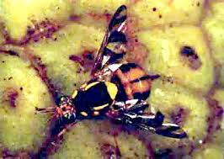
Breadfruit Fly
Bactrocera umbrosa
Host plant:
Breadfruit (Artocarpus altilis)
Jackfruit (Artocarpus heterophyllus)
https://www.google.com/search?rlz=1C1SQJL_enPW851PW851&biw=1288&bih=915&tbm=isch&sa=1&ei=bXc6XZb4FYzh-gSnv7-oAg&q=bactrocera+umbrosa&oq=bactrocera+umbrosa&gs_l=img.3..35i39.86953.88681..88934...0.0..0.268.1542.2-7......0....1..gws-wiz-img.JuRfQp66oaE&ved=0ahUKEwjW4sGG1tHjAhWMsJ4KHaffDyUQ4dUDCAY&uact=5

Slide 8
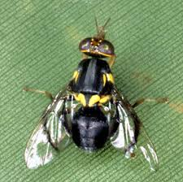
Mango Fruit Fly
Bactrocera frauenfeldi
Host plant:
Starfruit (Averrhoa carambola)
Mango (Mangifera indica)
Tropical almond (Terminalia catappa)
Guava (Psidium guajava)
Mountain apples (Syzygium malaccanse)
https://www.google.com/search?rlz=1C1SQJL_enPW851PW851&biw=1288&bih=915&tbm=isch&sa=1&ei=yXc6Xey2CMT7-gTg0IagDw&q=bactrocera+frauenfeldi&oq=bactrocera+fraue&gs_l=img.3.0.0i24.135085.136986..139783...1.0..0.282.1456.2-6......0....1..gws-wiz-img.-7R-jMe0wI0

Slide 9
Bactrocera calophylli
Host fruit:
Indian laurel (Calophyllum inophyllum)
No photo
This species does not affect the economy.

Slide 10
Life Cycle

Slide 11
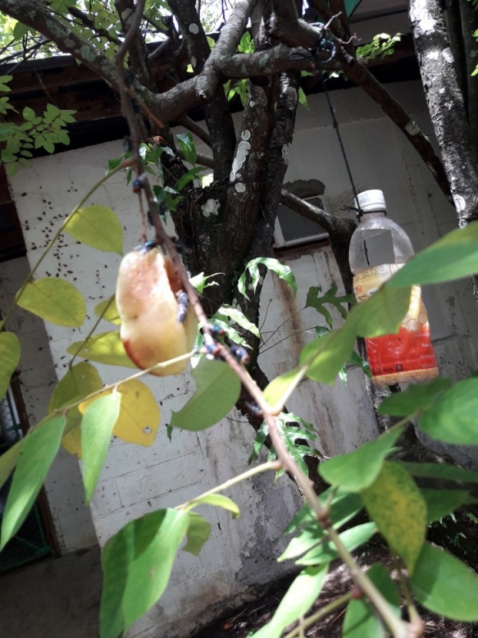
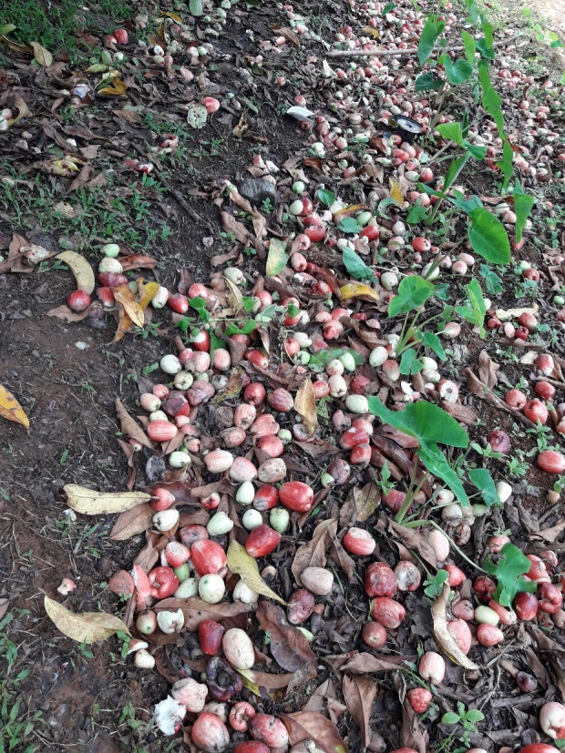
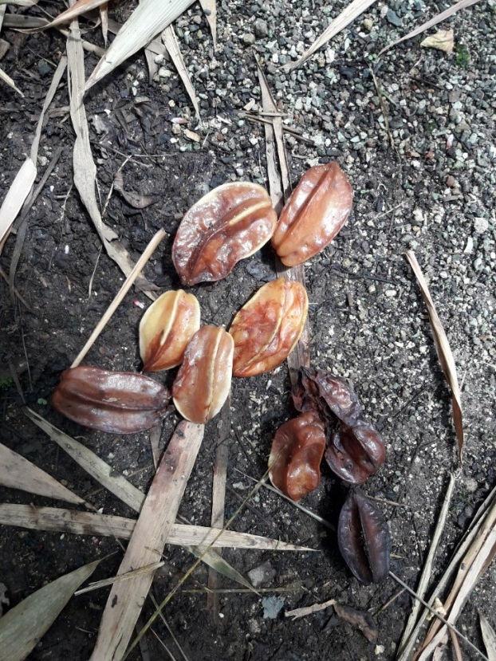
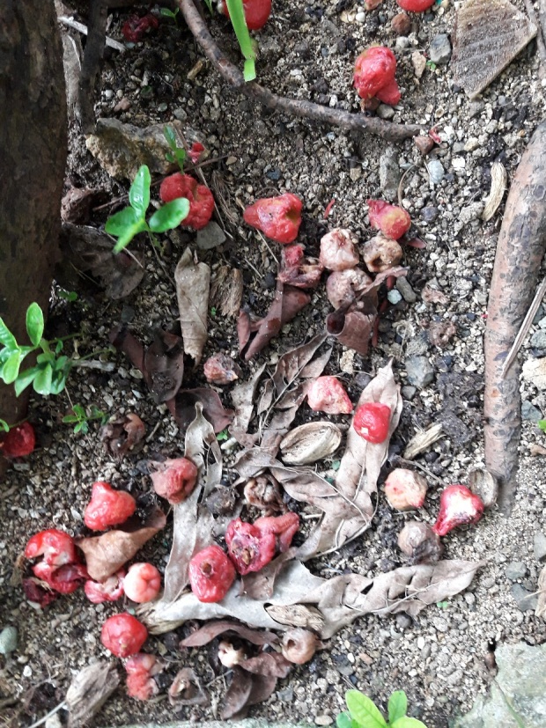
Fruit Fly Damage to Fruits
There are 4 known fruit flies found in Palau which all have contributed to nearly 90% of fruit losses in Palau. The female fruit flies would find a host fruit and with its stinger, inject its larvae into the semi-ripened fruit and from there the fruit begins to rot. From the inside, the larvae feed on the fruit until it rots than fall to the ground where they start to develop their hardened shell and grow into adults.

Slide 12
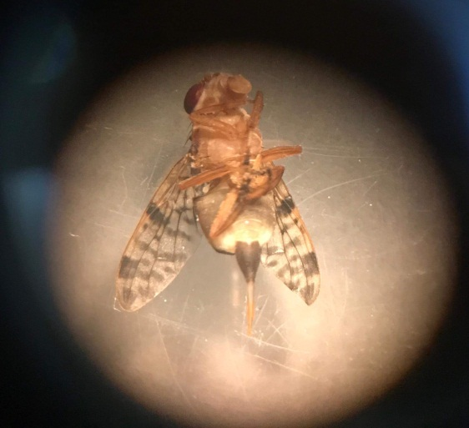
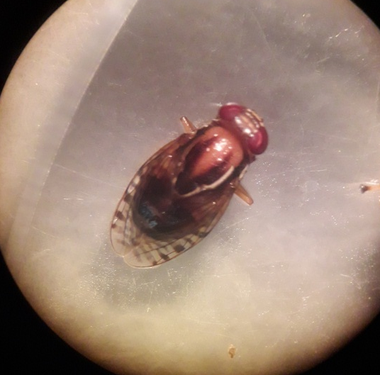
Objectives
In the last 60 years, our attempts to catch a female fruit fly have all been unsuccessful. This is because traps are using female pheromones which attract male fruit flies.
My objective for this project was to create a sustainable, all-natural, and relatively inexpensive trap which could collect female fruit flies as well as the males.

Slide 13
Trapping and Eradication attempts
Some methods to manage and control fruit fly populations have been implemented in different pacific island countries such as Fiji and Cook Islands.
Physical control such as bagging, which provides a physical barrier between the host fruit and female fruit fly. (It is a very effective method but very time consuming.)
Harvesting the fruit at color break.
Protein bait sprays. In Palau, similar method has been used but as traps.
Eradication of fruit flies in Palau is very expensive. In 1999 it was estimated to cost $1 million to eradicate oriental fruit and breadfruit fly. And now it is estimated that it will cost more that 10 million.

Slide 14
Hypothesis
Utilizing a prior established spray method of a yeast, papain and organic solvent we will be able to attract the female fruit fly to a vat mixture and capture without the use of pesticides.

Slide 15
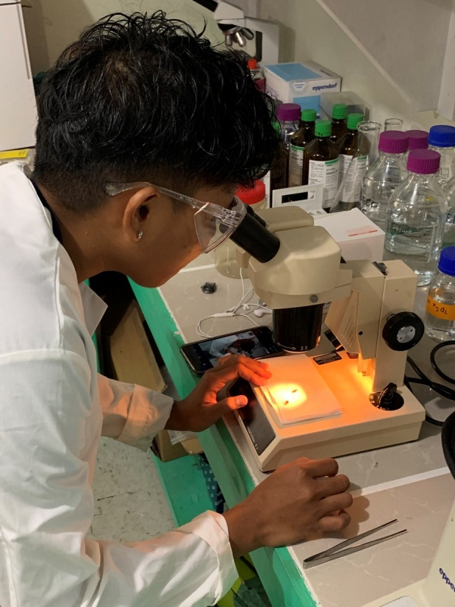
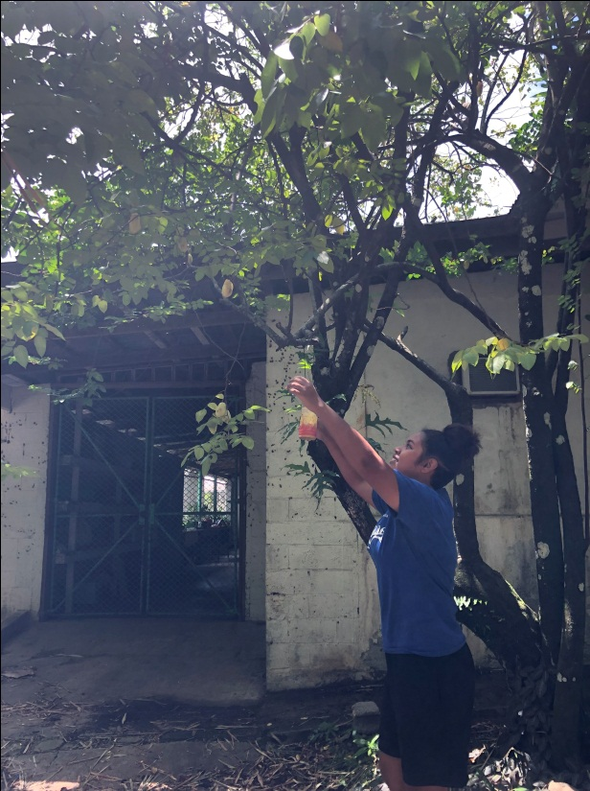
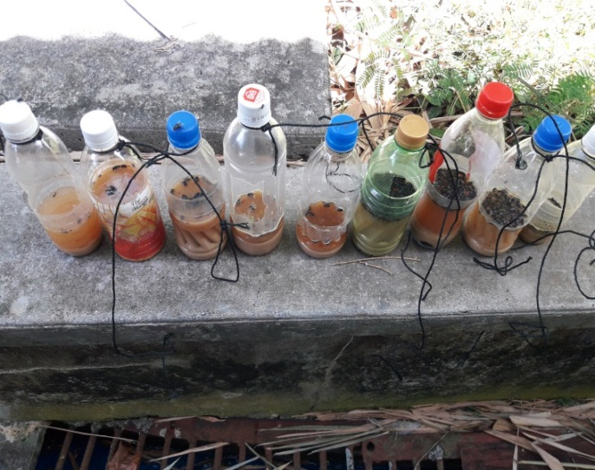
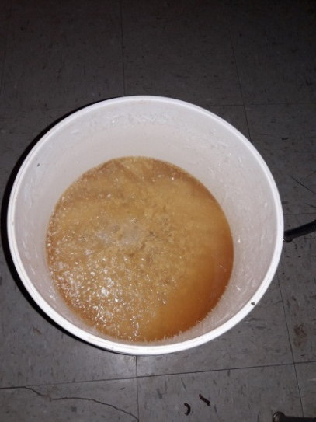
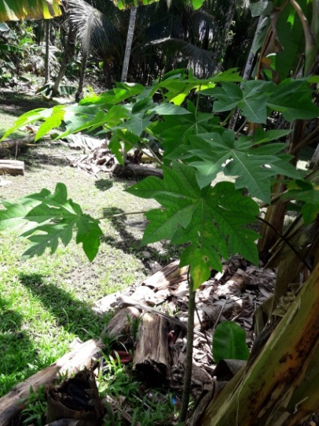
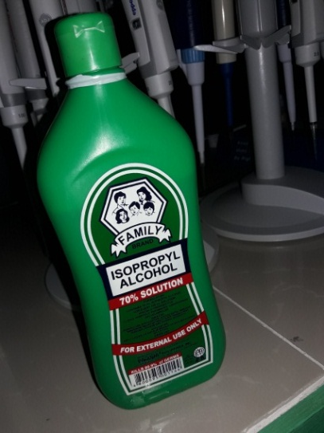
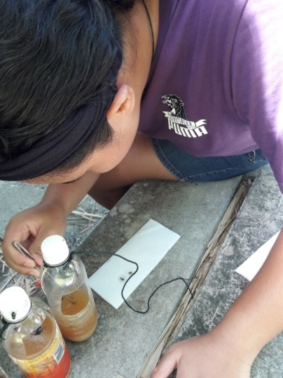
Methods and Materials
Mixture of waste yeast brewery, papaya leaves and 70% isopropyl alcohol.
For every 5-gallons of waste yeast, add 10-15 crushed papaya leaves and 1 cup of isopropyl alcohol. Mix well and let it settle for at least an hour. This is done so that the papain in the papaya leaves can be secreted and mixed with the yeast.
Reused bottle filled with bait halfway and hung on fruit bearing trees.
Strain and assess traps weekly for specimens.

Slide 16
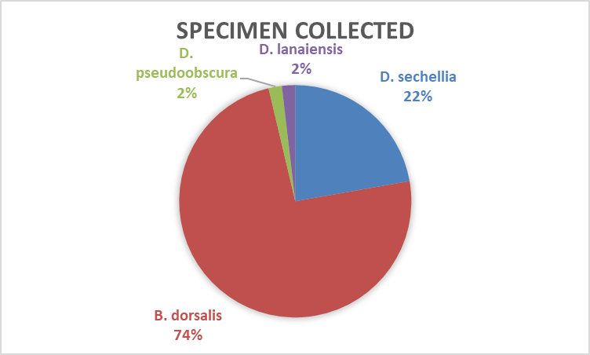
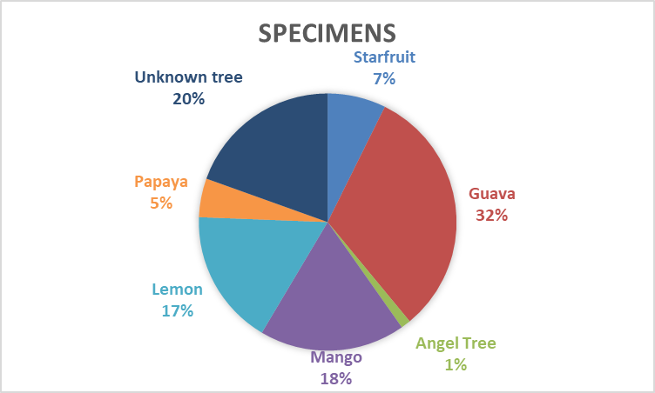
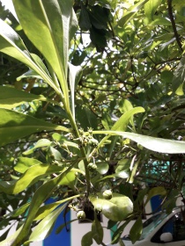
Results: Trap Data

Slide 17
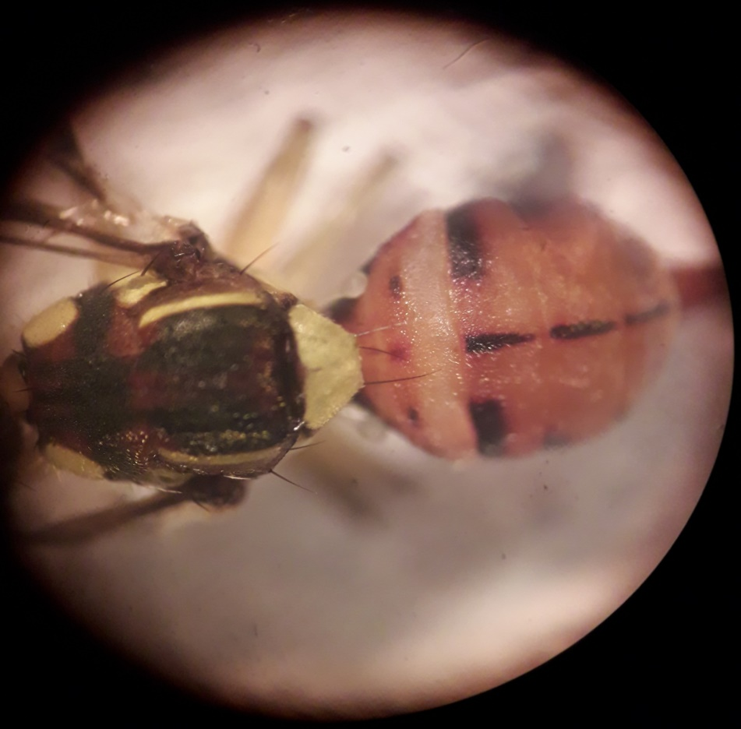
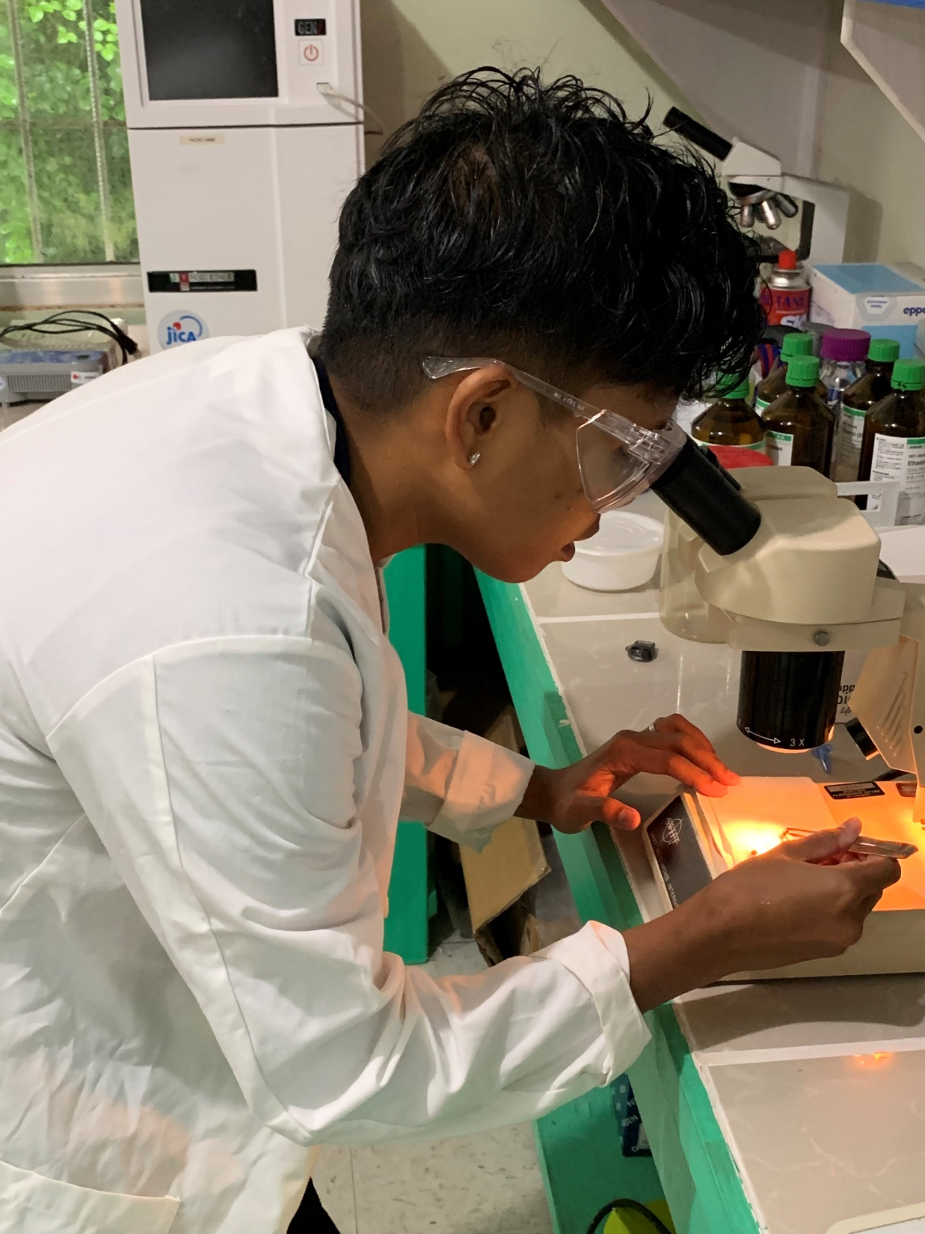
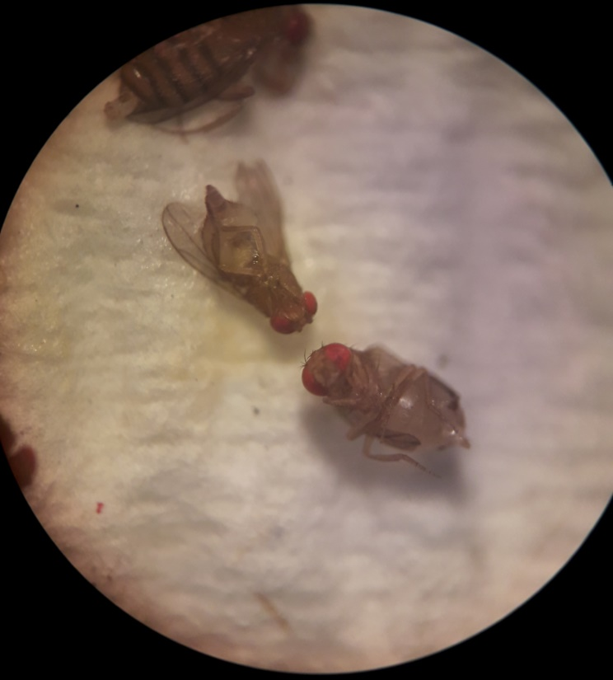
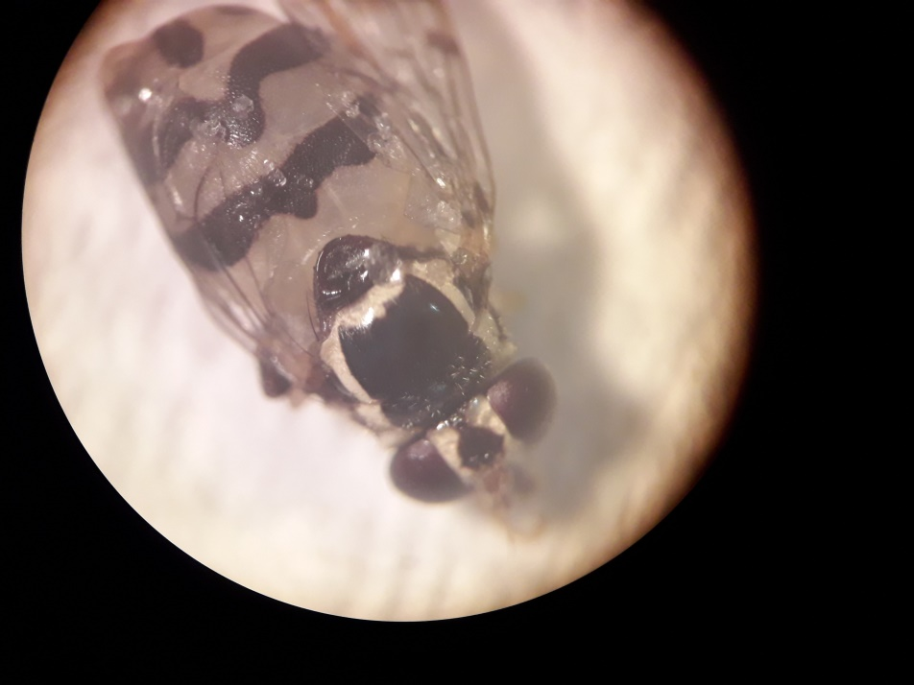
D. pseudoobscura
B. dorsalis
Stinger=Female (XX)
D. sechellia
D. lanaiensis

Slide 18
Discussion
FIRST successful capture of FEMALE fruit fly in Palau!!!!!!!!!
Trapping method does NOT CONTAIN PESTISIDES.
VERY ECONOMIC: trapping method is inexpensive and easy to recreate on any tropical island.

Slide 19
Conclusion
1. The implementation of traps around the Palau Community College campus has proven successful in catching female fruit flies.
2. Utilizing multiple tree locations has helped us determine which types of fruit flies are mostly found on which type of tree and therefore has given us a better understanding of how to control this problem.
3. These methods will be nation-wide project is already underway with the Bureau of Agriculture to produce the bait on a larger scale and to be placed around Palau and local farms.
4. This method can be easily transferred to other places across the Pacific.

Slide 20
Acknowledgments
STEP-UP
Palau Community College: Cooperative Research Extension
Mr. Konrad Englberger (FAO Consultant)
Mr. Jordan Fleetwood (Palau Brewery Co.)
Bureau Of Agriculture
PAIR Camp Team (Kobe, Raimunt, Albright, Grayson, James)
Palau Community College Upward Bound Students
Follow us:
Facebook @ PAIR CAMP
Instagram @ paircamp

