Slide 1
Effectiveness of Compost Application on Growing Spoon
Cabbage (Brassica rapa) in Salt Treated Soil
PENNELY LAKJOHN
REPUBLIC OF THE MARSHALL ISLANDS
HIGH SCHOOL STEP-UP
AUGUST 6-10, 2017
Natcher Conference Center Bethesda, MD

Slide 2
INTRODUCTION
Marshall Islands soil conditions are generally sandy and poor in quality. It does not retain enough water and nutrients for
healthy plant growth and development (Deenik & Yost, 2006).
Problems like salt spray, inundation and strong winds are somechallenges the island is facing. Imported foods are flooding the island and noncommunicable diseases are on the rise. Local farming is so limited, producing very minimal amounts of
vegetables and fruits for the markets. Some farmers have given
up tilling the land due to the many challenges encountered in
addition to poor soil conditions and salt stress.

Slide 3
TEST PLANT
Spoon cabbage (Brasicca rapa) is one of the
popular green leafy vegetables on the island, a
common ingredient in soups and stir-fried
vegetables. Spoon cabbage is a good source of
vitamins and minerals, fibers and anticancer
phytochemical agents

Slide 4
OBJECTIVES
This experimental study was conducted at the RMI
Cooperative Research and Extension garden facility
located at Arrak, Majuro Atoll, from May 22 to July 31,
2017. This study aims to fulfill the following objectives:
1. to assess the growth performance of spoon cabbage with varying concentrations of salt stress on sandy and
compost treated soils in terms of:
a. Mortality
b. Percent growth
c. Marketable weight
2. To compare and analyze statistically the growth
performance of spoon cabbage in both soil types and
determine each salt tolerance threshold level.

Slide 5
RESEARCH HYPOTHESIS
It was hypothesized that
compost application on soil would result in a higher salt
tolerance threshold level.
ALLPPT.com _ Free PowerPoint Templates, Diagrams and Charts

Slide 6
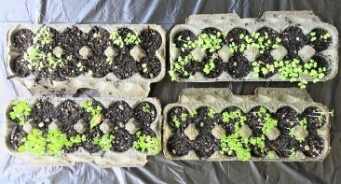
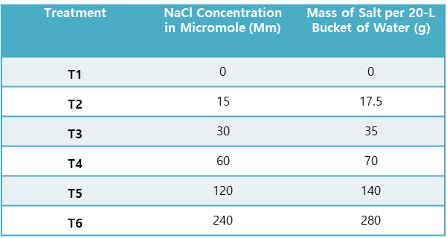
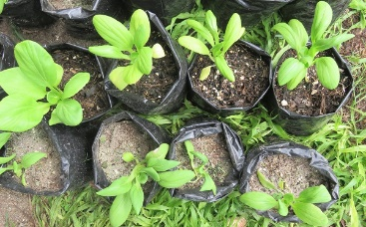
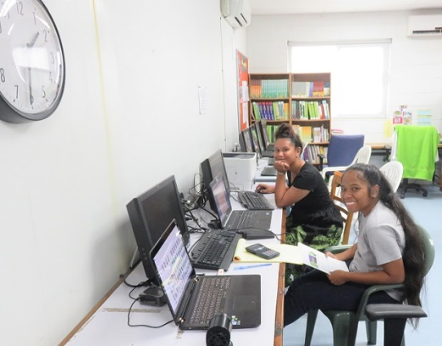
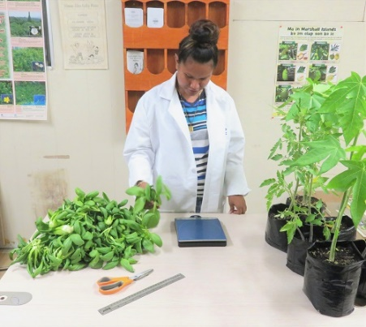
METHODOLOGY
1. Soil Prep
Sandy: 3 areas, blackish,
fertile-looking
Compost: 1 sandy: 1 coconut husk:
1 seaweed debris: 1 chicken manure
2. Seedling
Prep
3. Salt Water Prep
15$mM NaCl ×\frac{1Mol NaCl}{1000mM NaCl}×\frac{58.4g NaCl}{1Mol NaCl} ×20=17.5g NaCl$
Irrigation for 10 days twice a day
4. Data Gathering & Analysis

Slide 7
RESULT & DISCUSSION
Figure 1. Appearance of spoon cabbage on both planting media after 10 days of
salt water irrigation

Slide 8
RESULTS AND DISCUSSION
Table 2
Comparative growth performance pattern of spoon cabbage on sandy topsoil and compost treated soil, the same letter on the line indicates no significant difference (p˂0.05)

Slide 9
RESULTS AND DISCUSSION

Slide 10
SUMMARY & CONCLUSION
The overall pattern shows that the growth performance of spoon
cabbage in a compost-treated soil was found to be significantly more effective than the plants grown in the sandy soil. The results suggest
that compost could be used as a soil amendment for the saline soil
environment in the Marshall Islands. The results agreed with the
previous studies that compost could improve, alleviate and remediate
saline affected soil by improving its physical, chemical and biological
properties (Ouni et al., 2013; Lashari et al., 2012; Rousk, et al., 2011;
Lakhdar et al., 2009).
CONCLUSION
Application of compost on soil resulted in a higher salt
tolerance threshold level and therefore the hypothesis was
accepted.

Slide 11
BIBLIOGRAPHY
Deenik, J.L. & Yost, R.S. (2006). Chemical properties of atoll soils in the Marshall Islands and constraints to crop production. Geoderma. 136: 666-681. DOI10.1016.
Lakhdar, A., Rabhi, M, Ghanya, T., Montemurro, F., Jeddi, N. & Abdelly, C. (2009). Effectiveness of
compost use in salt-affected soil. Journal of Hazardous Materials. 171:1-3: 29-37.
Lashari, M.S., Liu, Y., Li, L., Pan, W., Fu, J., Pan, G., Zheng, J., Zheng, J., Zhang. & Yu., X. (2012).
Effects of amendment of biochar-manure compost in conjunction with pyroligneous solution
on soil quality and wheat yield of a salt-stressed cropland from Central China Great Plain. Field Crops Research. 144: 113-118.
Ouni, Y., Lakhdar, A., Sceiza, R., Scotti, R., Abdelly, C., Barhoumi, Z. & Rao, M.A. (2013). Effects of two composts and two grasses on microbial biomass and biological activity in a salt-affected soil. Ecological Engineering. 60: 363-369.
Rousk, J., Elyaagubi, F., Jones, D.L. & Godbold, D.L. (2011). Bacterial salt tolerance is unrelated to soil salinity across an arid agroecosystem salinity gradient. Soil Biology and Biochemistry. 43-9: 1181-1887.

Slide 12
ACKNOWLEDGEMENT
Special thanks to:
Vincent Enriquez, MA (mentor): Agriculture Researcher, College of the Marshall Islands, Land Grant/USDA-NIFA Cooperative Research & Extension Program
George Hui, PhD: Pacific STEP-UP Program Director, John A. Burns School of Medicine UH, Manoa
Dr. Lawrence Y.C. Agoda, F.A.C.P.: Director OMHRC/NIDDK
Mr. Biuma Samson: Dean, Land Grant/USDA-NIFA Cooperative Research & Extension Program, College of the Marshall Islands
Walton Bohanny, MSN: Pacific STEP-UP Regional Coordinator, Republic of the Marshall Islands
Moses Sumaoang, RN-BSN, MA: Pacific STEP-UP Regional Coordinator, Republic of the Marshall Islands
Sali Andike, BSc.: Pacific STEP-UP Program Coordinator, Republic of the Marshall Islands
Kommol Tata

