Slide 1
Determining How Sec10 and the Exocyst Complex
Regulate Ureter Development
Olivia Yoshida
John A. Burns School of Medicine
Anatomy, Biochemistry, and Physiology Department
Mentor: Dr. Ben Fogelgren

Slide 2
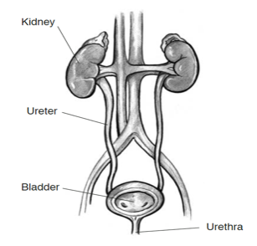
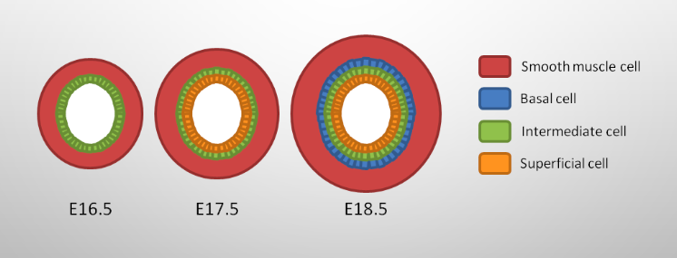
Background: Urinary System
Four main functions:
Filtration
Reabsorption
Secretion
Excretion
Kidney development
Ureteric buds off from Wolffian duct
Ureteric bud branches proximally and distally
Proximal portion develops into kidney
Distal portion develops in the ureter

Slide 3
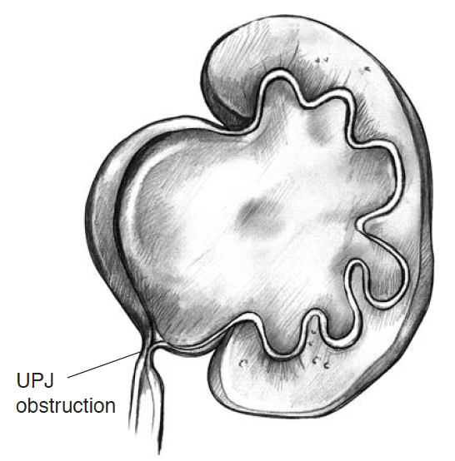
Background: Congenital Obstructive Nephropathy (CON)
Most common cause of end stage renal disease (ESRD) and chronic kidney disease (CKD) in children
Occurs in 1:500 births
Leading cause of CON is ureteropelvic junction (UPJ) obstruction
Prevents urine outflow, causing hydronephrosis(swelling of the kidney due to urine accumulation in renal pelvis)
Underlying cause is poorly understood

Slide 4
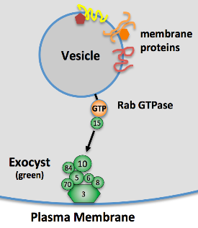
Background: Exocyst Complex
Eight membered protein complex
Assists in epithelial cell growth, communication, and apical/basil polarity establishment
Sec10 central protein component
Attaches Sec15 to the exocyst complex on the plasma membrane
During stratification, urothelial cells die in absence of the exocyst complex
Lipschutz and Mostov, Curr Biol, 2002

Slide 5
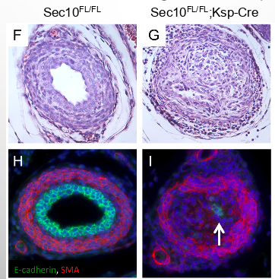
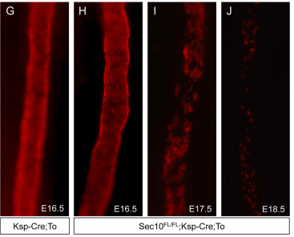
Background: CON in Sec10 Urothelial Knockout
Obstructed ureters shown in Sec10 conditional knockout mice
Fogelgren et al., PLOS One, 2015; Lee et al., Scientific Reports
Progressive loss of urothelial cells after E16.5 (embryonic day 16.5)
Lee et al., Scientific Reports, 2016

Slide 6
Hypothesis:
Abnormal cell signaling pathways may underlie cell death in affected epithelium
Research Question:
Which genes, of those associated with epithelial stress in mutant ureters, could be responsible for observed cell death?

Slide 7
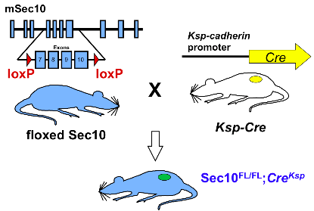
Methods:
Sec10 conditional knockout mouse model created to model UPJO
Mouse husbandry and handling
Fogelgren et al., PLOS One, 2015; Lee et al., Scientific Reports

Slide 8
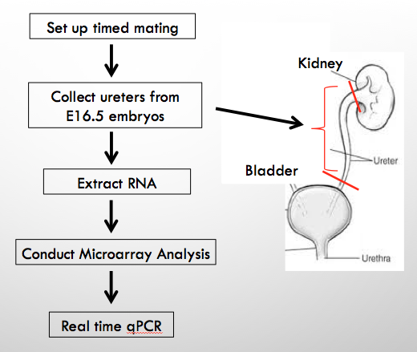
Methods:

Slide 9
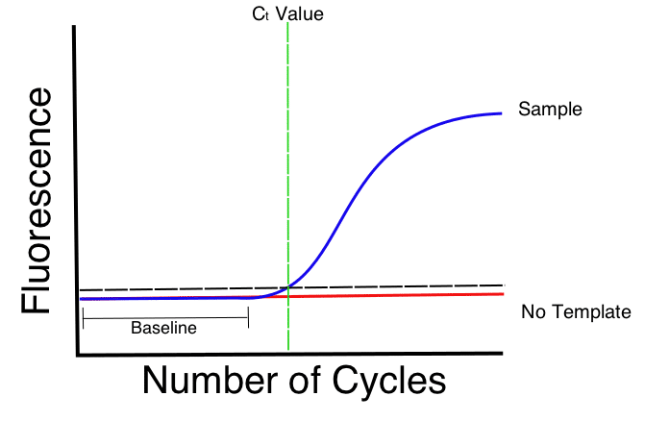
Methods:
Affymetrix microarray
Transcriptome analysis software (TAC) to identify gene expression
Primers created from genes with the highest numbers of fold changes
Real time quantitative polymerase chain reaction (RT-qPCR)
Using SYBR green probe
Binds to double stranded
Amplification and measurement

Slide 10
Affymetrix Microarray Analysis of E16.5 Ureters
What molecular changes occur prior to cell death at E17.5?
Table 1. Upregulated genes in E16.5 CKO vs WT ureters
Table 2. Downregulated genes in E16.5 CKO vs WT ureters
Gene Name | Fold Change
Gprc5a | 21.28
Tmem171 | 13.81
Efemp1 | 13.09
Krt14 | 9.62
Gadd45b | 7.93
Epha2 | 7.55
Gene Name | Fold Change
Upk3a | -94.57
Sptssb | -26.5
Fxyd2 | -24.97
Gsdmc2 | -24.34
Tmem27 | -19.9
Aqp3 | -11.3

Slide 11
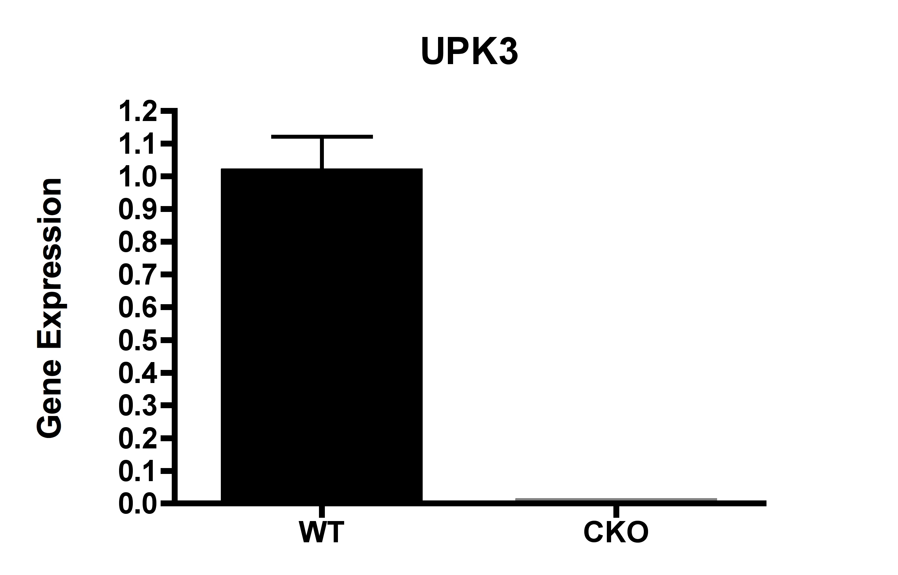
Results:
P<0.001

Slide 12
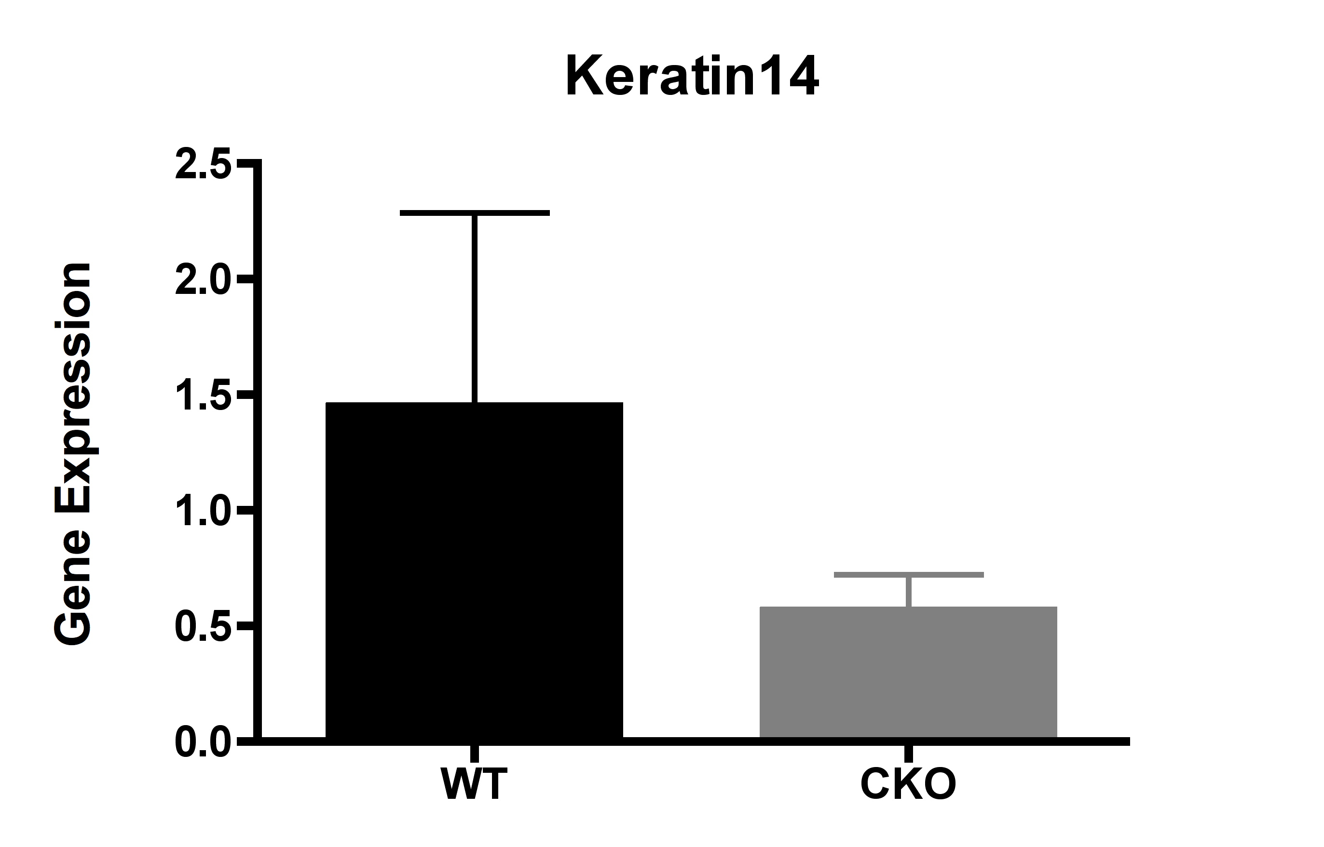
Results:
P>0.05

Slide 13
Discussion:
UPK3a significantly down-regulated in CKO ureters
Confirms integrity of the samples
No significant difference in Keratin14 expression between WT and CKO ureters according to qPCR analysis
Does not confirm microarray data
Other primers from Affymetrix Microarray were tested
Had difficulty optimizing primers

Slide 14
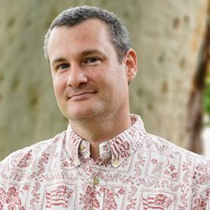
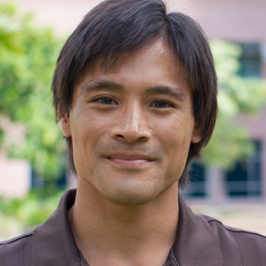
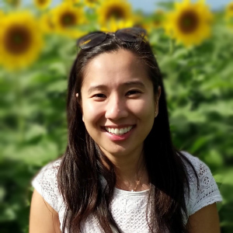
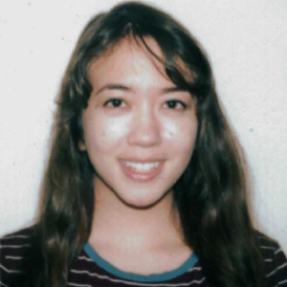
Acknowledgements:
Fogelgren Lab - UH JABSOM
Ben Fogelgren, Ph.D.
Amanda Lee, Ph.D.
Michael Ortega, Ph.D.
Brent Fujimoto
Ross Villiger
Suzanna Lieu
Kadee-Kalia Tamashiro
Madison Williams
Funding
NIDDK - NIH
NIGMS - NIH
Pacific STEP-UP
George Hui, Ph.D.
Aneesa Golshan

Slide 15
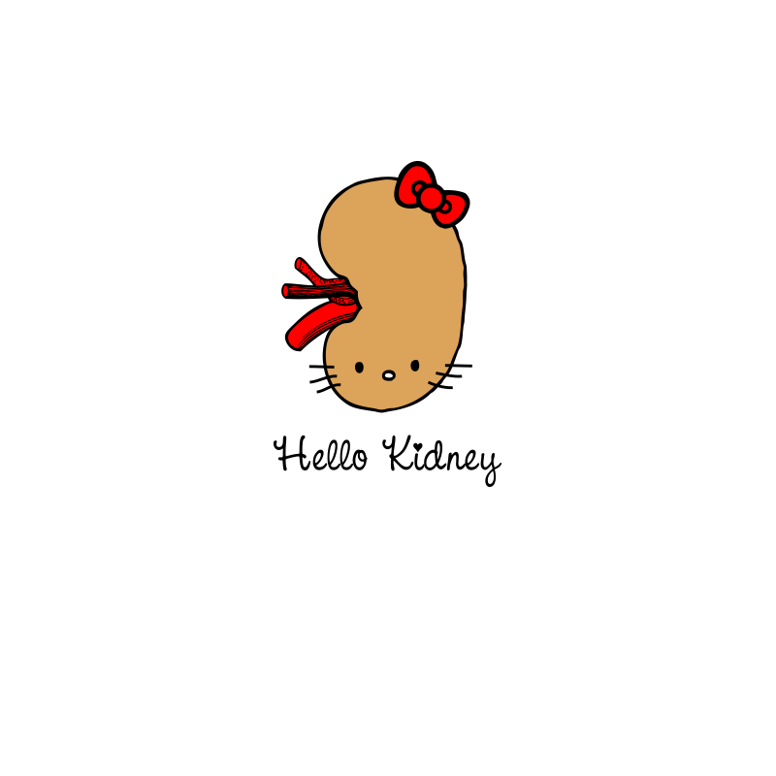
Questions?

