Slide 1
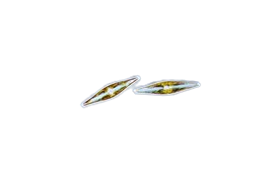
Determining the Abundance and Diversity of Phytoplankton Relative to a Stream Source in Pago Harbor, American Samoa
Penny Solaita
Fa’asao Marist High School
Mentor: Eric Brown, Ph.D., Marine Ecologist,
National Park of American Samoa
Notes:
Add pics of phytoplankton

Slide 2
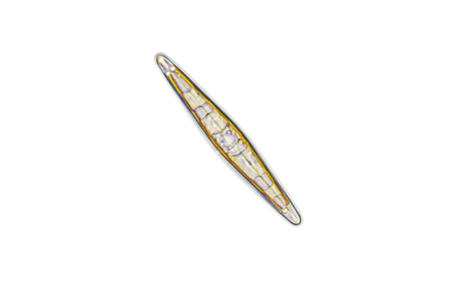
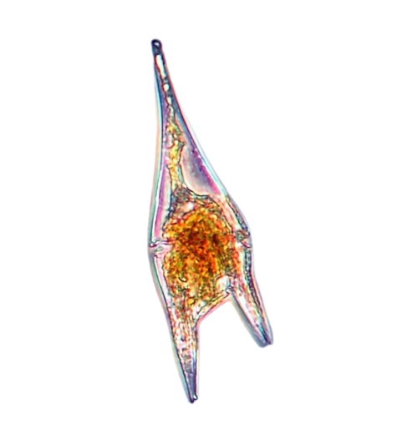
https://www.phytoplankton.com
Phytoplankton: microscopic plants drifting in the ocean
Diatoms and Dinoflagellates
They serve as the foundation of the ocean food web
They are responsible for producing half of the world’s oxygen
Phytoplankton are vastly understudied in American Samoa
The purpose of this research is to fill in baseline knowledge gaps on the abundance and diversity of phytoplankton, relative to stream proximity
Introduction
Notes:
intro/background research

Slide 3
https://www.phytoplankton.com
Null Hypothesis: no difference among sites for either phytoplankton abundance or diversity
Alternative Hypothesis: we expect phytoplankton nearest to a stream to have higher abundance and higher diversity
Hypothesis
Notes:
Hypothesis
We expect phytoplankton nearest to stream to havr higher abundance and higher diversity

Slide 4
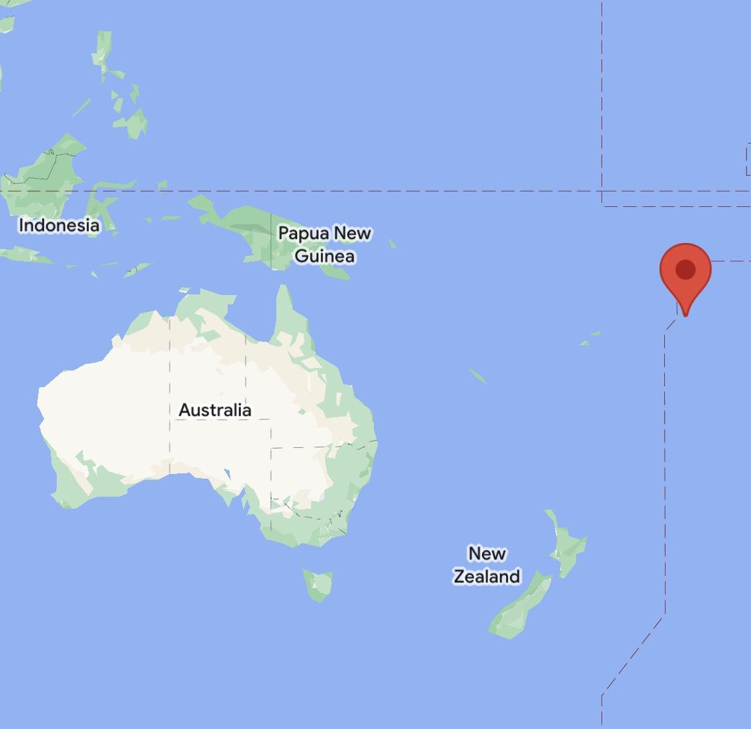
American Samoa

Slide 5
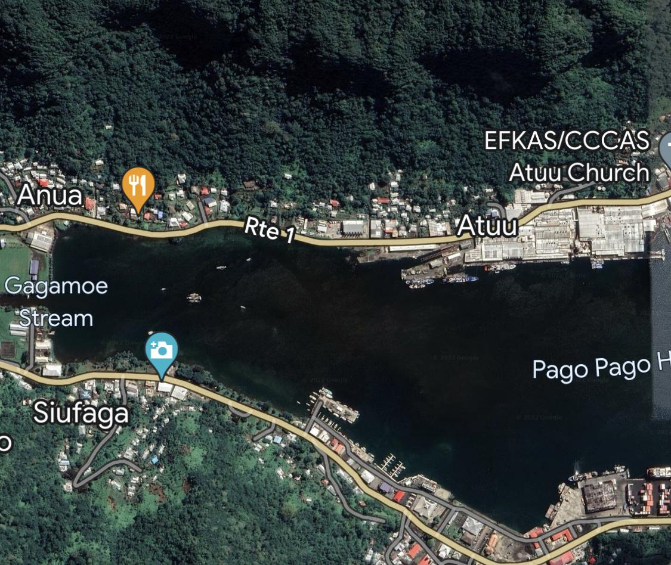
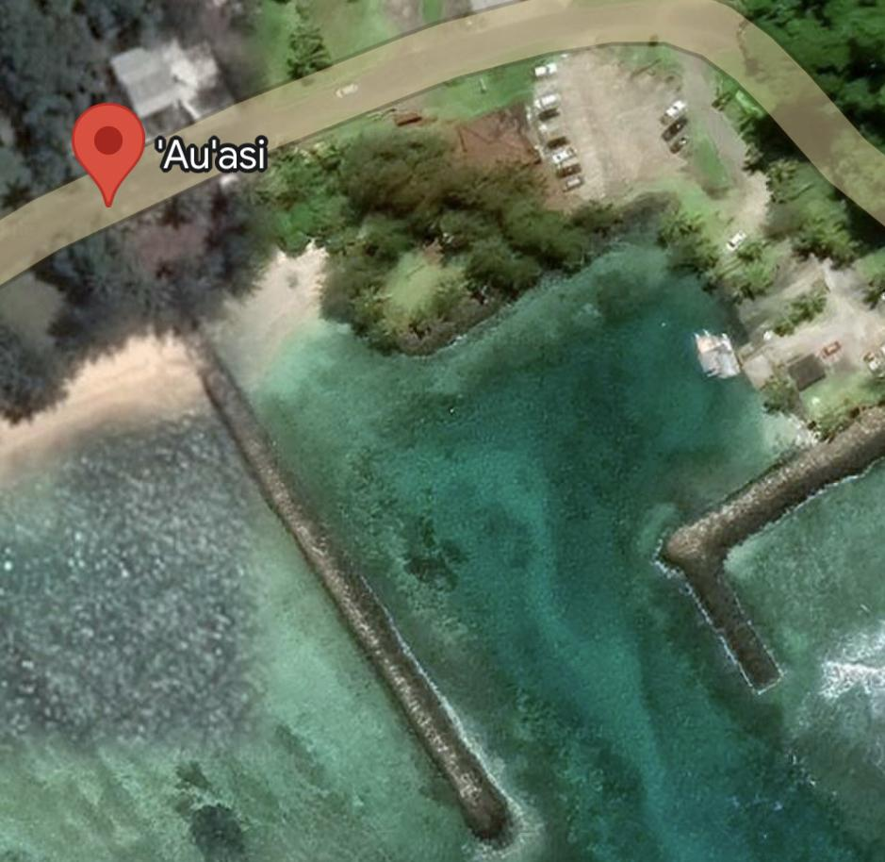
study area
control site
Notes:
Auasi

Slide 6
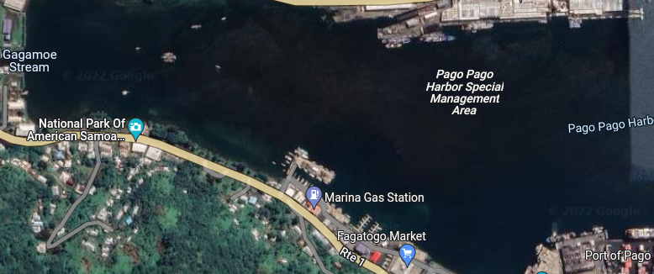
https://www.phytoplankton.com
Will phytoplankton be more abundant in areas closer to the stream?
Pago Pago Boat Ramp (85 meters)
Malaloa
(800 meters)
Pago Pago Port
(1,160 meters)
Notes:
Question
Change map

Slide 7
https://www.phytoplankton.com
Chose 3 sites that ranged from closest to furthest from a major stream and 1 control site with minimal stream input
3 replicate plankton net tows at each site. Each tow was 3 minutes in duration and approximately 30 meters in distance (Volume filtered: 0.94 m³).
Measured chlorophyll, dissolved oxygen, salinity, temperature, and turbidity with a multiparameter sonde at each site
Analyzed each preserved sample (Lugol’s Solution) microscopically for phytoplankton abundance and diversity
Methods
Notes:
Add control
How much water was filtered 0.94 m^3

Slide 8
(Net diameter: 0.2m, Mesh size: 20 µm)
Photo source: https://slideplayer.com/slide/3461332/

Slide 9
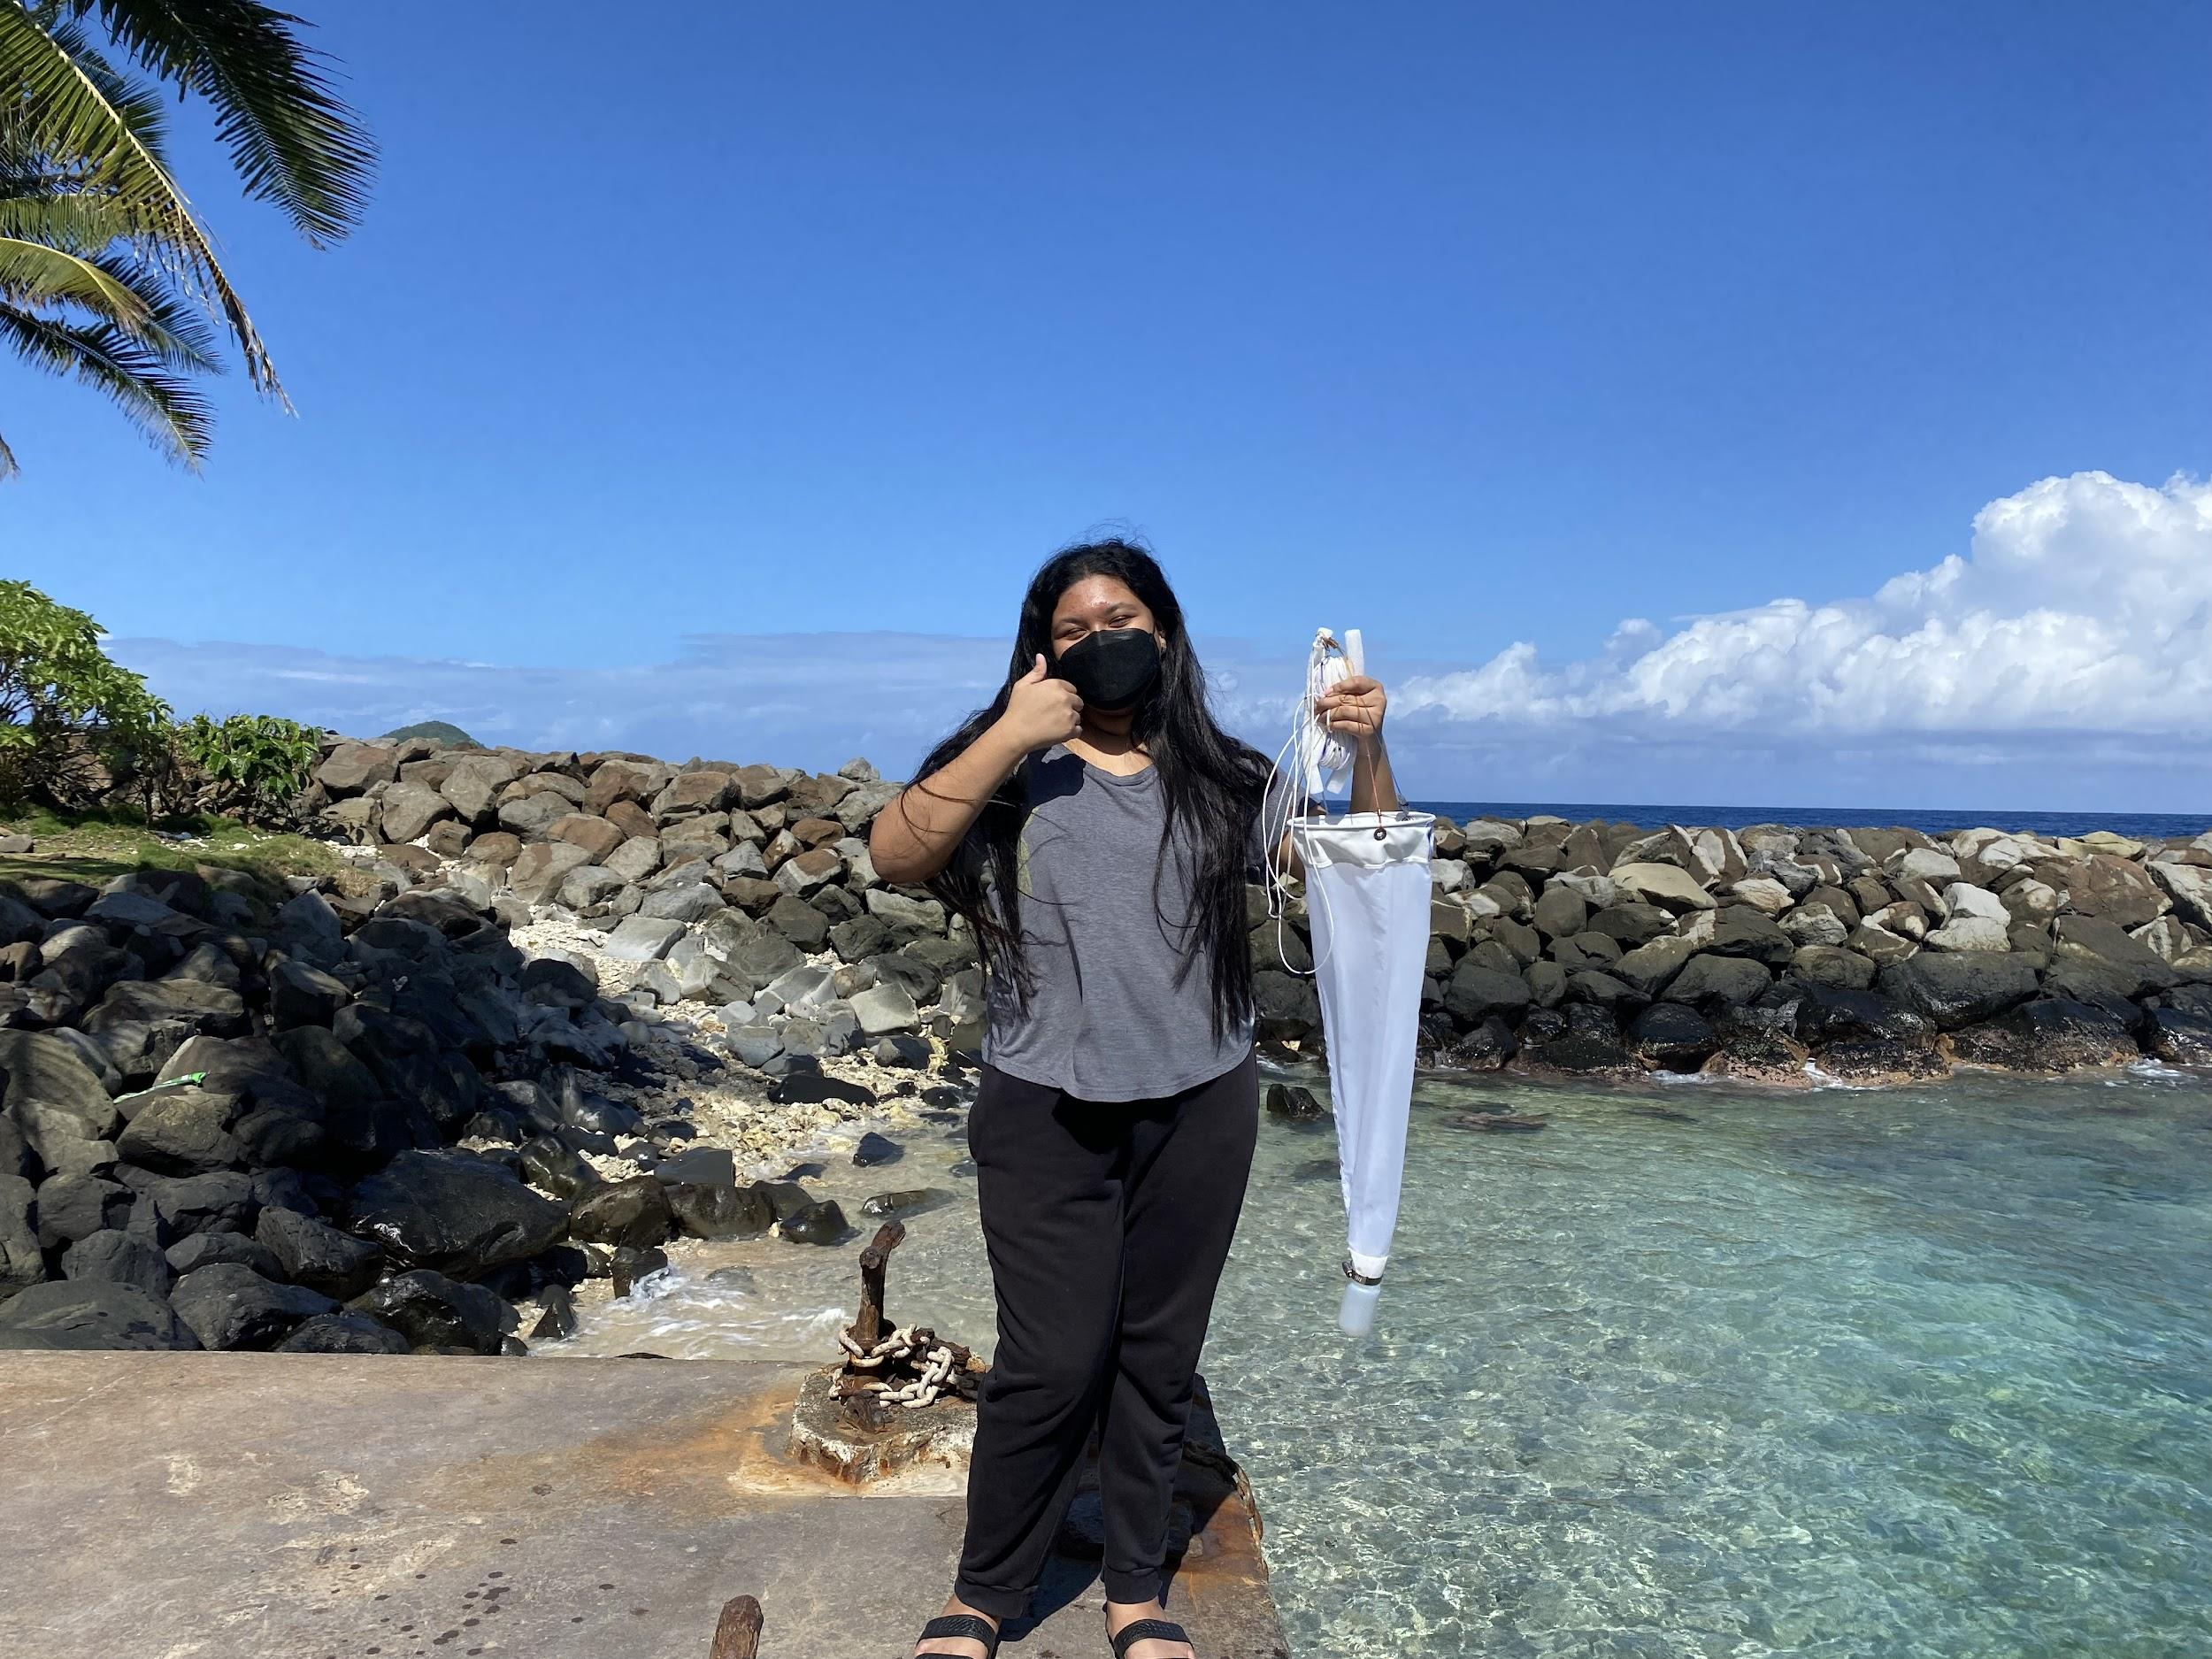
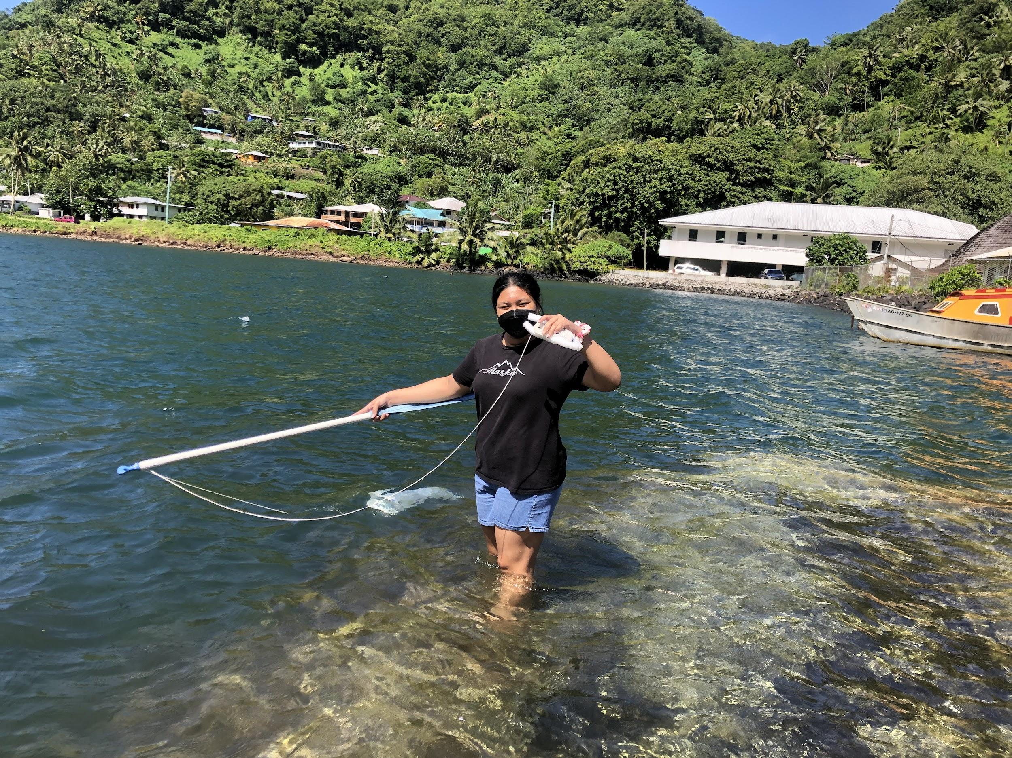
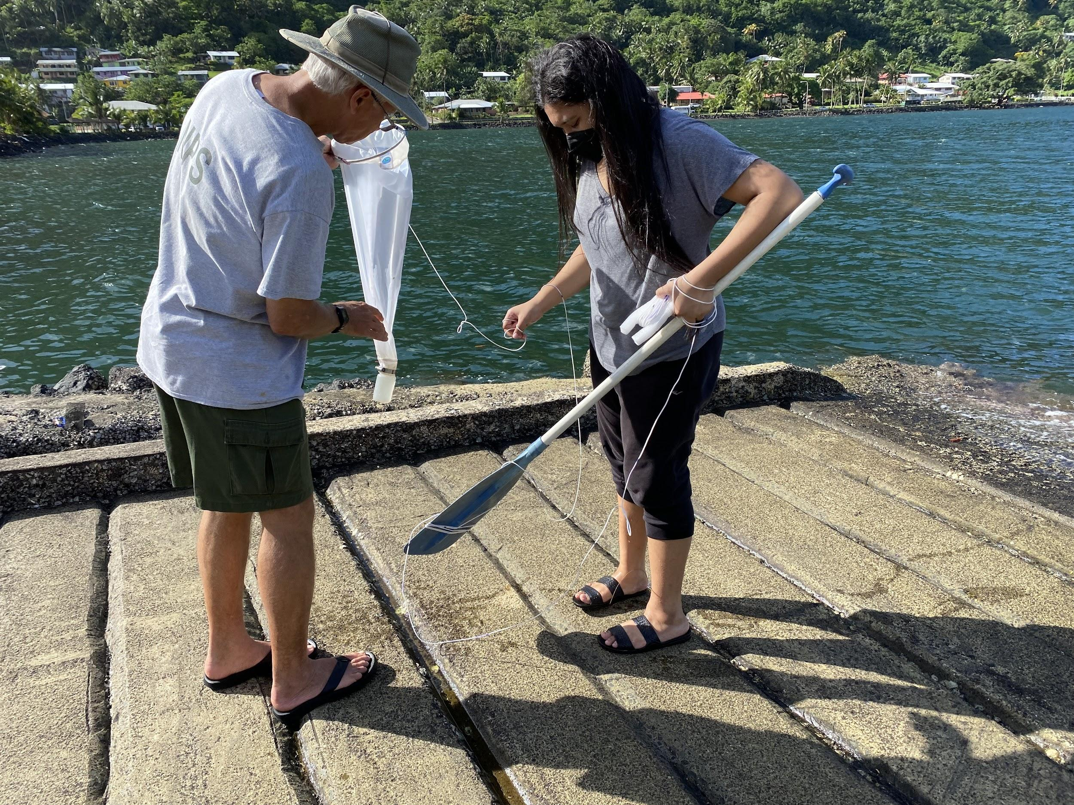
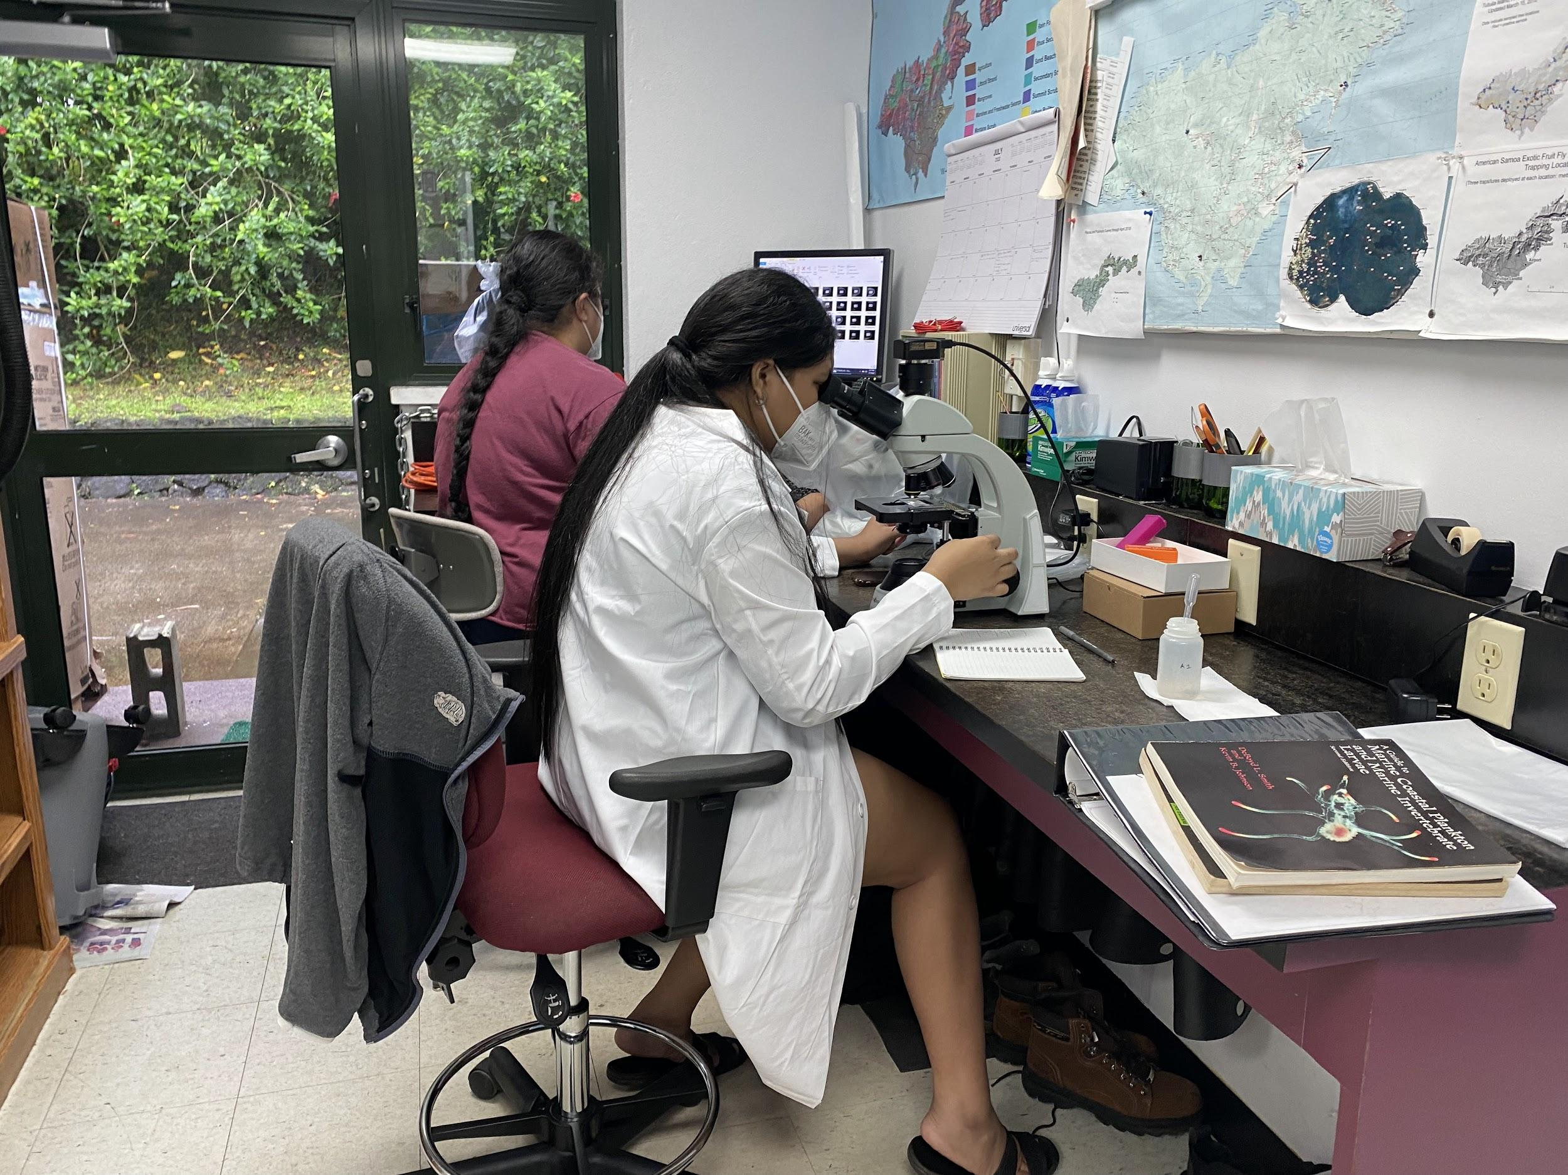
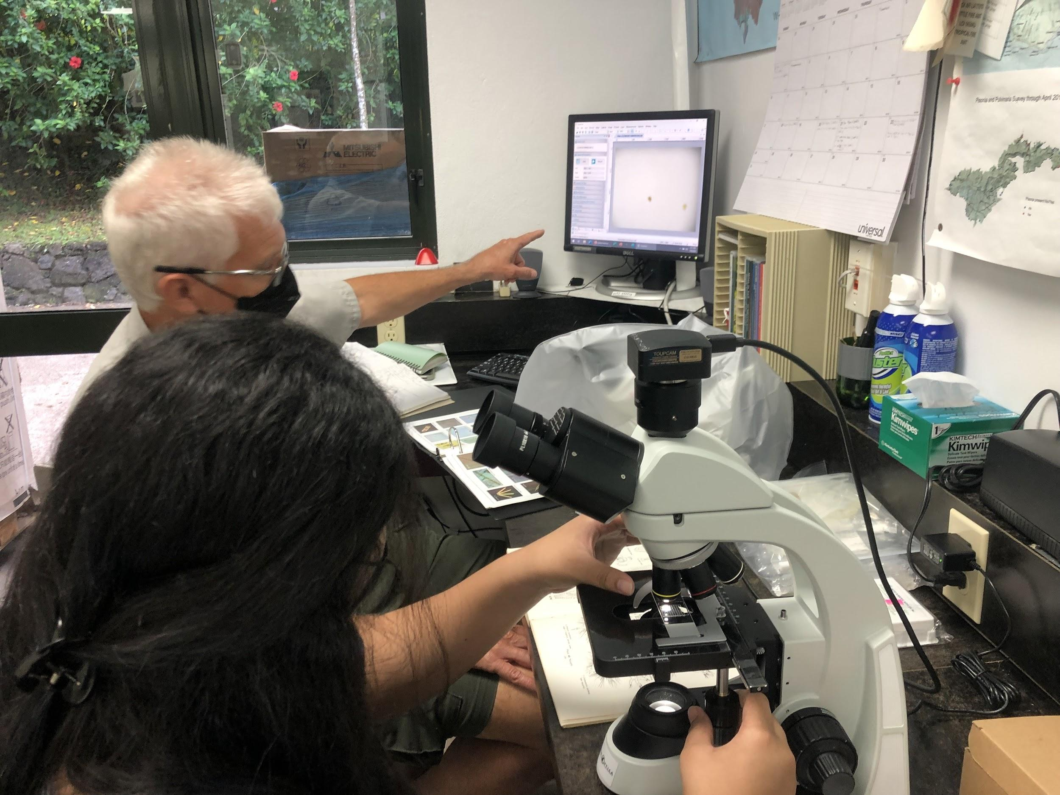
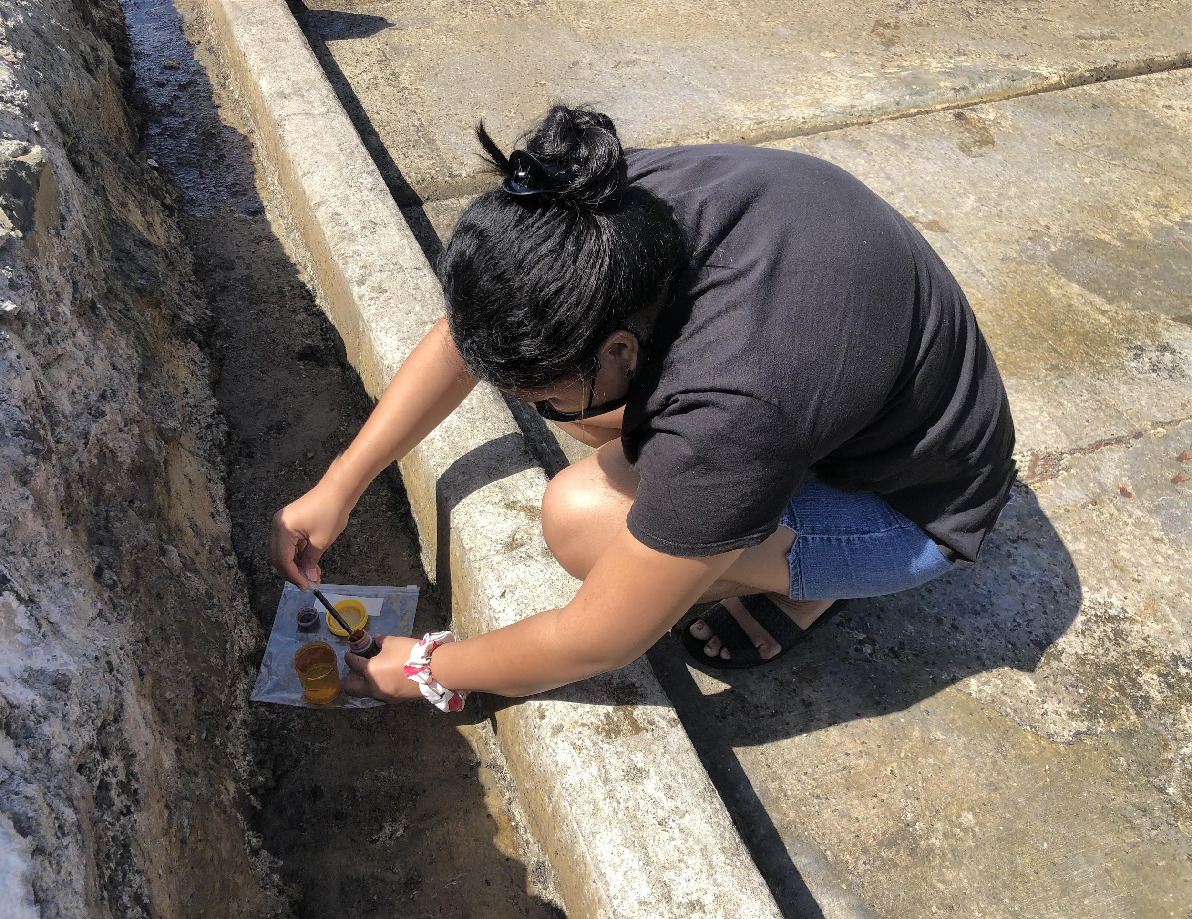

Slide 10
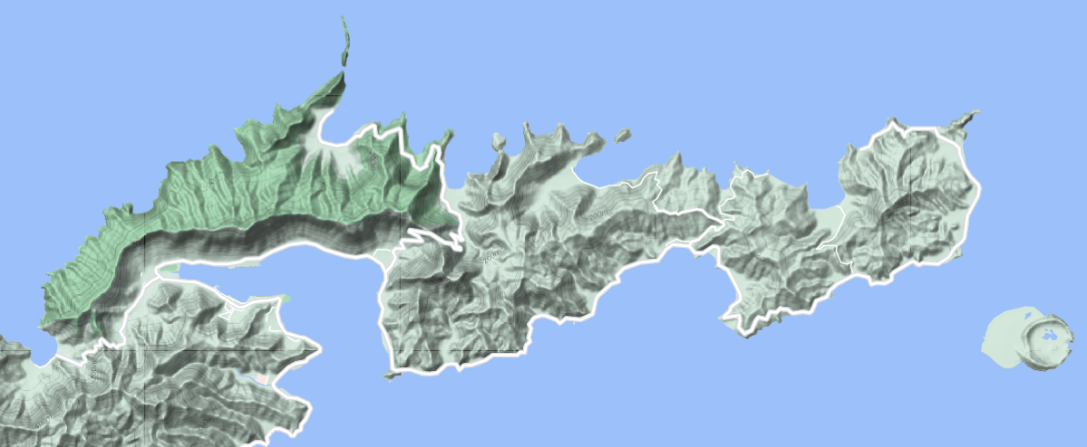
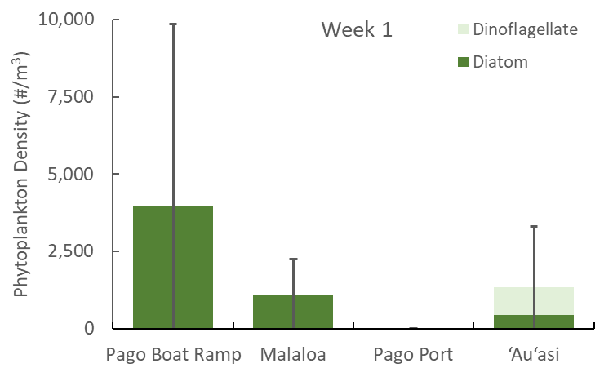
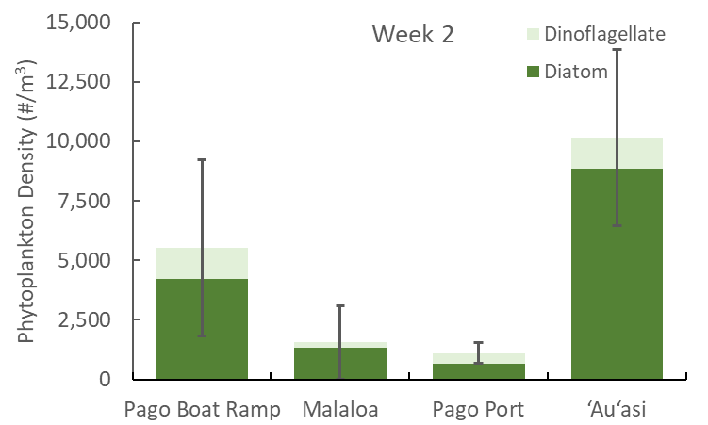
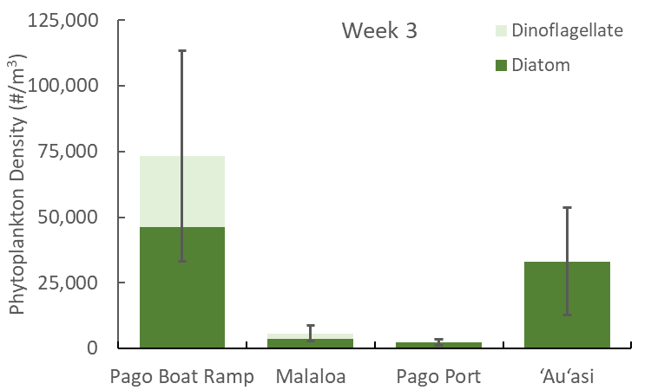
Marine Ecology Program Management
https://www.phytoplankton.com
Results - Abundance (mean ± 95% CI)
2 km
2 km
2 km
Notes:
graph

Slide 11
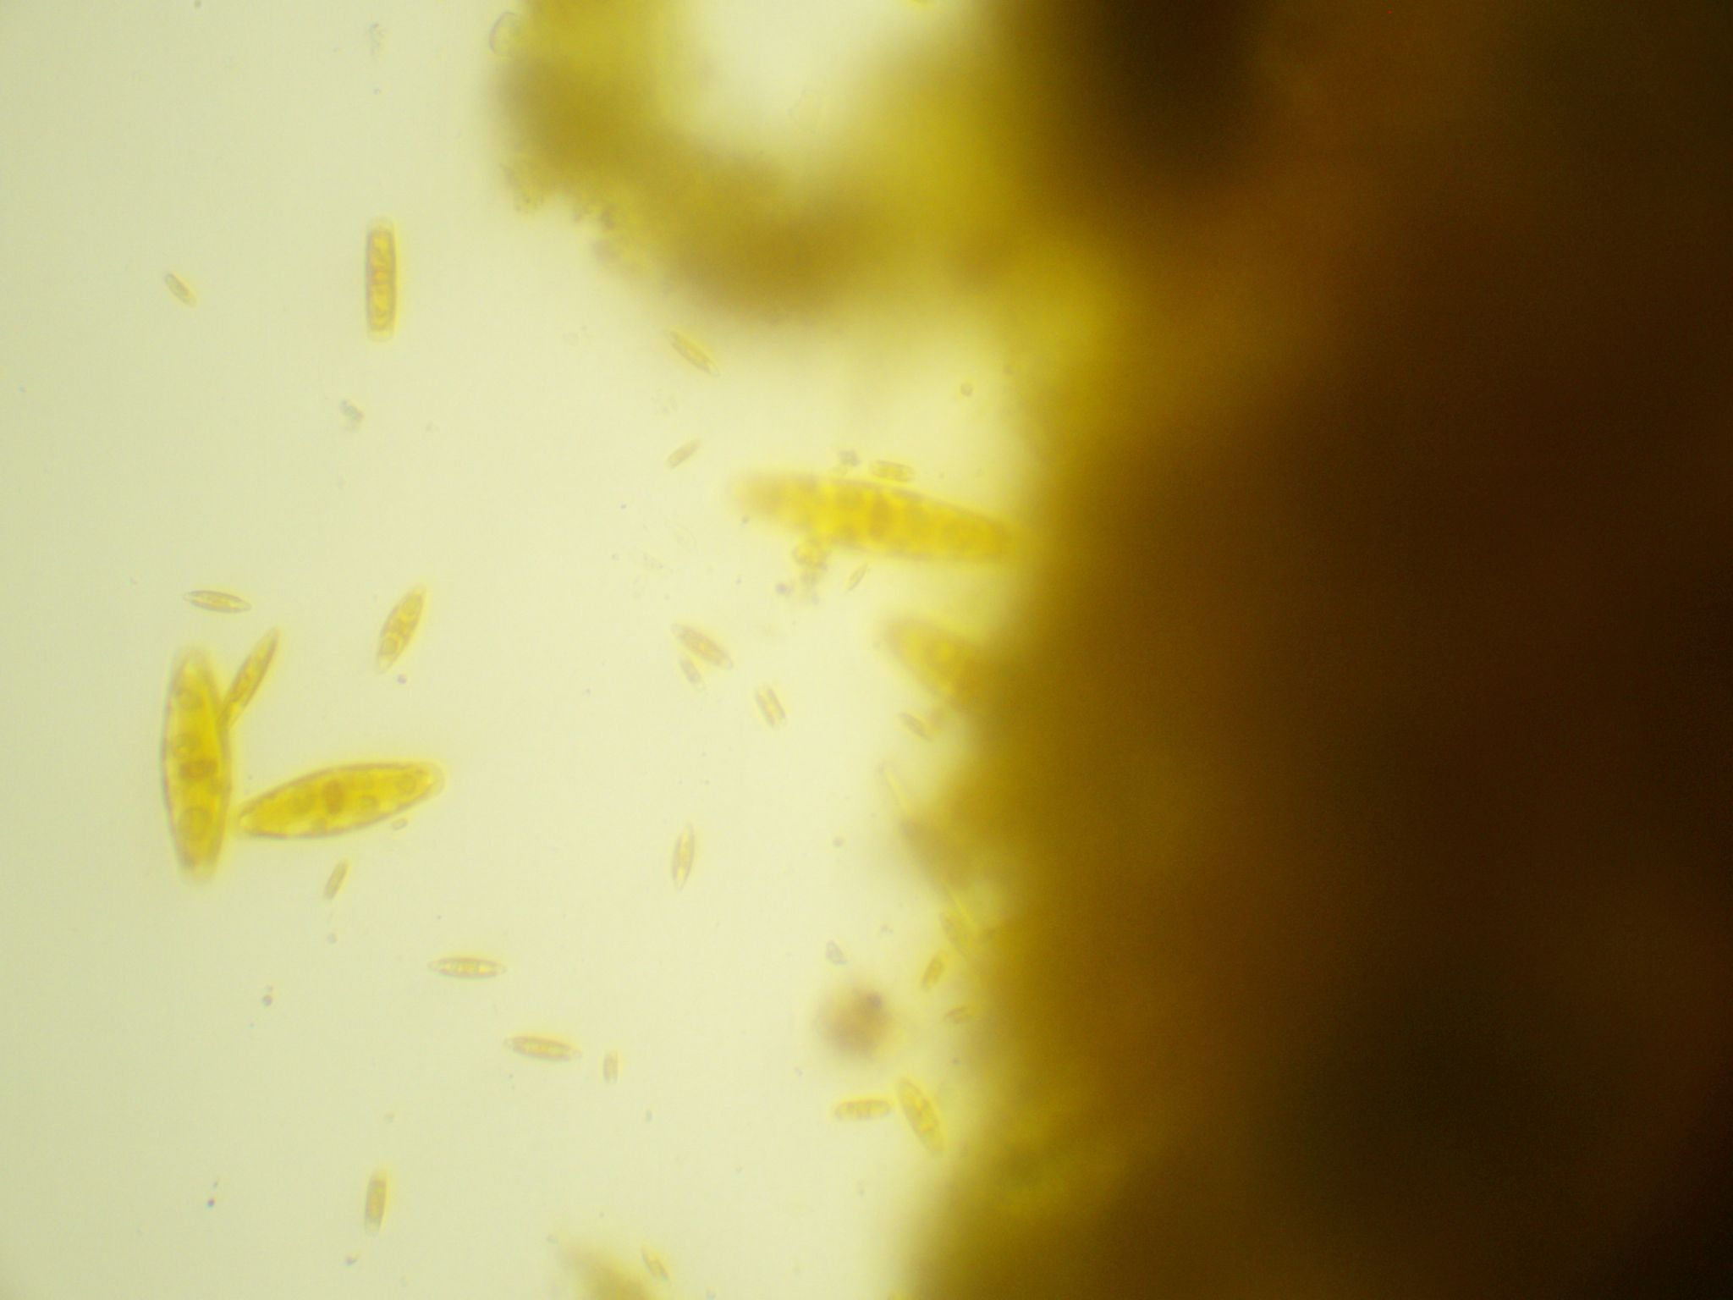
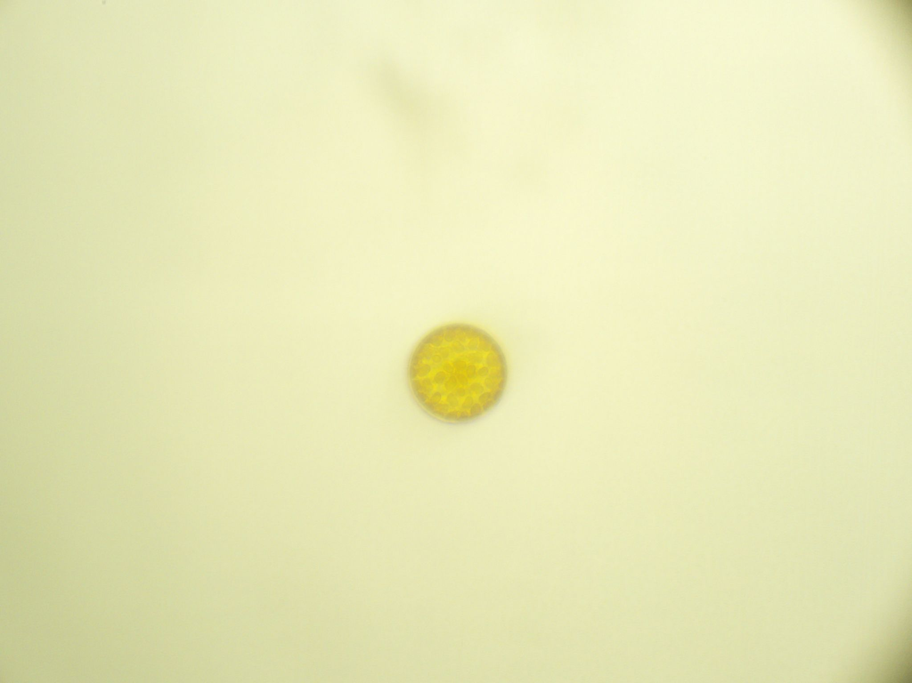
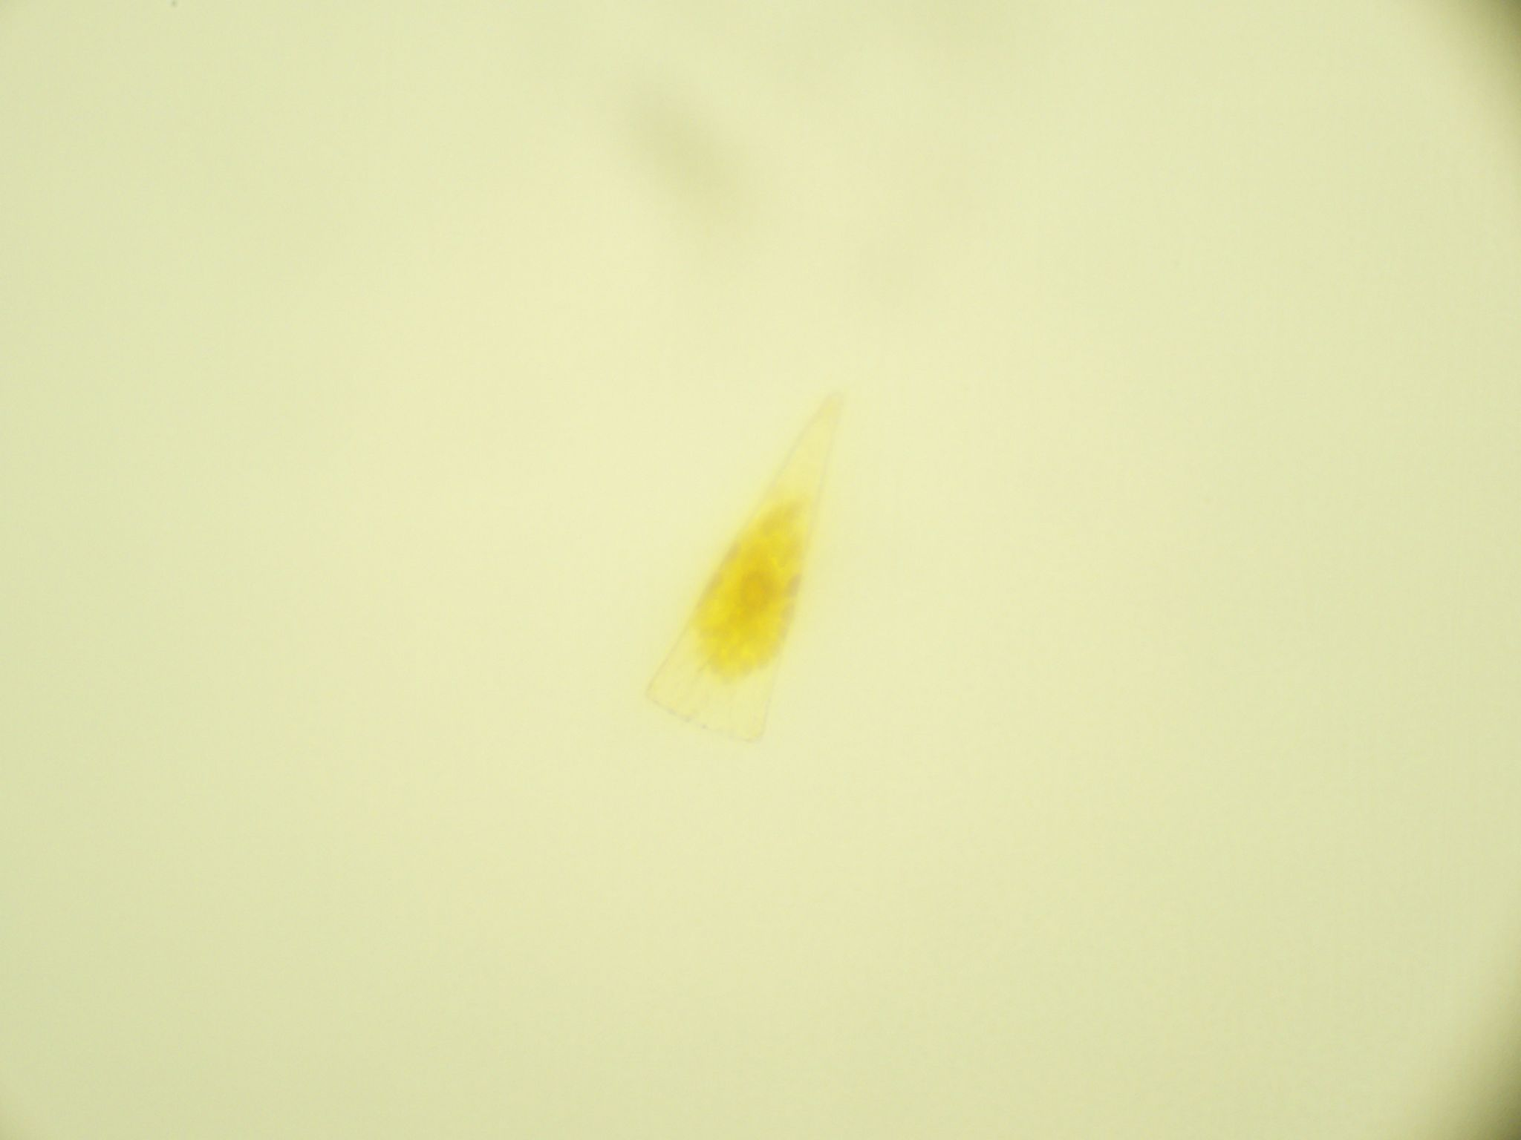
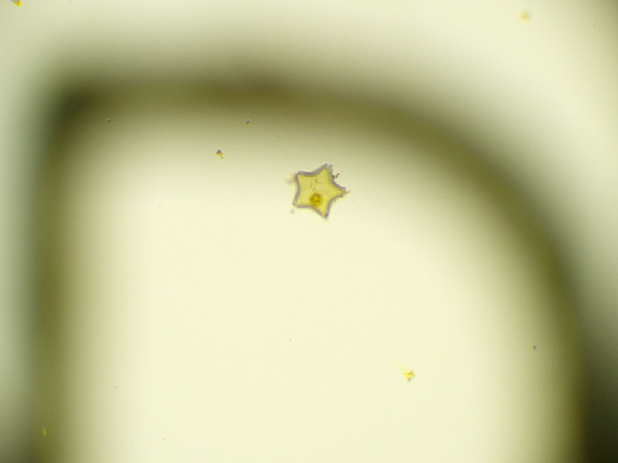
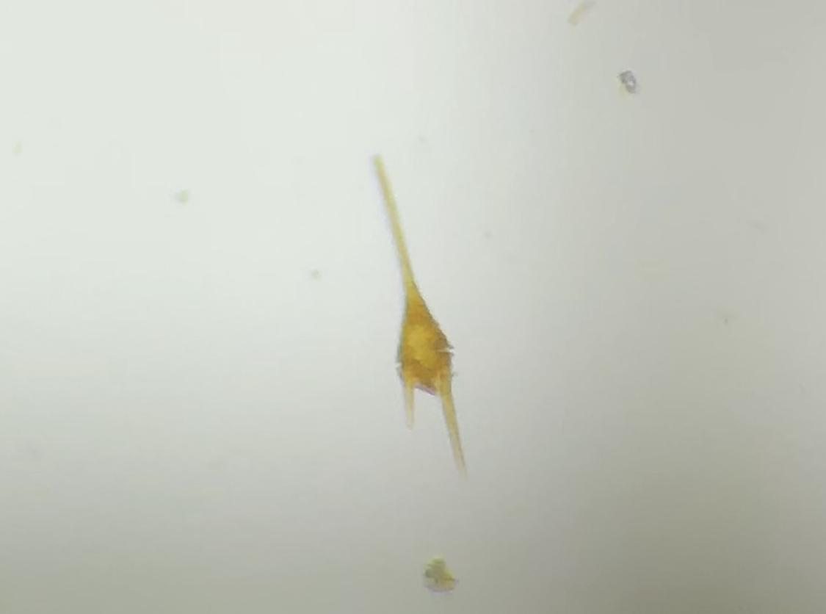
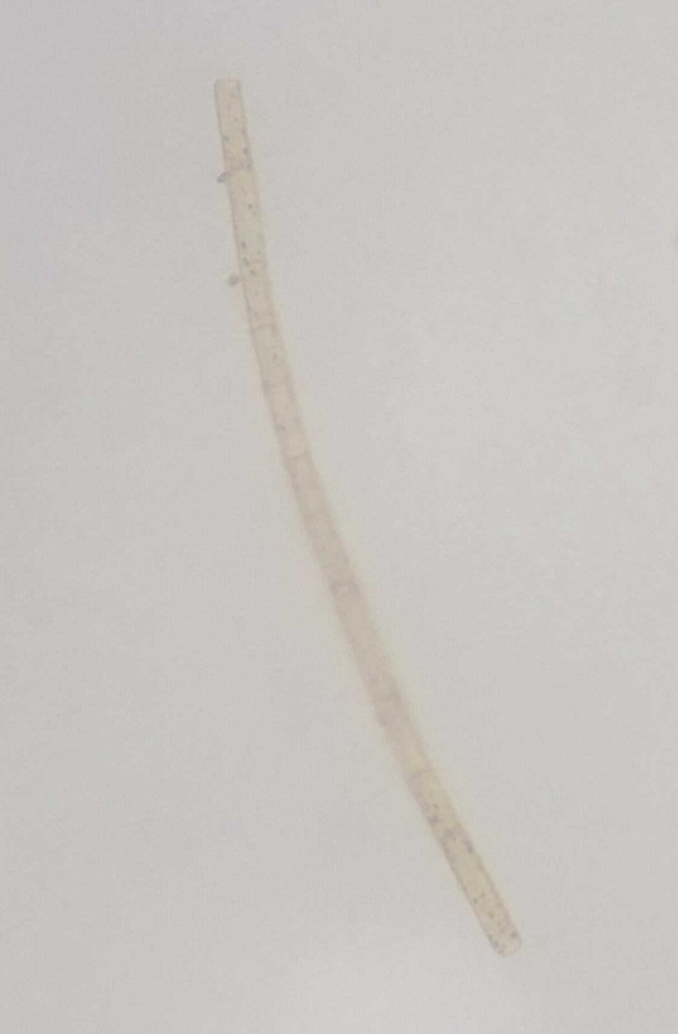
50-100 $µm (L)$
50-200 $µm (W)$
100-300 $µm (L)$
Navicula Coscinodiscus Licmophora
Triceratium Ceratium furca Leptocylindricus
100-200 $µm (L)$
30-100 $µm (L)$
100-400 $µm (L)$

Slide 12
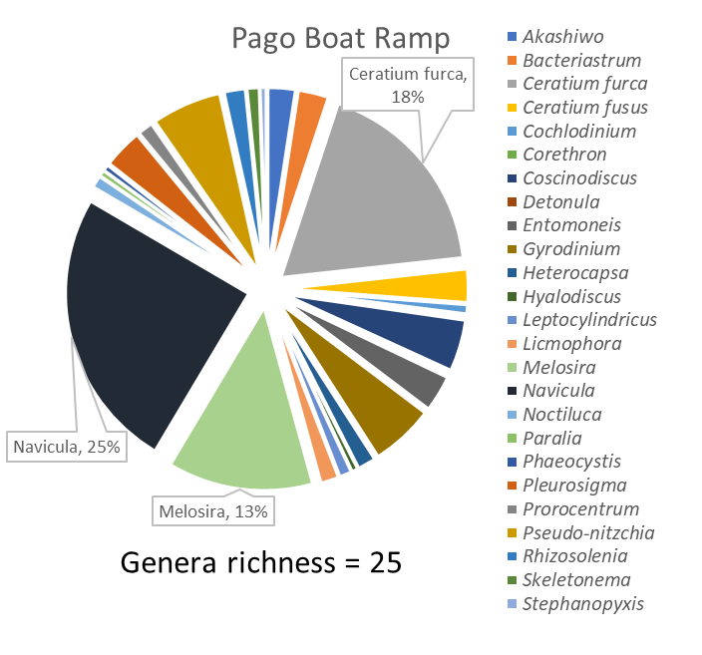
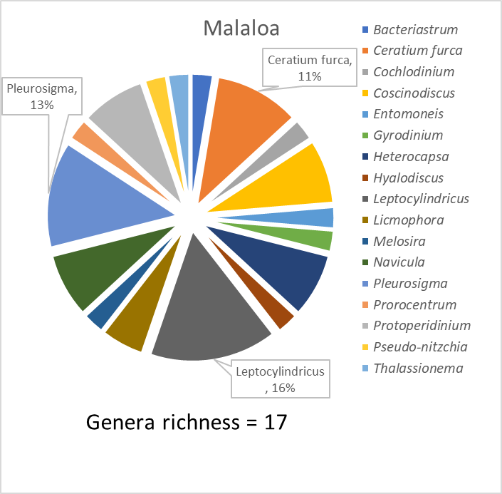
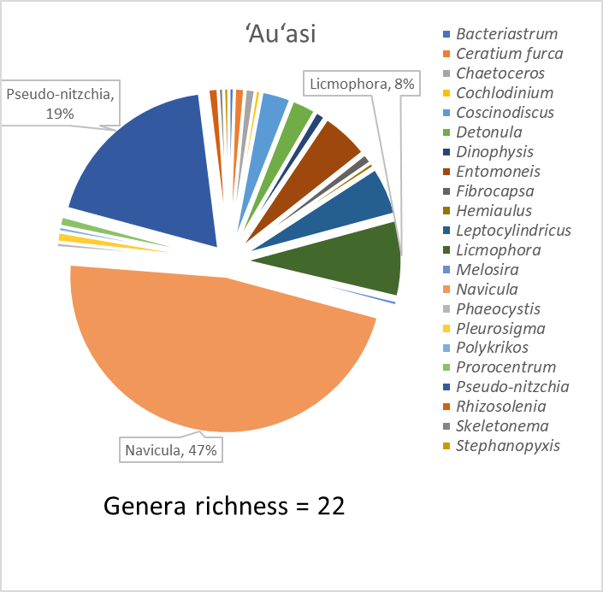
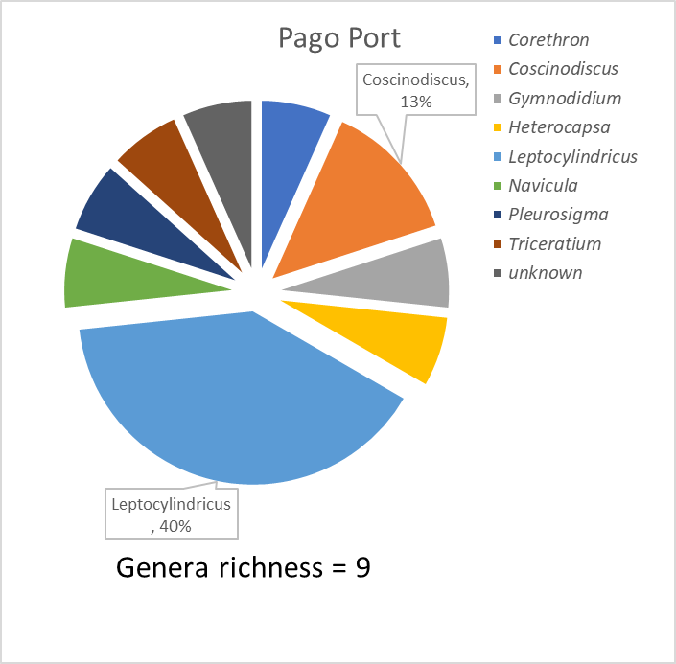
https://www.phytoplankton.com
Results - Genera Richness
2 km
Notes:
Graphs

Slide 13
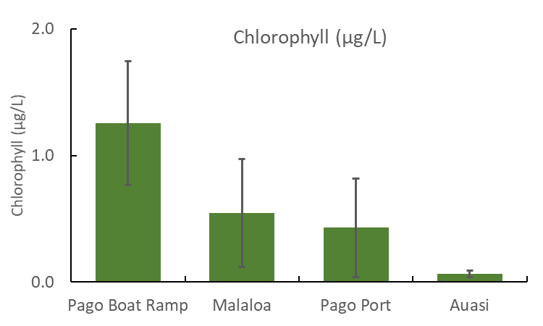
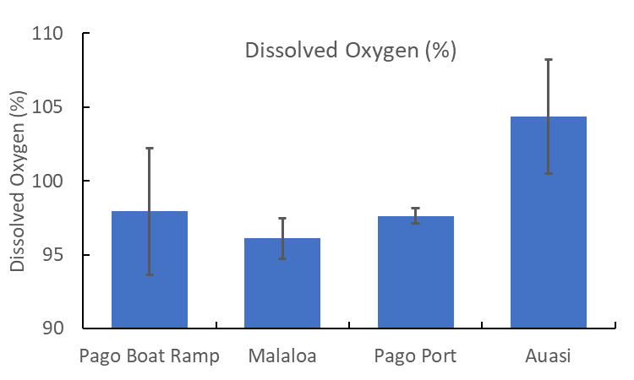
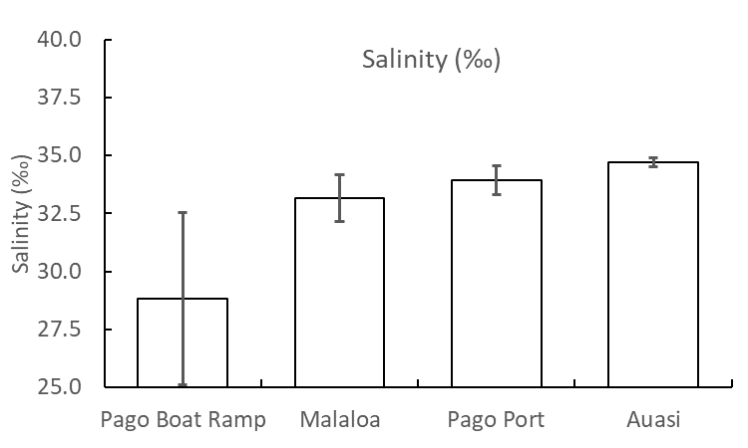
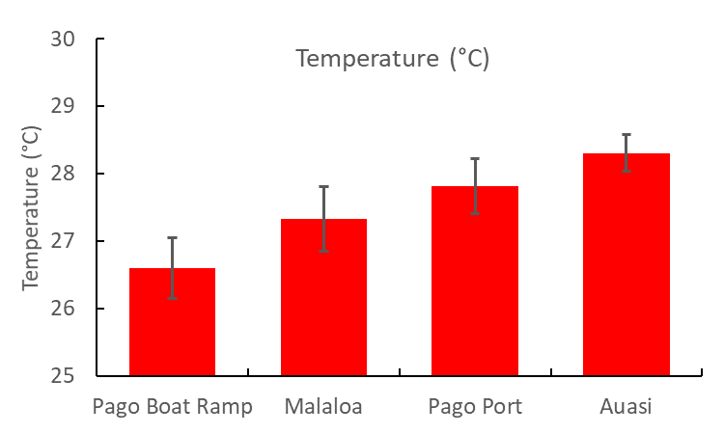
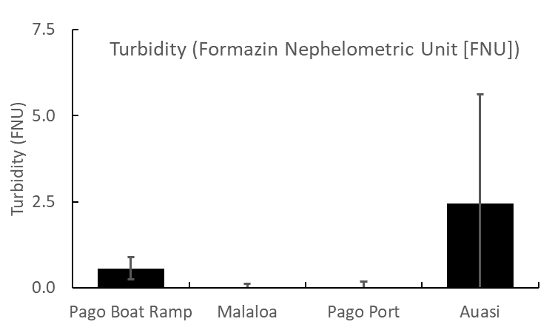
https://www.phytoplankton.com
Results - Environmental Observations
2 km
Notes:
Results slide - graphs

Slide 14
https://www.phytoplankton.com
Hypothesis was partially correct. Site closest to the stream in the harbor showed higher abundance and diversity than sites farther away
Control site, Auasi, however, had higher abundance than Pago Boat Ramp in the second week of sampling, but diversity was still lower.
Diatoms were more abundant than Dinoflagellates during the duration of the study
Environmental observations:
Temperature and Salinity were lowest at Pago Boat Ramp and highest at Auasi
Dissolved Oxygen was lowest at Malaloa and highest at Auasi
Chlorophyll was lowest at Auasi and highest at Pago Boat Ramp
Turbidity was lowest at Pago Port and highest at Auasi
Conclusions
Notes:
results

Slide 15
https://www.phytoplankton.com
Phytoplankton abundance is a critical indicator of ocean and planetary health
Baseline information of phytoplankton distribution is important in identifying healthy regions of the ocean
Phytoplankton identification can identify toxin producing species, especially during red tides
Significance

Slide 16
https://www.phytoplankton.com
Analyze nutrients from stream
Increase sample size to decrease/improve confidence intervals
Experiment with different plankton net sizes
Examine zooplankton abundance in relation to phytoplankton abundance
Comparison studies of abunance at different depths (coastal and open ocean)
Future Improvements/Recommendations
Notes:
Discussion slide

Slide 17
https://www.phytoplankton.com
The STEP-UP HS program is supported by the National Institute of Diabetes and Digestive and Kidney Diseases of the National Institutes of Health.
Dr. Eric Brown
Dr. Mark Schmaedick
Field Assistance included: Tilali Scanlan, Alisha Gill, and Valentine Vaeoso
Program Coordinator: Aneesa Golshan
CRAG - Coral Reef Advisory Group
My Parents: Melanie and Fuli Solaita
Acknowledgments
Notes:
Common species present

Slide 18
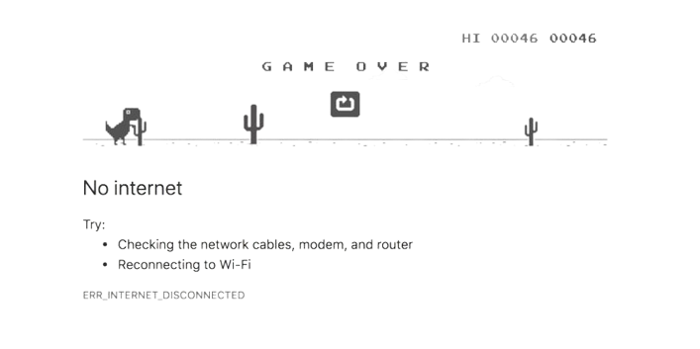
https://www.phytoplankton.com
Ha
Ha
Ha
Notes:
acknowledgments

