Slide 1
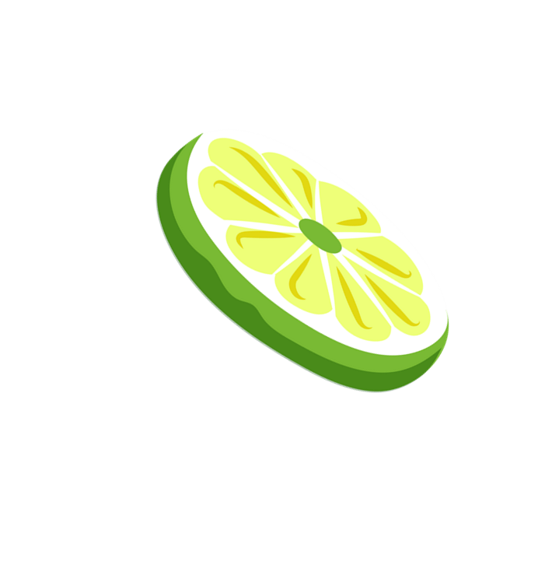
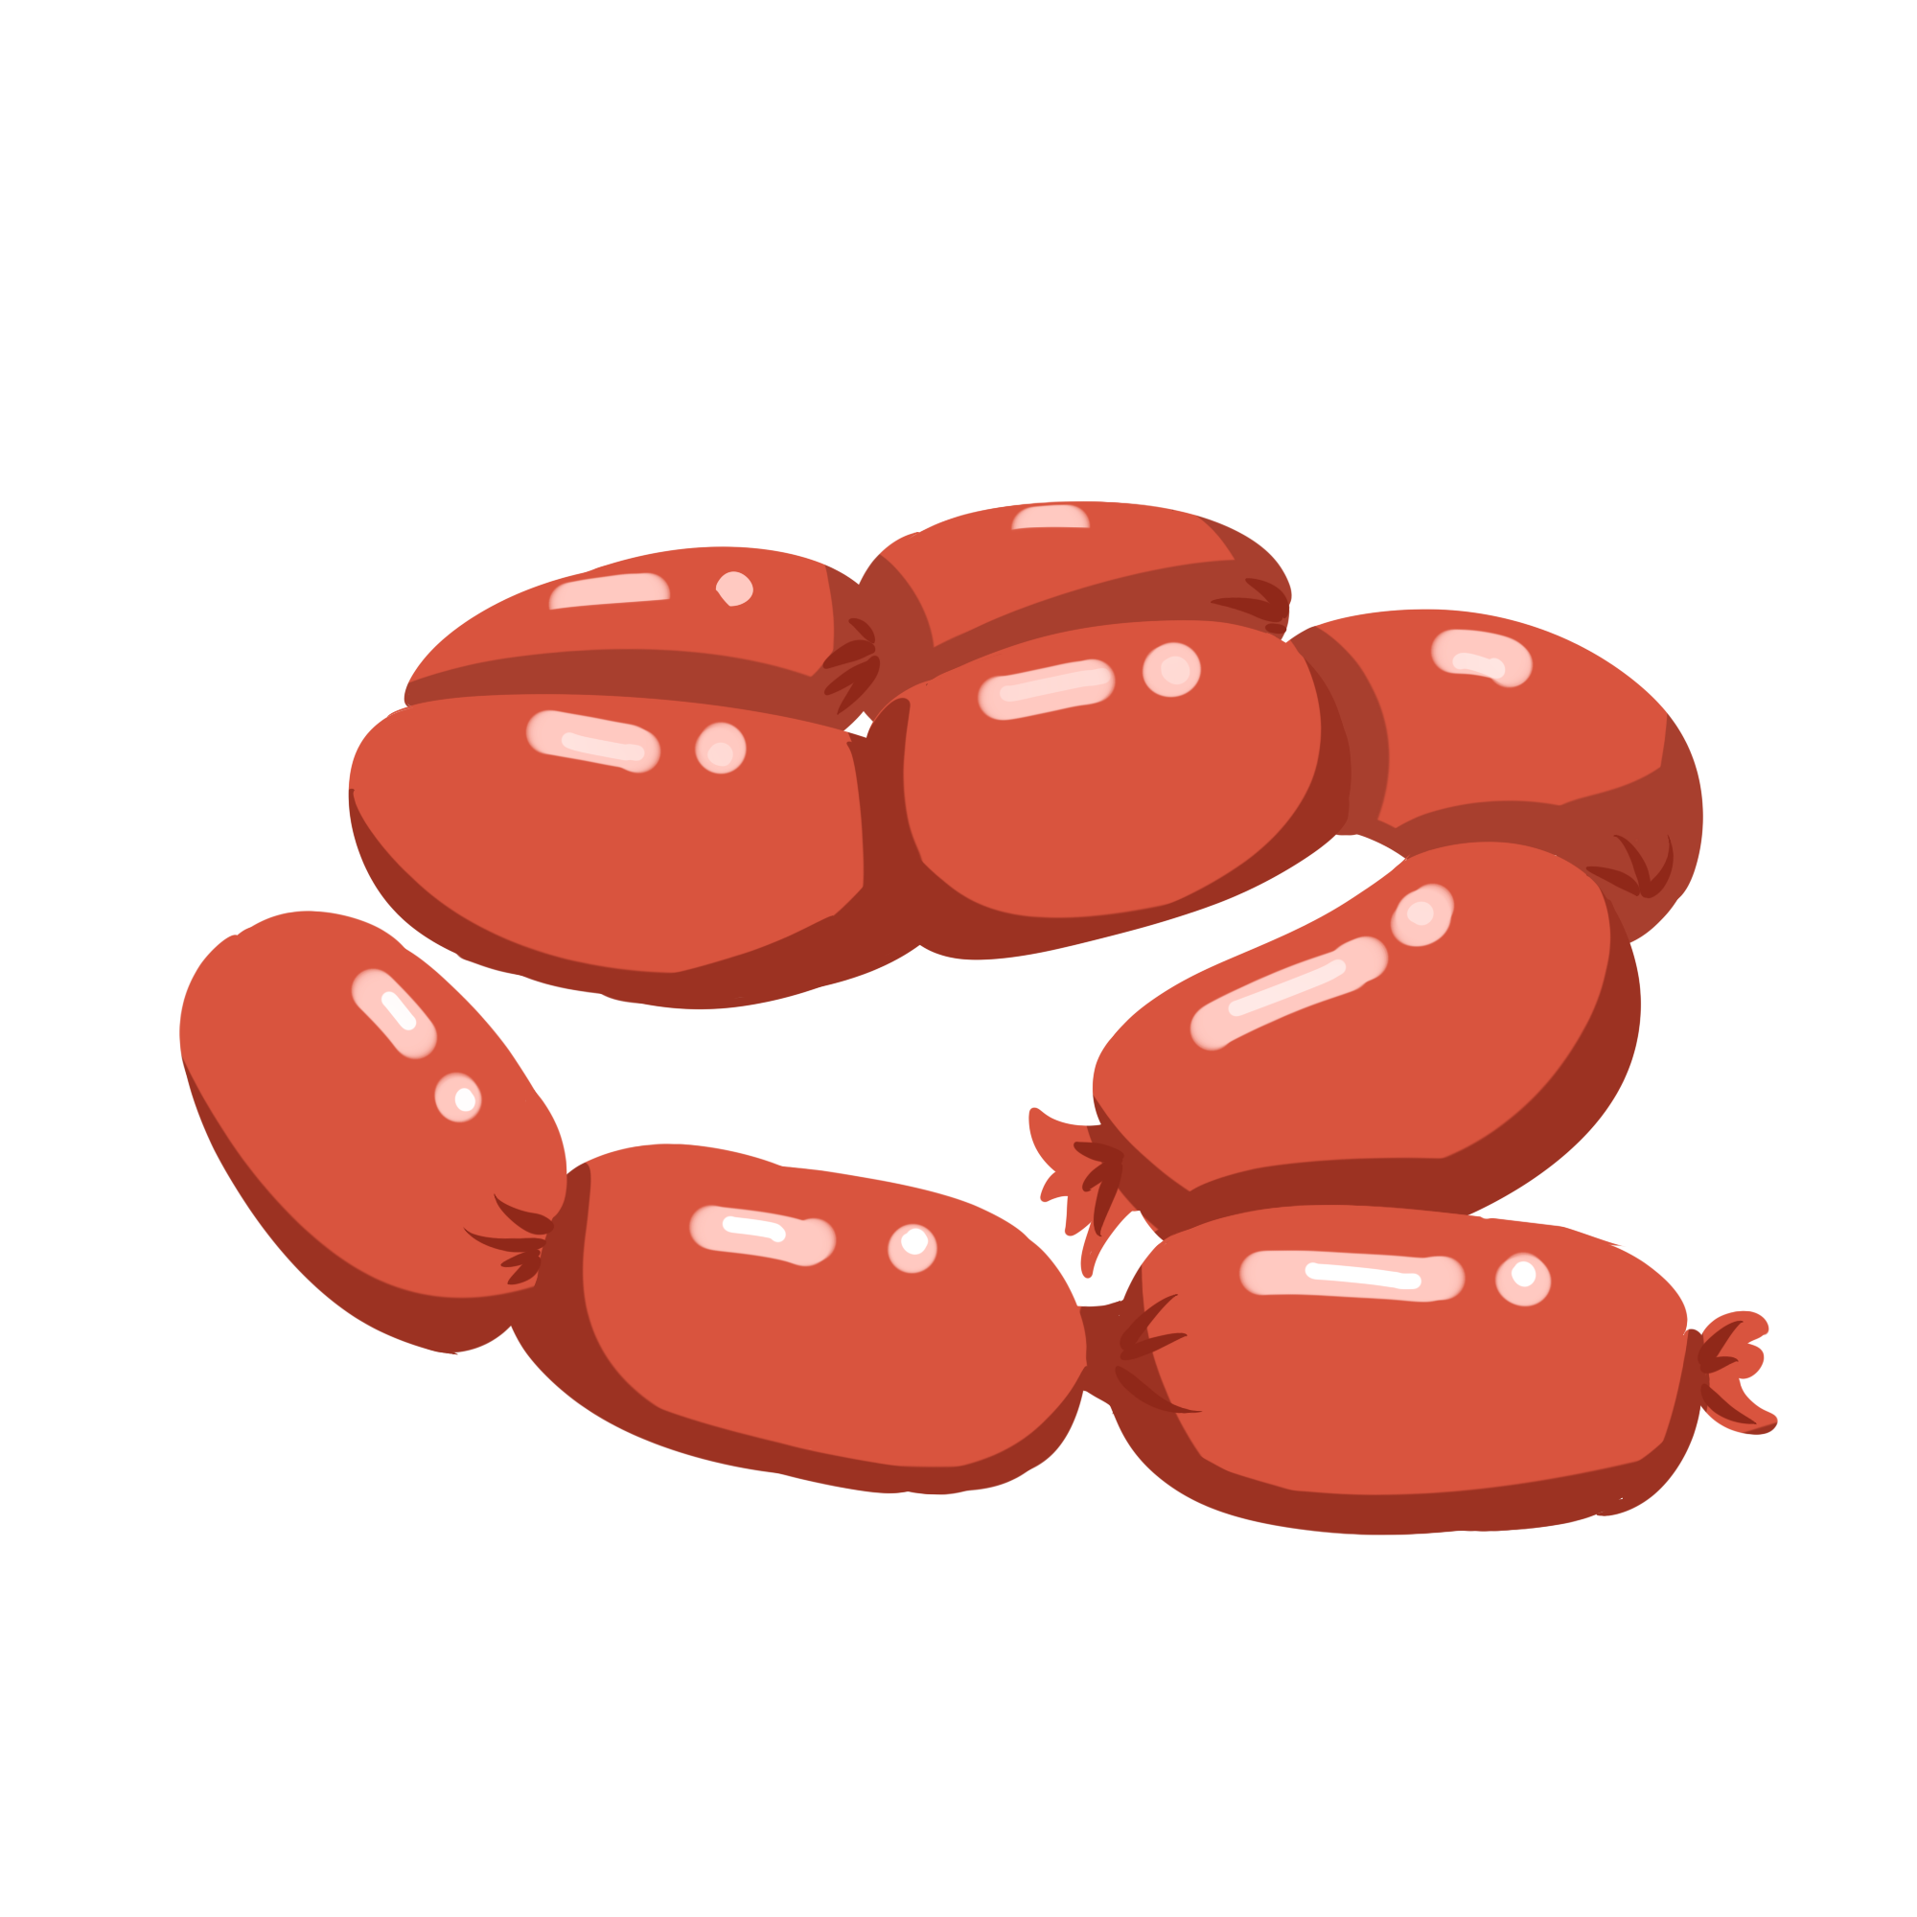
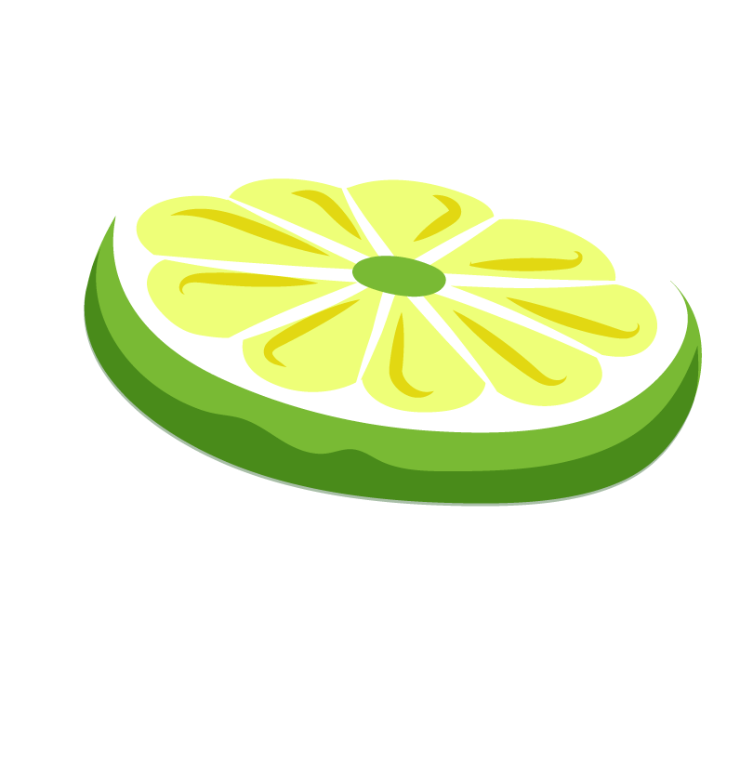
Total Phenolics, Antioxidant Activity, and Sensory Evaluation of Sausages Incorporated with Calamansi Peel Powder
Veronica Rose Obias
Mentors: Dr. Jian Yang and Kristi Hammond, University of Guam
Art by: lovepik.com

Slide 2
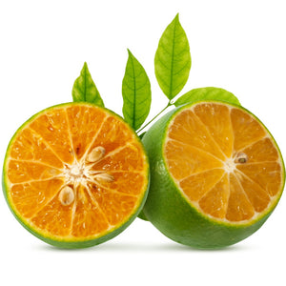
Calamansi (Citrus microcarpa)
Local citrus fruit in Guam that is a member of the Rutaceae family
Appearance:
Citrus peels are excellent sources of polyphenols (phenolic acids, flavanones, flavanol, and flavones) which protect tissues from oxidative processes [1].
Citrus flavonoids exhibit health benefits, such as antioxidative, anticancer, anti-inflammatory, and cardiovascular protective activities [2].
Small in diameter, approximately 3 cm
Green or yellow, depending on the maturity level
Photos by:
StockVector
exoticanz

Slide 3
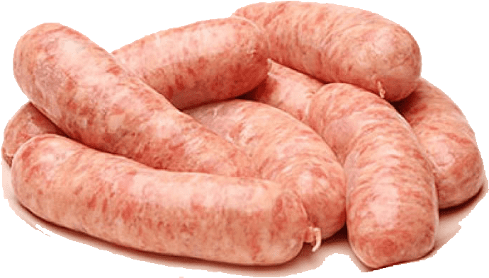
Sausages
Sausage is a meat product made up of a mixture of grounded meat stuffed into a natural casing.
Sausage contains a high lipid content and is prone to oxidation. Since lipid oxidation negatively affects the sensory and nutritional quality of sausage, synthetic antioxidants are often added to the meat mixture to prevent the oxidation.
However, synthetic antioxidants may have some negative effects on human health, such as causing DNA damage [3].
Photo by:
TOPpng

Slide 4
Hypothesis
Since calamansi peels are a good source of phenolic acids and flavonoid compounds, adding them to sausages can increase the sausages’ total phenolic content and antioxidant activity.
Objectives
To determine the total phenolic content of sausages incorporated with calamansi peel powder
To determine the antioxidant activity of sausages with the added calamansi peel powder
To develop a sausage recipe with appropriate sensory attributes and health benefits for consumers

Slide 5
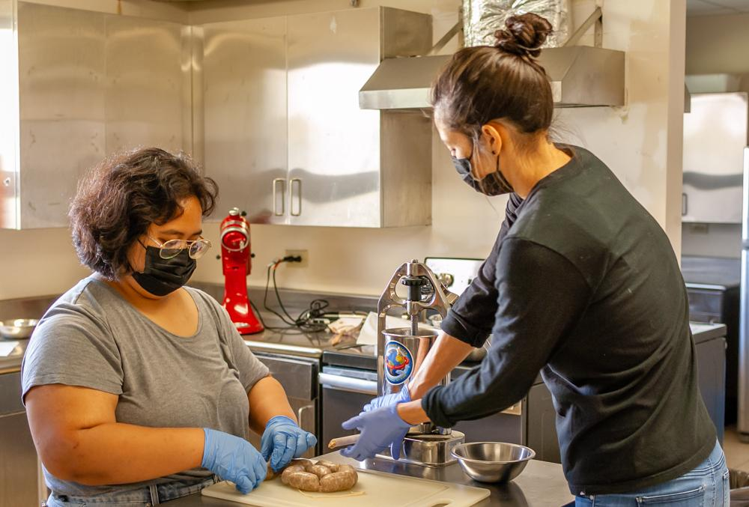
Preparation of Sausages Incorporated with Calamansi Peel Powder
Pork Sausage Recipe:
Lean Meat (61%)
Fat (30%
Water (6%)
Salt (1.8%)
Black Pepper (0.7%)
Garlic Powder (0.5%)
Onion Powder (0.5%)
Green Calamansi Peel Powder (0%, 2.5%, and 5%)

Slide 6
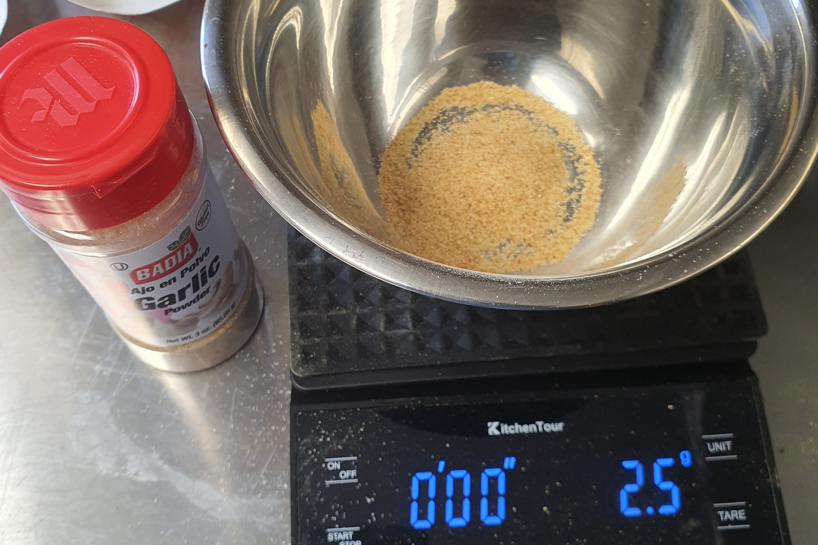
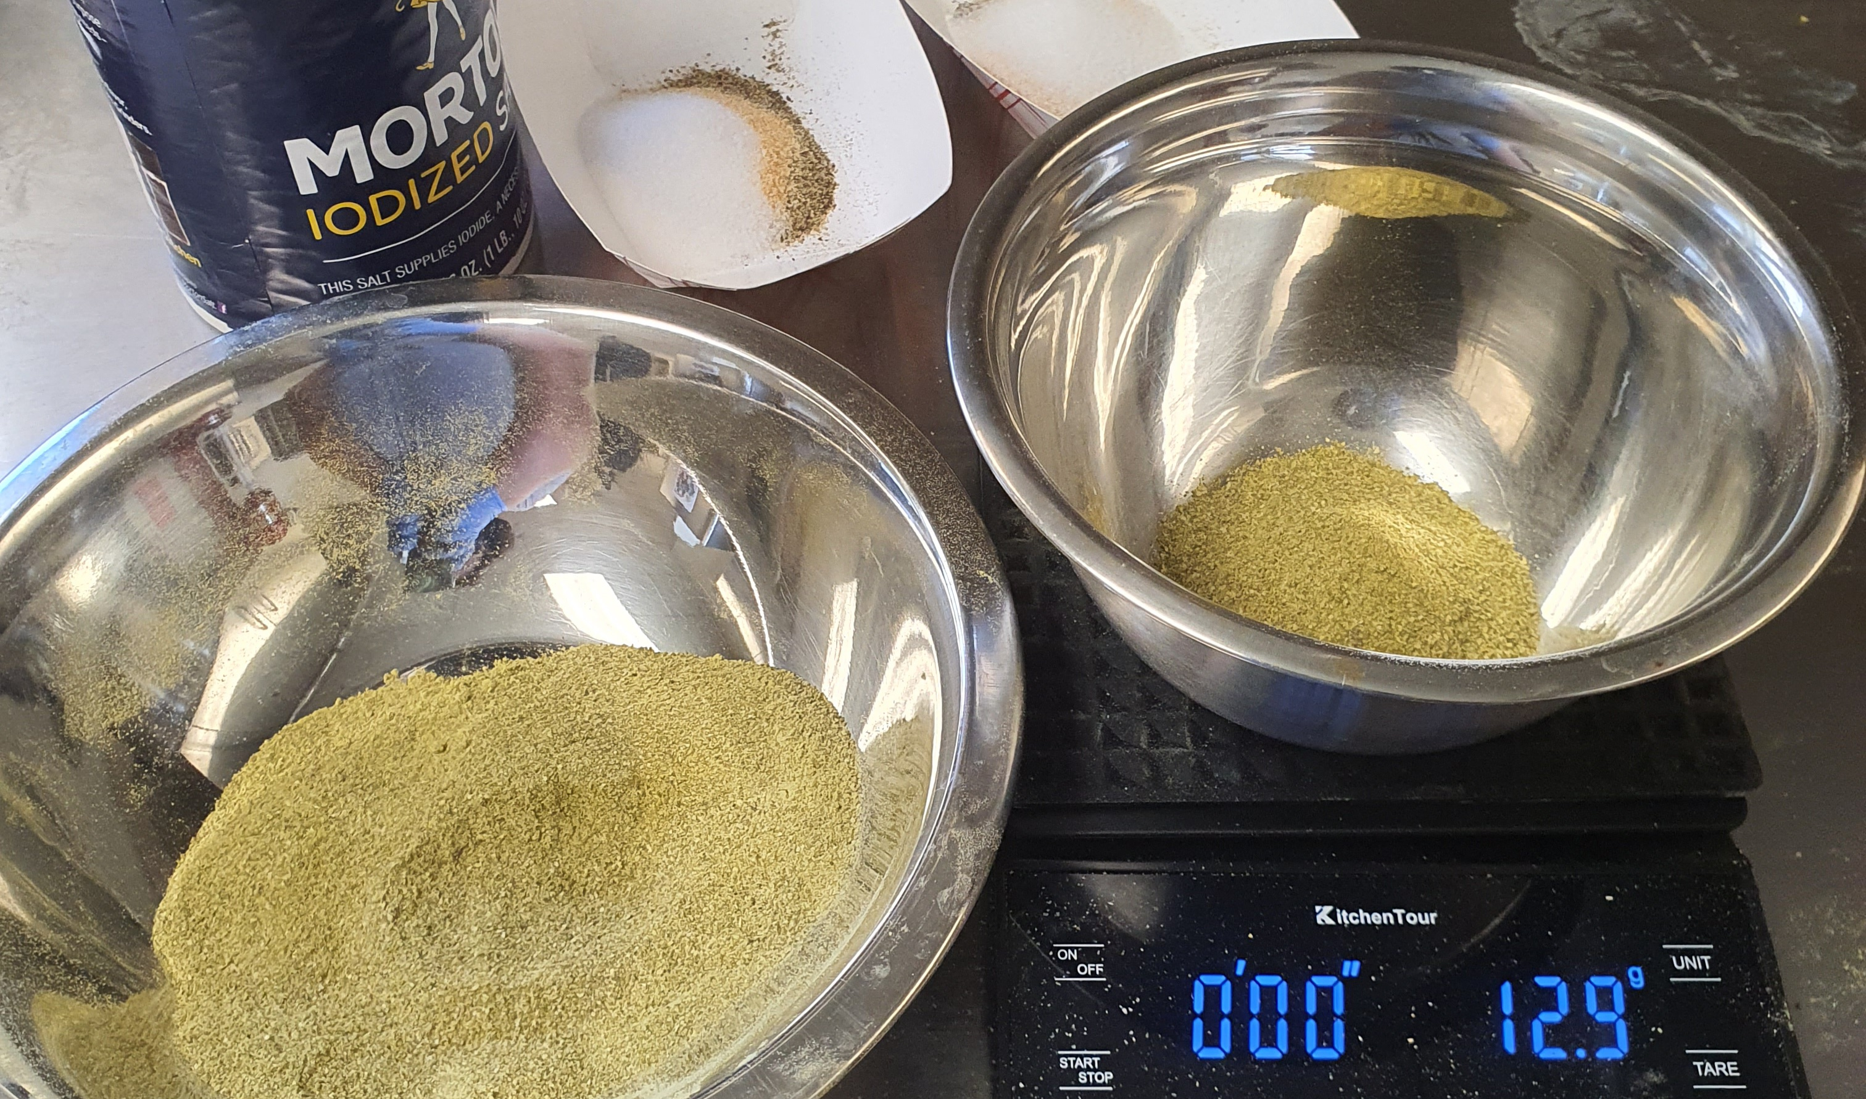
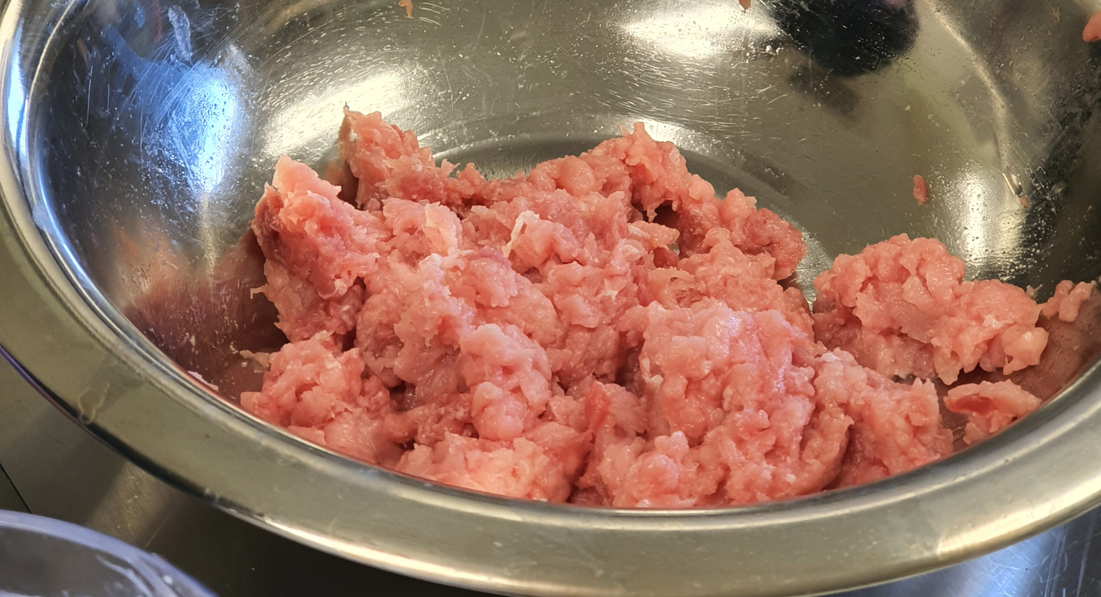
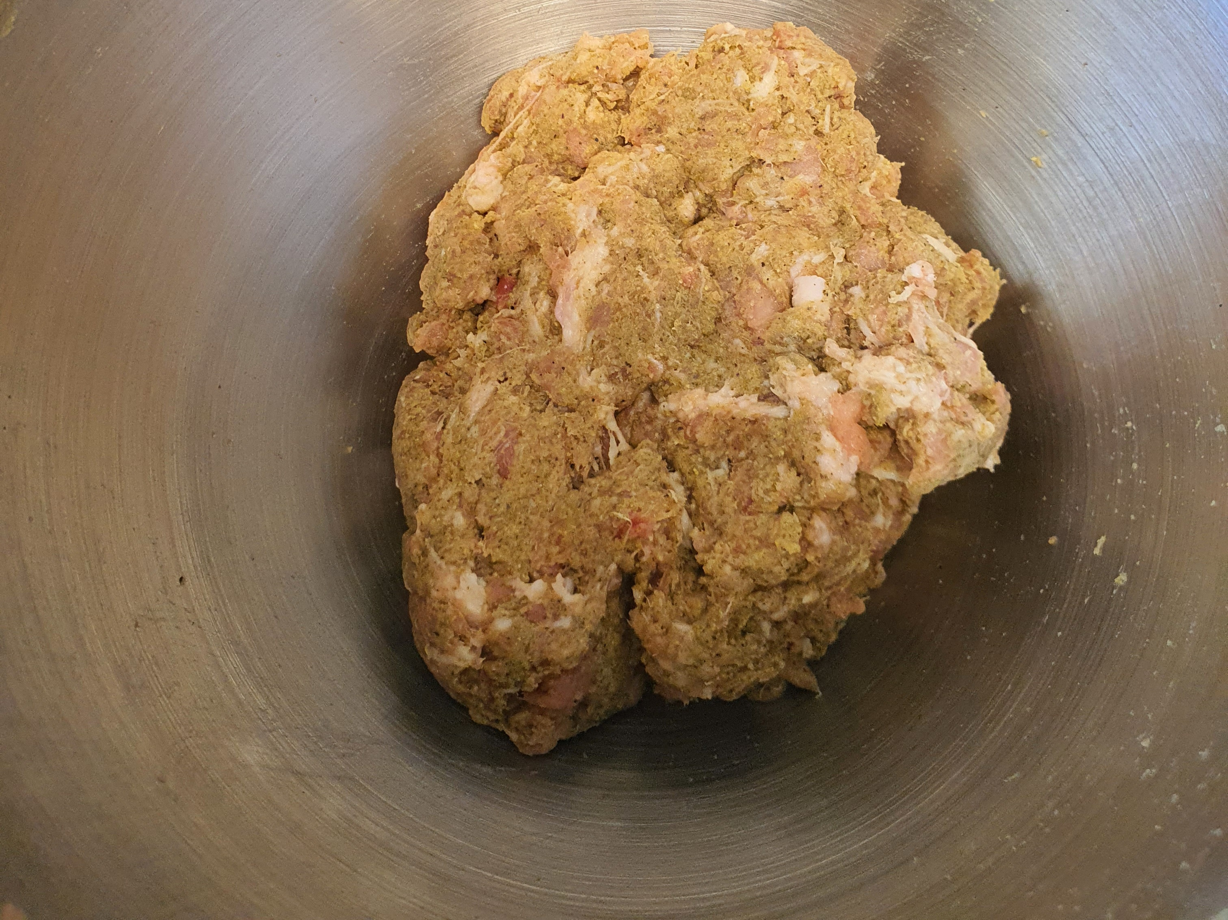
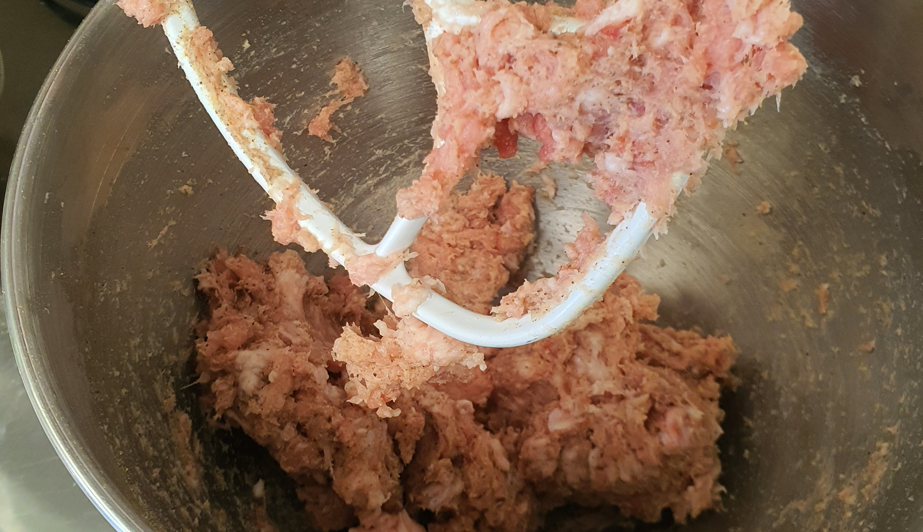
Method: Sausages with Calamansi Peel Powder Recipe
Weigh each ingredient
Mix grounded lean meat and fat
Add the spices to the meat mixture
Mix sausage mixtures and place into natural casing
Add the calamansi peel powder (0%, 2.5%, 5%)
Add water

Slide 7
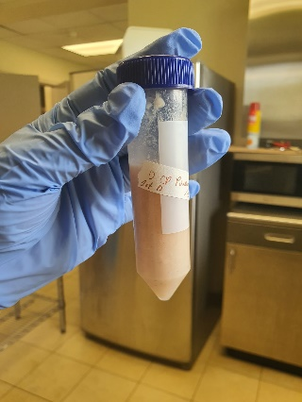
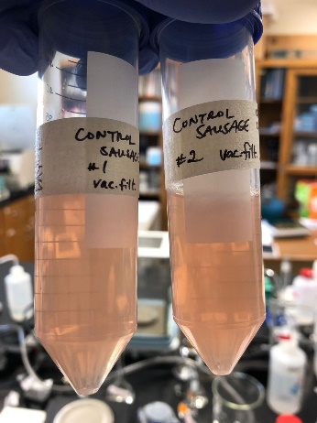
Methods and Experiments
Preparation of Extracts
The sausage mixture was blended with water until homogenized.
Mixtures were centrifuged. The supernatant was collected, vacuumed filtered, and used as the extract for analysis.
Blended Extract
Filtered Extract

Slide 8
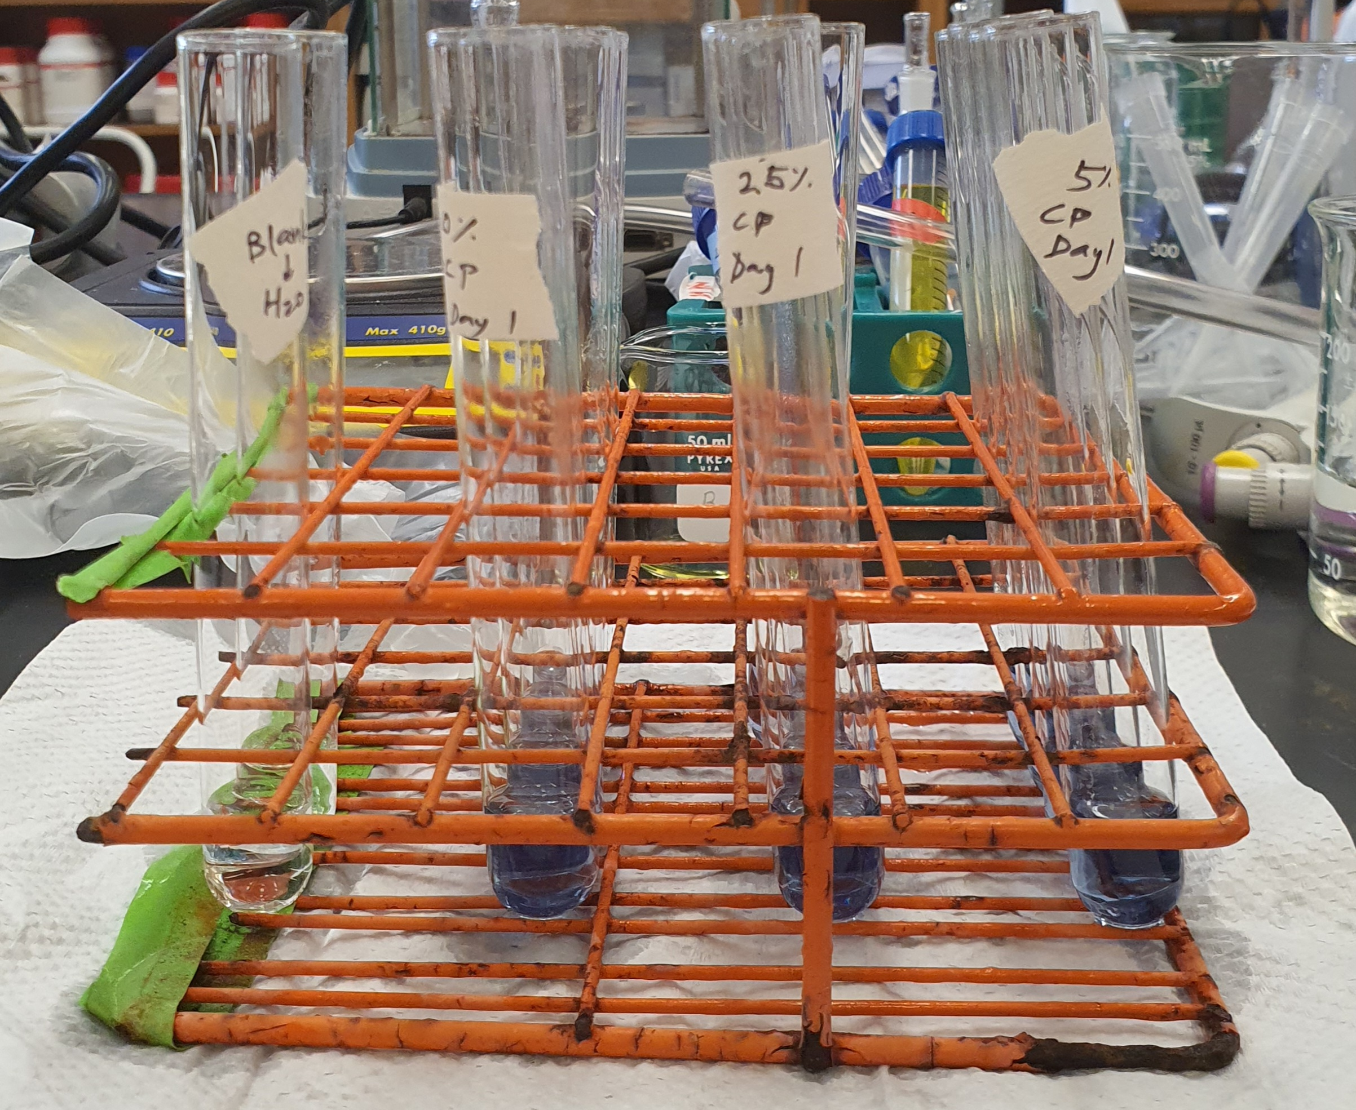
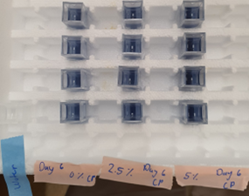
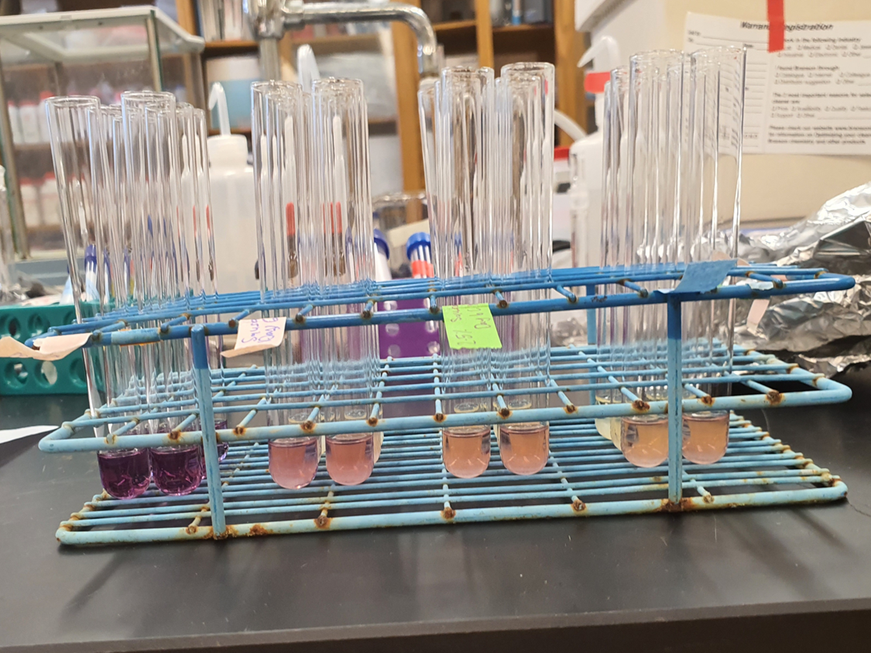
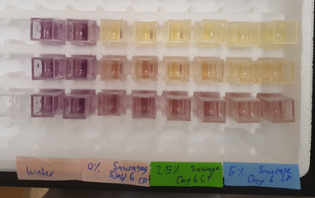
Methods and Experiments Cont.
Total Phenolics
Extracts were mixed with the Folin-Ciocalteu (FC) reagent and the absorbance was measured at 765 nm.
Total phenolic content was calculated as gallic acid equivalents (mg/100g) based on a standard curve.
Total Phenolics Test Samples
Antioxidant Activity
Antioxidant activity was measured using the 2,2-diphenyl-1-picrylhydrazyl (DPPH) radical scavenging assay.
Extracts were mixed with DPPH solution and the absorbance was read at 515 nm.
Inhibition (%) = (A_{DPPH} – A_{DPPH+Extract})*100/A_{DPPH}.
Antioxidant Activity Test Samples

Slide 9
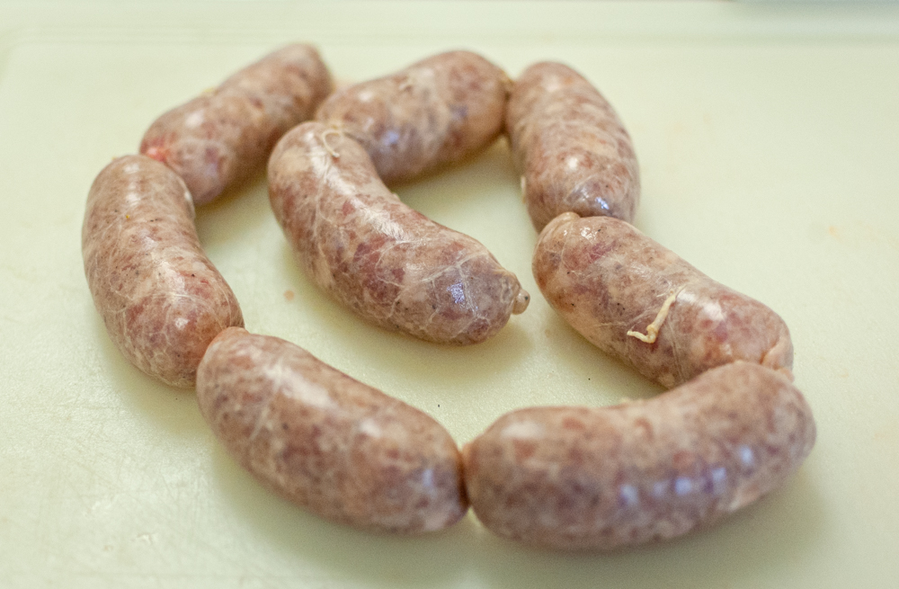
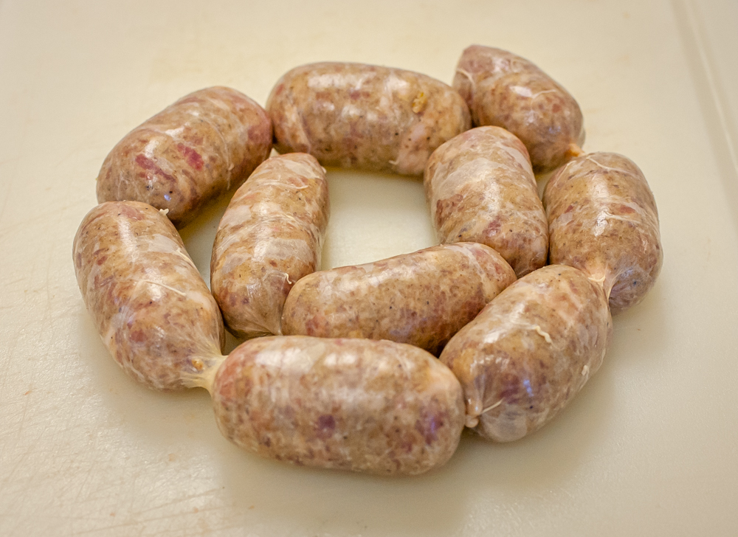
Methods and Experiments Cont.
Sensory Evaluation
Through blind testing, ten panelists evaluated the sausage quality by the consumer acceptance test.
A hedonic scale was used to evaluate the quality attributes of sausages.

Slide 10
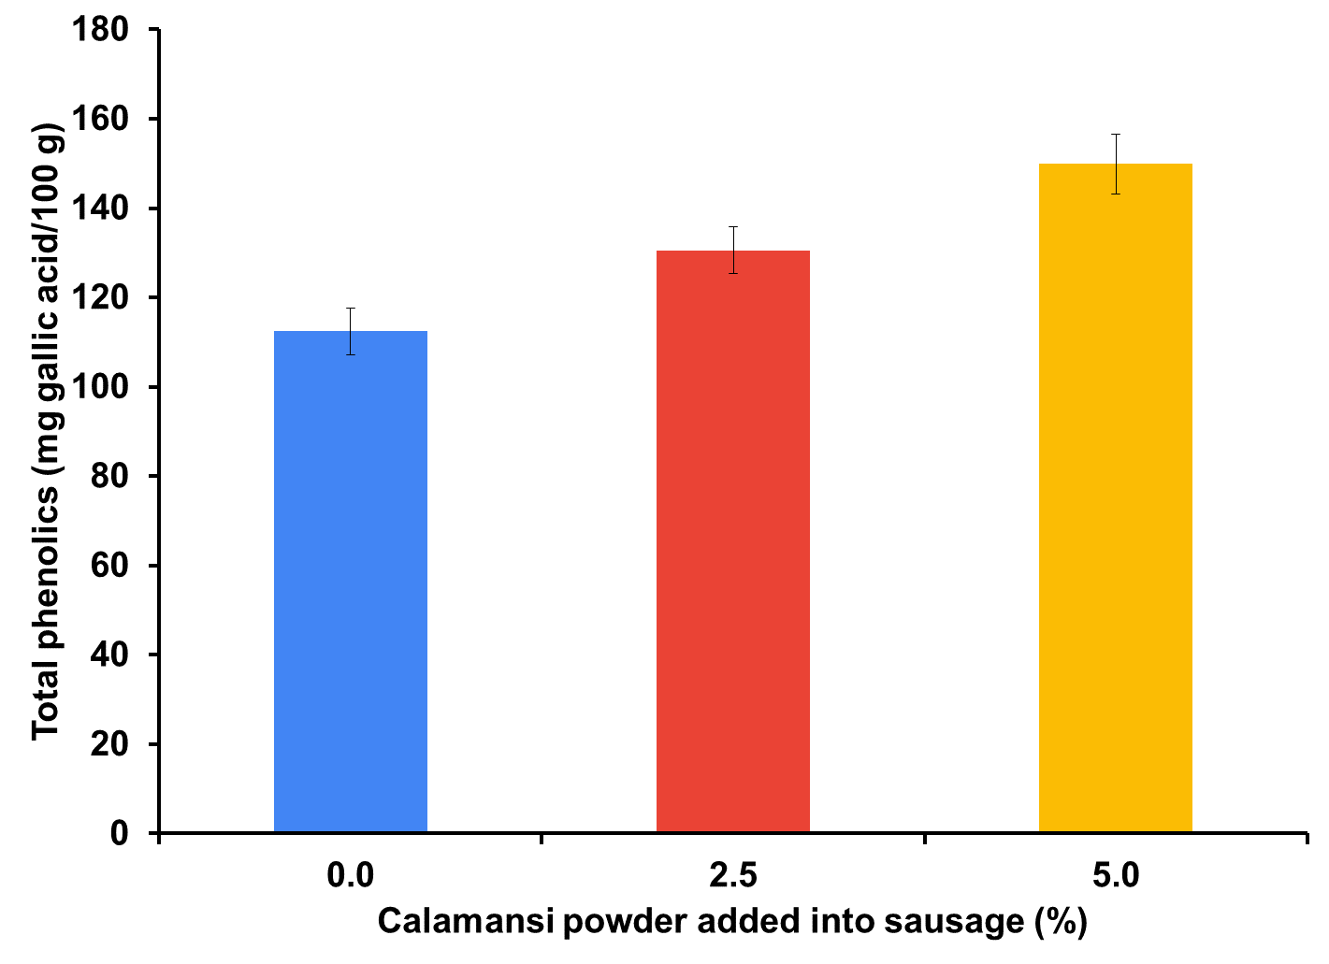
Total Phenolic Content of Sausages Incorporated with Calamansi Peel Powder for Day 1

Slide 11
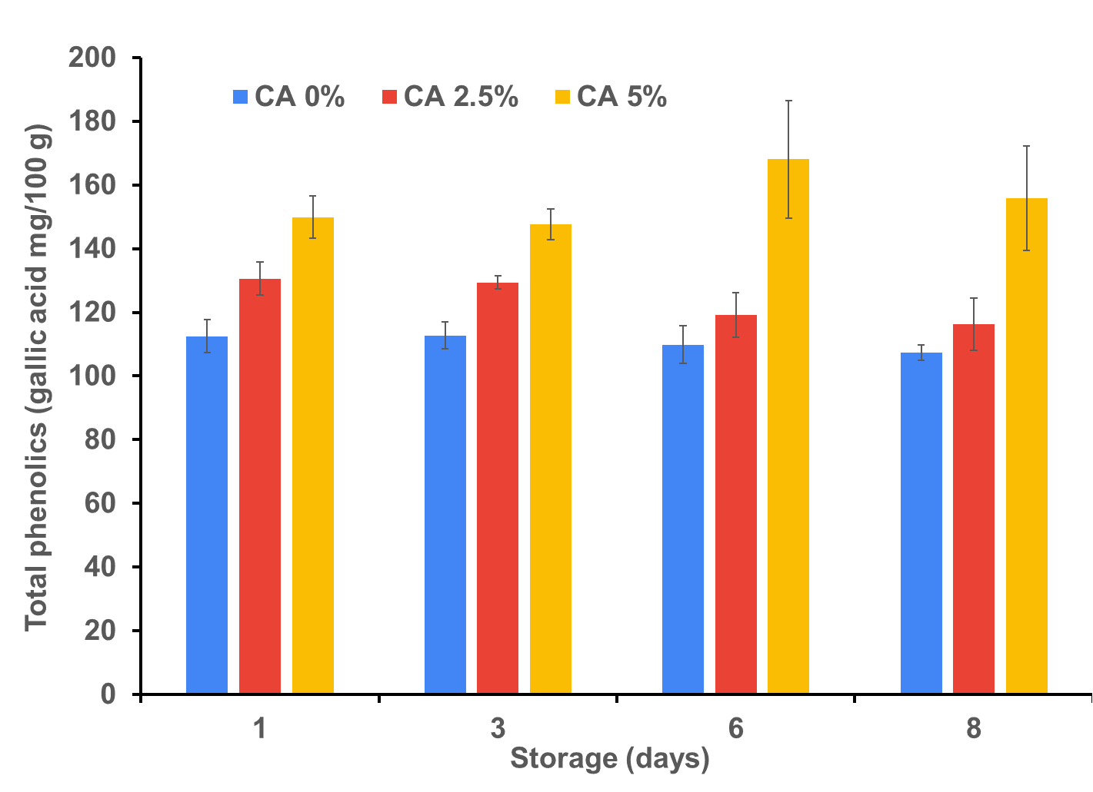
Total Phenolic Content of Sausages Incorporated with Calamansi Peel Powder Throughout a Storage Period

Slide 12
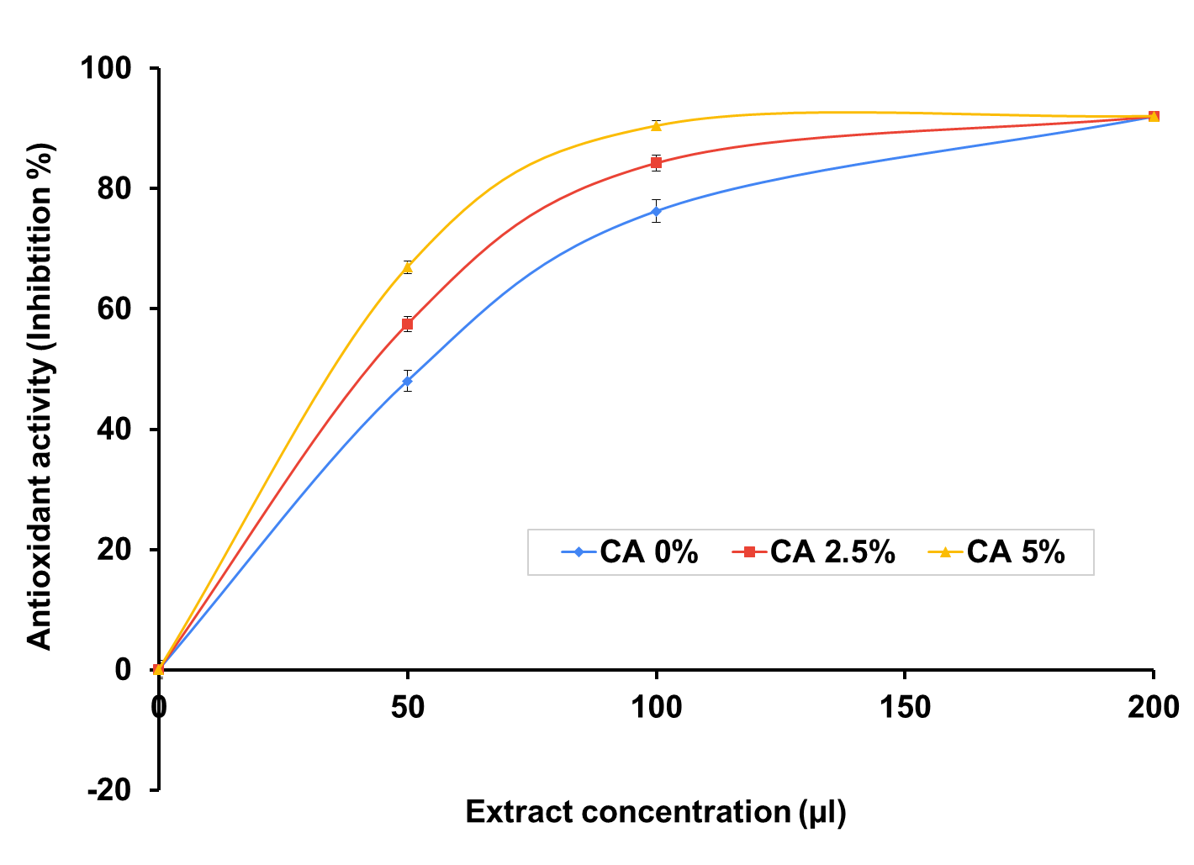
Antioxidant Activity of Sausages Incorporated with Calamansi Peel Powder for Day 1

Slide 13
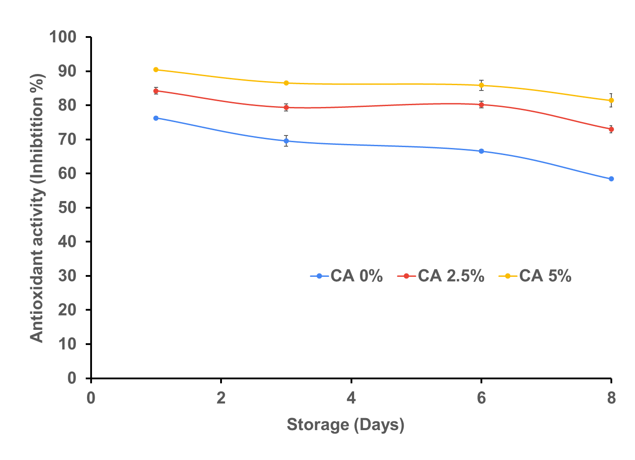
Antioxidant Activity of 100 µL Extract of Sausages Incorporated with Calamansi Peel Powder Throughout a Storage Period

Slide 14
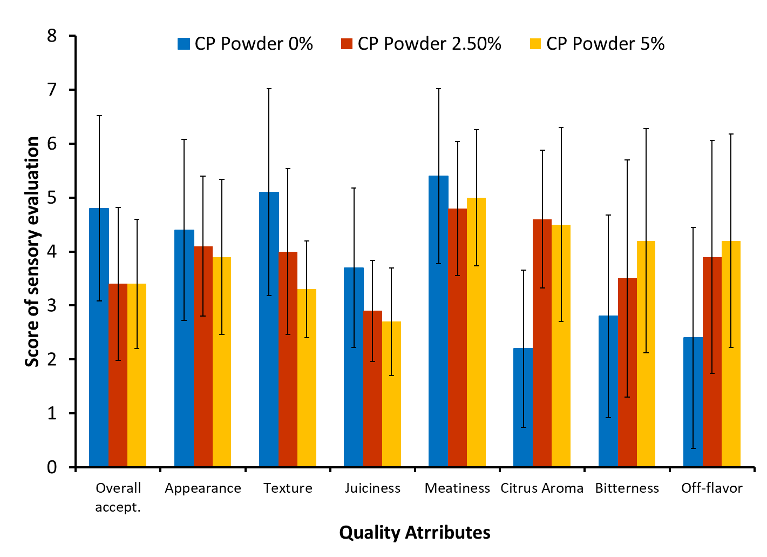
Sensory Evaluation of Sausages Incorporated with Calamansi Peel Powder

Slide 15
Discussion
Sausages incorporated with 2.5% and 5% calamansi peel powder have a higher total phenolic content compared to the sausage without calamansi peel powder.
There was a slight decrease in total phenolic content value among the sausages incorporated with 0%, 2.5%, and 5% calamansi peel powder during storage for 8 days.
Sausages incorporated with 2.5% and 5% calamansi peel powder have higher antioxidant activity compared to the sausage without calamansi peel powder.
During the storage for 8 days, sausages incorporated with calamansi peel powder exhibited a gradual decrease in antioxidant activity.

Slide 16
Discussion Cont.
Sausages without the calamansi peel powder exhibited a higher overall acceptance score than sausages incorporated with 2.5% and 5% calamansi peel powder and lower scores in citrus aroma, bitterness, and off-flavor.
Significance
The results show that adding calamansi peel powder to sausages was able to increase the total phenolic content and antioxidant activity of sausages.
The study shows that there is a possibility for calamansi peel powder to become a natural antioxidant for meat products.
If the study was to be continued, the sausage recipe could be revised to include peels from mature/ripened calamansi.

Slide 17
References
Singh, B., Pal Singh, J., Kaur, A., & Singh, N. (2020). Phenolic composition, antioxidant potential and health benefits of citrus peel. Food Research International. 109:114.
Baker, D. H. A. , Ibrahim, E. A. , & Salama, Z. A. E. (2021). Citrus Peels as a Source of Bioactive Compounds with Industrial and Therapeutic Applications. In (Ed.), Phenolic Compounds - Chemistry, Synthesis, Diversity, Non- Conventional Industrial, Pharmaceutical and Therapeutic Applications. IntechOpen. https://doi.org/10.5772/intechopen.99591
Kornienko, J.S., Smirnova, I.S., Pugovkina, N.A. et al. High doses of synthetic antioxidants induce premature senescence in cultivated mesenchymal stem cells. Scientific Report 9, 1296 (2019).

Slide 18
Acknowledgements
The STEP-UP High School program is supported by the Nation Institute of Diabetes and Digestive and Kidney Diseases of the National Institutes of Health, Grant Number: R25DK78386-16. This material is based upon work supported by NIH/NIDDK under Grant No. R25DK07836
Special thanks to Kristi Hammond, Sophie D.V. Santos, and Dr. Jian Yang

