Slide 1
Water Quality in the Majuro
Lagoon
Presenting by: Maati Anterea
Mentor: Moriana Phillip MS,Republic of the Marshall Islands
Coordinating center: University of Hawai’i at Moana

Slide 2
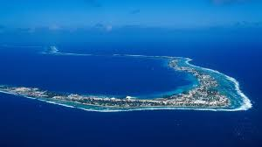
Index:
The background information
What is enterococci?
Why is it important for community members to know?
Purpose/Hypothesis
Why is it important to evaluate enterococci?
What are the tools for doing marine test sample
Result
Summarizing
(Photo of Majuro Atoll)

Slide 3
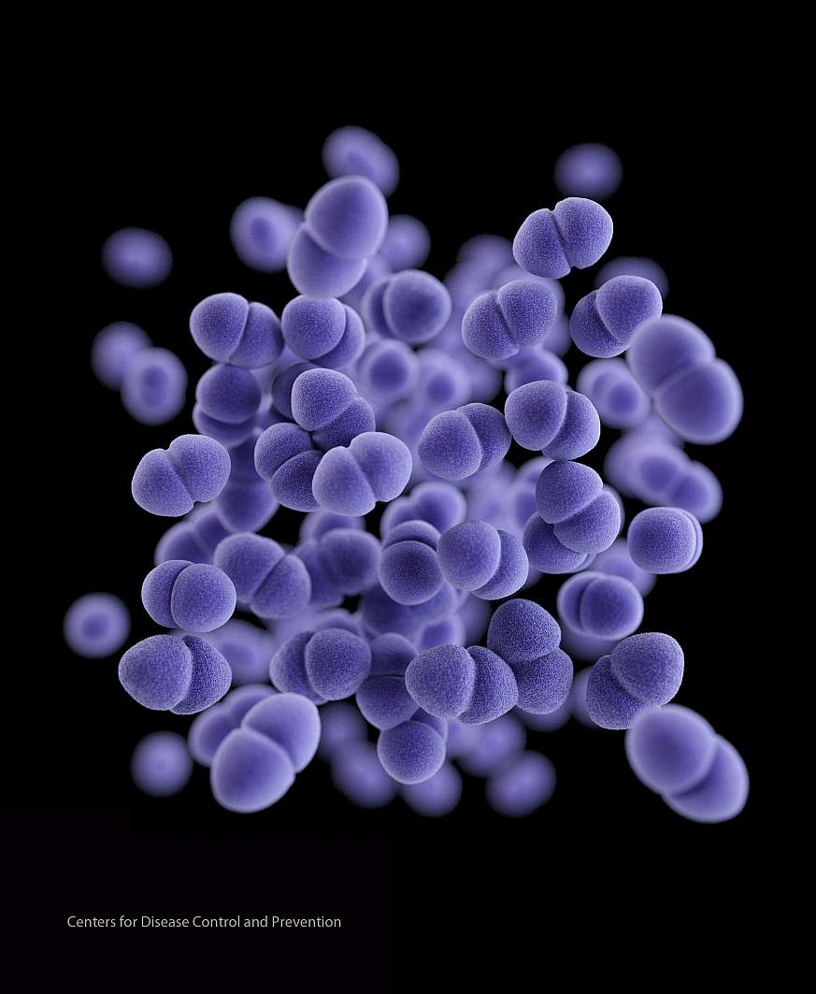
Background Information
What is Enterococci?
Enterococci are a group of bacteria that are a part of the normal intestinal flora. Many enterococci have plasmid-encoded resistance genes. Enterococci are a common cause of nosocomial urinary-tract infections as well as wound and blood infections
THE Republic of the Marshall Islands Environmental Protection Agency (RMIEPA) measures enterococci concentration in Majuro Lagoon, which is a commonly used approach in water quality monitoring. Enterococci are a group of bacteria used as indicators of water quality because of their prevalence in human and animal waste. If a location has high concentration of enterococci from sewage or untreated wastewater inputs, it likely has other pathogenic microorganisms. Water samples were obtained from Alwal, R.E.S, Marshall Islands High School (MIHS),Jenrok Park, Uliga Dock, Delap Park, and Delap Dock. Enterococci concentration was high at Alwal, R.E.S., MIHS, Jenrok Park and Delap Dock and low atUliga and Delap docks. The purpose of this report is to inform community members of high Enterococci levels. Community members are advised to avoid swimming, especially for children. To improve the levels of Enterococci in water sources, community efforts can be made to improve sanitation services such as trash collection and recycling. Increasing awareness of this problem will not only keep residents healthy, but improve the environment for future generations.
(Figure 1)

Slide 4
Why is it important for community members to know?
Indicators:Enterococci
Enterococci are bacteria that live in the intestinal tracts of warm-blooded animals, including humans, and therefore indicate possible contamination of streams and rivers by fecal waste. Sources of fecal indicator bacteria such as enterococci include wastewater treatment plant effluent, leaking septic systems, stormwater runoff, sewage discharged or dumped from recreational boats, domestic animal and wildlife waste, improper land application of manure or sewage, and runoff from manure storage areas, pastures, rangelands, and feedlots. There are also natural, non-fecal sources of fecal indicator bacteria, including plants, sand, soil and sediments, that contribute to a certain background level in ambient waters and vary based on local environmental and meteorological conditions
https://www.epa.gov/national-aquatic-resource-surveys/indicators-enterococci

Slide 5
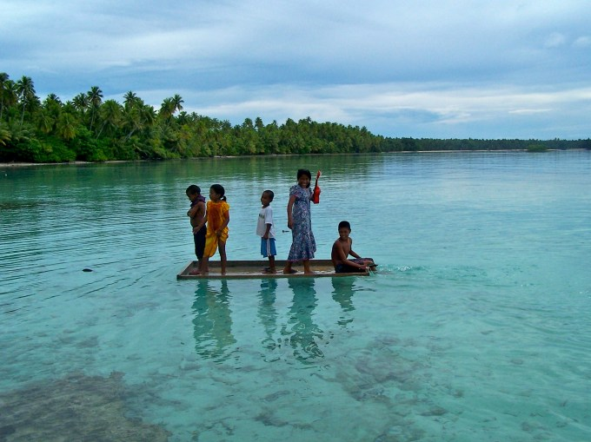
Purpose/Hypothesis
Hypothesis:
In Majuro atoll, children are most likely found swimming and enjoying the moment they had in the ocean but what they don’t know is that enterococci are all around them and throughout my mentor and I hard work and investigation we had gather some simple from the area where children love to go swimming.
Purpose: Enterococci are bacteria found in the intestines of animals and humans and indicate the presence of faecal pollution in coastal water.

Slide 6
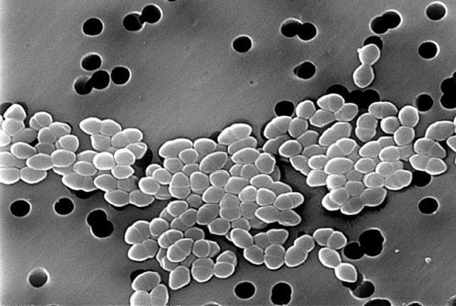
Why is it important to evaluate enterococci?
Scanning electron micrograph of enterococci
Enterococci are indicators of the presence of fecal material in water and, therefore, of the possible presence of disease-causing bacteria, viruses, and protozoa. These pathogens can sicken swimmers and others who use rivers and streams for recreation or eat raw shellfish or fish. Other potential health effects can include diseases of the skin, eyes, ears and respiratory tract. Eating fish or shellfish harvested from waters with fecal contamination can also result in human illness.

Slide 7
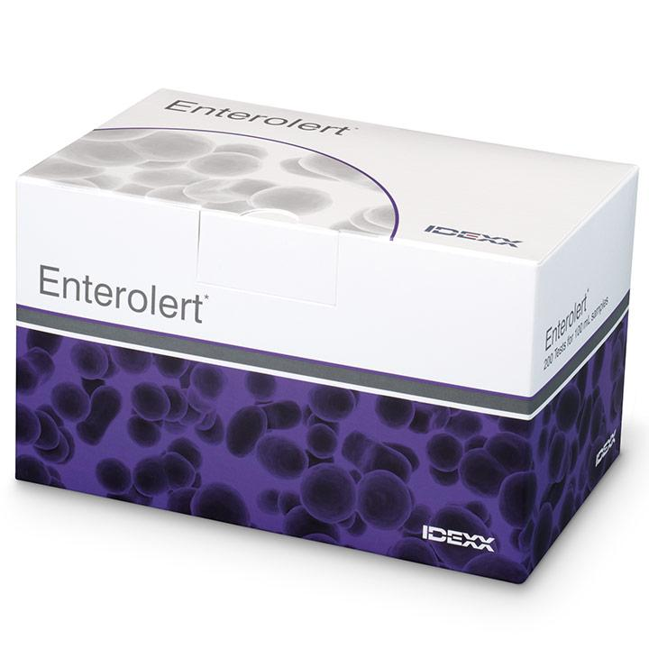
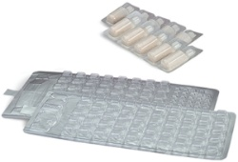
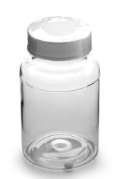
Materials to used for marine test simple:
bottle Enterolert Quanti-tray
(Figure 1) (Figure 2) (Figure 3)

Slide 8
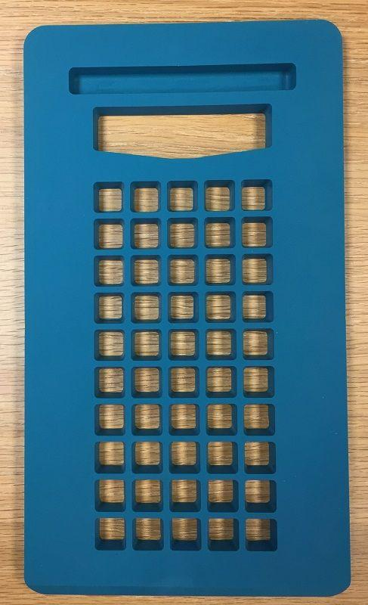
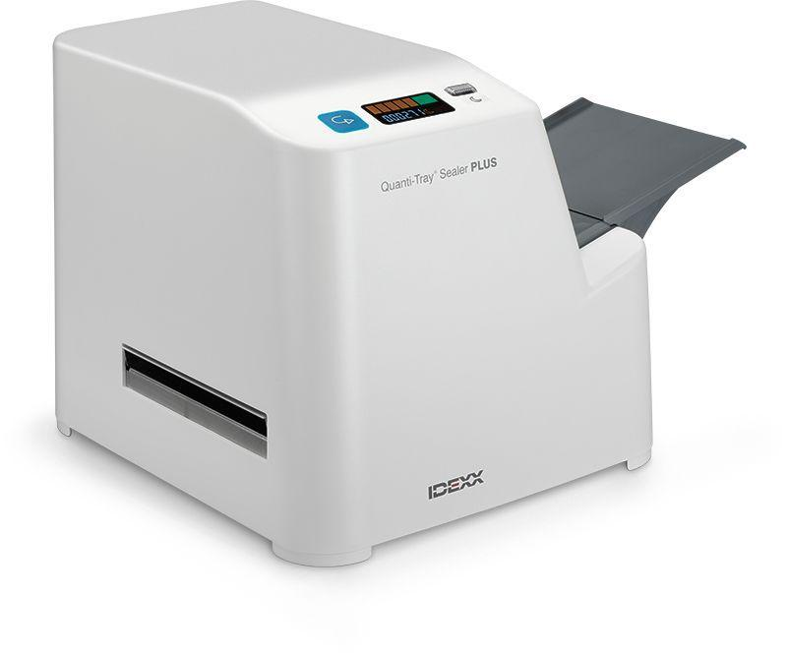
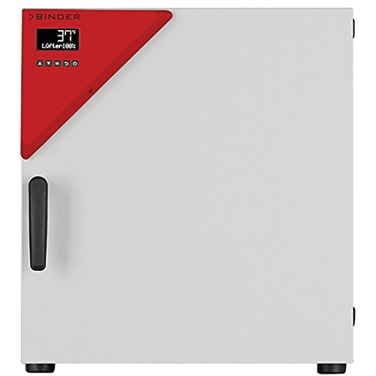
Materials to use for Marine test simple:
Rubber quanti-tray Quanti-tray sealer Binder incubator
(Figure 4) (Figure 5) (Figure 6)

Slide 10
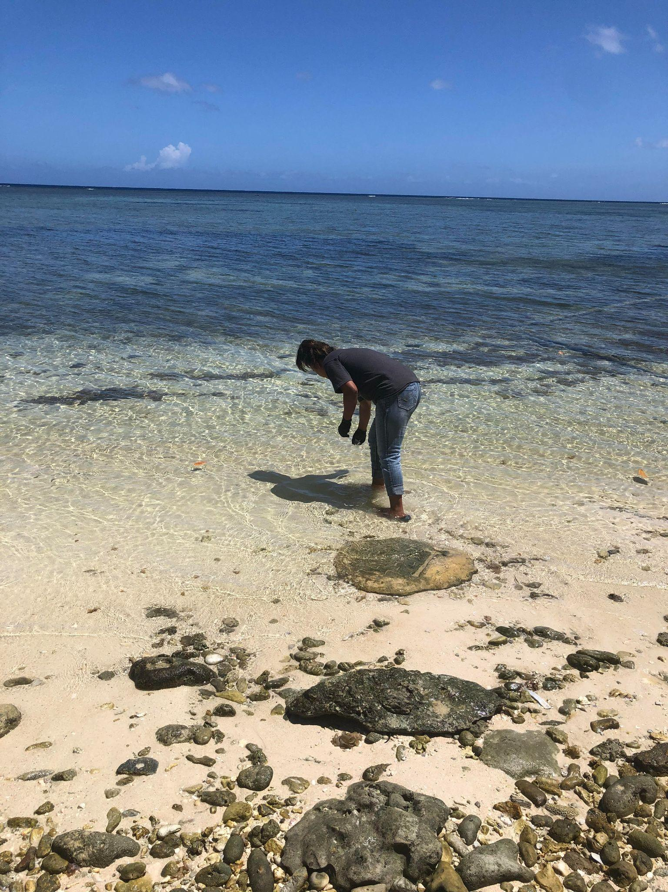
Methods/Experimental
During the few weeks of doing test simple we had not come across any changes and by that it look to us that it can take years to improve our lagoon from enterococci but on the other hand awareness will be spread out to our community members to be inform of what’s happening.

Slide 11
Results
For the result of testing marine water in Marshall Island, there were some good changes the last week where we took some sample in the outer islands there were a few member of EPA and I, we went out to the sea riding on the boat sealing and collecting sample and as the time flew by we seal back to Majuro and went straight to the laboratory and started doing the samples, the next day the result were out and it look to us that the marine water were safe and clean and we like and try to keep it that way.

Slide 12
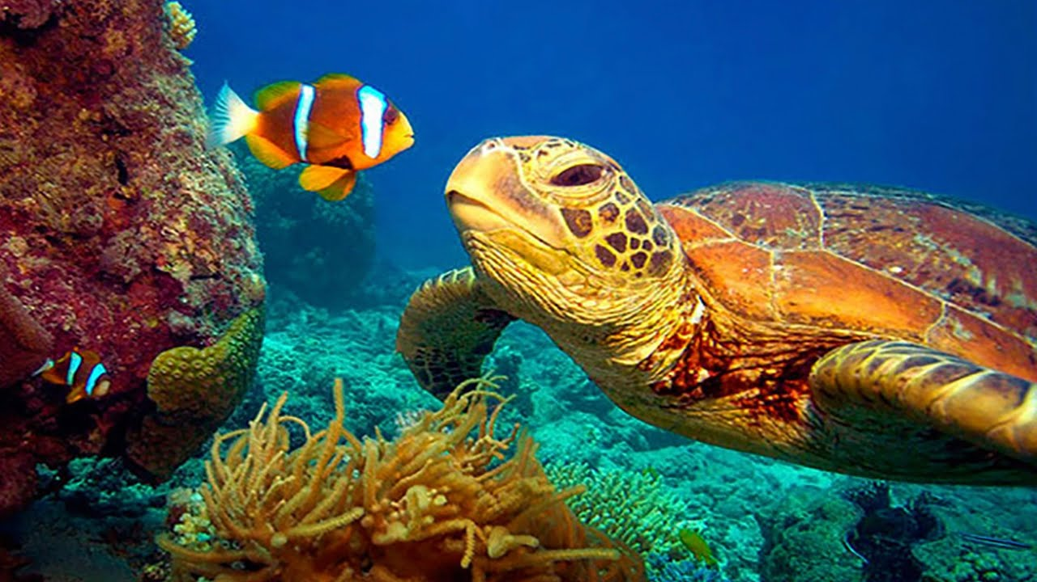
Summarizing
To sum everything up enterococci are typically not considered harmful to humans, but their presence in the environment may indicate that other disease-causing agents such as viruses, bacteria, and protozoa may also be present. Significant amounts of enterococci in a water body can negatively affect the recreational and economic value of the aquatic resource. Overabundance of fecal bacteria in the water can cause beach closures, swimming and boating bans and closures of fishing and shellfishing areas.

Slide 13
THE FUTURE WE WANT
The future we want for the next generation would be the health of our ocean, why? As we all know Majuro is surrounded by water, and the land is fill with kids who we hold dearly, as I had stated earlier kids are wild and with each day kids are seen swimming and it had been a concern for all of us. We all just don’t want the kids to be ill while coming out of the sea not just them but for the marine creature such as fish and coral with hands reaching out and awareness spreading, I am sure we can slowing improving our ocean with a lot of good ideas.

