Slide 1
ASSOCIATION BETWEEN STUDENTS’ DIET AND ACADEMIC PERFOMANCE AMONG SUMMER SCHOOL STUDENTS AT MARSHALL ISLANDS HIGH SCHOOL
RYBACK DOMNICK
REPUBLIC OF MARSHALL ISLANDS
HIGH SCHOOL STEP-UP

Slide 2
INTRODUCTION
In RMI, there is an increasing advocacy for a healthy diet and exercise among its people for all ages.
RMI-Public School System had mandated every school on the island to serve healthy food to all students everyday.
At MIHS, which is the largest secondary public school in RMI, received most 8th Grade students that were in the beginning and developing level according to the MISAT result, probably due to several factors such as absenteeism, poor healthy diet, and transportation issues.
The researcher aimed to investigate the association between students’ diet and academic performance among the 2022 summer school students at Marshall Islands High School.

Slide 3
SIGNIFICANCE OF STUDY
Public School System: Provides a valuable tool for reviewing the school’s lunch program
School Administrators: School stakeholders can collaborate with various non government organization to seek additional funding in providing healthy breakfast.
Students: Provide awareness and a better understanding of how their food intake affects their academic performances

Slide 4
PROBLEM STATEMENT
To what extent do the following independent variables affect the academic performances of the respondents:
1.1 breakfast intake
1.2 local food intake
1.3 imported food intake
Is there any significance association between the students’ academic performances and the following independent variables:
2.1 breakfast intake
2.2 local food intake
2.3 imported food intake

Slide 5
HYPOTHESIS
1. There is no significant association between the students’ academic performances and their breakfast intakes.
2. There is no significant association between the students’ academic performances and their local food intakes.
3. There is no significant association between the students’ academic performances and their imported food intakes.

Slide 6
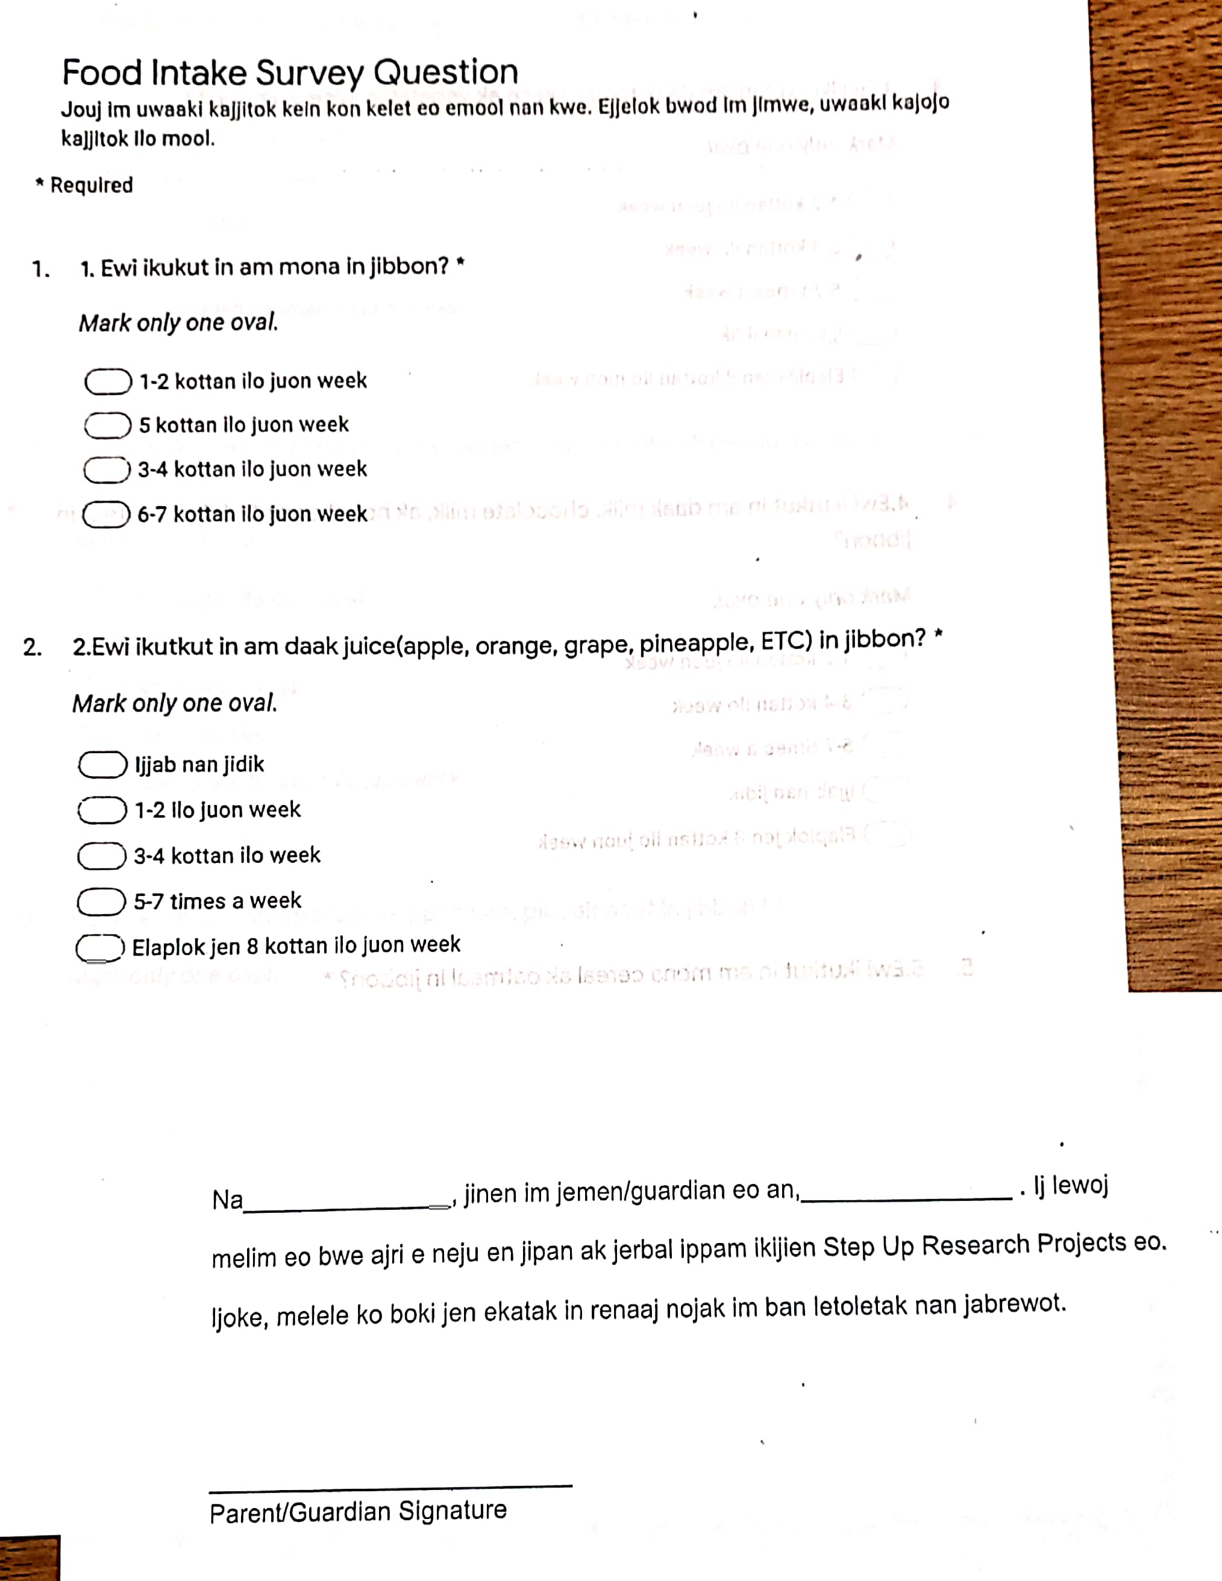
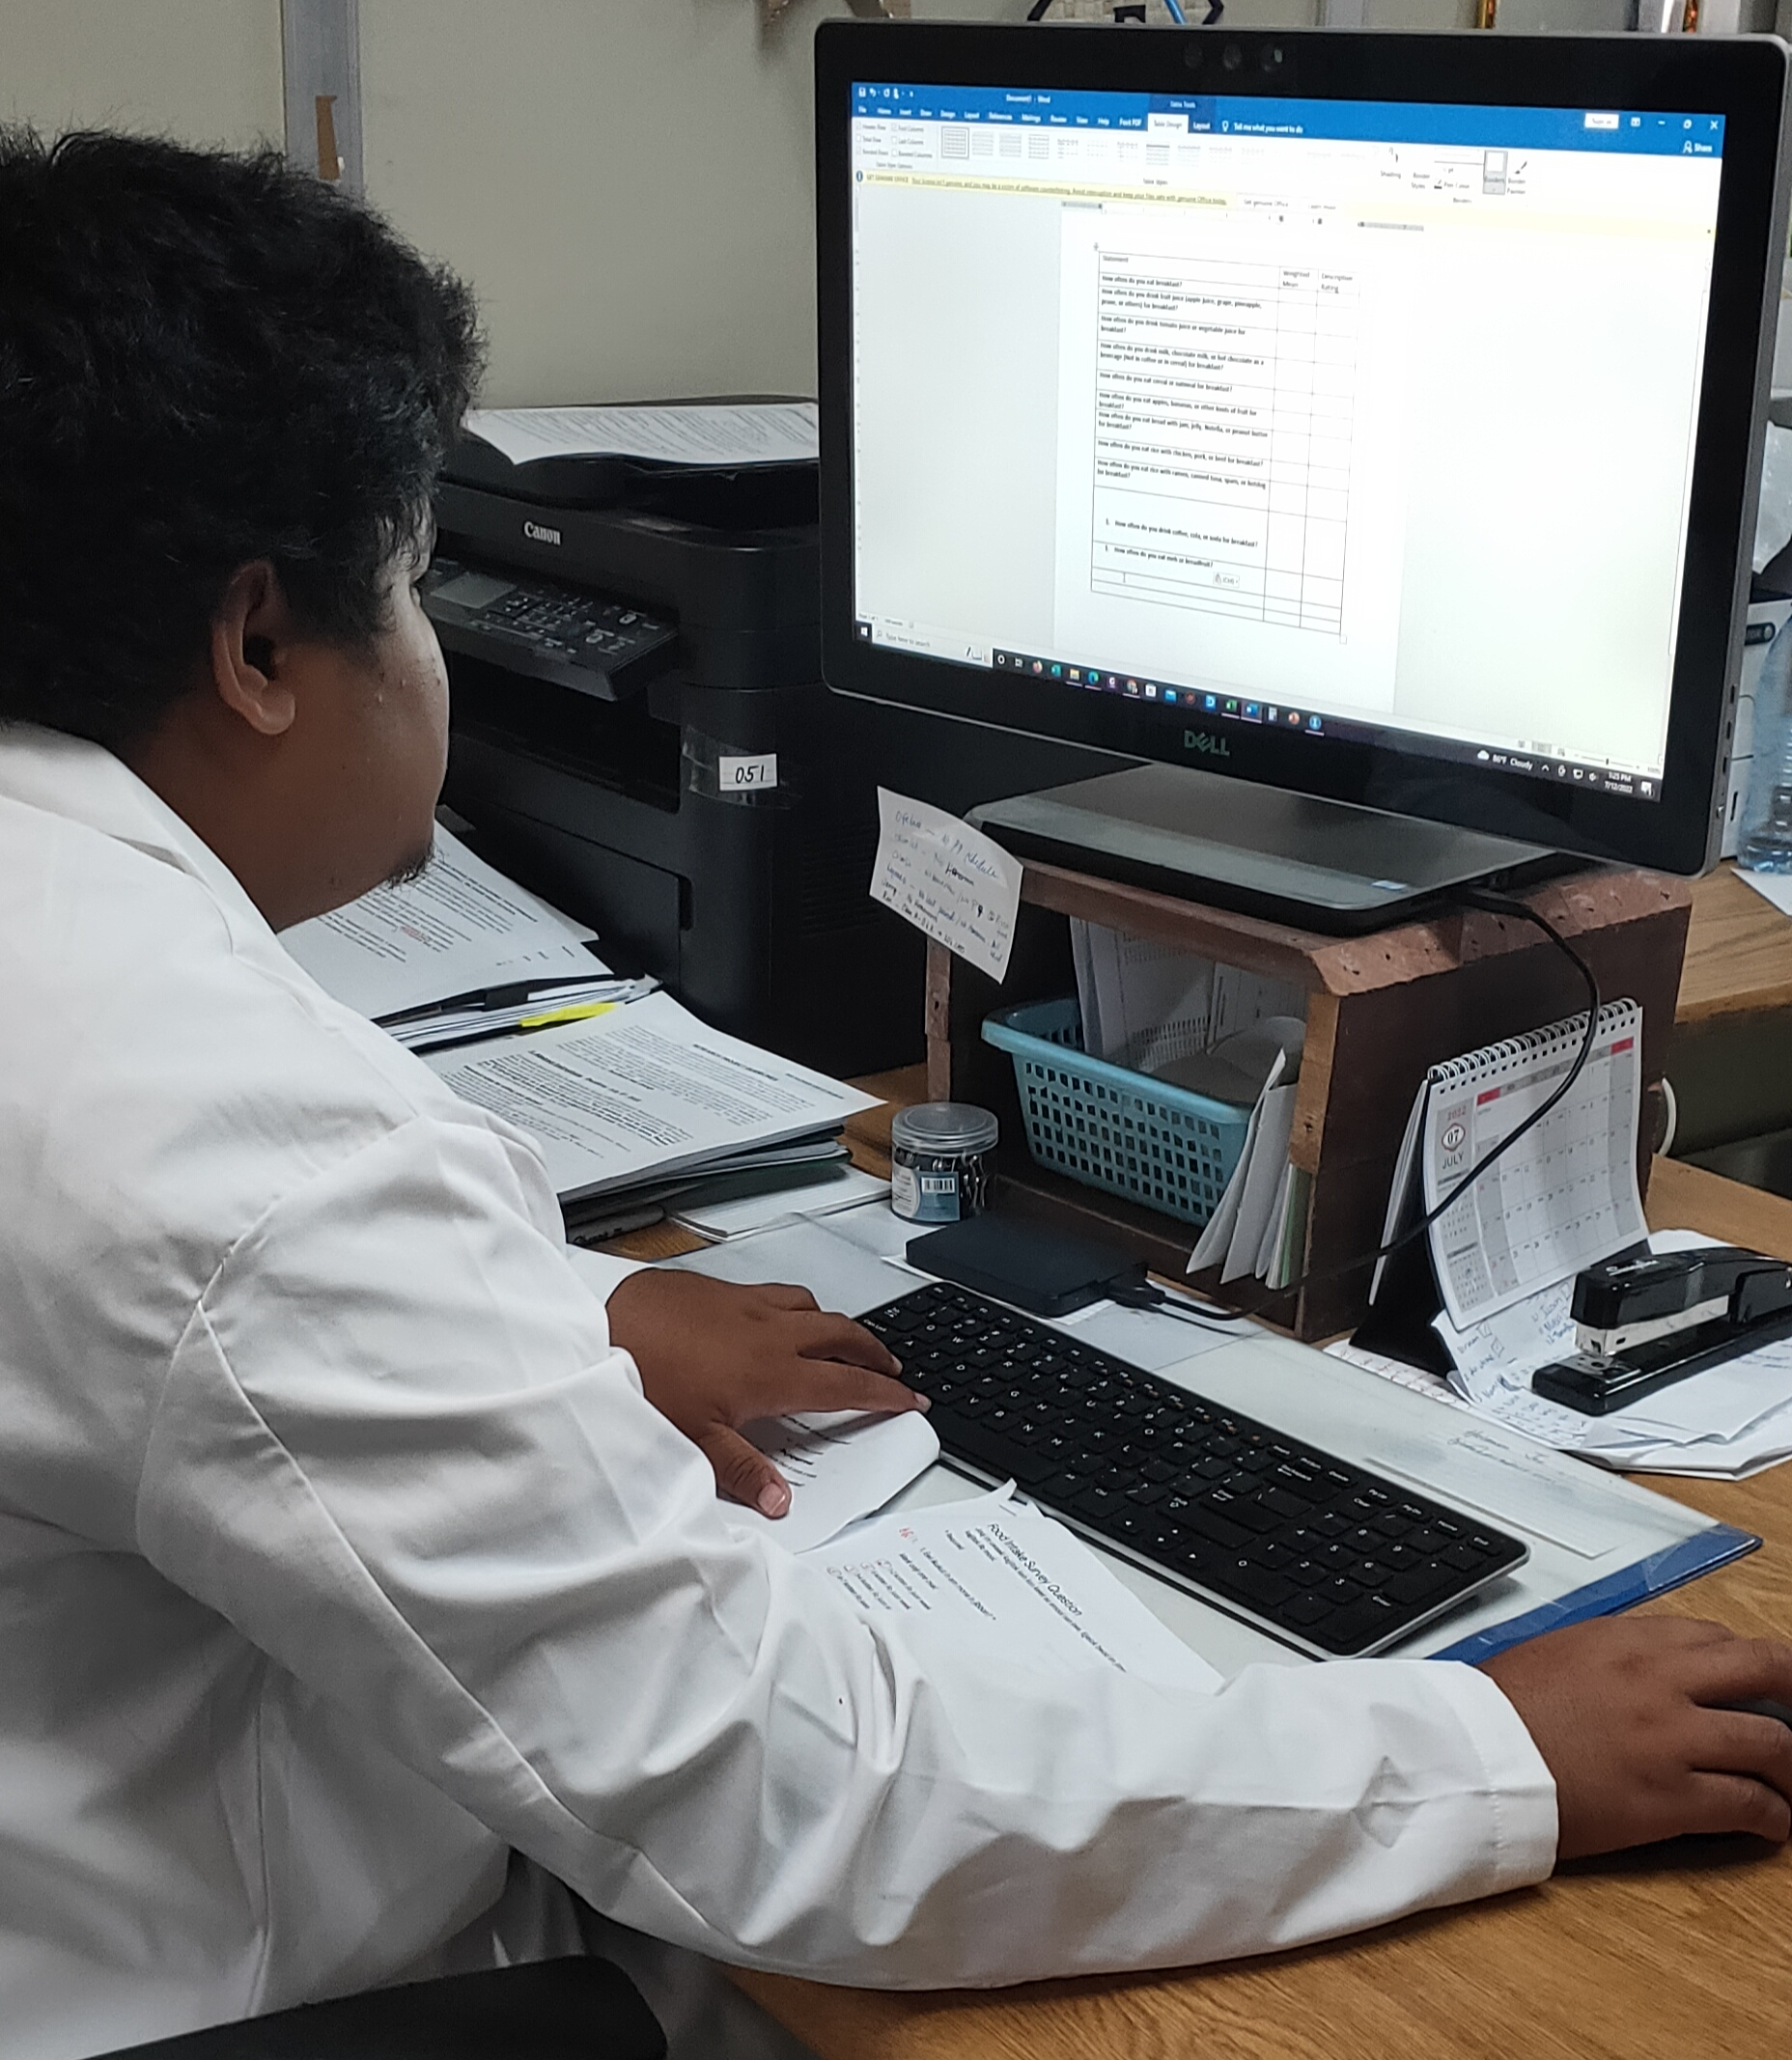
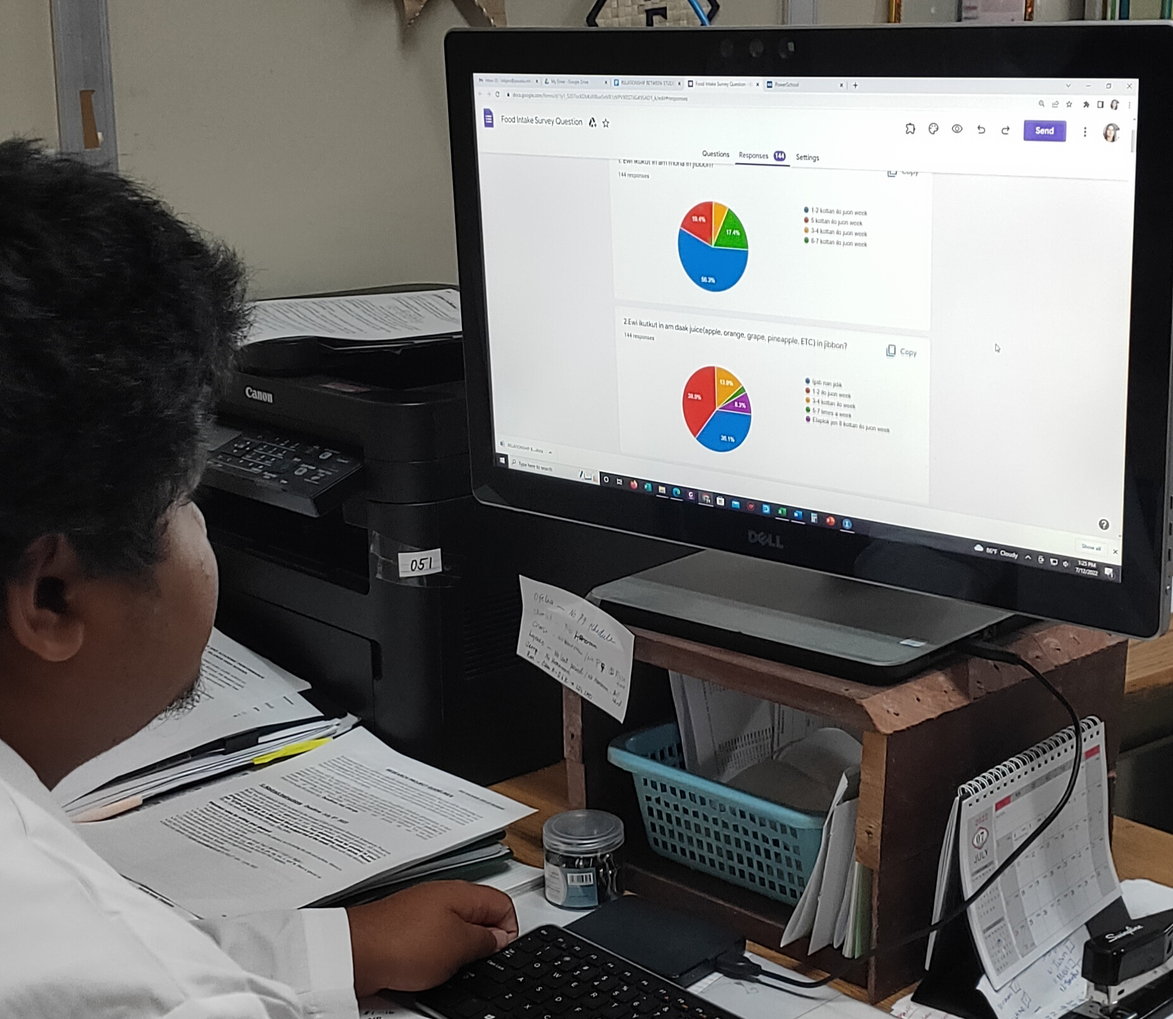
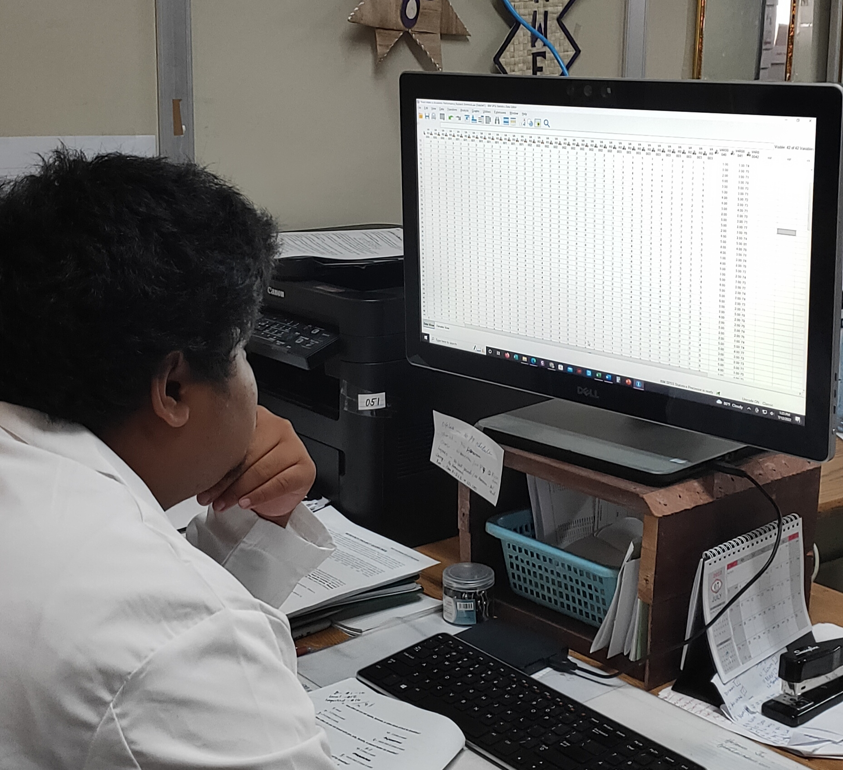
METHODOLOGY
The study used a descriptive correlation design and convenience sampling techniques to select 143 respondents from pre-9th to 11th grade.
A survey questionnaire was administrated to the student respondents to gather data.
For statistical analysis: Five point Likert scale, frequency distribution, weighted mean, and Chi-square test

Slide 7
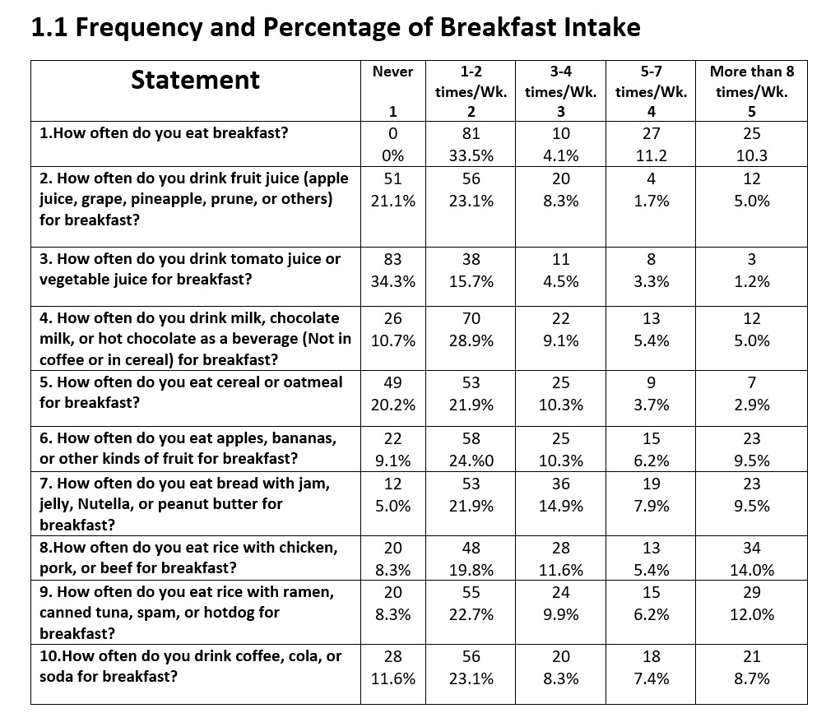
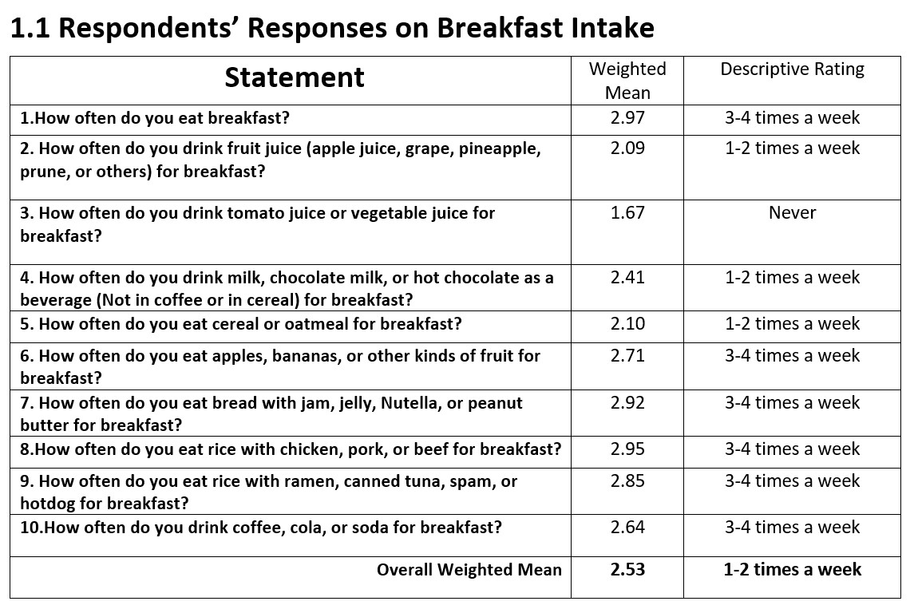
RESULTS AND DISCUSSION
To what extent do the following independent variables affect the academic performances of the respondents:

Slide 8
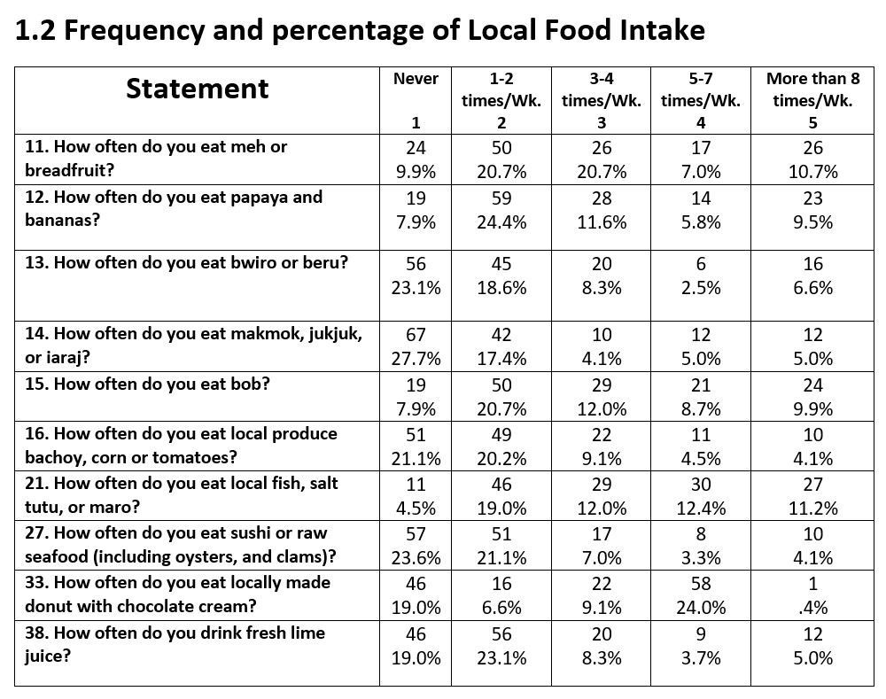
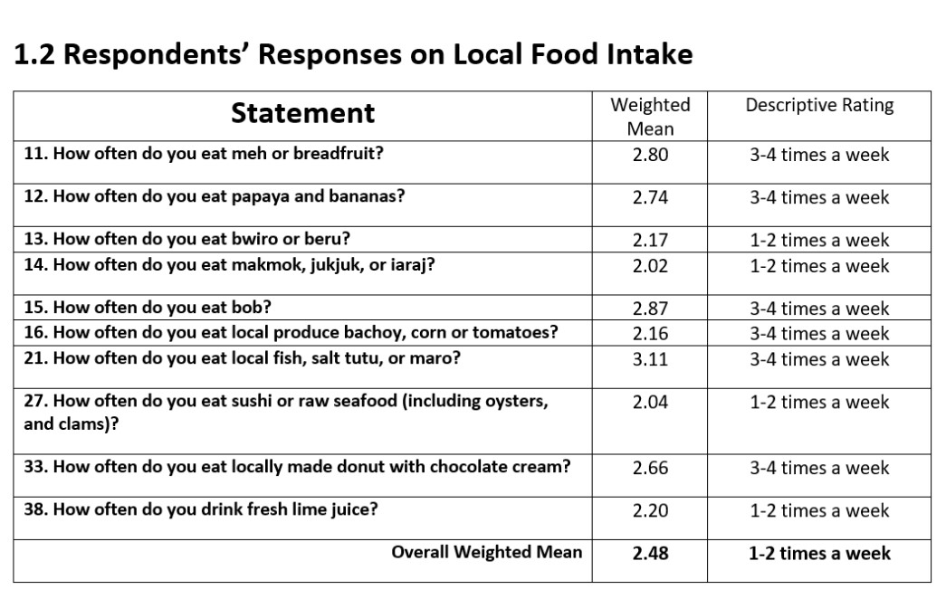
RESULTS AND DISCUSSION

Slide 9
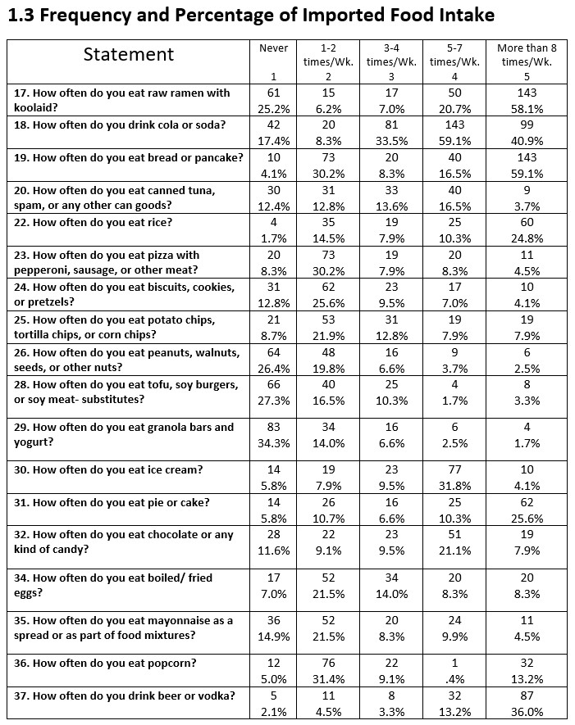
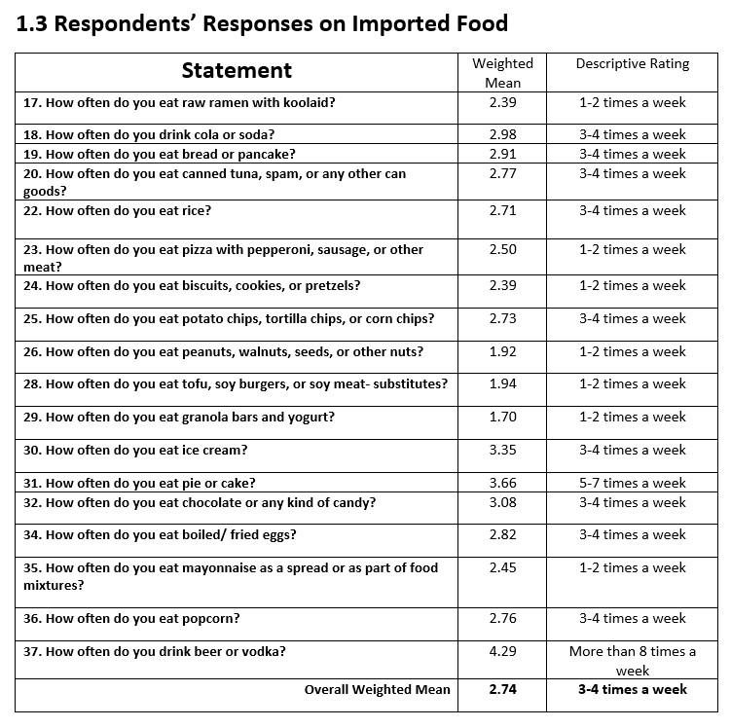
RESULTS AND DISCUSSION

Slide 10
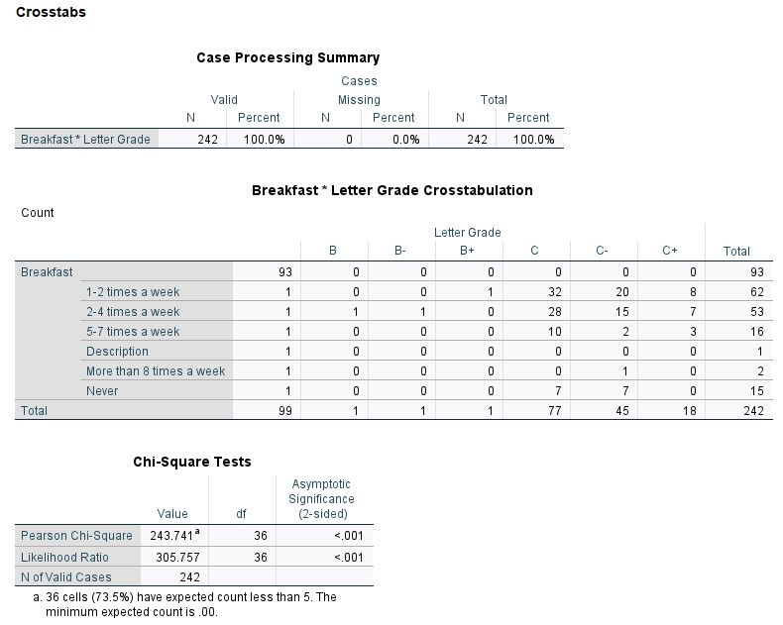
RESULTS AND DISCUSSION
There is a significant association between breakfast intakes and students’ academic performances.

Slide 11
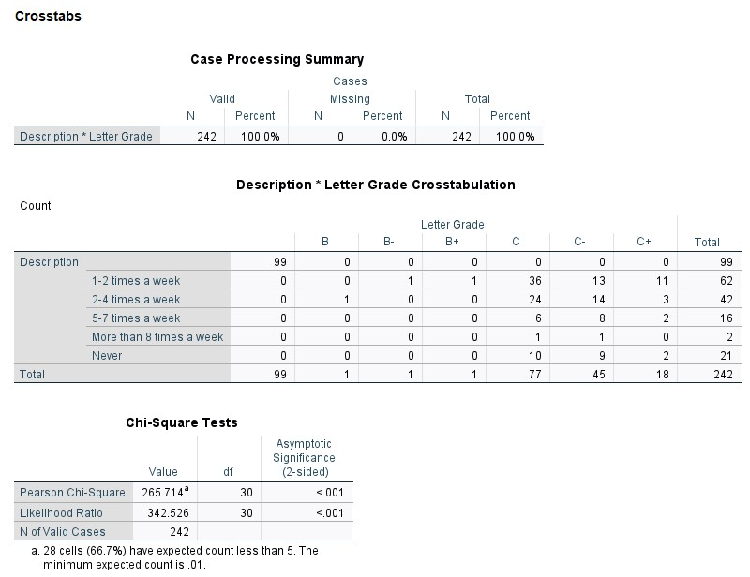
RESULTS AND DISCUSSION
There is a significant association between local food intakes and students’ academic performances.

Slide 12
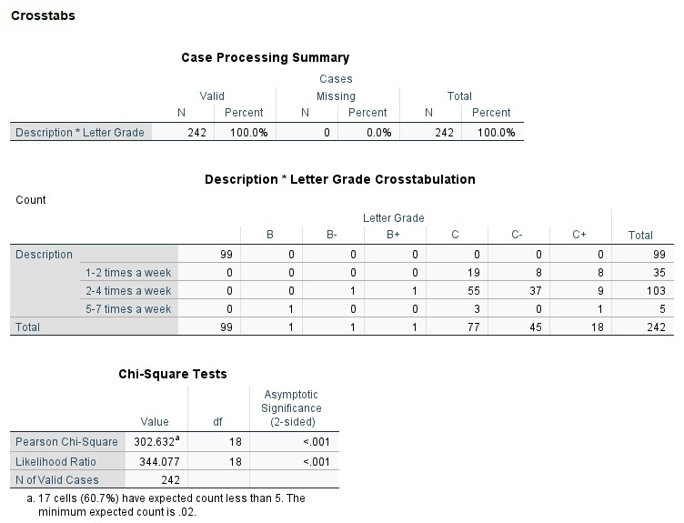
RESULTS AND DISCUSSION
There is a significant association between imported food intakes and students’ academic performances.

Slide 13
SUMMARY AND CONCLUSION
Based on the analysis of the results gathered, the following findings are hereby presented:
The imported food intake obtained the highest overall weighted mean of 2.74 (3-4 times a week), breakfast intake of 2.53 (1-2 times a week), and local food intake with a lowest weighted mean of 2.48(1-2 times a week).
Data revealed that there is a significant association between students’ diets and academic performances.

Slide 14
REFERENCES
MacLellan, D., Taylor, J., & Wood, K. (2008). Food Intake and Academic Performance Among Adolescents. Canadian Journal of Dietetic Practice and Research, 69(3), 141–144. https://doi.org/10.3148/69.3.2008.141
NHANES Food Questionnaire. (2005). https://www.cdc.gov/nchs/data/nhanes/nhanes_03_04/tq_fpq_c.pdf
UKEssays. (November 2018). Relationship between Student Diet and Academic Performance. Retrieved from https://www.ukessays.com/essays/nutrition/academic-performance-nutritional-status-8263.php?vref=1

Slide 15
ACKNOWLEGDEMENTS
George Hui, PhD: Pacific STEP-UP Program Director, John A. Burns School of Medicine UH, Manoa
Aneesa Golshan: Program Coordinator, Pacific STEP-UP
Sali Andike: Pacific STEP-UP Program Coordinator, Republic of the Marshall Islands
Barbara Ned: Principal, Marshall Islands High School
Kathy Digno (STEP-UP Mentor): MedM, Marshall Islands High School

