Slide 1
The Antibacterial Effects of Allium sativum (Garlic) on Environmental Bacteria
David Borja Marianas High School Mentor Johnny Aldan, BS, RN Northern Marianas College, Saipan, CNMI

Slide 2
Goals Of The Experiment
Examine the antibacterial properties of garlic on environmental bacteria
Determine whether or not garlic’s antibacterial properties will be effective against environmental bacteria

Slide 3
Hypothesis
It was hypothesized that the garlic extract would prevent the growth of the bacteria

Slide 4
Importance
Provide a natural antibacterial agent
Raise awareness for alternative and organic antibacterial agents

Slide 5
Allium sativum
Commonly known as “Garlic”
Native to Central Asia, but can be found around the world
Known Uses:
Food and Drinks
Traditional And Modern Medicine
Pest Control

Slide 6
Environmental Bacteria
There is a wide variety of bacteria that can be found all over the environment.
Some have beneficial effects that help aid our environment and body; such as, breaking down organic substances in soil, helping with the process of digestion, function of our immune system
However, there are also harmful types present that can cause diseases; such as, staph infections, pneumonia, strep throat, etc.

Slide 7
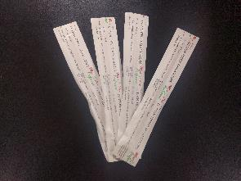
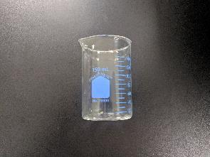
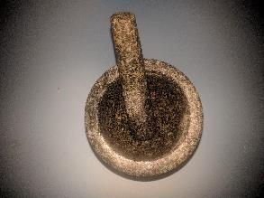
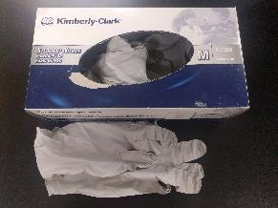
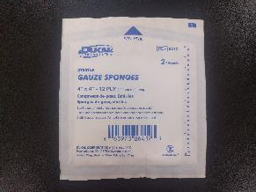
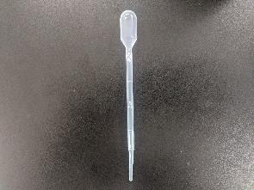
Materials
Cotton-Tipped Applicators
150ml Beaker
Mortar & Pestle
Gloves
1ml Pipette
4X4 Gauze Sponge

Slide 8
Growing The Bacteria
Used sterile cotton tipped applicators to swab sink
Used the spread method to smear the contents of the swab onto agars
Put agars into Incubator Shaker for 48 Hours at 37˚C
Notes:
We used 3 types of agars; Chocolate Agar, Blood Agar, and MacConkey Agar.
Between Steps 2 & 3 is when the Garlic Extract Steps take place.

Slide 9
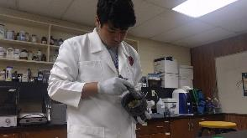
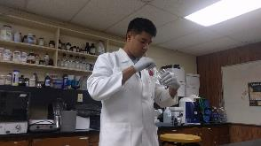
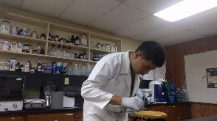
The Garlic Extract
Bought and peeled ~35g of fresh garlic
Used a sterile mortar and pestle to crush the garlic
Mixed in 2ml of distilled water with the crushed garlic
Put garlic into sterile gauze sponge
Squeezed the garlic extract into a 150ml sterile beaker
Used a sterile 1ml pipette to apply 3 drops of the extract to smeared agars

Slide 10
Results (2 Days)
Without The Extract (Control)
With The Extract (Experimental)

Slide 11
Results (7 Days)
Without The Extract (Control)
With The Extract (Experimental)

Slide 12
Results
* Numbers are an estimate based on observation of the agar’s surface area

Slide 13
Results
On the controlled agar the bacteria didn’t have a confluent growth
On the experimental agar the bacteria grew around the drops of garlic and had a more confluent growth

Slide 14
Conclusion
After careful observations and repeated tests, we can conclude that we reject our hypothesis based on inconclusive results
The results were inconclusive because of the irregular growth on the controlled agar and insufficient information from the controlled agar
However, it is suggestive that the garlic extract does have an antibacterial effect on environmental bacterial
More tests should be conducted to solidify this claim

Slide 15
Future Experiments
Agar diffusion test
Different concentrations of extract
Use freshly made agars
Run tests in triplicate
Use a better control method; e.g., apply drops of water

Slide 16
Bibliography
Arya, Niharika. "Bacteria That are Helpful to Humans and the Environment." Buzzle. Buzzle.com, 22 Aug. 2016. Web. 01 Aug. 2017.
Borade, Gaynor. "Diseases Caused by Bacteria." Buzzle. Buzzle.com, 04 Aug. 2016. Web. 01 Aug. 2017.
Ohta, Rie, Norihiko Yamada, Hisae Kaneko, Keiko Ishikawa, Hiroyuki Fukuda, Tsuchiyoshi Fujino, and Atsushi Suzuki. "In Vitro Inhibition of the Growth of Helicobacter Pylori by Oil-Macerated Garlic Constituents." Antimicrobial Agents and Chemotherapy. American Society for Microbiology, July 1999. Web. 5 July 2017.
Sanders, Helen. "Is This Vegetable Really A Good Antibiotic?" Health Ambition. N.p., 20 June 2016. Web. 27 June 2017.
Smith, Grace. "Kitchen Bacteria - Where It Grows and How to Fight It." Food Safety First. N.p., 22 Sept. 2016. Web. 3 July 2017.
"E.coli (Escherichia Coli)." Centers for Disease Control and Prevention. Centers for Disease Control and Prevention, 03 Mar. 2017. Web. 3 July 2017.
"GARLIC: Uses, Side Effects, Interactions and Warnings." WebMD. WebMD, n.d. Web. 27 June 2017.
"Northern Mariana Islands ." Northern Mariana Islands | Data. N.p., n.d. Web. 21 July 2017.

Slide 17
Acknowledgments
Mr. Johnny Aldan
Dr. George Hui
Northern Marianas College
Commonwealth Healthcare Corporation
CNMI Public School System

