Slide 1
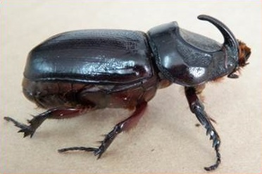

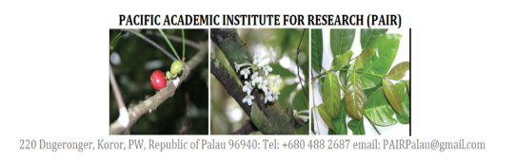
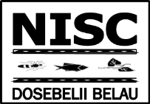

2018 CRB Damage Assessments and Distribution In Palau
Melemalt E. Benedict
Mentors: Justin O. Ramarui,
Joel Miles PhD, & Christopher Kitalong PhD

Slide 2
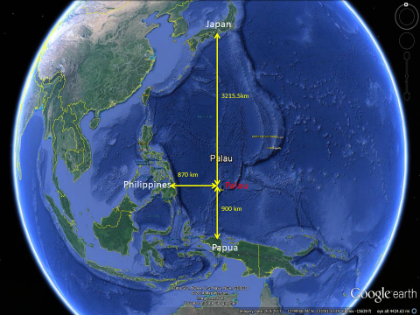
Palau

Slide 3
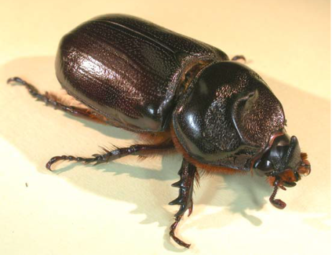
OVERVIEW
ABSTRACT
IMPORTANCE OF COCONUT TREES
CRB AND THEIR IMPACT ON COCONUT TREES
METHODS AND MATERIALS
RESULTS
DISCUSSION
CONCLUSION

Slide 4
ABSTRACT
Assessment of Coconut Rhinoceros Beetle Damage and Resistance in the Palau Archipelago
Melemalt Benedict
Christopher Kitalong PhD, Joel Miles PhD, Pacific Academic Institute for Research
Justin Omak Ramarui, Jason Ngiramengior, Balang Skey, Nelson Masang, Shizu Watanabe, Michael Melzer, Madoka Nakai
Coordinating Center: Pacific Academic Institute for Research, University of Hawai’i at Manoa, Palau Community College and Tokyo University of Agriculture and Technology
ABSTRACT
The Coconut Rhinoceros Beetle (CRB), a.k.a. Oryctes rhinoceros, is an invasive insect that kills coconut trees and other palm species by feeding on the plant’s crown. There is a confirmed presence of at least two biotypes of the CRB in Palau, Nudivirus (OrNV) resistant CRB-G versus all other CRB types. The resistant CRB-G has caused the devastation of palm trees throughout Southeastern Asia and Pacific. Multiple institutions across the globe have been working to help control and eradicate CRB.
In Palau, Damage Assessment Surveys were conducted on coconut trees at representative locations throughout all states in 2016, 2017, and 2018. Specialized traps were used along with manual searches through debris to collect samples as well. DNA analysis was used to determine distribution of CRB-G as well as incidence of Nudivirus infection in each sample.
The results of the Damage Assessment Surveys show slow recovery/reduced damage in coconut tree fronds. Furthermore, analysis of biotype and viral detection show a very high rate of infection of all CRB with the Nudivirus (CRB: 92%; CRB-G: 83%).
These findings lead to the preliminary conclusion that the OrNV in Palau’s CRB is virulent. This is one of the largest collections and assessment in the region and the first sites where the resistant strain was found infected by the Nudivirus. Further assessment is necessary but immediate focus of all parties should be made to identify and test virulence of OrNV in Palau in order to control CRB for the region.

Slide 5
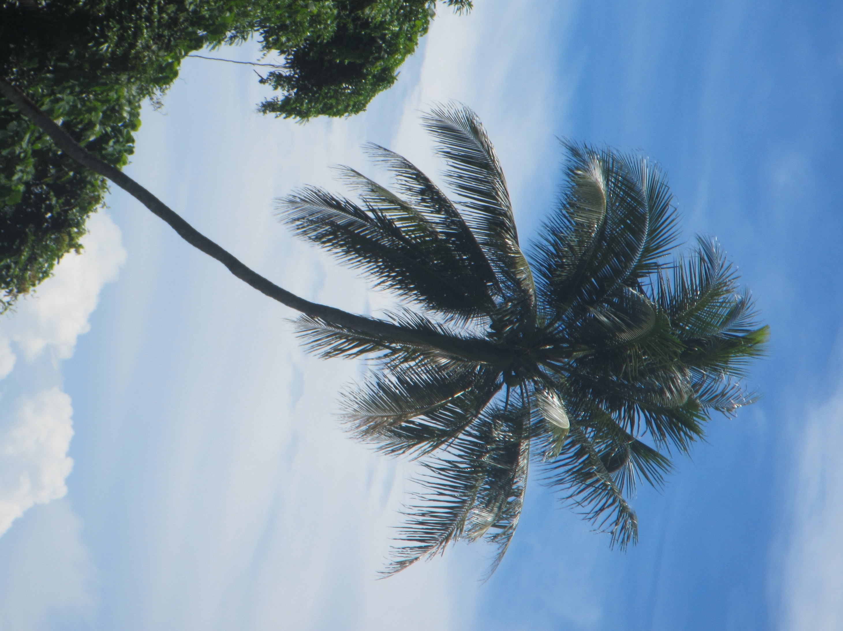
WHY COCONUT TREES ARE IMPORTANT…
TOURIST ATTRACTION
SIGNIFICANT PART OF PALAUAN CULTURE
USED IN PRODUCING OIL, BASKETS, & BROOMS
IMPORTANT SOURCE OF FOOD & DRINK

Slide 6
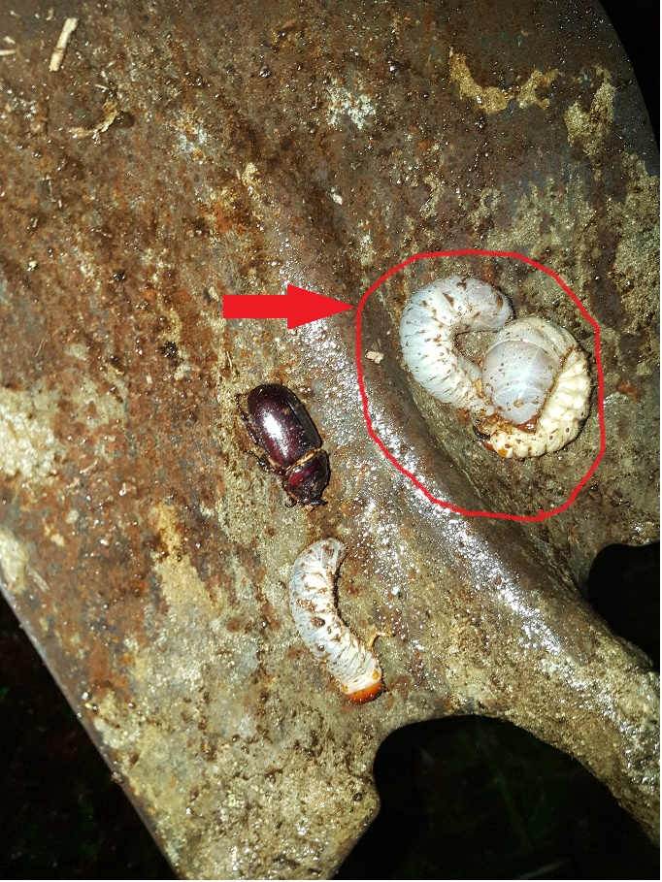
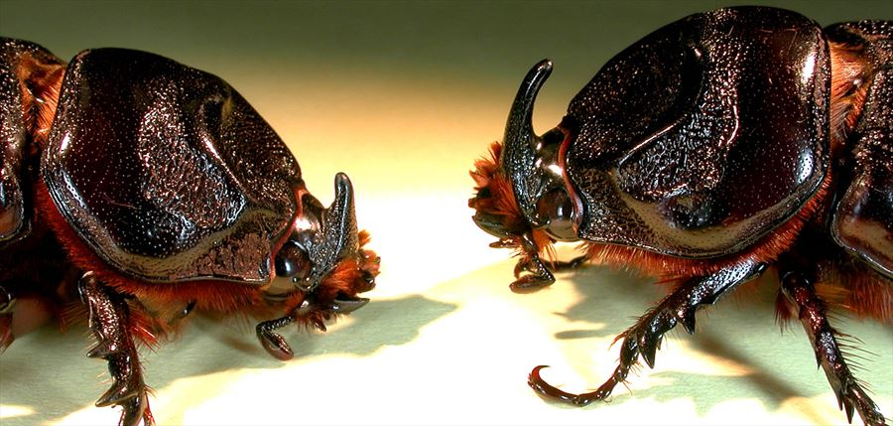
CRB (COCONUT RHINOCEROS BEETLE)
INVASIVE SPECIES FROM SOUTHEAST ASIA
FIRST APPEARED IN PALAU IN THE 1950S
ADULT MALES LIVE FOR ~5 MONTHS FEMALES ~9 MONTHS
CRB LARVAE
CRB Adult
https://dlnr.hawaii.gov/hisc/info/invasive-species-profiles/coconut-rhinoceros-beetle/

Slide 7
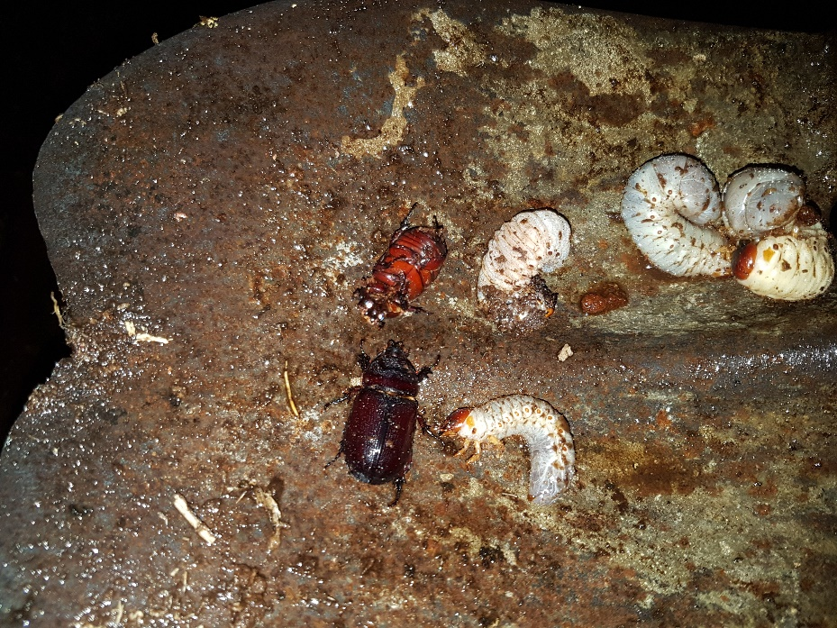
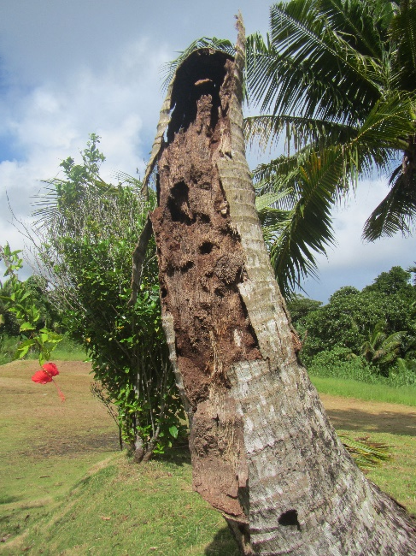
CRB BREEDING SITES
ROTTEN COCONUT LOGS
COMPOST PILES
MULCH
OLD PILES OF LEAVES OR FRONDS

Slide 8
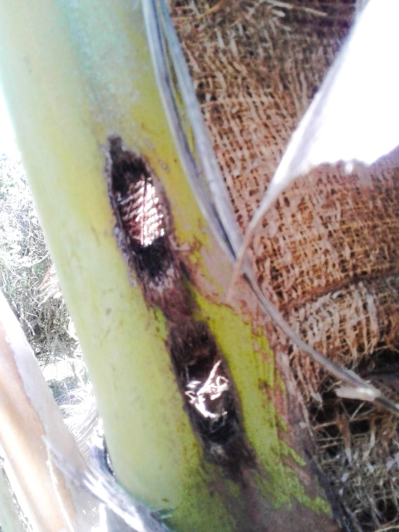
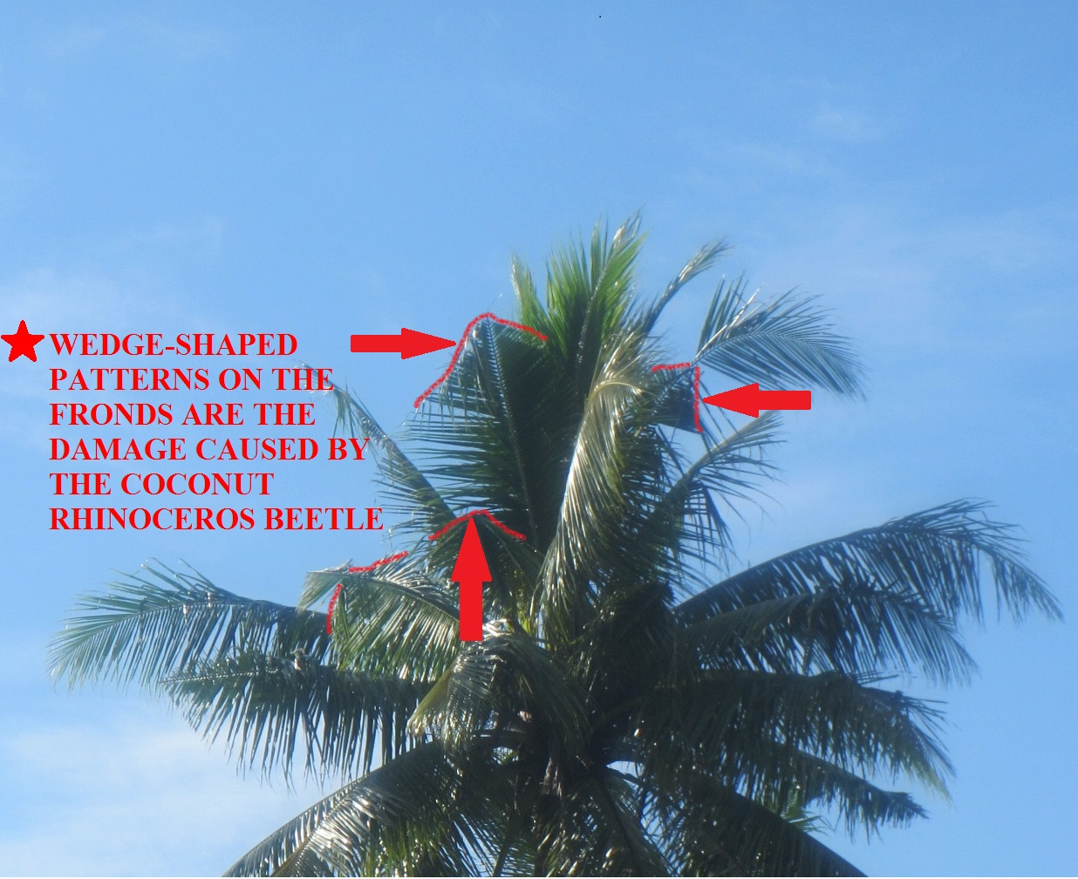
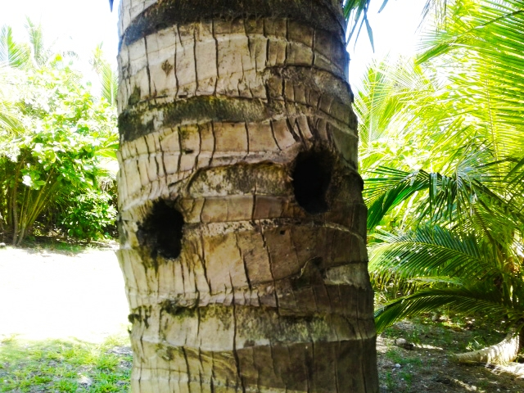
CRB DAMAGE TO COCONUT TREES
The CRB drills holes into the coconut when the coconut tree is still young and makes its way to the crown or “heart” of the tree where it feeds on the inside. Damage to the leaves is later indicated by wedge shapes on the fronds.

Slide 9
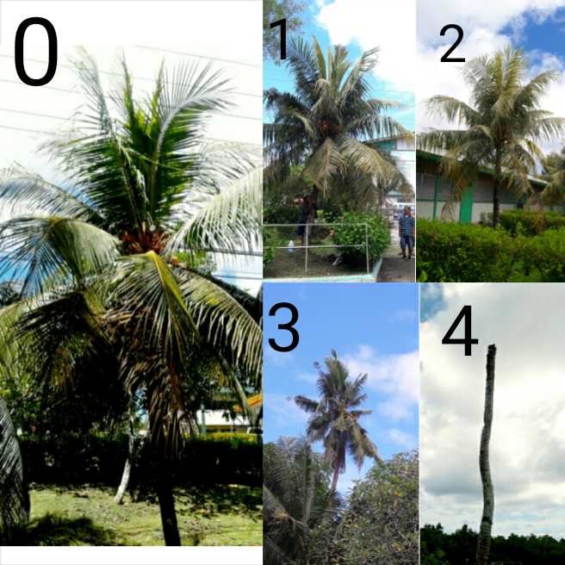
TREE DAMAGE
CRB DAMAGE ASSESSMENTS, A scale of 0-4, developed by SPC (Secretariat of the Pacific Community), is being used to rate the amount of damage on coconut trees in numerous sites around Palau.
0 = No damage (0% of leaves are removed)
1 = Light Damage (1% - 29% of leaves are removed)
2 = Moderate Damage (30% - 49% of leaves are removed)
3 = Severe Damage (>50% of leaves are removed)
4 = Dead Tree (100% of leaves are removed)

Slide 10
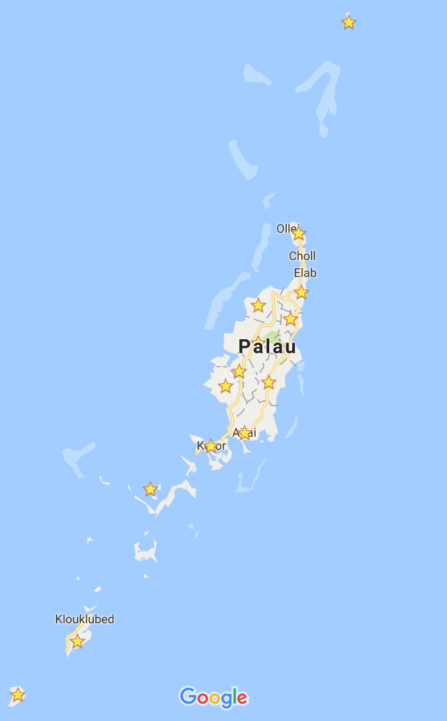
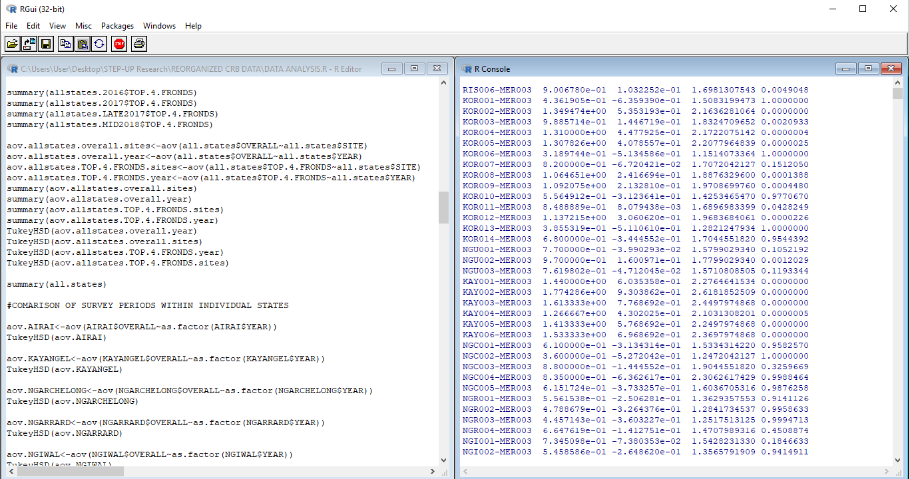
METHODS AND MATERIALS
LOCATING SURVEY SITES AND RECORDED THEIR GPS COORDINATES
RECORDING DAMAGE ASSESSMENT DATA
ANALYZED ASSESSMENT DATA IN R VERSION 3.5.1 VIA ANOVA .

Slide 11
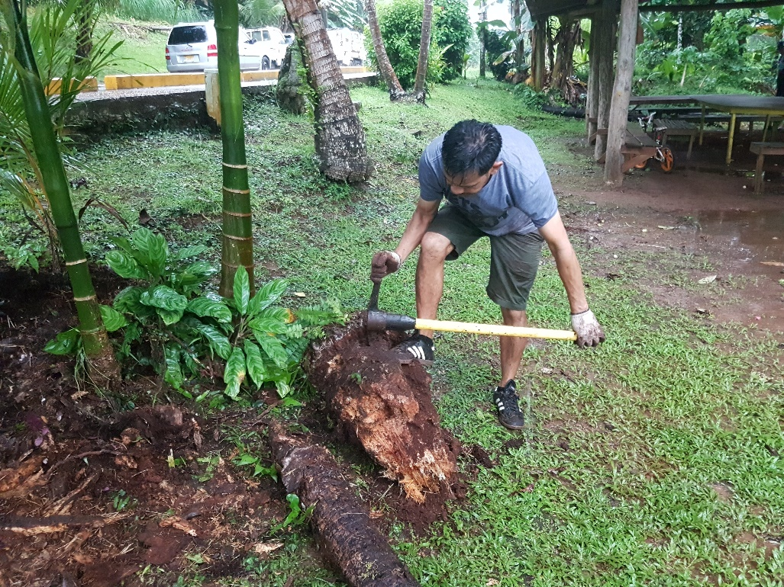
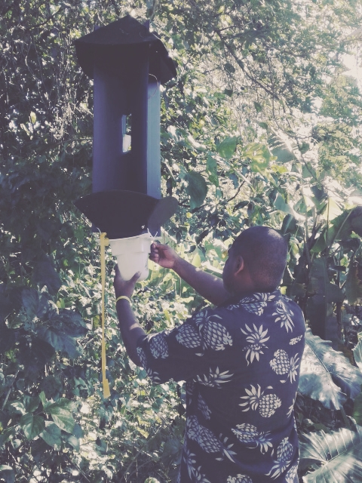
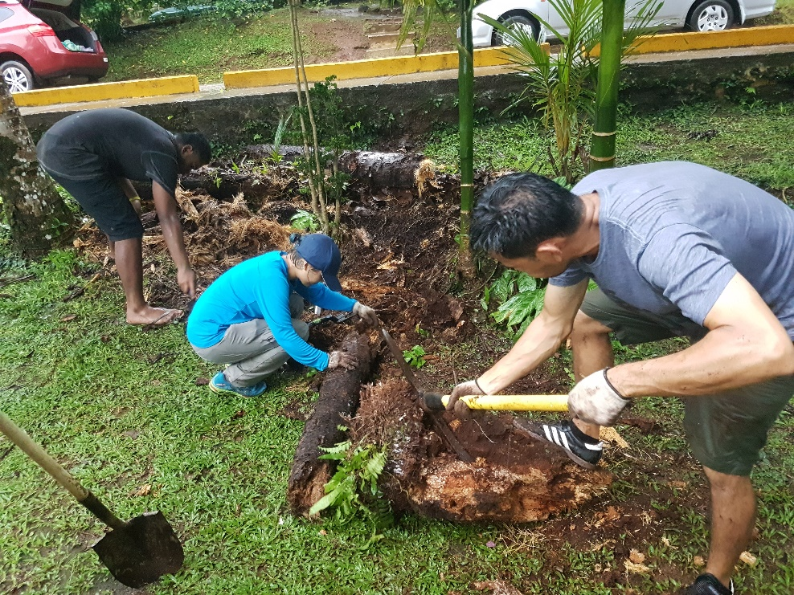
METHODS AND MATERIALS
COLLECTING ADULT CRB SPECIALIZED PHEROMONE TRAPS WITH UV LIGHTS PROVIDED BY UH ARE USED TO CATCH ADULT BEETLES.
USED GLOVES, PICKS, & SHOVELS TO BREAK UP MULCH, ROTTEN COCONUT LOGS, COMPOST PILES TO COLLECT THE CRB LARVAE INSIDE.
DISECTED SAMPLES, DETERMINED BIOTYPES, & DETECTED THE PRESENCE NUDIVIRUS (OrNV)

Slide 12
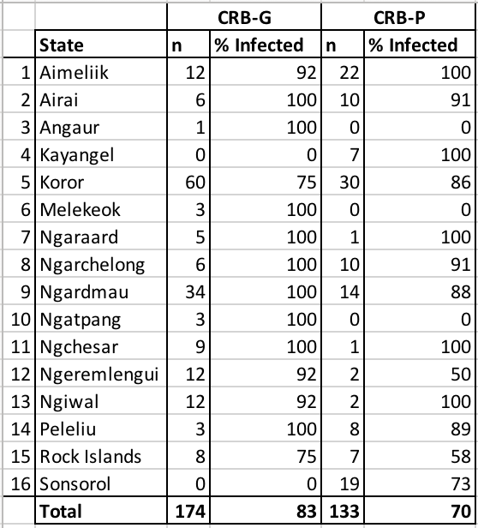
Collected 2015-2017
P-Values for Overall
2017-2016=0.0000000
2017-Late 2017=0.0926417
Late 2017-2018=0.0000000
P-Values for Top 4 Fronds
2017-2016=0.0121349
2017-Late 2017=0.0018246
Late 2017-2018=0.0000000
174 CRB-G
133 CRB-P
83% of CRB-G tested positive for OrNV

Slide 13
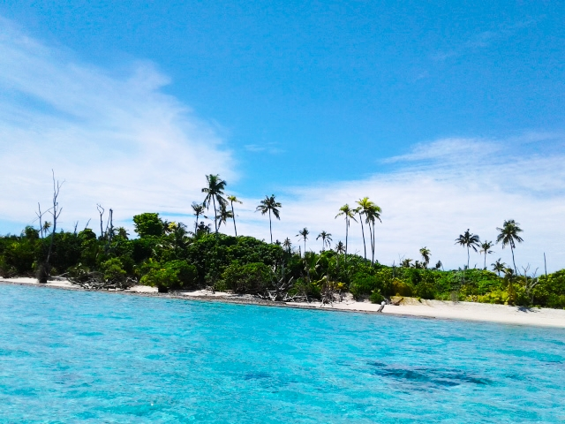
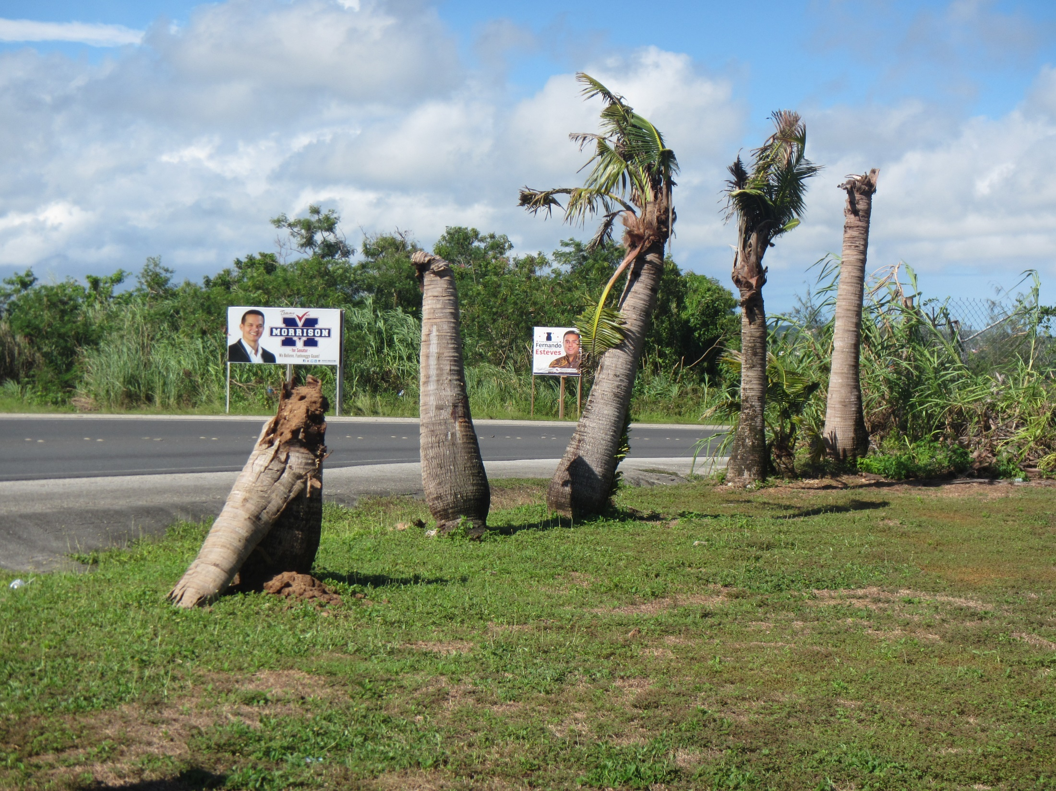
DISCUSSION
Based on the survey we did these past three years, the coconut trees showed slight increase in damage.
The rate of increase of damage to the trees is much lower in Palau compared to other affected countries.

Slide 14
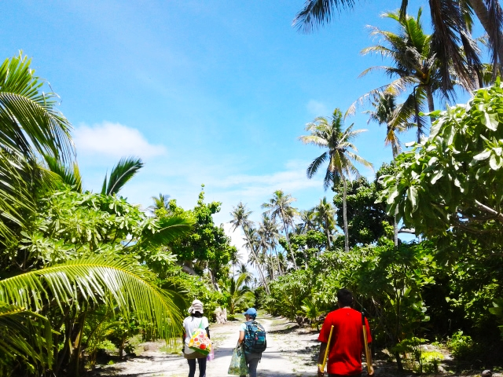
CONCLUSION
These trends in addition to other evidence have led us to believe that cross-breeding between the two bio-types in Palau has made the resistant strain susceptible to the Nudivirus thereby killing them and sparing the coconut trees.

Slide 15
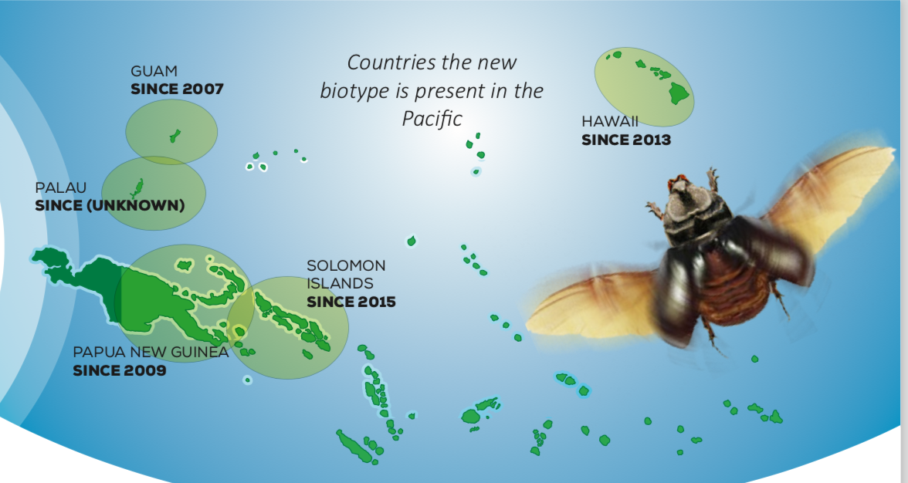
WHAT’S NEXT?
We will raise awareness of CRB.
Share information between countries that are afflicted by CRB.
Take Actions to eradicate this threat through international support & cooperation to solve this problem.

Slide 16
Acknowledgments
STEP-UP
The University of Hawaii
PCC
Dr. Joel Miles
David Mason
Special thanks to Shizu, Mike, & Brandi
Jose, Yaya, Marinca, Jason, & Jesse “PAIR CAMP TEAM”
  Follow us on Facebook PAIR CAMP
  Instagram @ pair.camp #saveournuts

