Slide 1




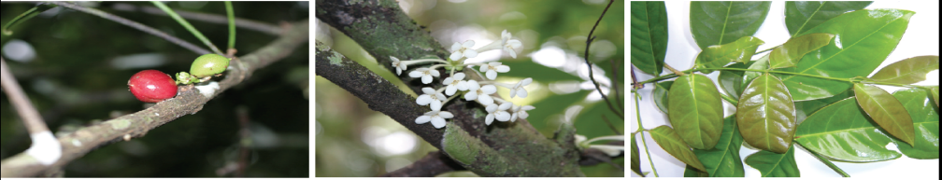
Food Habits Survey & Source Assesment: Republic of Palau
Omreng Aimie Sid Oilouch
Mentors:
Kitalong, Christopher PhD
Akiko Iida, PhD
Pearl Marumoto
PAIR

Slide 2
Contents
Abstract
Objective
Introduction
Materials
Methodology
Results
Conclusion
Bibliography
Acknowledgments

Slide 3
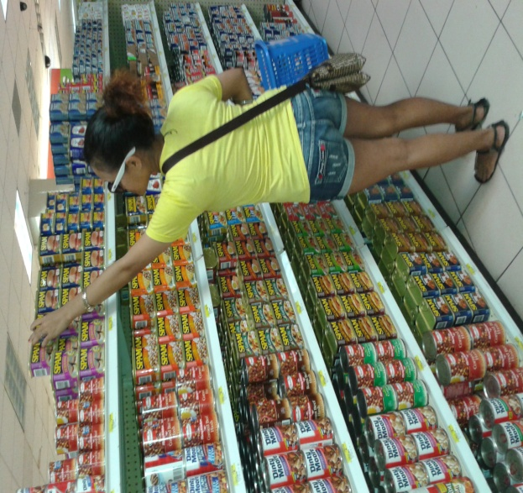
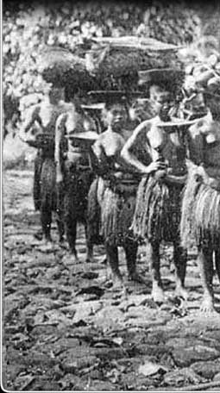
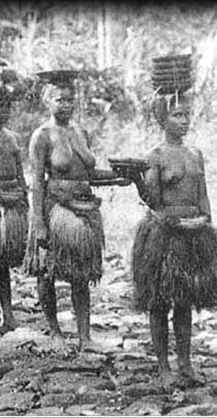
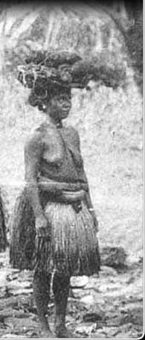
Abstract
Years of foreign influence introduced various diets/lifestyle habits some of which include increase of disease
Surveys were designed to analyze the amount of local/foreign food as well as lifestyle activities.
Surveys were conducted at one of the most rural states, Ngarchelong in 2015, Koror, the most urban/populated state in 2016, and 12 states out of 16 in the span of 2 months.
Approximately 250 surveys have been collected
Preliminary results show more than 70% reliance on outside foods and 50% reduced activity.
Notes:
Over the generations, Palauans have been introduced to foreign lifestyles and diets. As food habits researchers, my team and I conducted a food habits survey all over Palau to examine food sources of the Palauan people, relaince on local and/or imported foods and hopefully find out whether they are correlated to the increase of disease such as Diabetes Type II: Mellitus, which has been one of the leading causes of morbidity in Palau. Over the past three years, we have collected over 250 samples and preliminary results show more than 70% reliance on imnported foods 50% reduced activity.

Slide 4
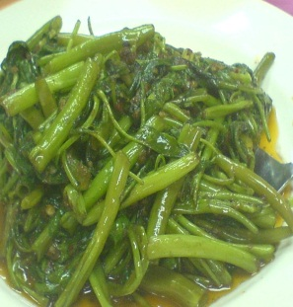
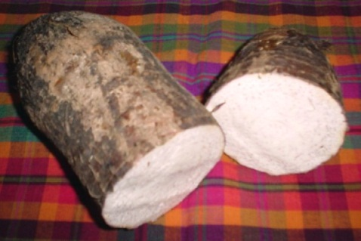
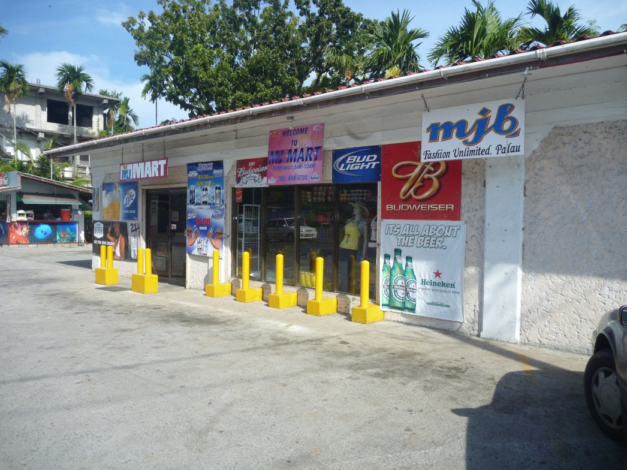
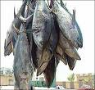
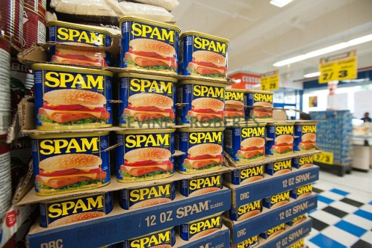
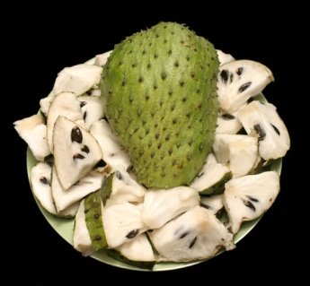

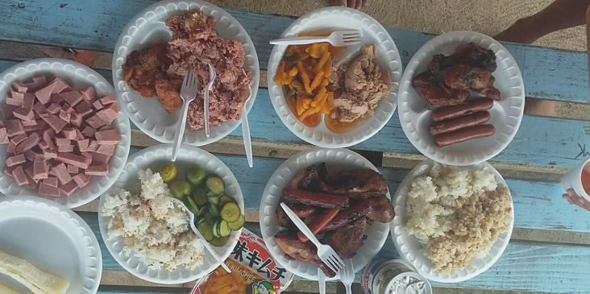
Objective
Analyze drastic changes in the diets of the Palauan people through surveys (Food Habits Survey 2017)
20 households per state (16 states)
#NCDelicious
Notes:
Goal: analyze change in diet 10yrs ago vs. 2015/2016/2017

Slide 5
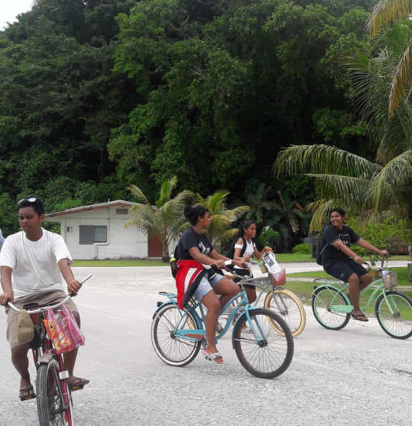
Intro
Summer of 2017: conducted a Food Habits Survey; this survey is a 2-part survey.
The initial survey, the General Information Survey asked about lifestyle activities of the respondent.
The Food Habits Survey is a 7-day meal audit ---breakfast, lunch, snack and dinner.
Notes:
This project which consisted of a two-part survey was founded by Dr. Iida Akiko of Tokyo University in Japan. The first survey asked about basic information such as age, gender, phone number, and number of people living in household and lifestyle activities in general. The second part of the survey is a food journal they would keep at for 7 days.

Slide 6
Materials
2015 & 2016
2017
PC tablets (20 count) distributed by Tokyo University
Surveys were uploaded onto the tablets on Excel spreadsheets
Paper-based surveys (also provided by Tokyo University) were used as backup
Paper-based surveys designed by the STEP-UP survey team (Food Habits pamphlets and General Info Surveys)
Notes:
Dr. Akiko was also the provider of our survey tools which include 20 PC tablets which were great for the project because they allowed surveyees to take pictures of their meals for a more developed review of the surveys. and 20 paper-based surveys for back-up throughout 2015-2016. During the summer of this year, we started to use paper-based materials

Slide 7
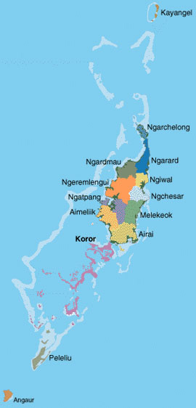
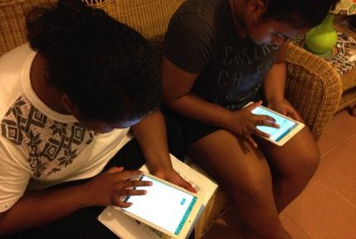
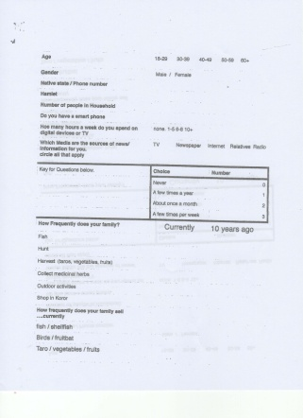
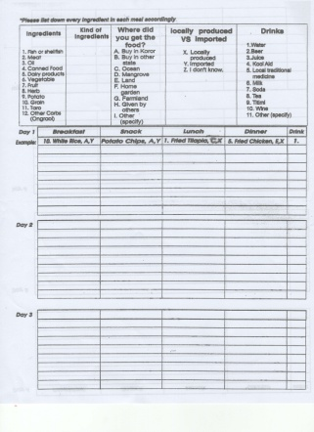
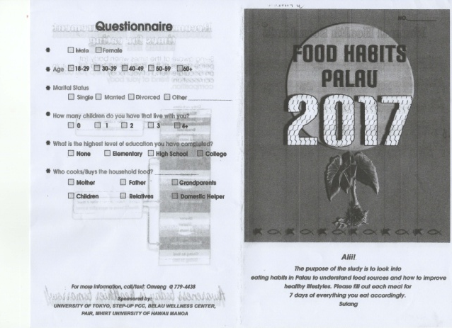

Methodology
2015 & 2016
2017
20 PC tablets
Ngarchelong and Koror
collected 7 days later
Paper-based
12 states
collected 7 days later
Notes:
Dr. akiko and leah hit 2 states, 2017 – 12 states out of 16. By switching to paper-based surveys instead of PC tablets, it enabled us to distribute numerous surveys in dispersed locations in a short period of time instead of waiting for the first 20 respondents to finish their 7 day meal audit. Convenience for head of household

Slide 8
How frequently does your family fish?
Ngarchelong
(RURAL)
Koror
(URBAN)

Slide 9
How frequently does your family go shopping in Koror?
Ngarchelong
(RURAL)
Koror
(URBAN)

Slide 11
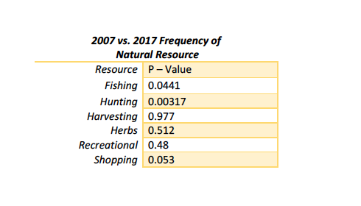
Differences between 2007 and 2017
Notes:
fishing.aov<-aov(FoodSurvey$FISHING~FoodSurvey$YEAR)
> summary(fishing.aov)
Df Sum Sq Mean Sq F value Pr(>F)
FoodSurvey$YEAR 1 7.2 7.203 4.084 0.0441 *
Residuals 347 612.1 1.764
---
Signif. codes: 0 ‘***’ 0.001 ‘**’ 0.01 ‘*’ 0.05 ‘.’ 0.1 ‘ ’ 1
> hunting.aov<-aov(FoodSurvey$HUNTING~FoodSurvey$YEAR)
> summary(hunting.aov)
Df Sum Sq Mean Sq F value Pr(>F)
FoodSurvey$YEAR 1 9.2 9.160 8.828 0.00317 **
Residuals 347 360.0 1.038
---
Signif. codes: 0 ‘***’ 0.001 ‘**’ 0.01 ‘*’ 0.05 ‘.’ 0.1 ‘ ’ 1
> harvesting.aov<-aov(FoodSurvey$HARVESTING~FoodSurvey$YEAR)
> summary(harvesting.aov)
Df Sum Sq Mean Sq F value Pr(>F)
FoodSurvey$YEAR 1 0.0 0.0019 0.001 0.977
Residuals 347 813.7 2.3451
>
> herbs.aov<-aov(FoodSurvey$HERBS~FoodSurvey$YEAR)
> summary(herbs.aov)
Df Sum Sq Mean Sq F value Pr(>F)
FoodSurvey$YEAR 1 0.9 0.8889 0.431 0.512
Residuals 345 711.9 2.0636
2 observations deleted due to missingness
> recreational.aov<-aov(FoodSurvey$RECREATIONAL~FoodSurvey$YEAR)
> summary(recreational.aov)
Df Sum Sq Mean Sq F value Pr(>F)
FoodSurvey$YEAR 1 0.9 0.8658 0.499 0.48
Residuals 346 600.1 1.7345
1 observation deleted due to missingness
> shopping.aov<-aov(FoodSurvey$SHOPPING~FoodSurvey$YEAR)
> summary(shopping.aov)
Df Sum Sq Mean Sq F value Pr(>F)
FoodSurvey$YEAR 1 3.42 3.422 3.77 0.053 .
Residuals 346 314.01 0.908
---
Signif. codes: 0 ‘***’ 0.001 ‘**’ 0.01 ‘*’ 0.05 ‘.’ 0.1 ‘ ’ 1
1 observation deleted due to missingness

Slide 12
Challenges
Surveying
  Difficult to collect completed 7 day survey as people:
    Forget to complete
    Misplaced Surveys
    Difficulty in understanding instruction
Data Analysis
  Quality of Data
    Reduced information, not complete ingredients
    States do not have 20 households
    Slowed by learning curve of data entry and analysis methods

Slide 13
So We Know…
Non-Communicable Diseases (NCDs) are the leading causes of morbidity and mortality in the United States Affiliated Pacific Islands (USAPIs) (American Samoa, Guam, Commonwealth of the Northern Mariana Islands [CNMI], Federated States of Micronesia [FSM], Republic of Palau, and the Republic of Marshall Islands [RMI]) [1]
NCD Hybrid Survey 2017 ROP
  There needs to be a focused study on the amount of agriculture and fisheries products made in Palau and where these resources are being sent/consumed in order to figure out how to best increase or annex local production.
  increase in awareness and support of consumption of healthy local foods
So We Think …
“Awareness Today is a Healthier Tomorrow!”
- Leah and Omreng
Notes:
Land management
government policies

Slide 14
What’s Next?
Analyze collected surveys during Summer 2017
Increase sample size as quantity increases quality of result will increase
Utilize results to compare with import data to analyze internal production.

Slide 15
Bibliography
WHO. Risk factors: Adult risk factors. 2008 ed: WHO; 2011.
2. WHO. WHO | Country and Regional Data. WHO; 2000.
3. Auwerx J. PPARgamma, the ultimate thrifty gene. Diabetologia 1999;42:1033-49.
4. Baig U, Belsare P, Watve M, Jog M. Can Thrifty Gene(s) or Predictive Fetal Programming for Thriftiness Lead to Obesity? Journal of obesity 2011;2011:861049.
5. Booth FW, Chakravarthy MV, Gordon SE, Spangenburg EE. Waging war on physical inactivity: using modern molecular ammunition against an ancient enemy. Journal of applied physiology 2002;93:3-30.
6. Coleman DL. Obesity genes: beneficial effects in heterozygous mice. Science 1979;203:663-5.
7. Cooper R. Diabetes and the thrifty gene. Lancet 1994;344:1648.
8. DiPatrizio NV, Piomelli D. The thrifty lipids: endocannabinoids and the neural control of energy conservation. Trends in neurosciences 2012;35:403-11.
9. Goh KP, Sum CF. Connecting the dots: molecular and epigenetic mechanisms in type 2 diabetes. Current diabetes reviews 2010;6:255-65.
10. Goustin AS, Abou-Samra AB. The "thrifty" gene encoding Ahsg/Fetuin-A meets the insulin receptor: Insights into the mechanism of insulin resistance. Cellular signalling 2011;23:980-90.
11. Khamaisi M, Raz I. Diabetes epidemic and the thrifty gene. The Israel Medical Association journal : IMAJ 2002;4:720-1.
12. Knight C. "Most people are simply not designed to eat pasta": evolutionary explanations for obesity in the low-carbohydrate diet movement. Public understanding of science 2011;20:706-19.
13. Myles S, Lea RA, Ohashi J, et al. Testing the thrifty gene hypothesis: the Gly482Ser variant in PPARGC1A is associated with BMI in Tongans. BMC medical genetics 2011;12:10.
14. Ritenbaugh C, Goodby CS. Beyond the thrifty gene: metabolic implications of prehistoric migration into the New World. Medical anthropology 1989;11:227-36.
15. Speakman JR. Thrifty genes for obesity, an attractive but flawed idea, and an alternative perspective: the 'drifty gene' hypothesis. International journal of obesity 2008;32:1611-7.

Slide 16

Acknowledgements
Tokyo University, Akiko Iida, PhD
Pacific STEP-UP, George Hui, PhD
PAIR, Christopher Kitalong, PhD
Belau Wellness Center, Pearl Marumoto
Belau Medical Clinic, Inc. ,Victor Yano, PhD
PCC Upward Bound, Larry Wakakoro
Survey Team ☺

Slide 17
Kom Kmal Mesulang!
Thank You Very Much!
Any Questions?

