Slide 1
Mapping Snail Spatial Distribution in Guam’s Rivers
Anna Katrina E. Aragon
Academy of Our Lady of Guam
Hagatna, Guam 96910 , USA
Mentor:
Timothy Righetti, Ph.D.
Department of Biology
University of Guam
Mangilao, Guam 96923, USA

Slide 2
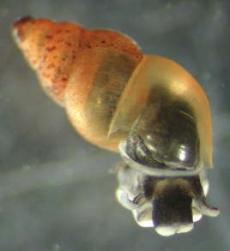
Introduction: Snails
Hydrobiidae is a family of snails also commonly known as the mud snail.
These mud snails can live in both fresh water and brackish water, making them capable of living in diverse environments.

Slide 3
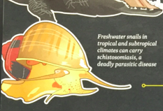
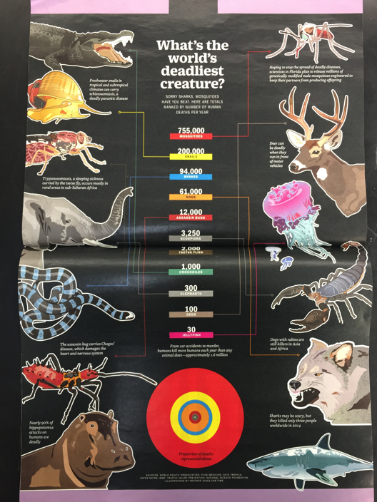
“Freshwater snails in tropical and subtropical climates can carry schistosomiasis, a deadly parasitic disease”
Affects over 2 million people, initially infecting urinary tract and intestines, and can lead to liver damage and kidney failure.

Slide 4
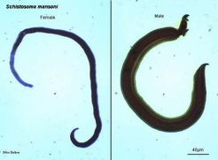
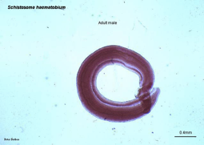
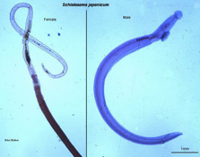
Schistosomiasis
Also known as bilharzia or “snail fever”
Transmitted by contact with snails that carry any one of the five varieties of schistosoma, the deadly parasite.
Larvae emerge from the snails and remain in the water until it comes into contact with, and eventually penetrates, the skin.
Male and female worms then remain in the individual’s blood vessels.

Slide 5
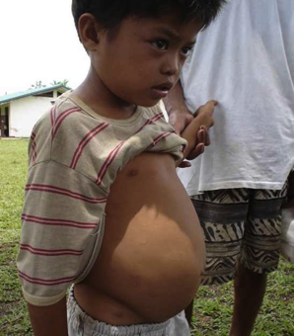
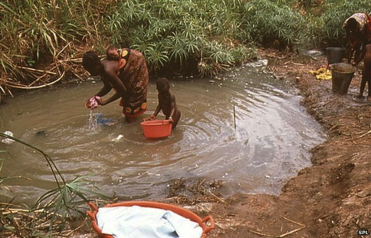
Prevention and Treatment
Eliminate water snails in water reservoirs
Vaccines are still in its early developing stages
Treatment includes taking Praziquantel, a prescription medication.

Slide 6
Understanding the factors that are important in snail distribution are crucial for the future management of schistosomiasis.
Another goal in my research is to help create laboratory modules that can be used in the Department of Biology’s introductory BI 157L and BI 158L
These labs use sophisticated but free open-source software.

Slide 7
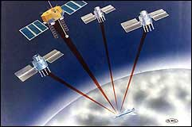
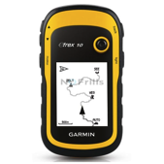
Introduction: Mapping
Global Positioning Systems (GPS) work using the mathematical concept known as trilateration.
Geographic Information Systems (GIS) are designed to store, analyze, and present all types of spatial or geographical data.
Ex. QGIS: Quantum Geographic Information System

Slide 8
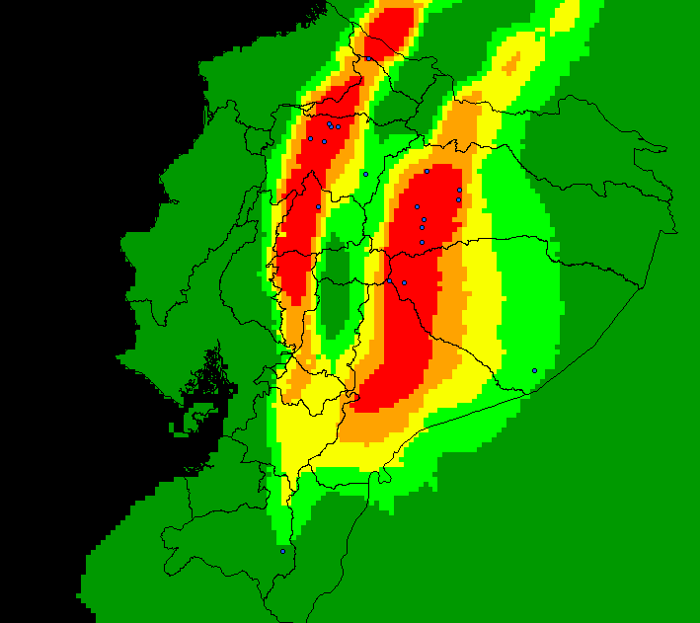
Introduction: Mapping
Snail distributions have been mapped in the past. We will use similar techniques as we sample five locations from bank to bank at 100m intervals.

Slide 9
Objectives
To determine the distribution of Hydrobiidae in three different rivers on Guam
Map their distribution using QGIS
Learn how the distribution changes in relation to environmental factors such as: pH, electrical conductivity (EC), and water depth.

Slide 10
Hypothesis
We expect snail population from the middle of the river to be less than that from the river’s shores; this is because of the salt deposits found in the middlemost areas of the river, causing pH and EC levels to peak and therefore account for the decrease of snails.

Slide 11
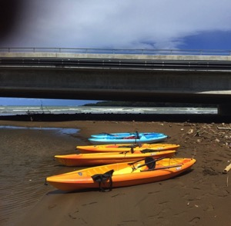
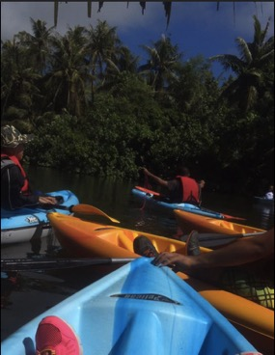
Materials and Methods
Kayakers travel through each of the three rivers and at 100m intervals form a straight line which stretches across the river’s width.
GPS coordinates and depth are recorded while mud samples are collected underneath each kayak.
Each sample is stored and later sieved for snails. This count (several genera) will then be illustrated by creating a distribution map on QGIS.
Once the snails are counted, the river sediment is tested for pH and EC.

Slide 12
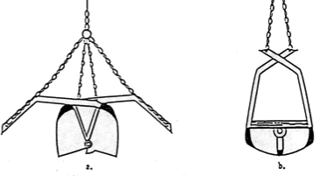
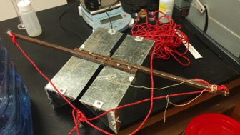
Results
Data collection is ongoing
Preliminary results suggest that there are many ecosystems within a river
We have developed a sampling protocol
There are differences in snail distribution according to preliminary experiments
We expect to determine the distribution of Hydrobiidae in rivers on Guam
We will be able to determine the relationship between environmental factors (pH, electrical conductivity (EC), and water depth) with snail distribution.

Slide 13
Results
Preliminary results suggest that the ecosystems drastically vary from shore to shore.

Slide 14
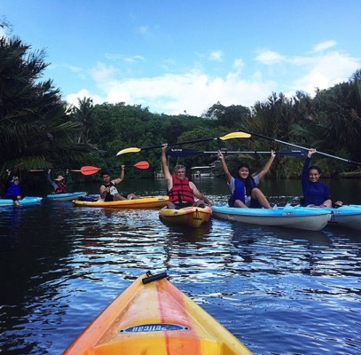
QUESTIONS?
A big thank you to the research team:
Dr. Timothy Righetti
Catherine Nguyen
Christina Nguyen
Daniel Salas
Gibson Lopez
Marcel Jardeleza
Archie Matta, Jr.
John Paul Batarao
Shao Wang

