Slide 1
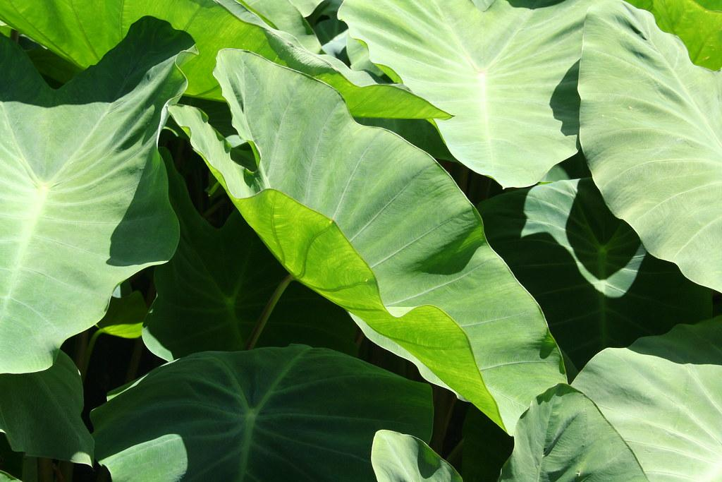
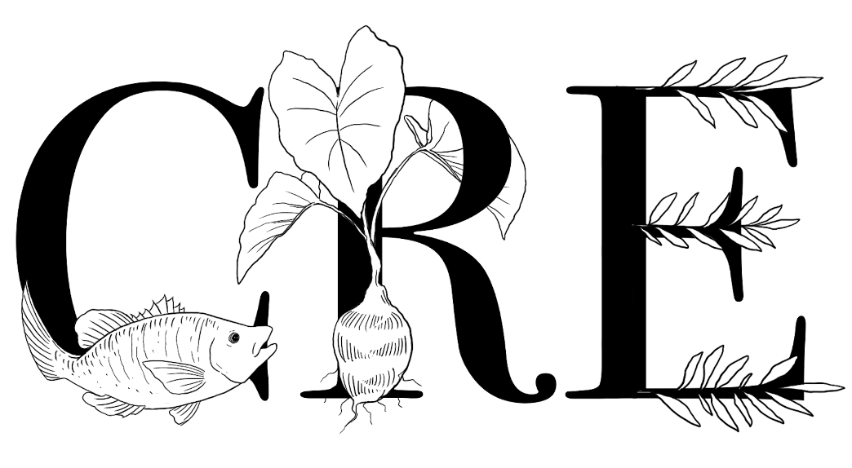
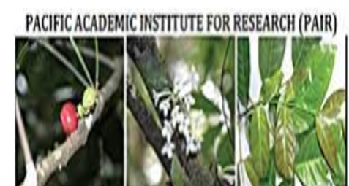
TISSUE CULTURE AND FIELD COMPARISON OF SALT WATER RESISTANT TARO
Limei R. Orukei
Mentors: Christopher Kitalong, PhD, Palau Community College - CRE, Elchung G. Hideyos, MA, Palau Community College-CRE, Emengel Singich, Palau Community College-CRE, Sayaka Naito, Palau Community College – CRE, Marinca Faimau, Northern Arizona University, Jack Layton Pacific Academic Institute for Research

Slide 2
OBJECTIVES:
Background Info
Introduction
Hypothesis & Question
Methods
Results
Conclusion
Future Directions
References
Acknowledgements & Funding

Slide 3
BACKGROUND INFO:
Taro is a traditional and staple food for us Palauans as well as the Pacific.
My previous research showed that collected varieties from the field had varying degrees of saltwater tolerance in a lab setting.
Not all taro are able to grow on taro patches that are affected by the saltwater and determining which collections are is important to understanding innate saltwater tolerance in varying edible Araceae in Palau.
Identify which taro varieties are able to grow in the taro patches with varying levels of salinity.

Slide 4
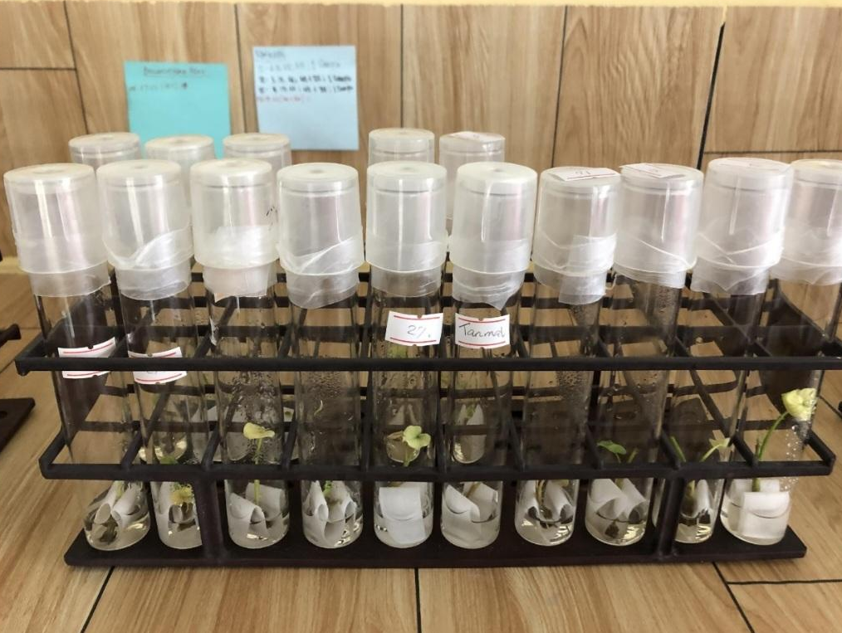
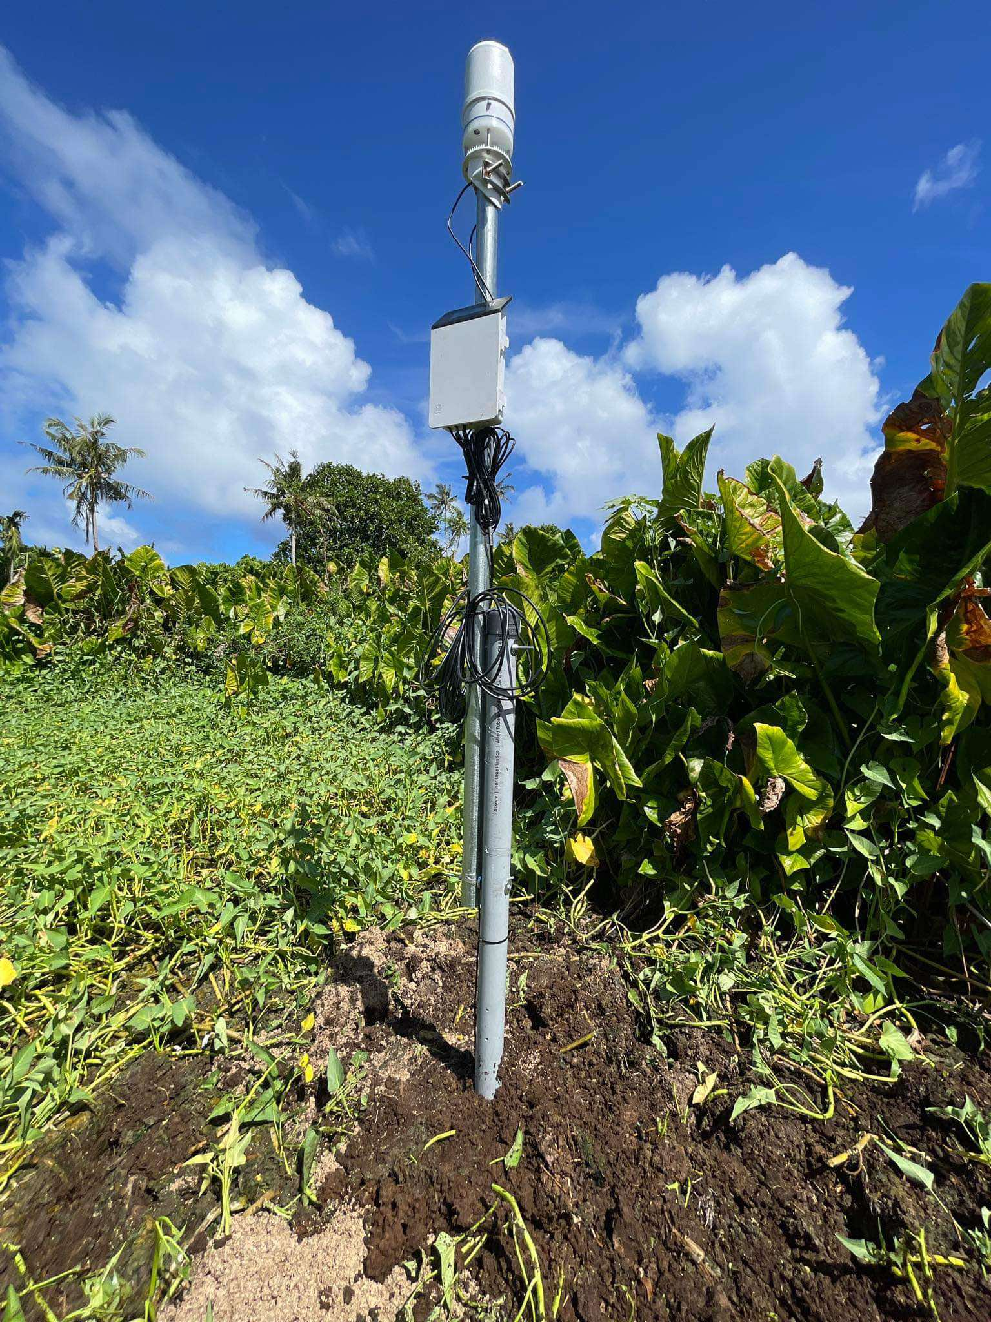
INTRODUCTION:
Instead of doing lab activities, which was done in the previous research project and is continued by my colleague, I'm doing a research within collecting data and analyzing which types of taro are thriving.
With the weather station system known as soil probe it helps me gather the data within the taro patch to help me analyze and identify which taro varieties are able to grow and are present in taro patches affected by the sea level rise.
Although there are many taro varieties in Palau , not all of them are able to survive in places that have high soil salinity.
In some places, there are different ways to grow taro plants because of these problems where climate change is taking over causing the sea level to rise and where the taro patches are located.

Slide 5
HYPOTHESIS: RESEARCH QUESTION:
The research on soil assessment, data collection and DNA Extraction to find salt resistant genes that are able to grow within the salt water affected areas.
How we can use soil probe data to identify which taro varieties are thriving in higher Electrical Conductivity (EC)?

Slide 6
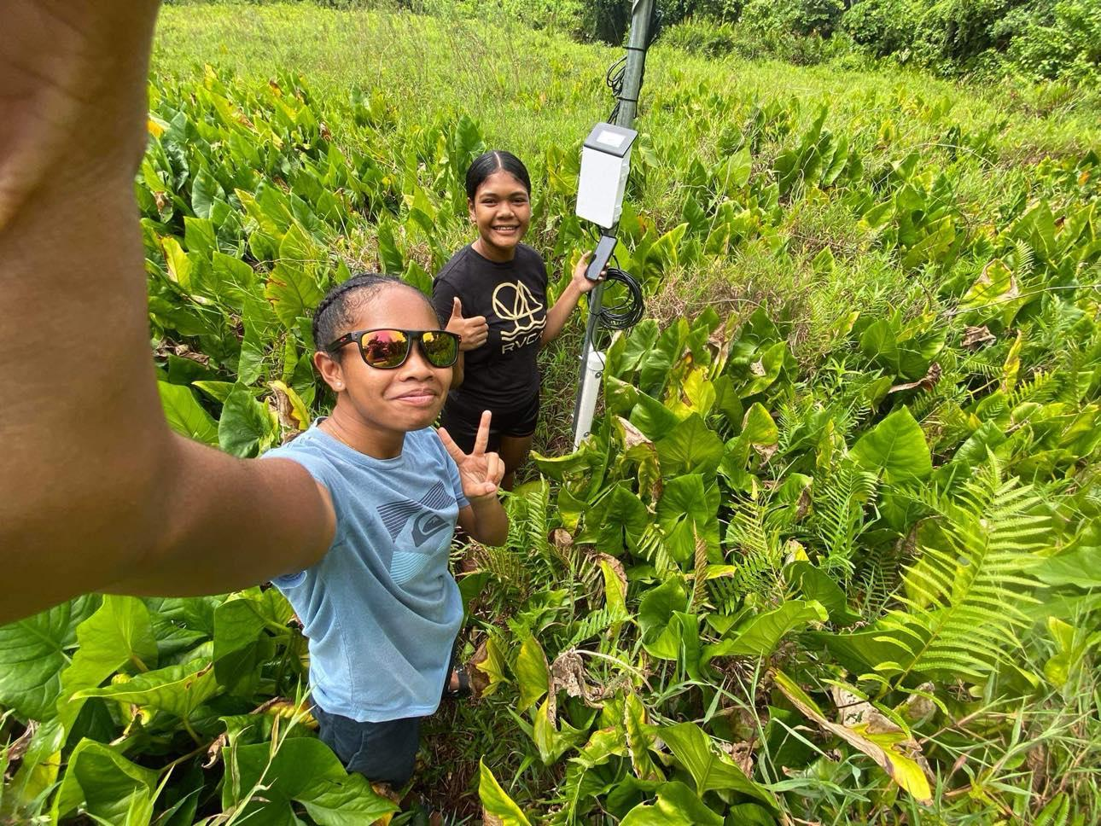
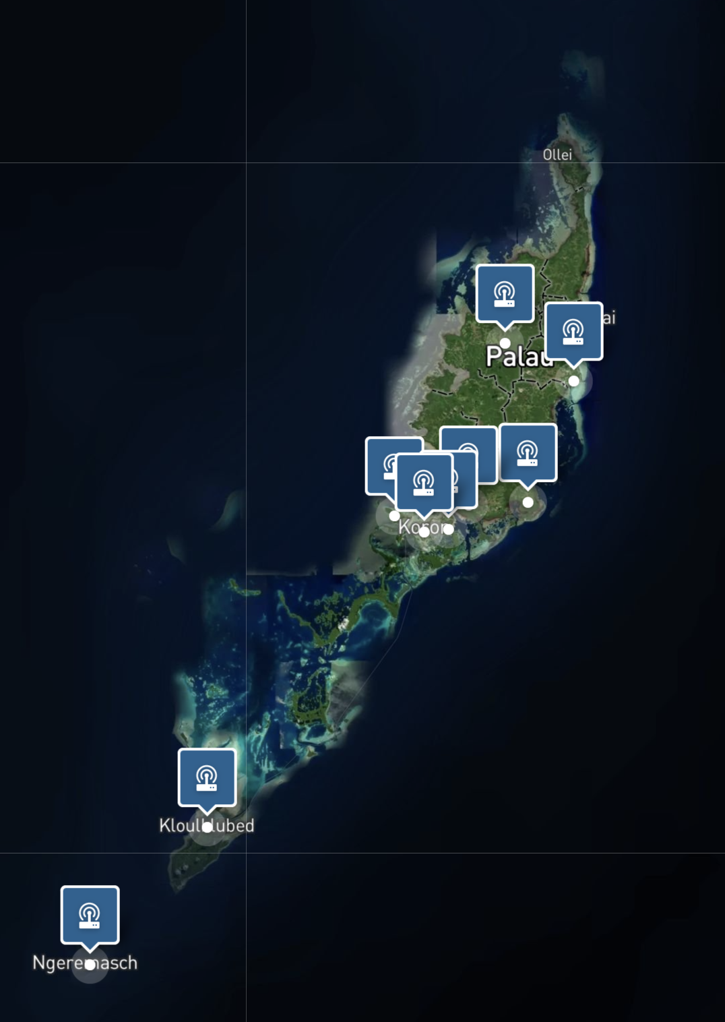
MATERIALS / METHODS:
Soil Probes
Data Collection
Data analysis
And see what types of taro plants are present in the taro patch.
Interviews
Data collection site:
Hatohobei
Peleliu
Ngermeskang, Ngeremlengui
Ngerbeched, Koror

Slide 7
RESULTS
Hatohobei
Peleliu
Ngermeskang, Ngeremlengui
Ngerbeched, Koror

Slide 8
TYPES OF TARO VARIETIES IN PALAU & PRESENT IN THE PLACES INVOLVED IN THE STUDY:
Local Varieties:
Dilisor
Dirrauosech
Dirratengadik
Dirrubong
Dois
Dungersuul
Dung Ra Terrekakl
Erderid
Esuuch
Homusted
Kerdeu
Kirang
Meltalt
Merii
Miuako Ngkeklau
Miuako Ouberburs
Ngermekeang
Ngertmau
Ngeruuch
Ngesuas
Ngetmadei
Ochab
Ochelochel
Ordiil
Okelang becheleleu
Renged
Terebkul
Terrekakel
Thomas
Ungil dil
Urungel
Ulechem
Introduced
Varieties:
Hawaii 12
Hawaii 26
Hawaii 37
Samoa 10
Samoa 12
Samoa 44
Samoa 111
Samoa 114
Samoa 115
Samoa 116
Samoa 128
Samoa 151
Indonesia 14
PNG 3
Malaysia 12
Malaysia 14
Other Varieties:
Hawaii 15
Tiger
Tewehiyeh (Local Tobi Taro)
Hatohobei | Peleliu | Ngermeskang | Ngerbeched
Hawaii 15 Tiger Tewhiyeh (local Tobi Taro) | Ngesuas Kirang | Ungildil Dois Dirrubong Dirrauosch Ngesuas Dungersuul Ochab Terrekakl Kirang Hawaii 12 | Ngesuas Kirang
Comparing with these 4 site Brak known as Alocasia or Giant taro, Kirang and the Ngesuas taro are present. The state of Hatohobei and Peleliu are the mostly affected by the sea level rise and it shows Ngesuas and Kirang are thriving.

Slide 9
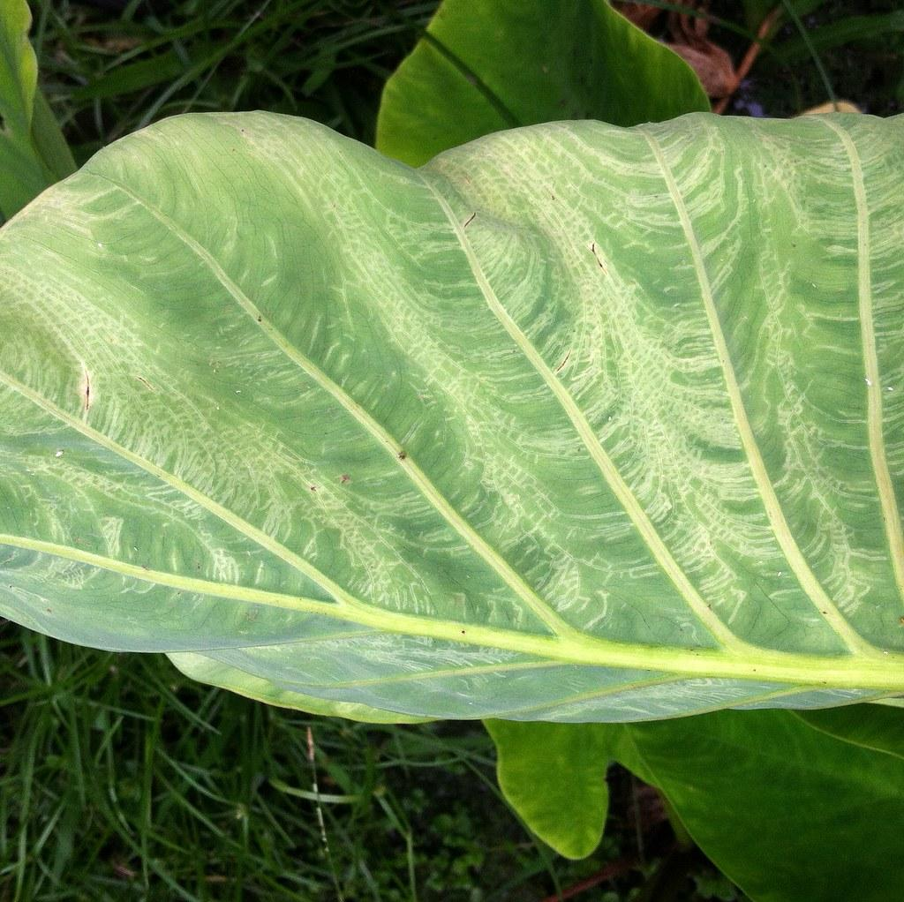
CONCLUSION
With data analysis and field comparison it shows that there are some taro plants that are present and thriving in taro patches that are affected by the sea water (sea level rise). It has been found that Ngesuas is one of the taro plant that can survive in taro patches that are affected by the sea level rise. In some places with really high salinity, it doesn’t really show which taro are present as they may not have enough rainfall to balance out the salinity of the soil. In places like Koror and Babeldaob, even though they may be affected by the sea level rise, the taro is able to grow as there is proper drainage and rainfall, which balances out the soil salinity.

Slide 10
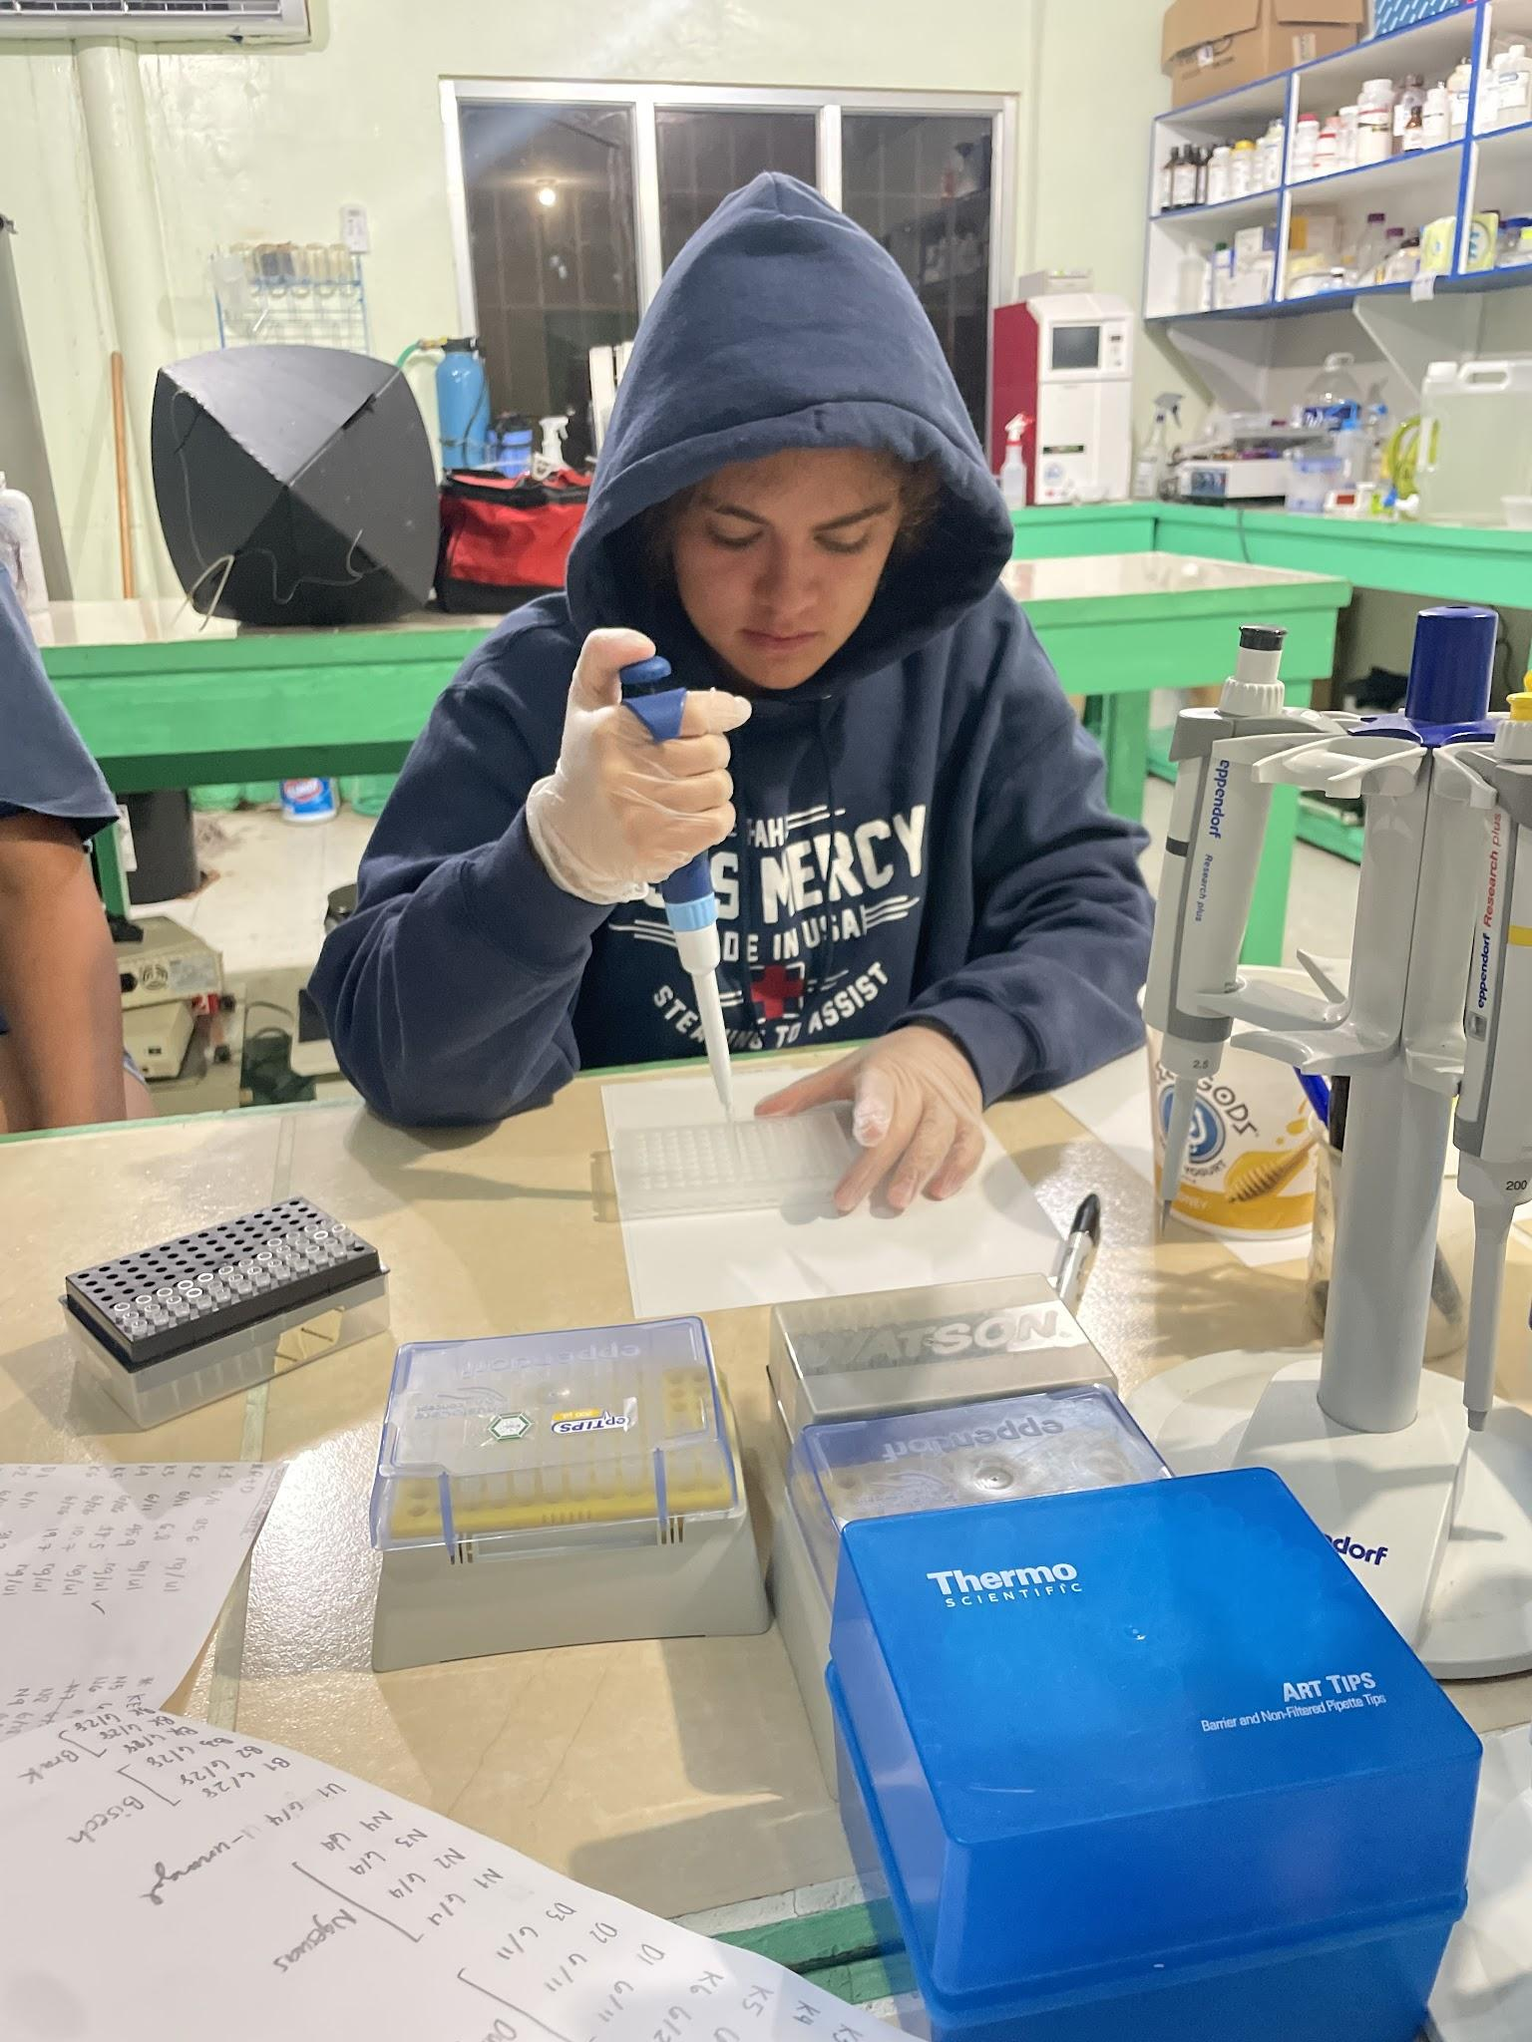
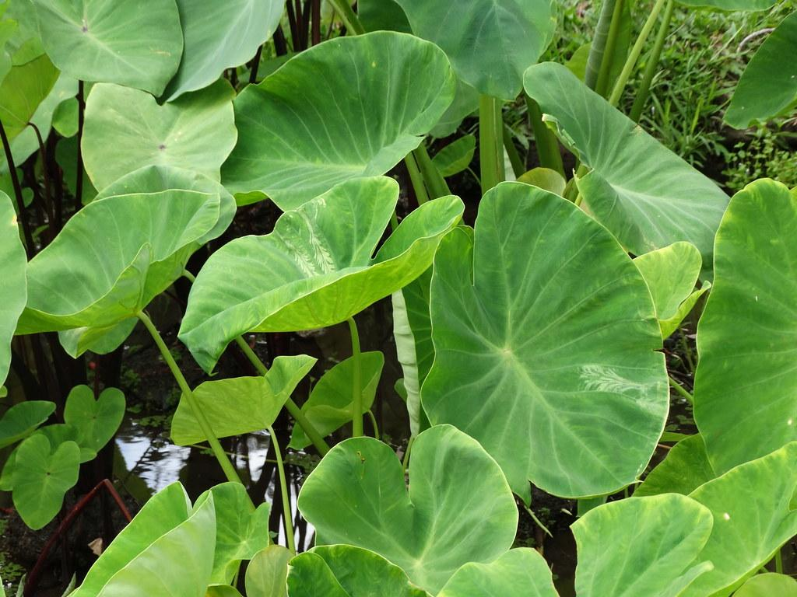
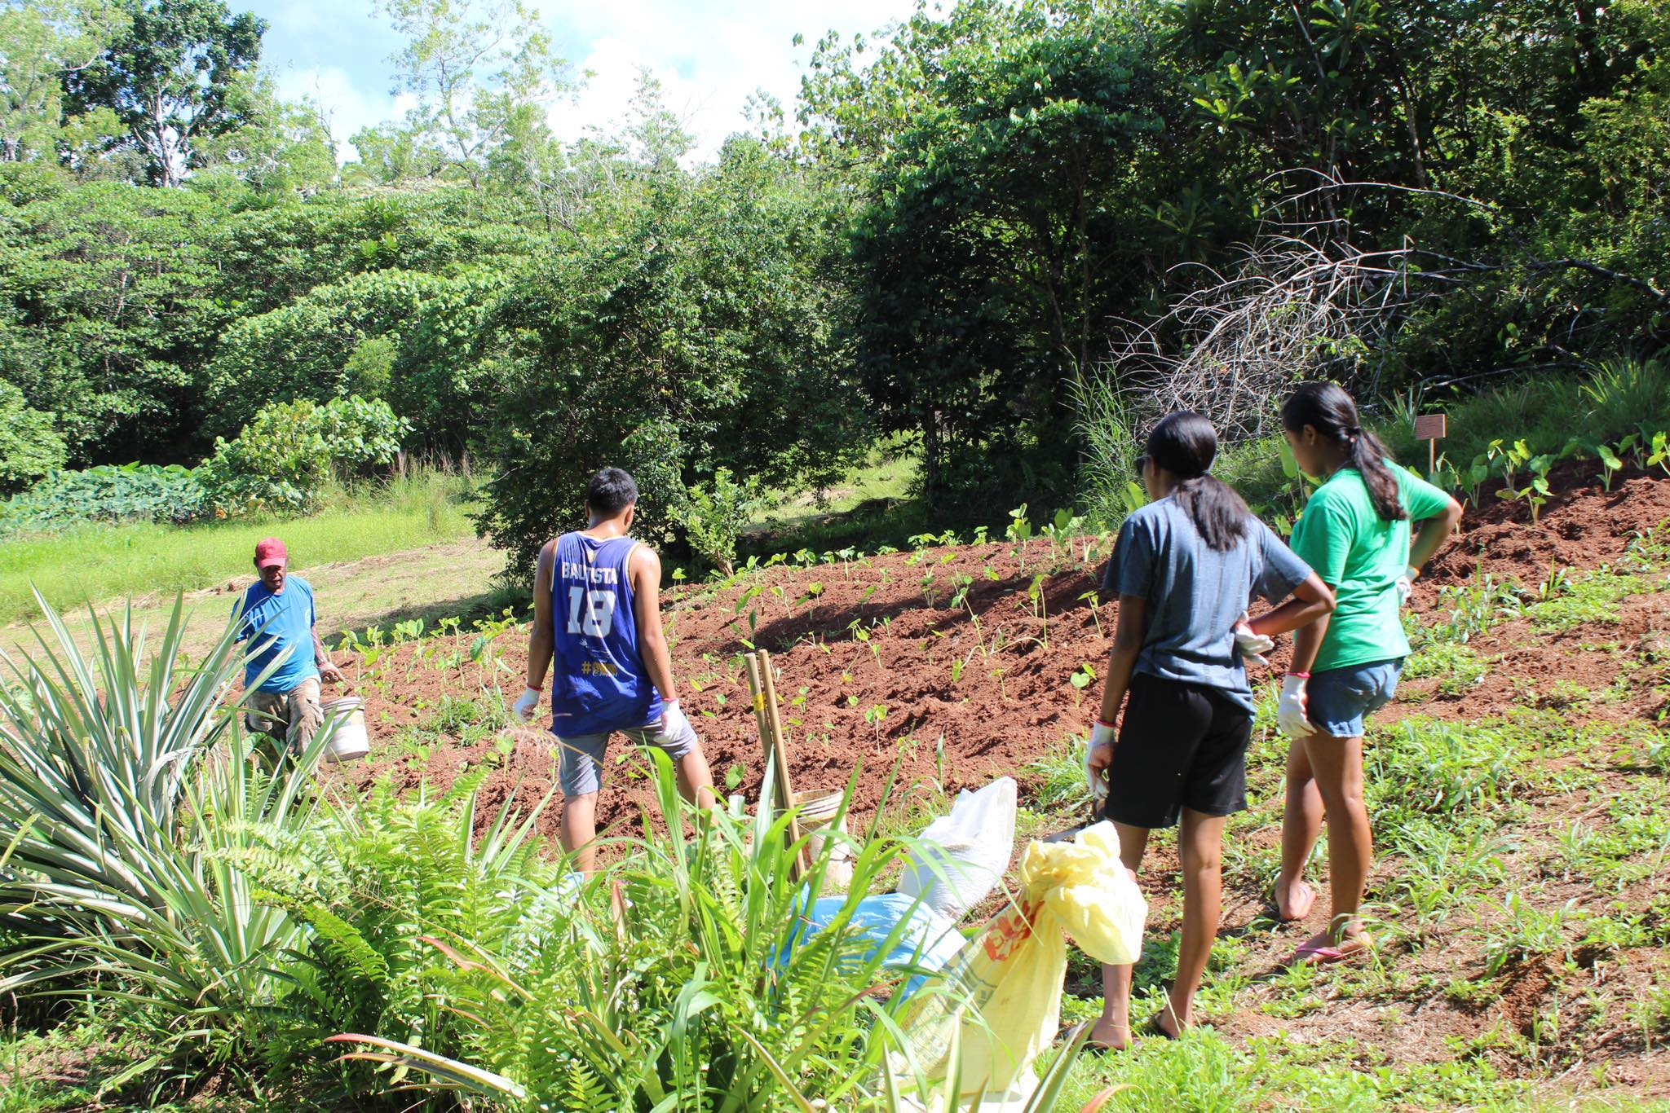
FUTURE DIRECTIONS
Plant taro varieties that are present in taro patches that are affected by saltwater inundation.
Improve drainage system to match traditional methods.
Conduct field tests on salt resistant taro varieties with relation to salinity in field.
Conduct DNA Extractions on salt water resistant taro to identify genes linked to this phenomenon (Presented by my STEP-UP colleague Ava Planz).
Taro Involved in the DNA Extraction Study:
Kirang (Colocasia)
Brak (Cyrtosperma)
Bisech (Alocasia)
Ngesuas (Colocasia)
Samoan (Colocasia)
Ngetmadei (Colocasia)
Monitor soil assessment, and ground water status.

Slide 11
REFERENCES ACKNOWLEDGEMENT
Tissue Culture Lab Agriculture Research and Development Station
Palau Community College-Cooperative Research and Extension
College of Micronesia Land Grant USDA NIFA
G., A., Rosario, N., & Esguerra, T. (2015). Taro Production In Palau (1st ed., Vol. 1). Palau Community College.
The STEP-UP HS program is supported by the National Institute of Diabetes and Digestive and Kidney Diseases of the National Institutes of Health, Grant Number: 5R25DK078386-18

