Slide 1
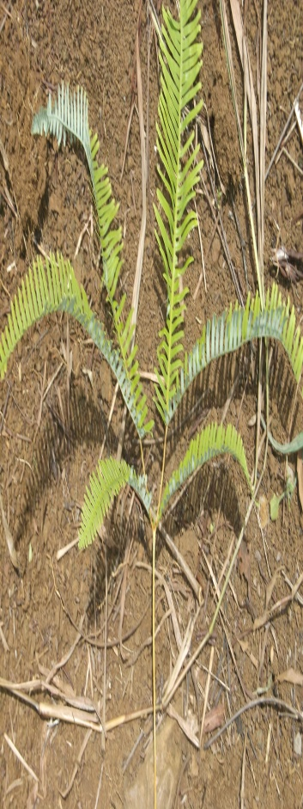
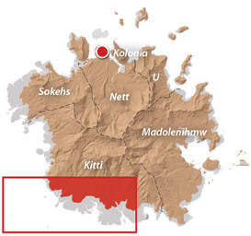
Natural and Artificial Rehabilitation of Degraded Soils (Mal) of Pohnpei island, FSM
Macmillan Willyander , Pohnpei
Our Lady of Mercy Catholic High School
Mentor: Dr. Nat Tuivavalagi

Slide 2
Introduction
“Mal” is the Pohnpeian word for barren or degraded soil, too poor to support crop growth
Occupies at least 15% of land in Pohnpei (Ioanis, 2015).
It has been controversial whether these mal soils could be made productive.
A few studies have clearly indicated that the mal lands could be rejuvenated, however, no management strategy has been properly documented or widely known to the local farmers thus leading to the continuing destruction of virgin forests whenever new land is needed for agriculture, while mal lands remain idle
Rather than clearing virgin forests for use of agriculture, we should utilize the currently unproductive and unutilized degraded mal lands that currently cover huge areas of the main island of Pohnpei.

Slide 3
Objective & Hypothesis
Objective
Hypothesis
To determine whether there has been some rehabilitation of mal soil.
It was hypothesized that some mal of Pohnpei have been transformed and rehabilitated both naturally and artificially into productive soils.

Slide 4
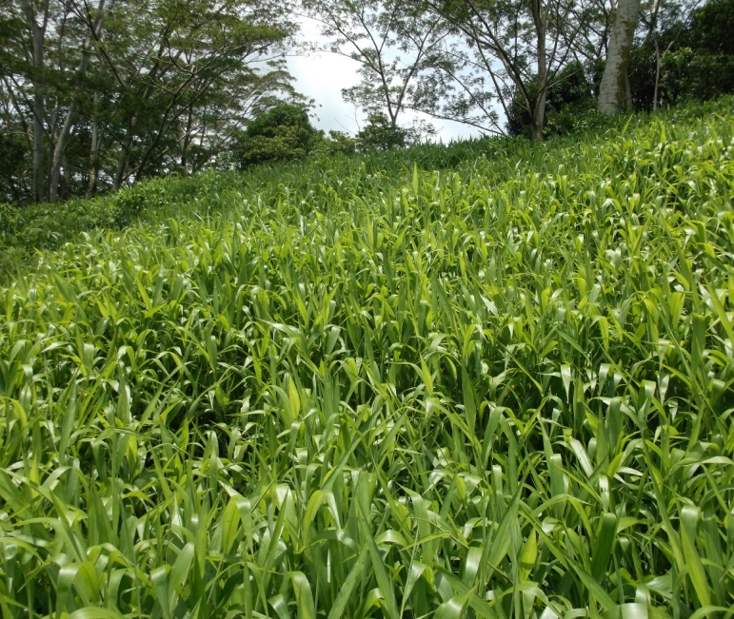
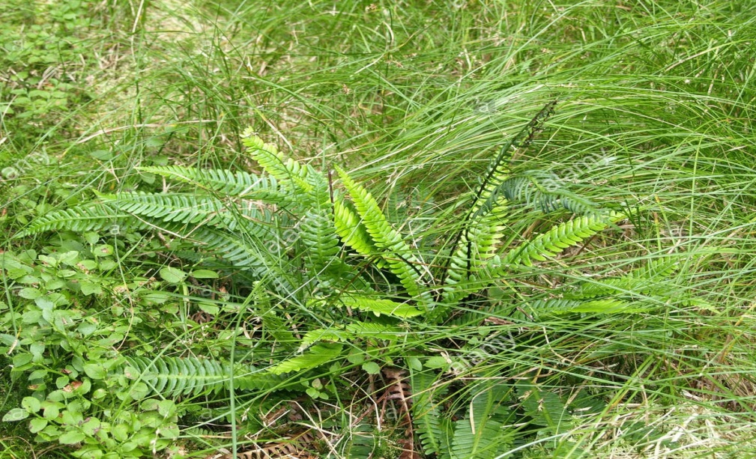
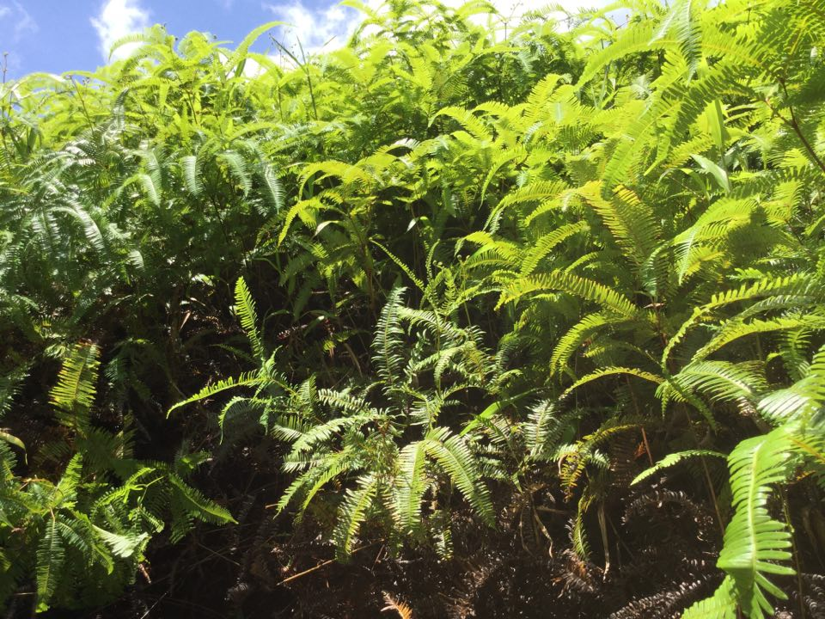
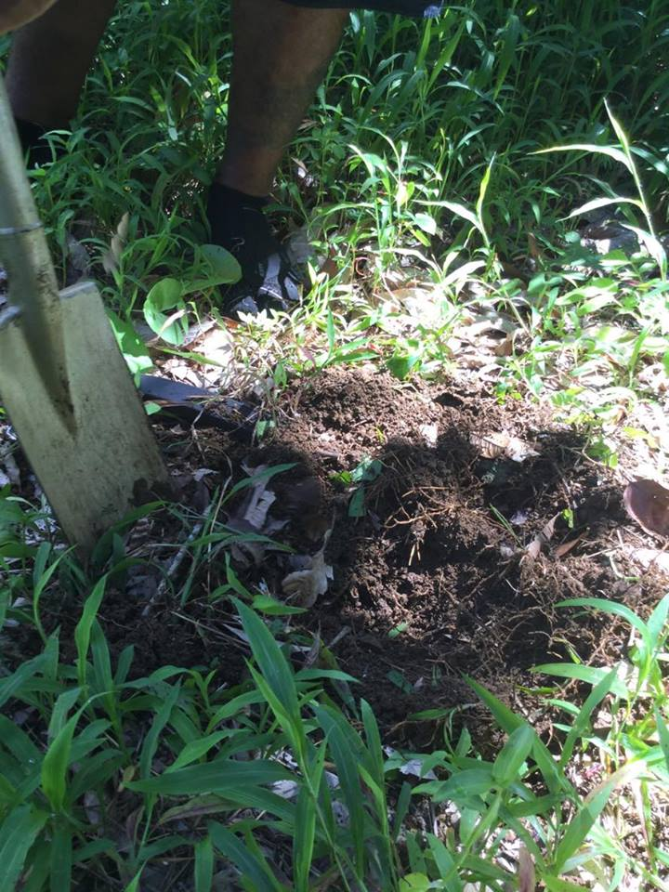
Methodology
1 Literature Search
3 Photography Evidence
4 Greenhouse Studies
5 Interview Questionnaires
2 Field Visits and Soil Sampling
Notes:
I also conducted interviews through the use of questionnaires

Slide 5
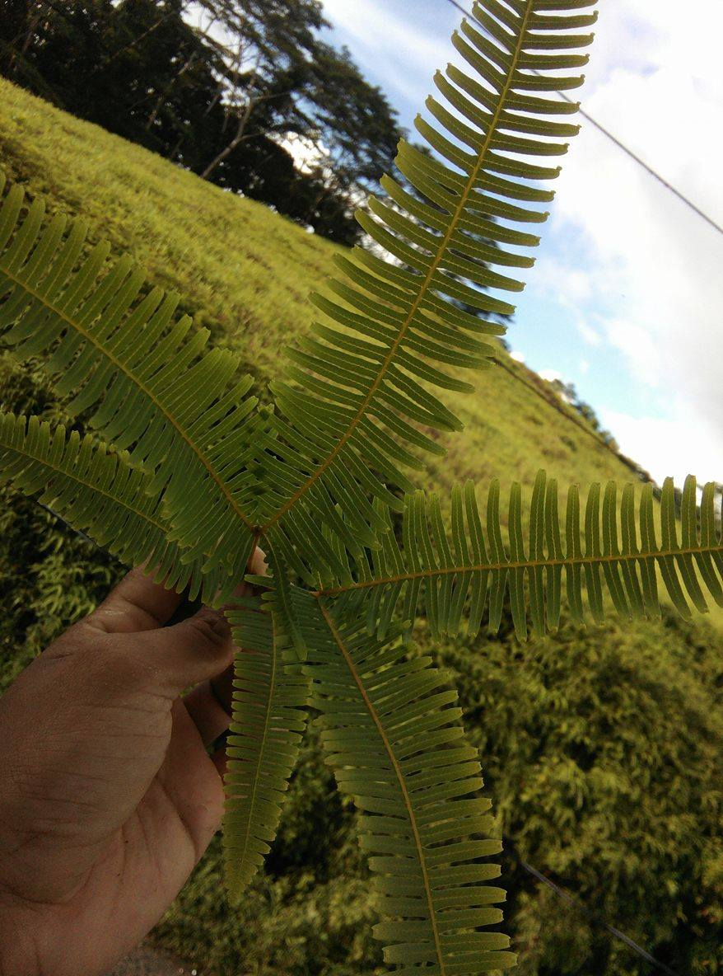
Results and Discussion 1- Literature Search
mal?
According to the Pohnpei’s Soil Book, mal is one of the most infertile soil on the island
Soil name: Umpump soil
Soil family name: Clayey, oxidic, isohyperthermic, shallow Typic Acrorthox
Most obvious vegetation on the mal is the DEER FERN
Formation of mal:
Topography
Continuous burning

Slide 6
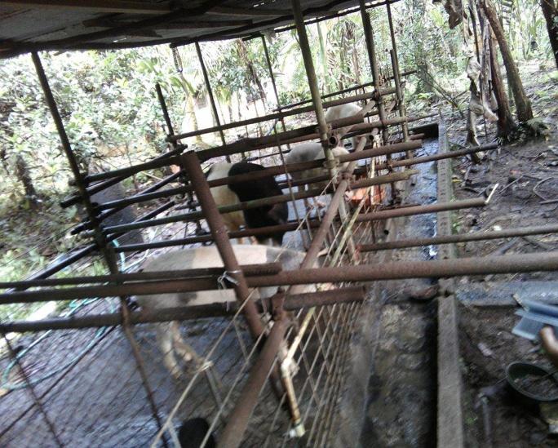
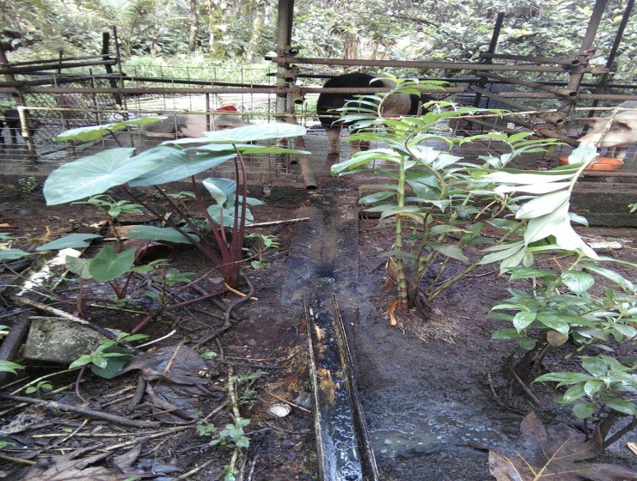
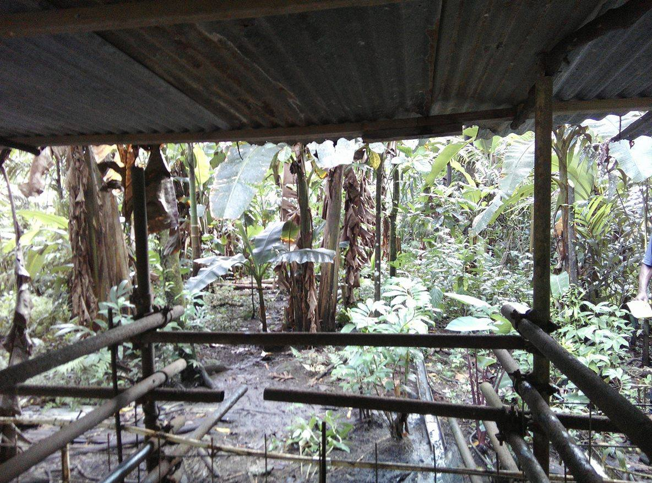
Results and Discussion 2- Field Visit and Soil Sampling
Mal Soil Vegetation | No. of Earth Worms (in 6’’ x 4’’ x 6’’ deep)
Fern | 0
Fern/Grass | 0
Grass | 12
Forest | 20
Notes:
During the field visit, we explored areas of mal and found that it is a wide area which is too sunny and receives less rain
GPS findings led the location of mal

Slide 7
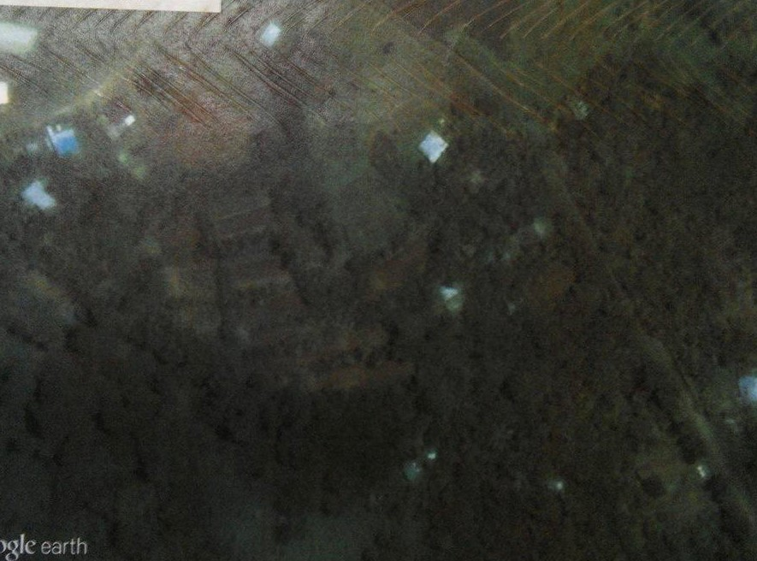
Results and Discussion 3- Photographic Evidence
3 photos taken different years shows mal area transitioning
2002
2005
2016

Slide 8
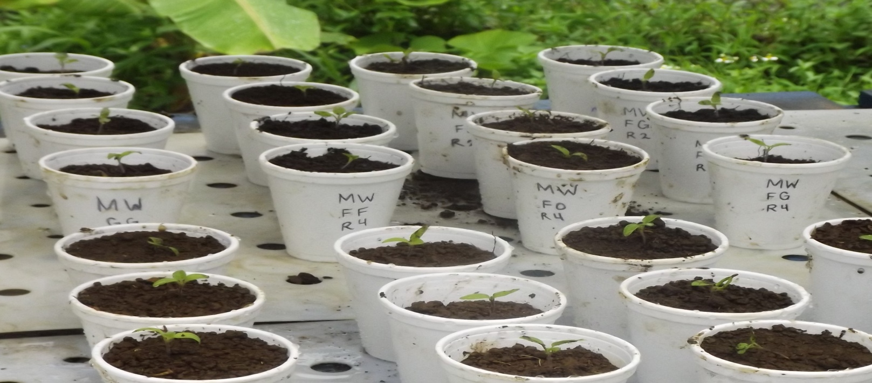
Discussions and Results 4- Greenhouse studies
Fertility changes in a transitioning mal:
FF(Fern)- original mal
FG(Fern/Grass mixture)- FF transitioning to fern and grass
GG(Grass)- FG transitioning to 100% grass
FO(Forest)- transitioning to Forest

Slide 9
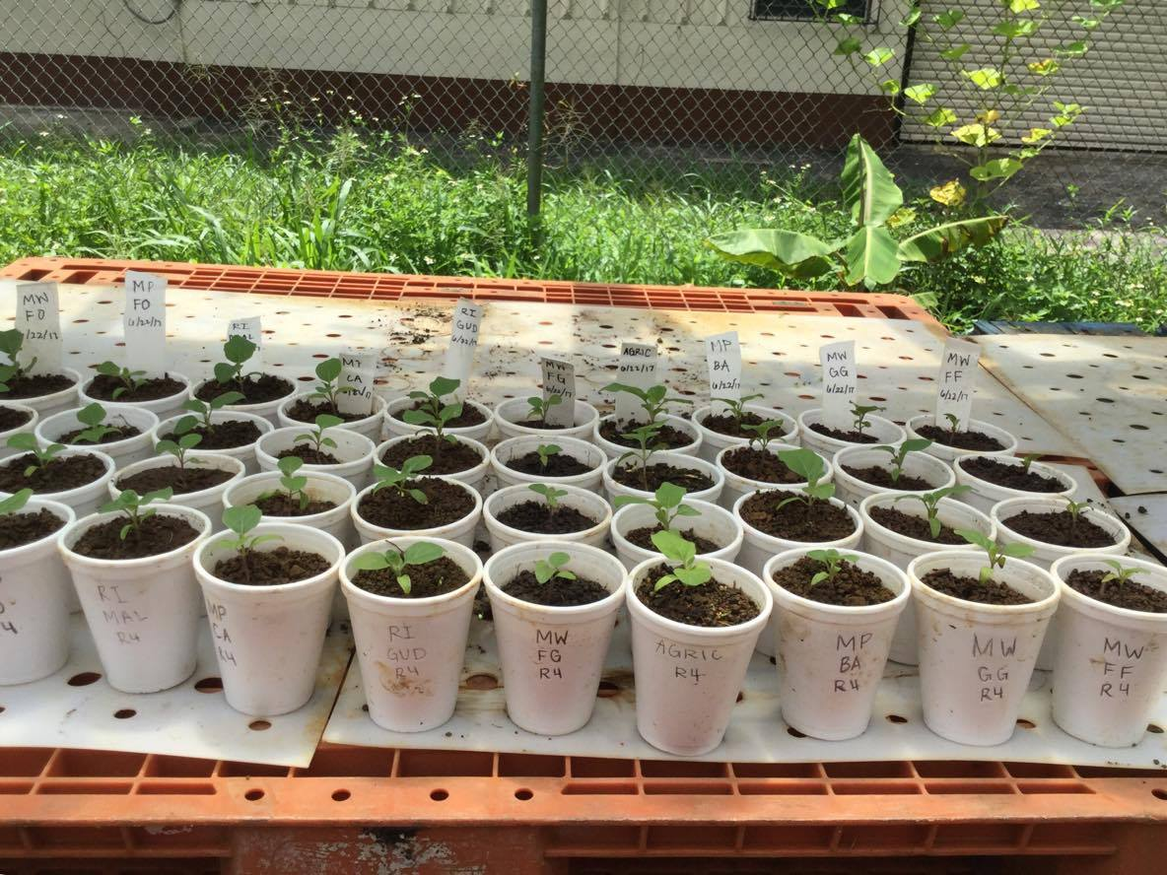
Comparing Fertility of mal soil with fertility of other soils in Pohnpei
Study confirmed that the mal soil(FF) is less fertile than other soils looked at
Notes:
FF: pure mal AG: potting mix
The pure mal is as not as fertile as other soils found in PNI

Slide 10
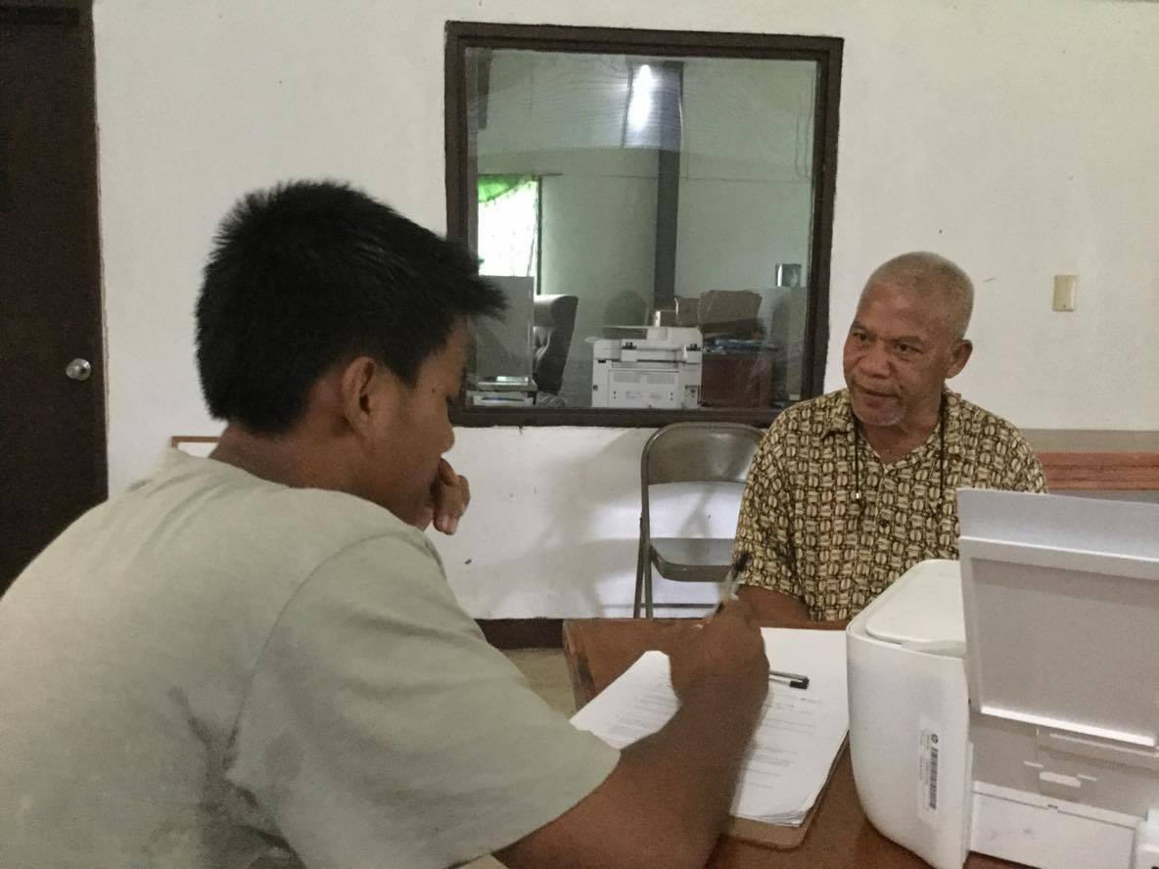
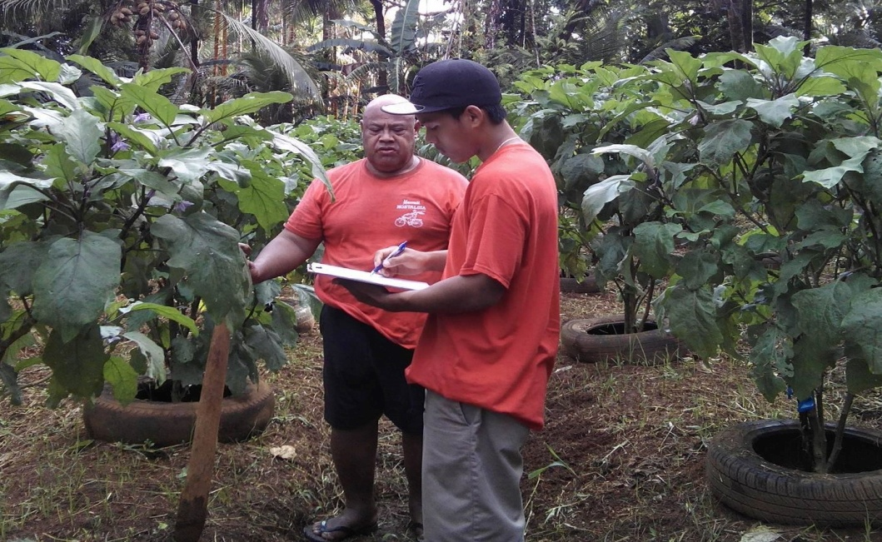
Results and Discussion 5- Interviews
34 interviewees
24 male and 10 female
Ages of 20’s-60’s
29 current farmers, 5 retired farmers
59% of the interviewees stated that mal is a treeless area that consists of mostly ferns
85% stated that mal was there before they were born
50% stated that they had no clue on how the area became a mal in the first place
56% stated that the best artificial intervention is applying dead leaves or compost the mal
12% stated that the best natural interventions are:
Seeding by bird droppings
High rainfall which Pohnpei island receives
Notes:
These are some info on the people interviewed……

Slide 11
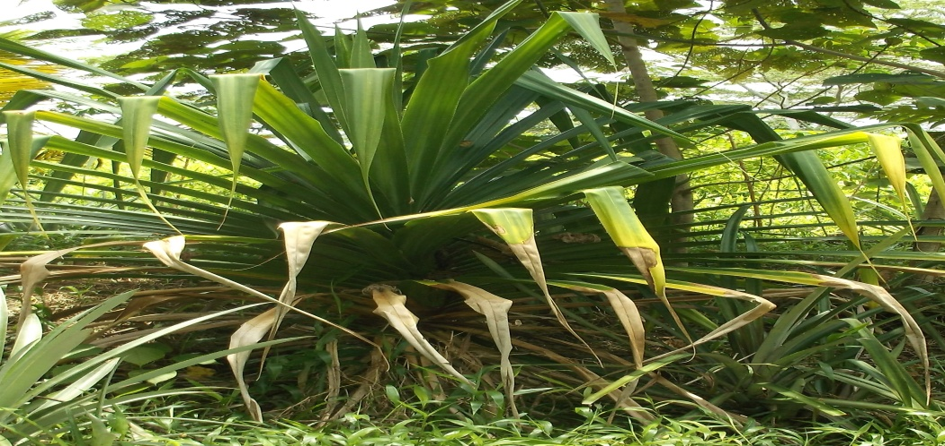
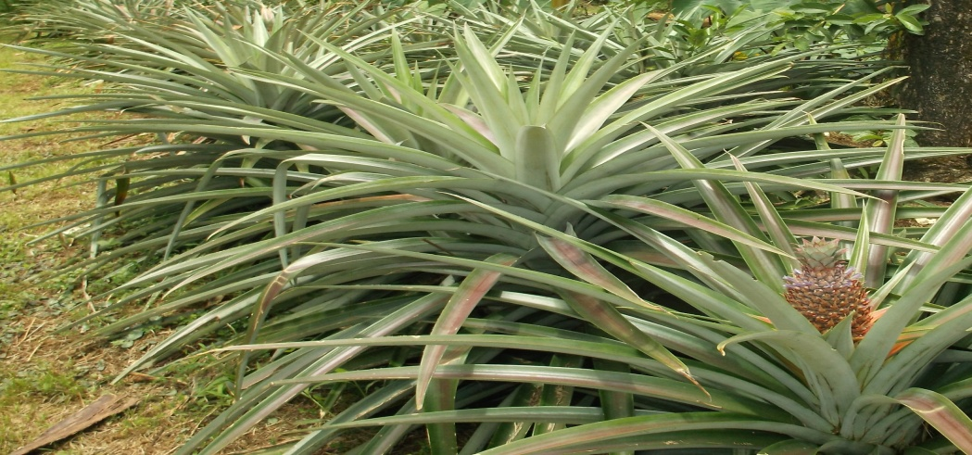
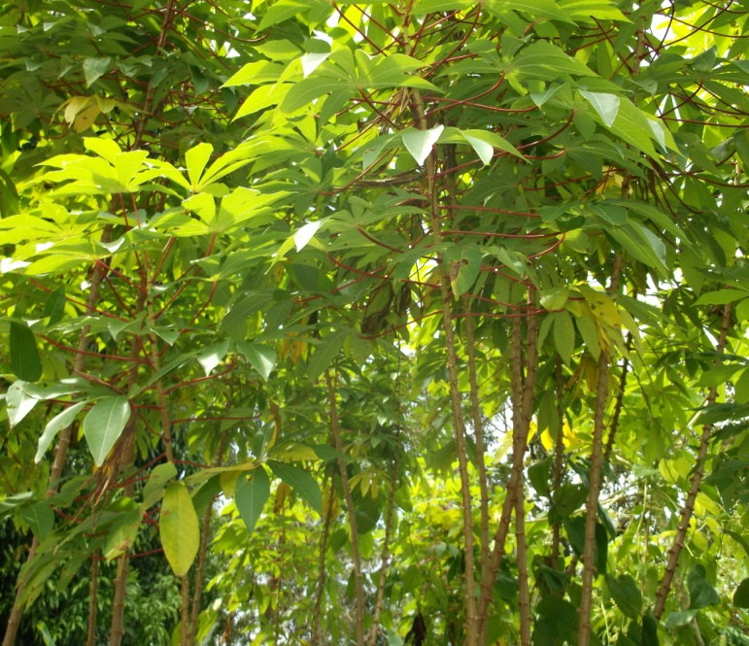
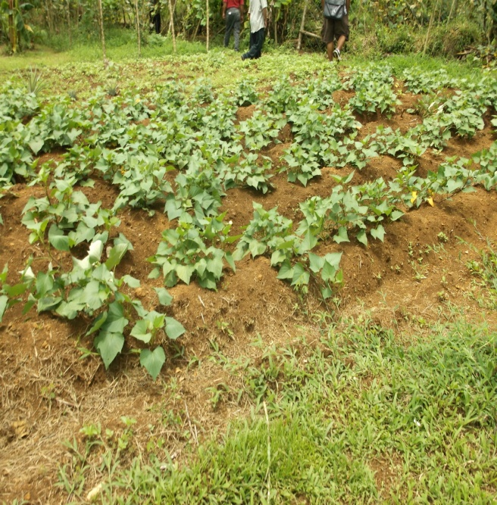
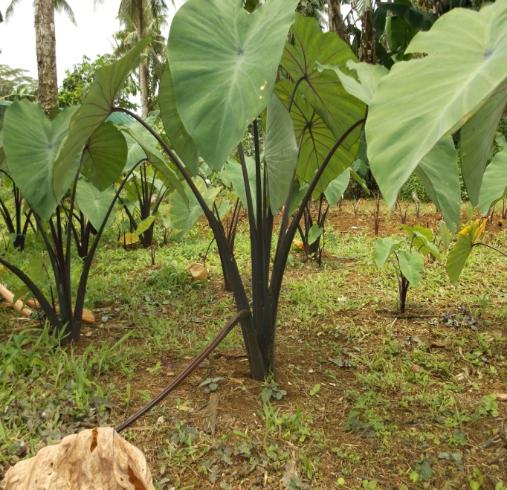
Statement by interviewed farmers:
Farmers growing Food Crops
With regard to mal rehabilitation
Mal is been rehabilitated by both natural and artificial means
With regards to the crops they are growing on the mal
Fruits (39%)
Local root crops: e.g.. Taro(25%)
Vegetables(15%)
None(21%)-tried to grow on mal but failed

Slide 12
Conclusion Summary
Photos taken over the years show that various mal areas have rehabilitated naturally and are now in forest
During the natural rehabilitation process a mal transitioned from being a fern land to a grassland, and from a grassland to a forest.
Interviewed farmers pointed out that the mal land had been made productive by natural means and human intervention
In conclusion, our hypothesis is accepted.
Mal of Pohnpei have been transformed and rehabilitated both naturally and artificially into productive soils.

Slide 13
Recommendations
In order to rehabilitate mal:
Plant trees (hibiscus/NO2-fixing trees)
Add organic matter/compost/fertilizer - if needed
Take care of the birds (no hunting)
Promote proper farming management (NO Burning)
Do awareness programs for villagers

Slide 14
Acknowledgments
Special Thanks To:
Dr Nat Tuivavalagi
Mr. Rickeyes Ikins
Ms Marla Pretrick
NRCS-USDA
Agriculture Staff
Interviewees
STEP-UP Program

