Slide 1
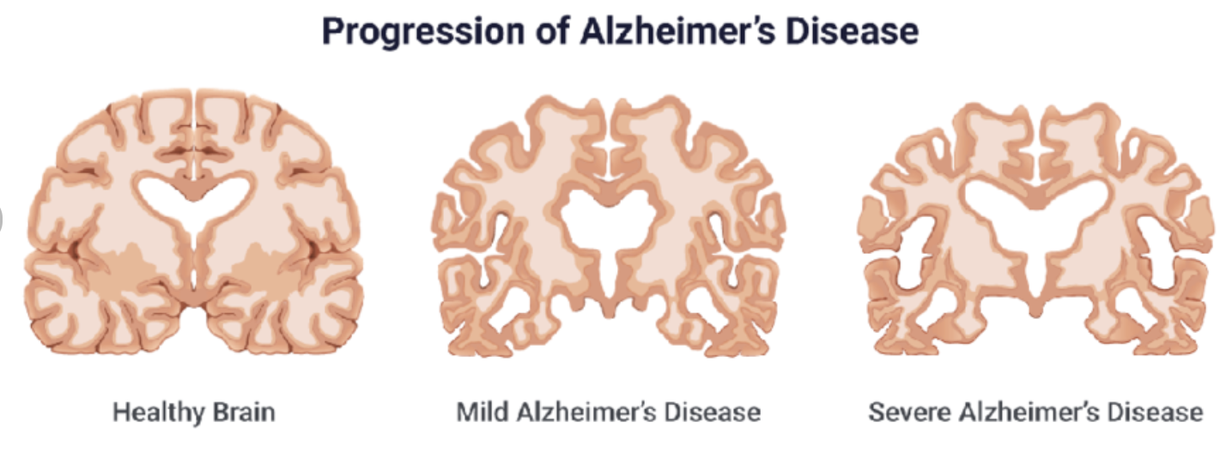
Investigating the Exocyst as an Insulin-Sensitive Regulator of Amyloid-beta Synthesis in Neurons
Amara Martin
Mentor: Ben Fogelgren, PhD
Coordinating Center: University of Hawaiʻi at Mānoa
Aparna, M., et al., International Journal of Artificial Intelligence, 2023
Notes:
Aloha my name is Amara Martin and I am from the island of O’ahu. This summer I worked at the John A. Burns school of medicine, researching the exocyst as an insulin sensitive regulator of amyloid beta synthesiss in neurons. For those who don’t know, Alzheimer’s is a devastating disease that causes mental decline and destroys neuronal connections in the brain.

Slide 2
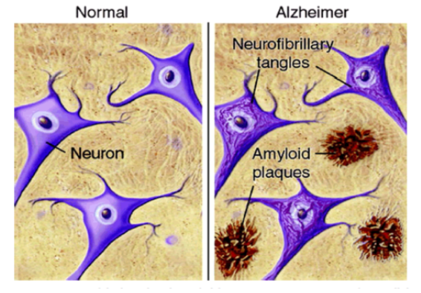
Pathological hallmarks of Alzheimer’s disease
Silbert, LC, Neurology, 2007
Notes:
There is much debate about the cause and pathogensis of alzhiemer’s. But two of the earliest biomarkers for this disease are neurofibrillary tangles and amyloid plaques.

Slide 3
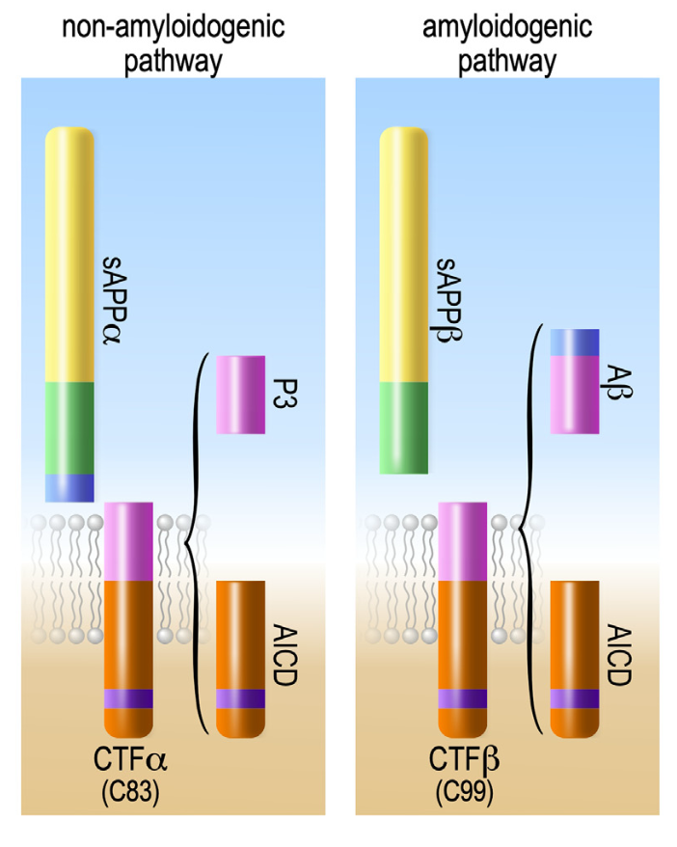
Amyloid-beta is derived from proteolytic processing of amyloid precursor protein (APP) in neurons
The processing of APP in neurons is largely determined by regulating its intracellular trafficking
Adapted from: Dunot, J.., et al., Neurobiology, 2023
Notes:
Amyloid plaques are caused by the buildup of amyloid-beta proteins in the brain. Amyloid-beta protein is produced when amyloid precursor proteins, or APP, which is shown right here, are cut by beta secratase.

Slide 4
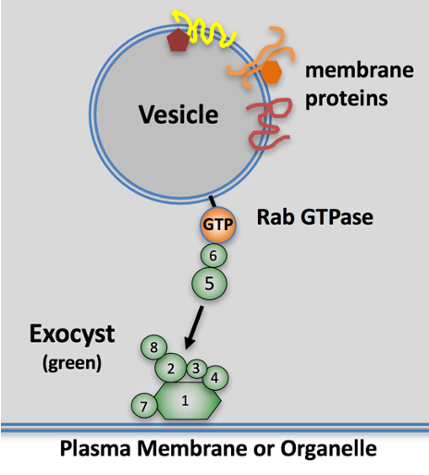
Exocyst: 8-protein complex facilitating targeted exocytosis and endocytosis of specialized cargo
Highly conserved from yeast to humans, the exocyst binds to specific Rab GTPases on transport vesicles
Highly expressed in neurons, although exocyst activities are still largely unknown.
In adipocytes and muscle cells, insulin rapidly induces exocyst assembly to deliver more glucose transporters to the plasma membrane
Notes:
Now, it is known that intracellular trafficking and APP are closely tied to amyloid beta production.
One of these intracellular trafficking complexes is the exocyst, an 8 protein _______.
The exocyst binds to specific Rab GTPases on transport vesicles
The exocyst is expressed in neurons, with its role in mature neurons being unknown.
In addition, insulin rapidly induces exocyst _____.

Slide 5
1st Question:
Does the exocyst have any role in regulating APP processing and Aβ production in neurons?
Notes:
So, the first question we had was does the ______? And we have found the answer to be yes.

Slide 6
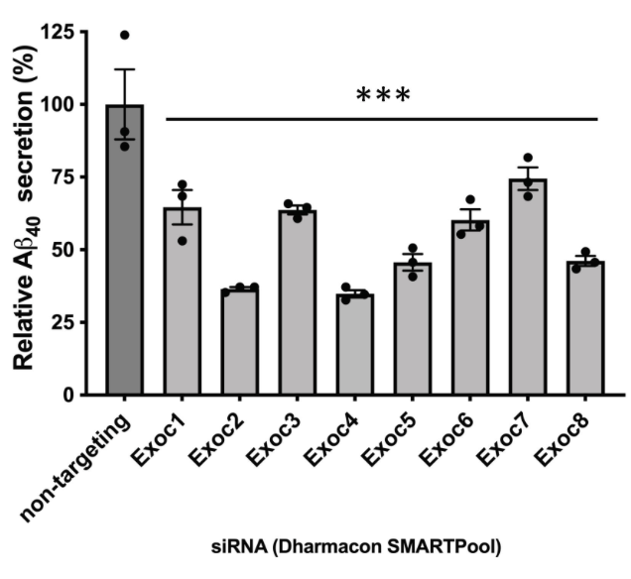
Knockdown of individual exocyst genes using siRNAs results in decreased Aβ secretion
Notes:
PREVIOUSLY we’ve found ____.
ELISA used (specifically measued abeta). Loss of function.
In this graph, an ELISA assay was used to measure the AB secretion when indivudal exocyst genes were knocked down (could be worded more precisely)

Slide 7
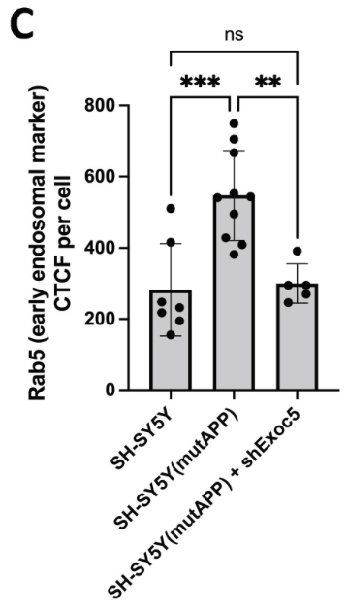
Overexpression of mutant APP shows endosomal swelling, but knockdown of Exoc5 restores early endosome sizes to normal levels
Notes:
Also found ____.
Say smtn to set up work after this. Like this lead to __________ (general statement) and like this was approached by ___ so two cell lines used inall experiments.. That could match?

Slide 8
Current Questions:
How does the exocyst regulate APP processing and Aβ production in neurons?
Is there a mechanistic connection between insulin signaling, the exocyst, and APP processing in neurons?
Notes:
Now that we know the exocyst does have a role in regulating APP processing and Ab production in neurons, new questions were asked (or smtn along those lines, restate what was already found bc fhey wont remember that first question)

Slide 9
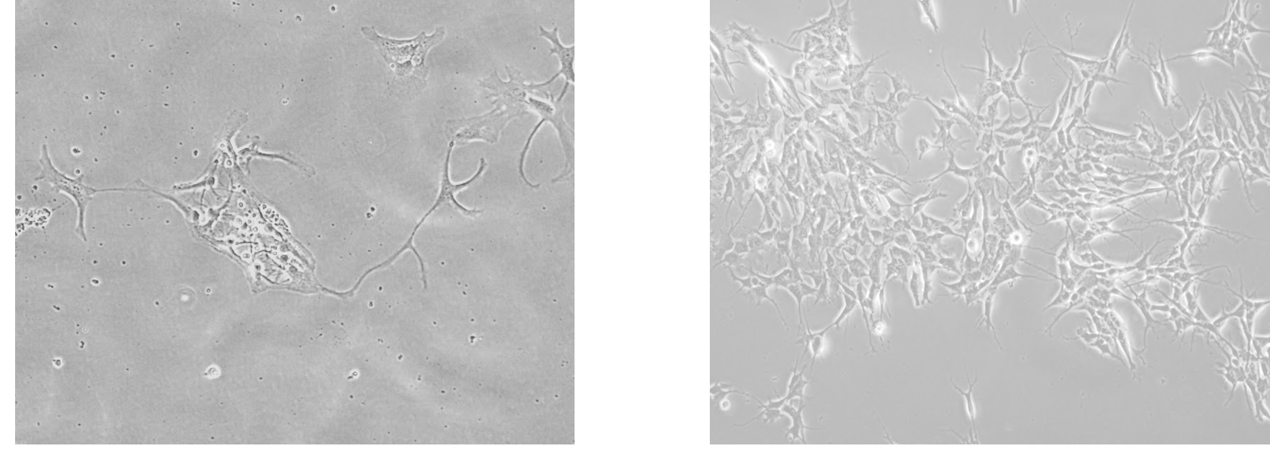
Two cell lines were used in all experiments
Mouse primary hippocampal neurons
SH-SY5Y human neuroblastoma cell line
(differentiated into neurons with retinoic acid)
Notes:
two cell lines were used in all experiments. The first was __ and second was ___

Slide 10
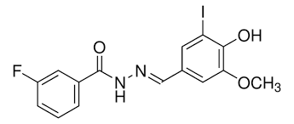
Two methods for loss-of-function of exocyst in these cell models
Genetic Knockout: floxed-Exoc5 mice + Cre
Chemical Inhibitor: Endosidin 2 (ES2)

Slide 11
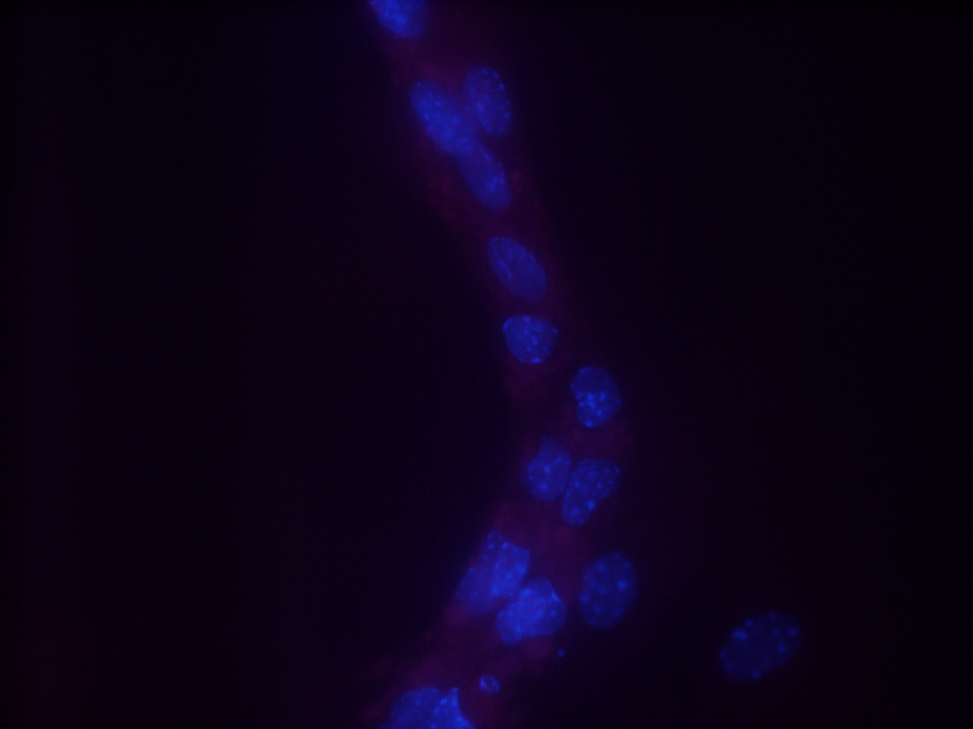
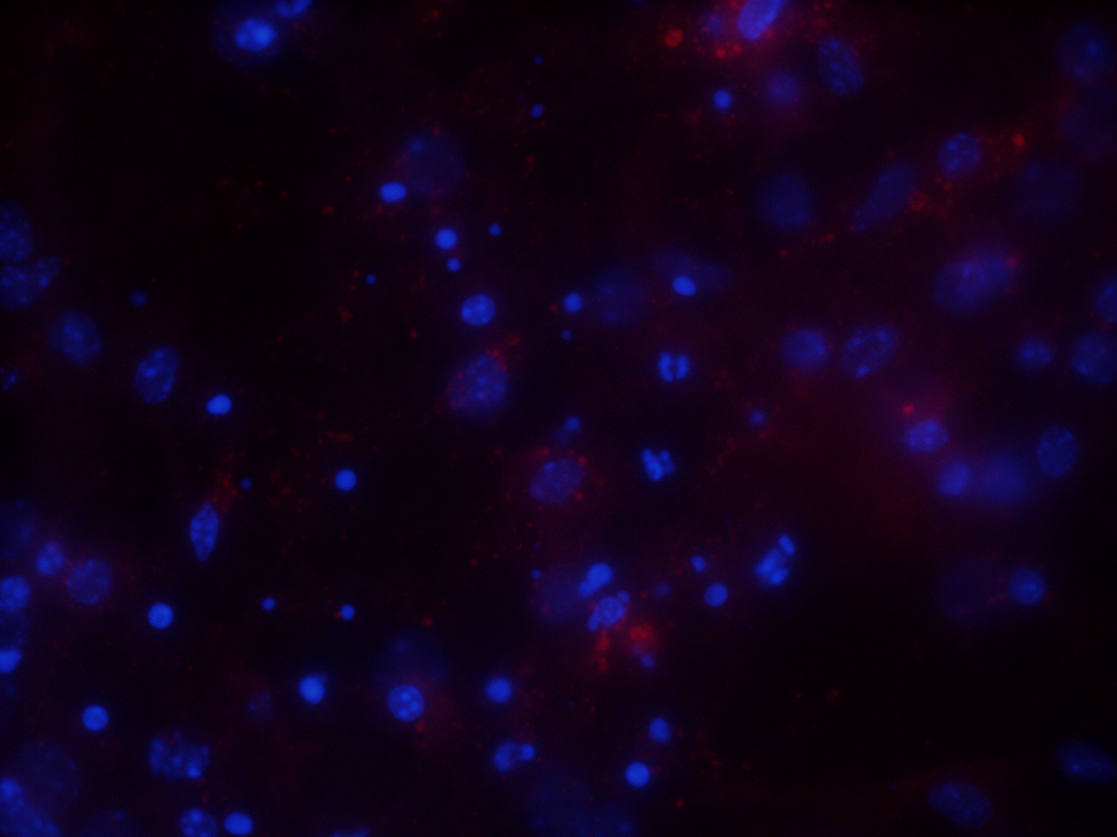
Knockdown of the exocyst via cre-recombinase
- Cre
+ Cre
DAPI
TdTomato
DAPI

Slide 12
Proximity Ligation Assay (PLA)
BSA
Seed Cells
Fix Cells
Block Cells
Image Cells
Treat with 2nd Antibody
Treat with 1st Antibody
Notes:
PLA requires the use of proximity ligation probes to detect interactions between proteins

Slide 13
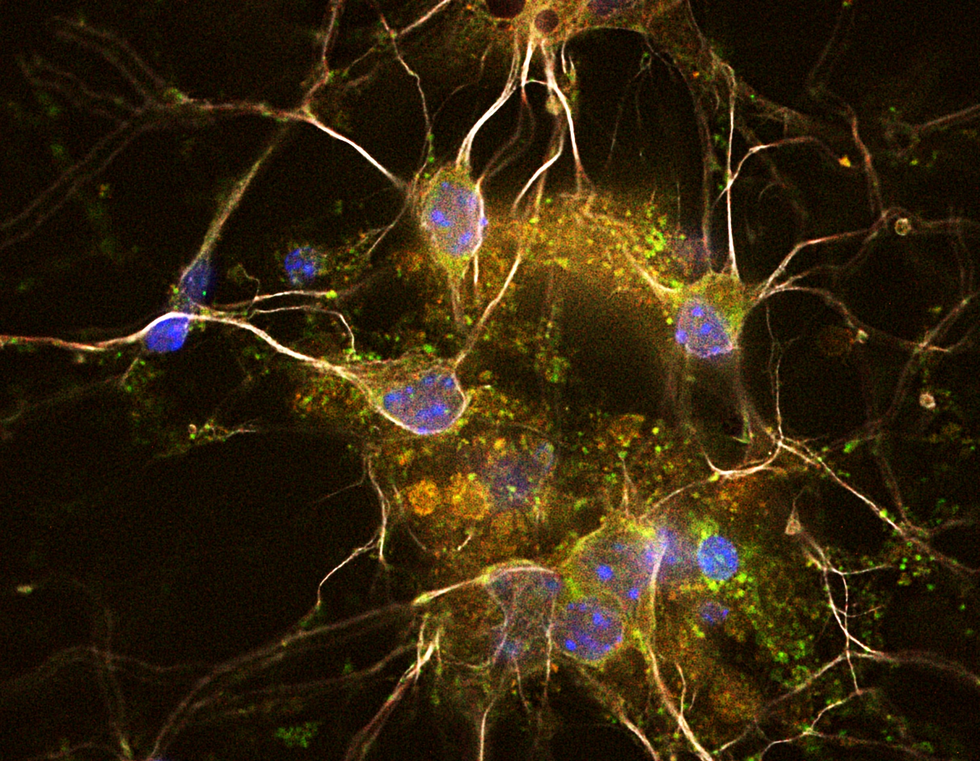
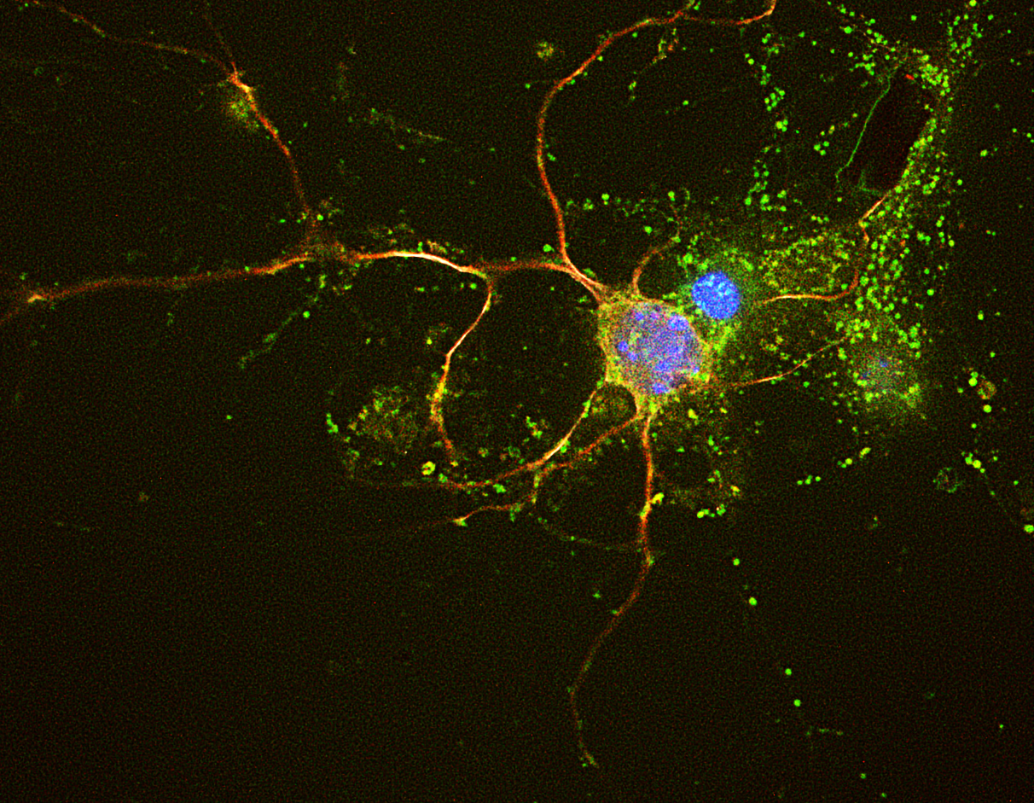
Colocalization of Exoc5 and APP in mouse primary hippocampal neurons
Exoc5-APP
DAPI Map2
TdTomato

Slide 14
ICC shows colocalization of Exoc5 and APP appears decreased with insulin treatment, when compared to insulin starved cells
- Insulin
+ Insulin
Exoc5
APP DAPI
Notes:
“Used smtn similar, immunocytochemistry (involves staining cells with primary and secondary antibodies to visualize protein localization within individual cells.)”
NOTE that it is NOT PLA, make that distinction in talk… maybe don’t make protocol graphic bc its very similar? Just different probe/staining

Slide 15
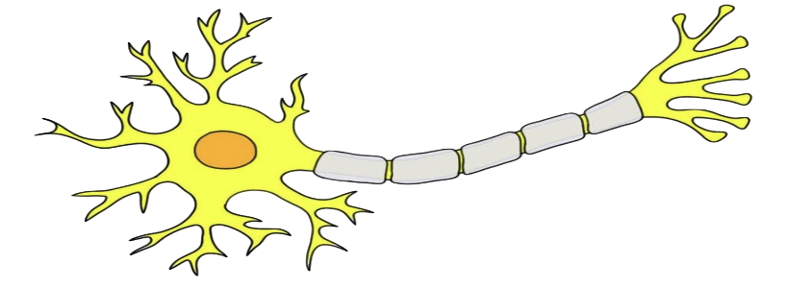
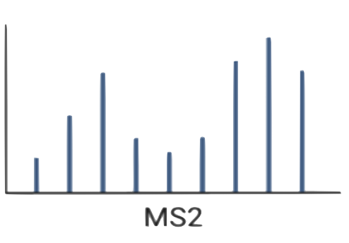
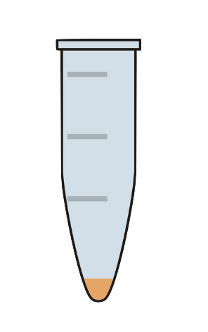
Proteomics
SH-SY5Y human cell line
18-day neuron differentiation protocol
Biotinylation of cell surface proteins
Proteoform Quantitative Analysis
Intact Protein Separation
Capture with streptavidin beads

Slide 16
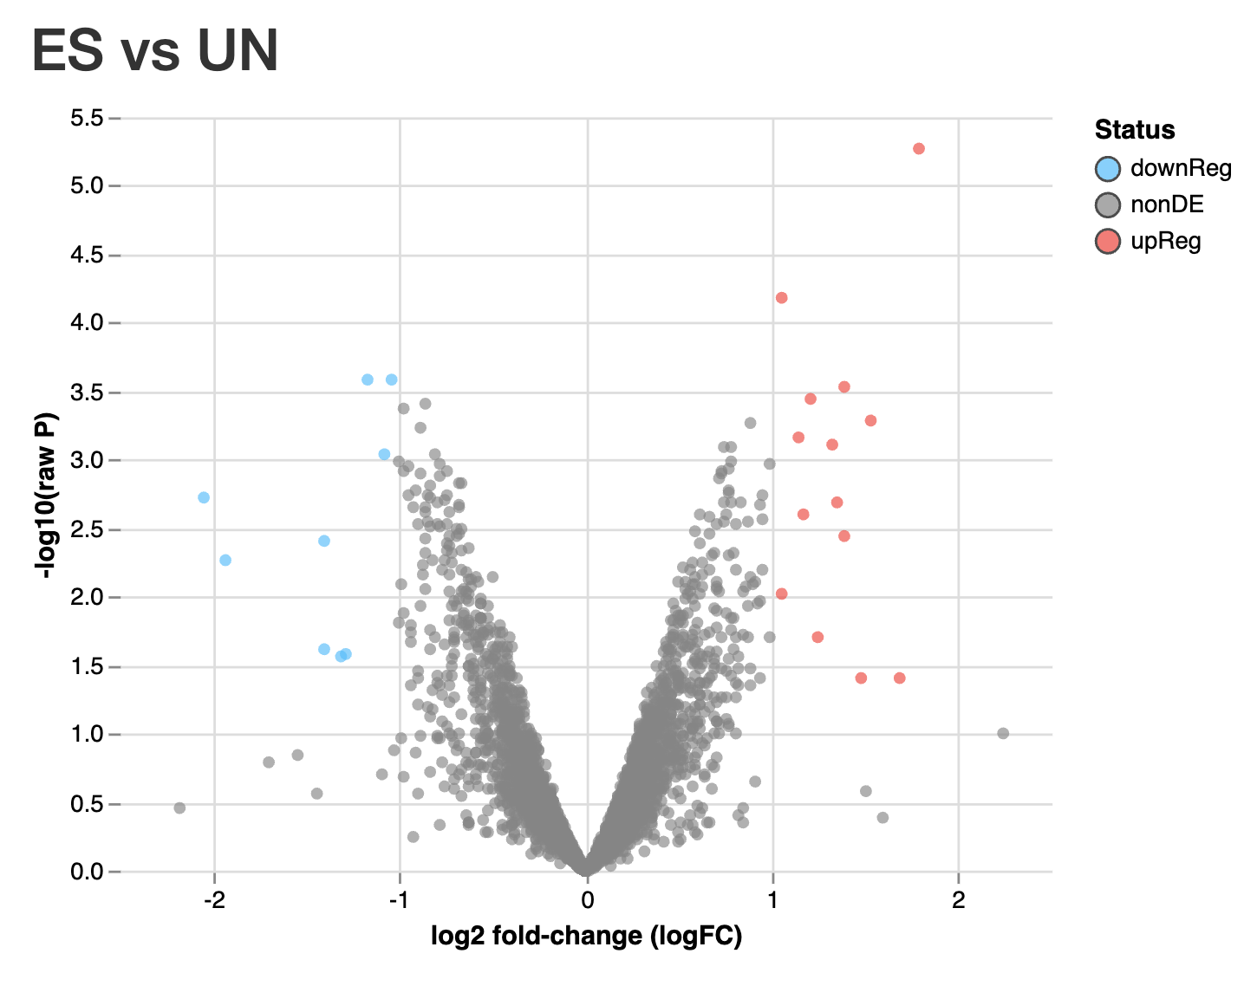
Increases, decreases, or no changes found in cell surface proteins
, raw P value
ES- endosidin treated
UN- untreated

Slide 17
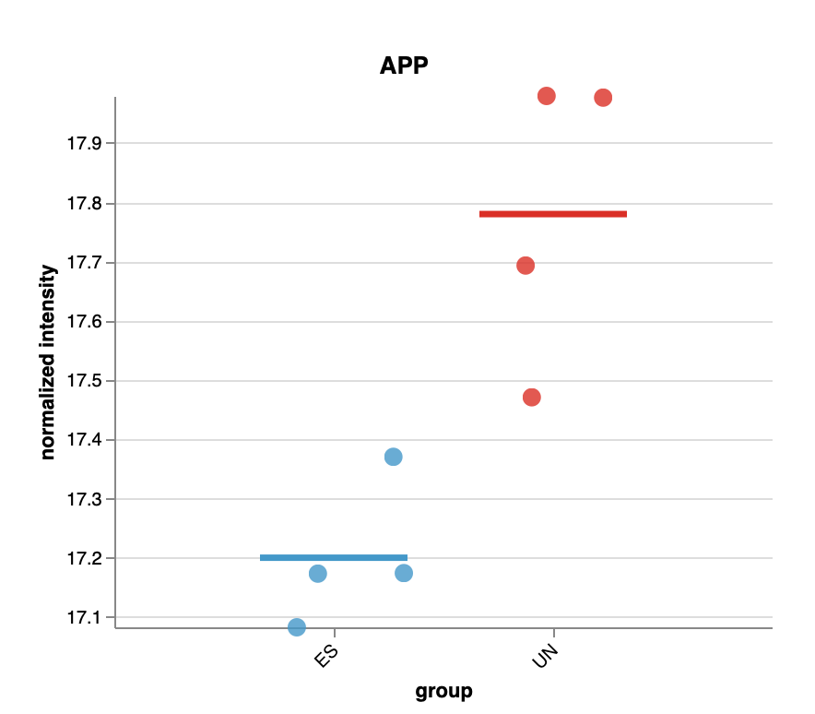
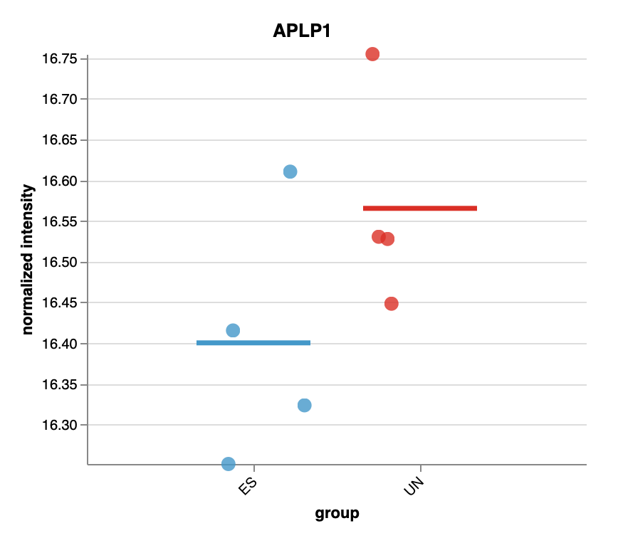
APP significantly decreased on the surface of neurons treated with ES2, while APLP1 is not.
APP
APLP1
p=0.34
normalized intensity
normalized intensity
p=0.007
ES UN
ES UN

Slide 18
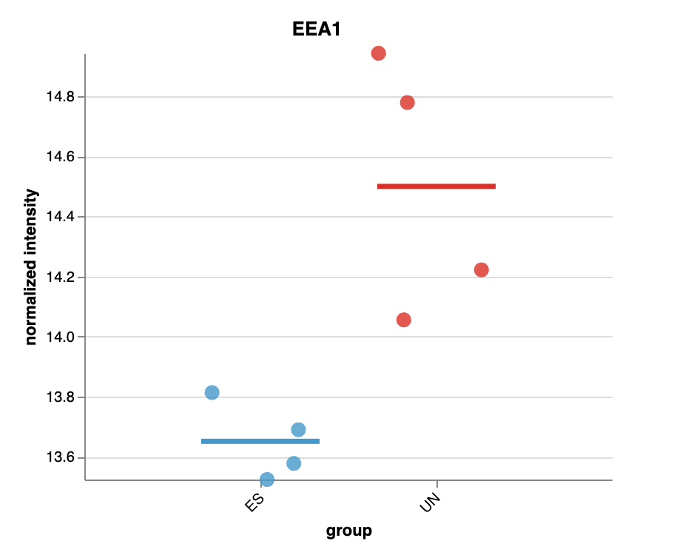
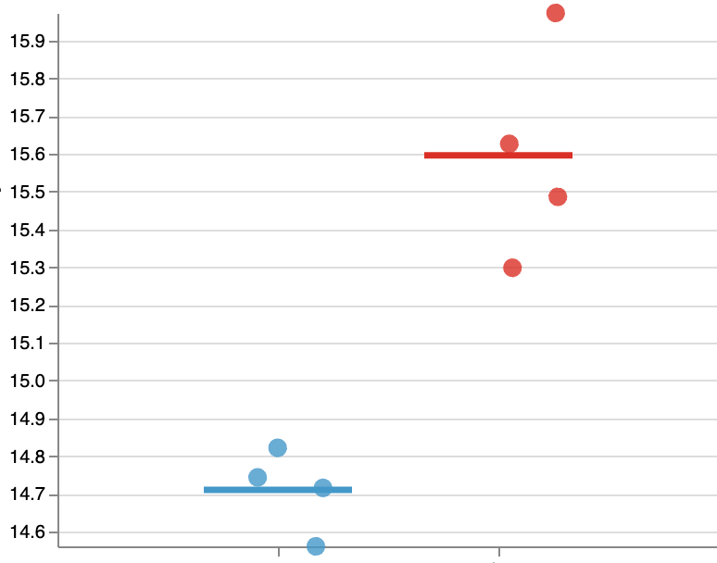
When treated with ES2, endosomal proteins EEA1 and KIF5B were significantly decreased
EEA1
KIF5B
normalized intensity
normalized intensity
p=0.003
p=0.0007
ES UN
ES UN

Slide 19
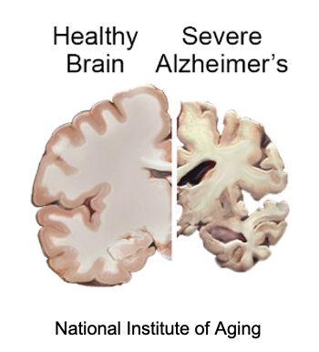
Conclusions
Exocyst plays a role in Aβ production and is involved in intracellular trafficking of APP in neurons.
Insulin may induce a re-targeting of the exocyst away from APP+ transport vesicles, reducing the production of Aβ
Proteomics identified cell surface proteins (including APP) that are affected by exocyst inhibition, underscoring its role in trafficking neuronal plasma membrane proteins
Greater understanding of exocyst function in the intracellular
trafficking of APP and regulation of Aβ in neurons may reveal
potential Alzheimer’s therapeutics
Notes:
This work shows that the exocyst plays a role in Aβ production and in trafficking APP within neurons.
Insulin might cause the exocyst to move away from APP+ vesicles, which could lower Aβ production.
Proteomics identified cell surface proteins, including APP, that are affected by exocyst inhibition, highlighting its role in protein trafficking.
Better understanding of exocyst function in APP trafficking and Aβ regulation could lead to new Alzheimer's treatments.

Slide 20
Acknowledgements
Fogelgren Lab
Ben Fogelgren
Chantell Balaan
Hanna Kumasaka
Swasthita Sadagopan
Shion Aou
NIDDK/NIH
The STEP-UP High School program is supported by the National Institute of Diabetes and Digestive and Kidney Diseases of the national Institutes of Health, Grant Number: 5R25DK078386-18
Owens Lab
Notes:
I would first like to thank my mentor, Ben Fogelgren, as well as our lab team, Chantell Balaan, Hanna Kumasaka, Swasthi Sadagopan, and Kelsey Zane for their amazing guidance. And thank you to the STEP-UP program coordinators and NIDDK and NIH for making this summer research experience possible. Mahalo!

