Slide 1
A Comparison of Coral Transplantation Methods in Recruiting Fishes
Maricia Chanel
Leone High School
Mentor
Eric Brown, Ph.D., Marine Ecologist,
National Park of American Samoa

Slide 2
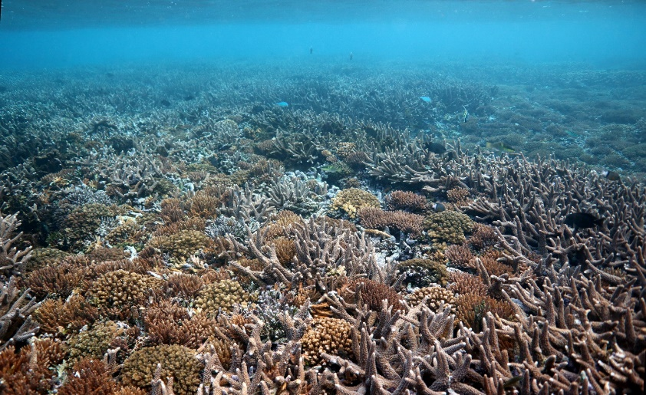
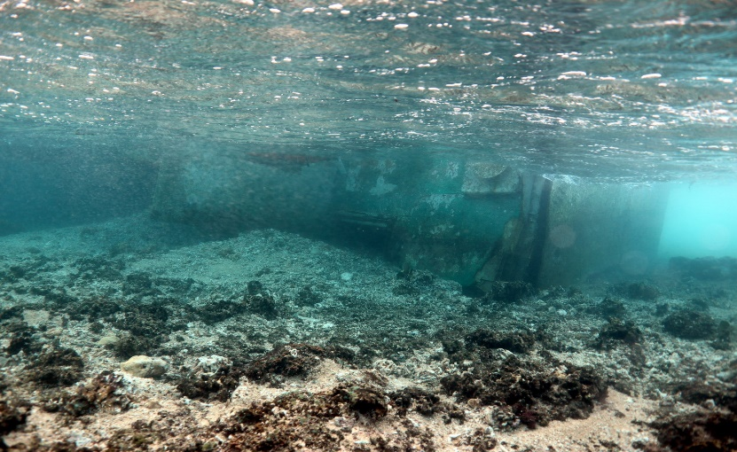
Introduction
Coral reefs are declining worldwide
Reefs serve as an important habitat for fish species
Coral transplantation can partially restore coral reefs and habitats for fishes
The purpose of this project was to determine which coral transplantation method recruited more fish

Slide 3
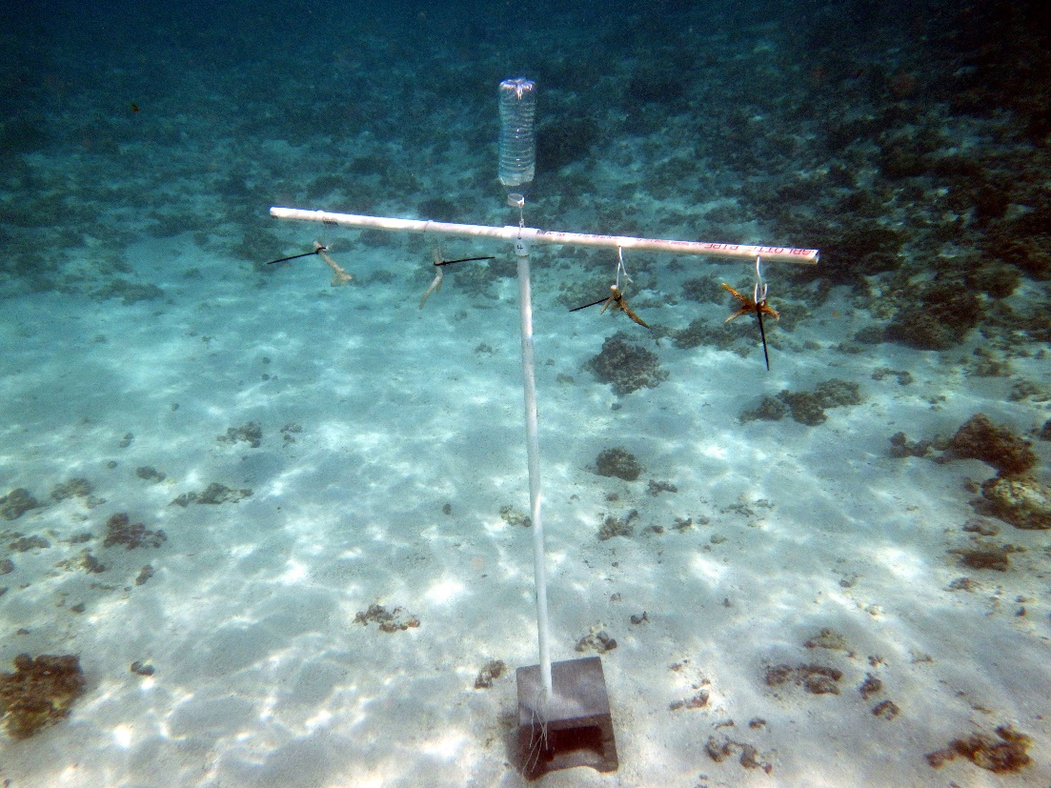
Which method will recruit more fishes?
Block Structure
VS
Tree Structure
Surface Area: 4,986 cm²
Surface Area: 5,110 cm²

Slide 4
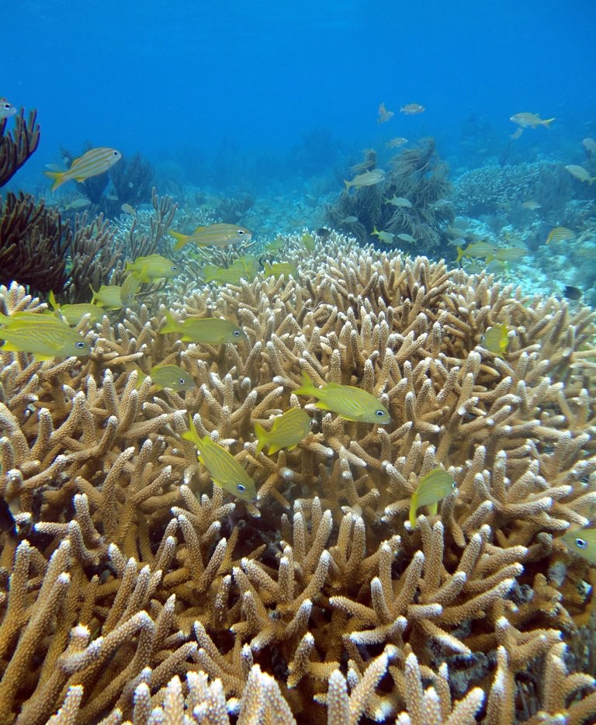
Hypothesis
The tree structure will recruit more fishes than the block

Slide 5
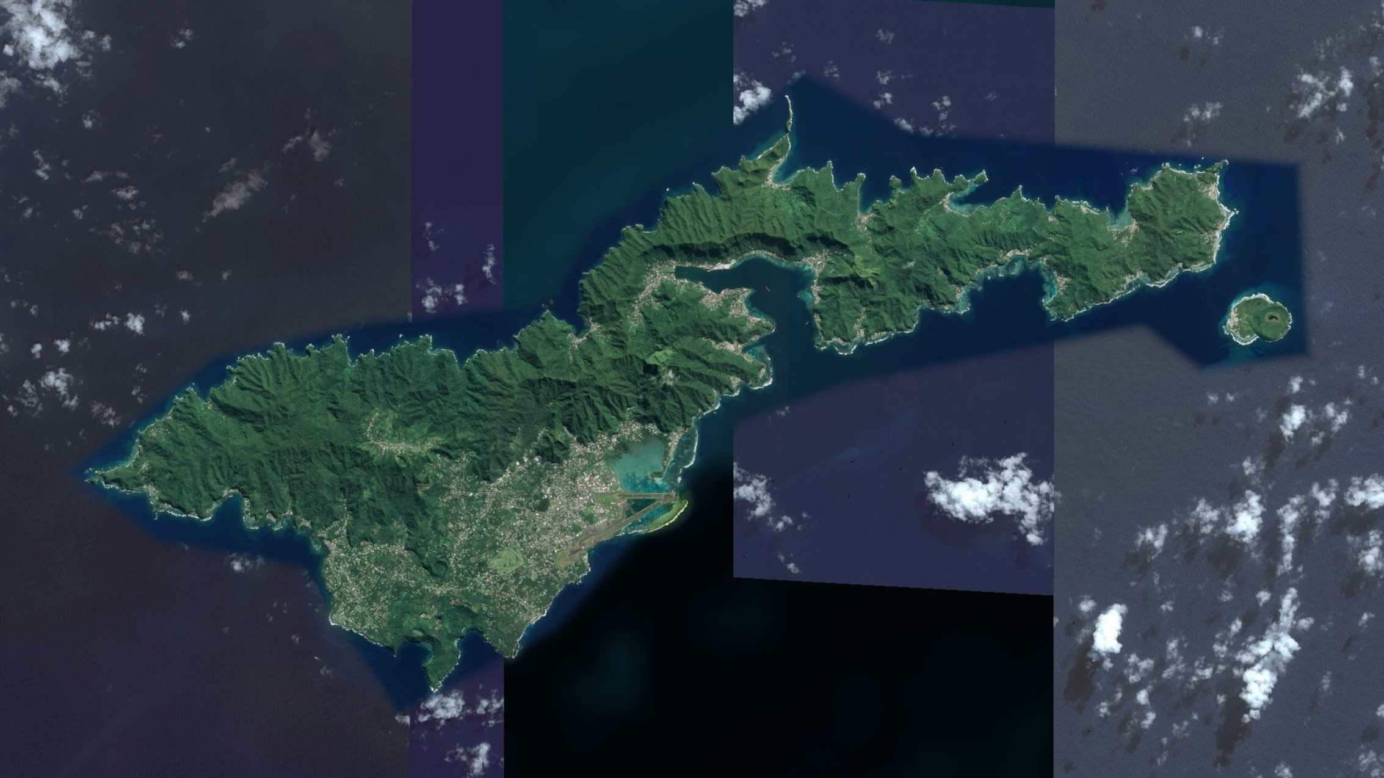
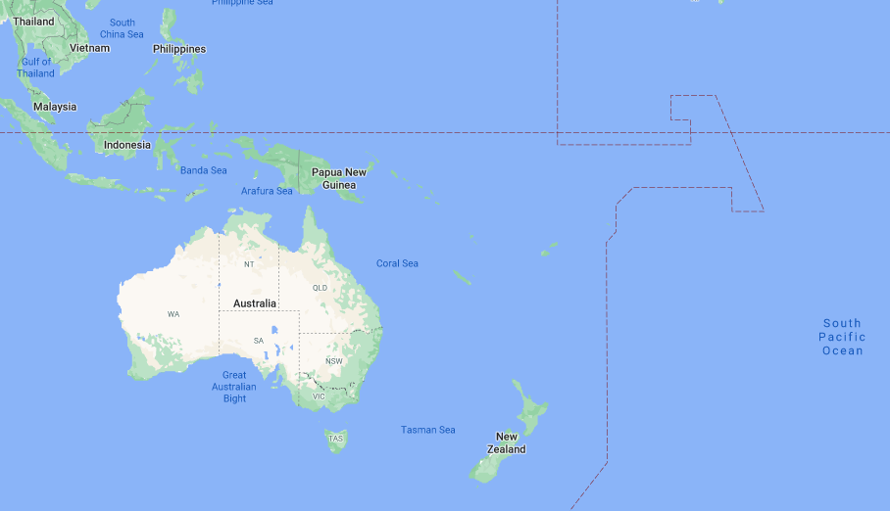
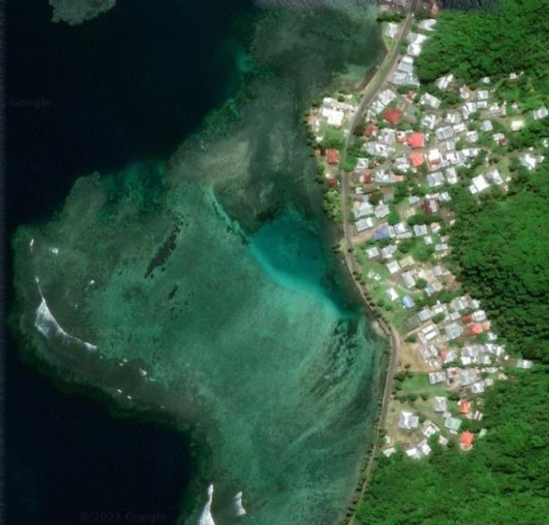
N
American
Samoa
Aua
Pago Pago
Tutuila
Study Area

Slide 6
Experimental Design
L D B D B L D B L
B L D B D L B L D
L- Live Acropora muricata fragments D- Dead A. muricata fragments B- Blank

Slide 7
Results – Abundance
‾x ± 95% C.I.
Block Method
Tree Method

Slide 8
Results – Species Richness
Block Method
Tree Method

Slide 9
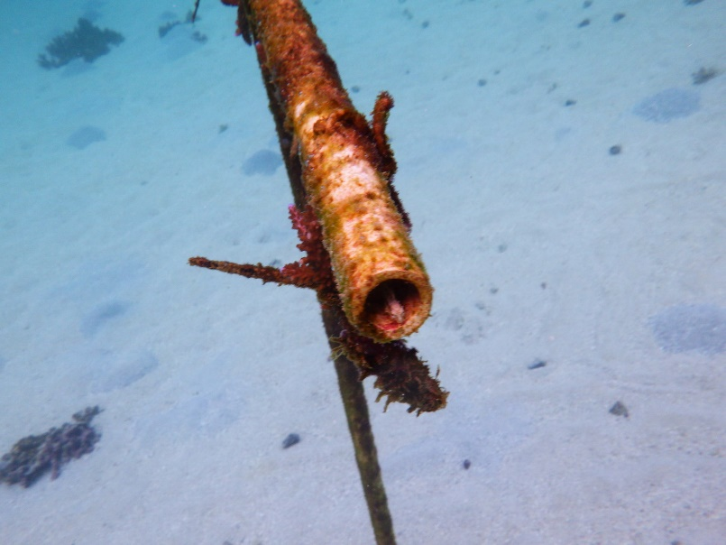
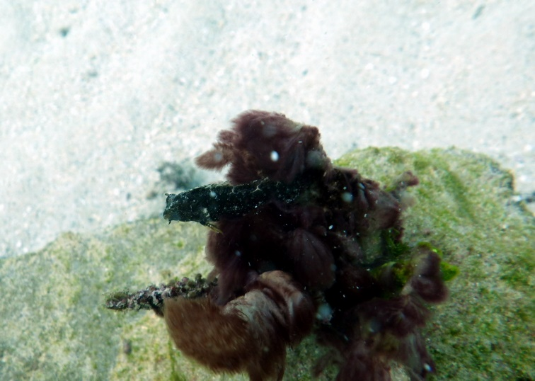
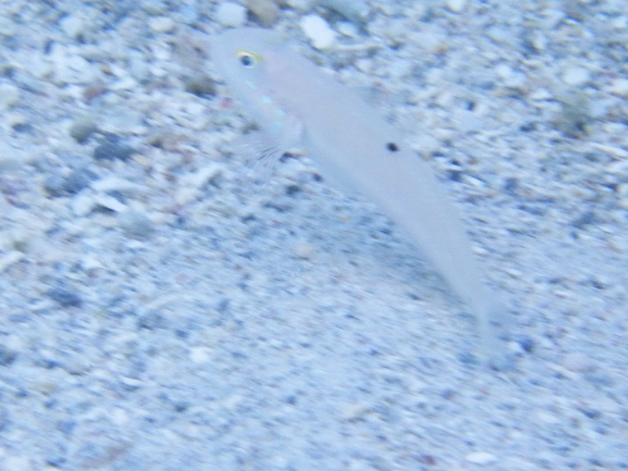
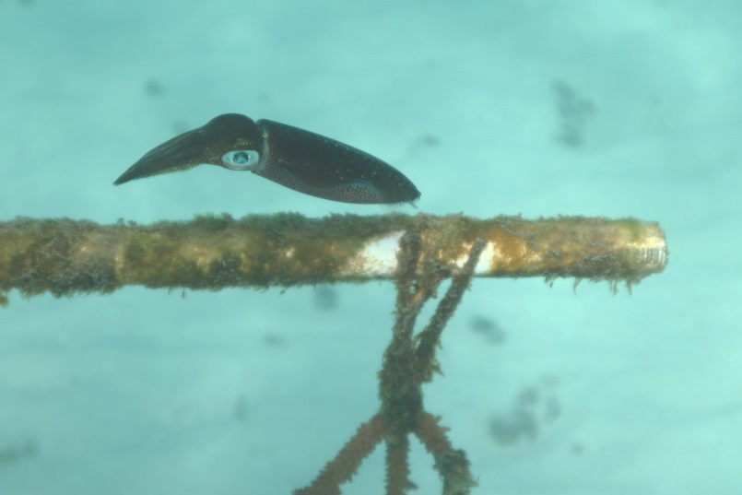
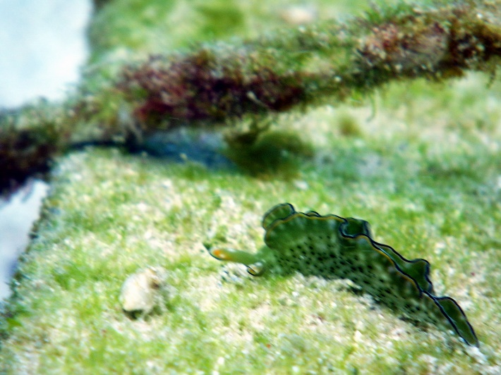
Common Species Present
Blenny (Salarias sp)
Floral fangblenny (Petroscirtes xestus)
Sixspot Goby (Valenciennea sexguttata)
Squid
Nudibranch

Slide 10
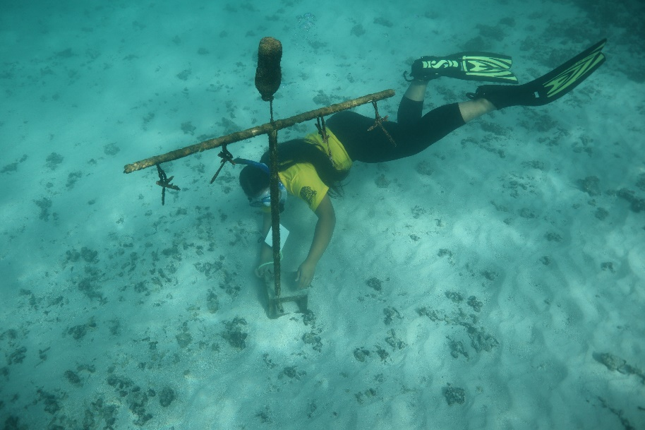
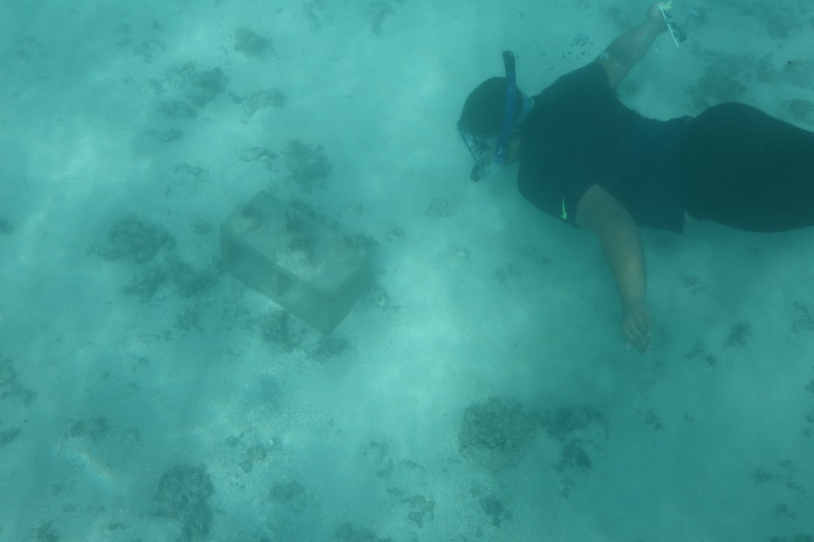
Conclusions
Hypothesis was correct. The tree method recruited more fish than the blocks
Tree method also recruited more fish species
No difference in fish recruitment between live coral, dead coral, and no coral
Fish recruited to the structures within 1 week

Slide 11
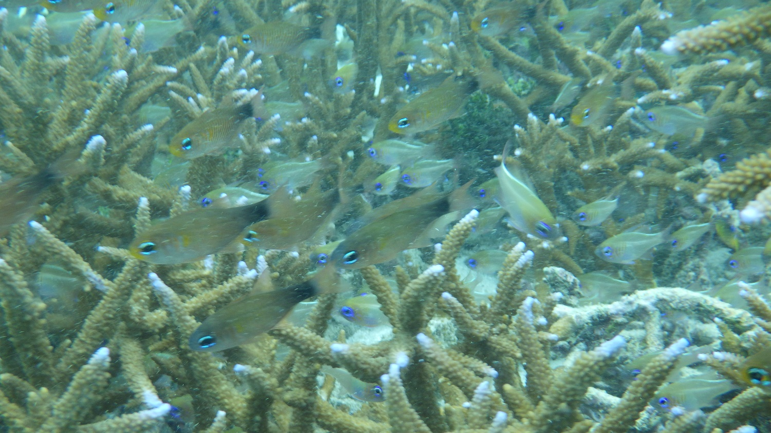
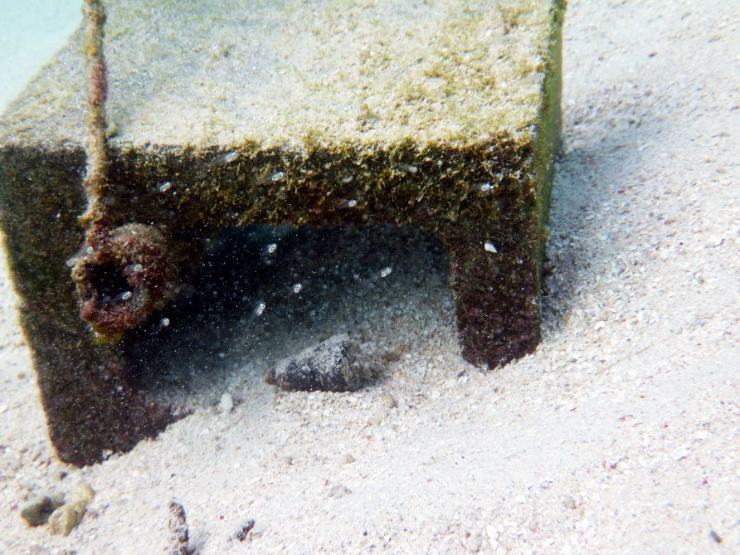
Significance
Structures are important for fishes
Humans can successfully intervene to improve fish populations

Slide 12
Future Improvements
Increase sample size and duration
Make more complex trees
Adjust spacing intervals
Experiment with alternative methods (e.g., Rope, Nail)
Survey fish on adjacent natural reefs

Slide 13
Acknowledgements
The STEP-UP HS program is supported by the National Institute of Diabetes and Digestive and Kidney Diseases of the National Institutes of Health.
Field assistance included Ian Moffitt, Katie Nalesere, Chloe Le’iato, and Kalista Koloi.
Dr. Mark Schmaedick
Program Coordinator- Aneesa Golshan
CRAG Coral Transplantation Permit
Dr. Eric Brown
My Parents

