Slide 1
4-phenylbutyrate therapy restores the calcification inhibition potential of ABCC6 missense mutations
Hi‘ilani Hopkins

Slide 2
ABCC6
Active (ATP-dependent) transporter
Helps to inhibit calcification through pyrophosphate production
Expressed in the liver, kidney, and intestine
Localized in the plasma membrane
Mutations lead to genetic diseases (PXE and GACI)
Bergen et al., 2000; Le Saux et al., 2000; Ringpfeil et al, 2000

Slide 3
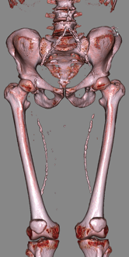
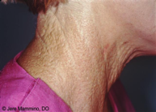
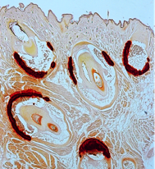
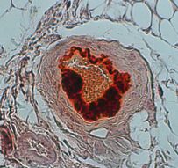
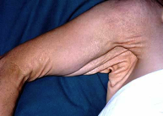
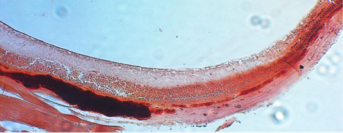
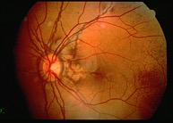
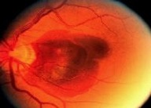
Pseudoxanthoma Elasticum (PXE)
Human Phenotype
Mouse Phenotype
Dermal
Abcc6^{-/-} Whiskers
Abcc6^{-/-} Artery
28 months old Abcc6-/- mouse
Ocular
Vascular
membrane
Retina
Bruch’s
*
Sclera
Abcc6^{-/-} eyes (Bruch’s membrane)

Slide 4
Hypothesis
4-phenylbutyrate (4-PBA)
drug used to treat urea cycle disorders
also interferes with ER chaperones
Most ABCC6 mutants have normal transport activity, but abnormal cellular localization, which can be rescued by 4-PBA
Because 4-PBA rescues plasma membrane localization of several ABCC6 mutants, we hypothesize that it will also rescue ABCC6’s function i.e. calcification inhibition
(Le Saux et al., 2011; Pomozi et al., 2014)

Slide 5
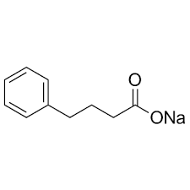
4-PBA interferes with ER chaperones
- Inducing Hsp-70 and Hsp-90
- Inhibiting Hsc-70 and CHIP
Maturation
Hsp-90
Hsp-70
4-PBA
Hsc-70/CHIP
ER
Degradation
Hsp-90/Aha1

Slide 6
Purpose
Can 4-PBA restore plasma membrane localization of various ABCC6 mutants and stop/prevent further calcification?
4-PBA
No rescue of plasma membrane localization
Intracellular (incorrect)
No calcification
inhibition
Rescue plasma membrane localization
Active
ABCC6 mutants (disease-causing)
Plasma membrane (correct)
?
Inactive
Calcification inhibition
in vitro
in vitro & in vivo
in vivo
As an existing drug, 4-PBA could be a feasible way to treat PXE patients.

Slide 7
Methods
Used an ABCC6 KO mouse strain (mice had no ABCC6 protein)
Hydrodynamic tail vein injections of a plasmid allowed expression of mutant and normal human ABCC6 in liver
Cryoinjury of hearts induced cardiac calcification in ABCC6 KO mice
Immunohistochemistry of livers to verify expression of human ABCC6

Slide 8
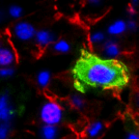
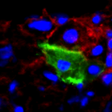
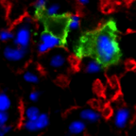
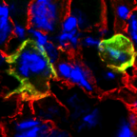
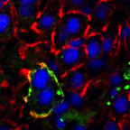
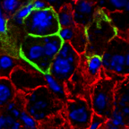
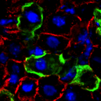
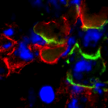
The cellular localization of 40% of the mutants can be rescued by 4-PBA treatment in vivo (in humanized mouse model)
R1314W
Q1347H
S1121W
R1114P
Untreated
Green: human ABCC6 protein
Red: plasma membrane marker (cadherin)
Blue: nuclei
4-4-PBA
Pomozi et al. 2013, J. Invest. Dermatol.; Le Saux et al. 2011, PLoS One

Slide 9
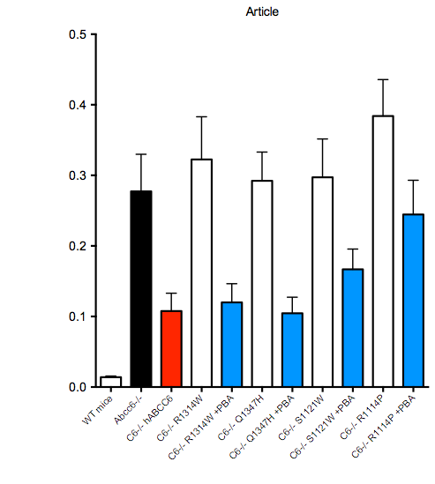
Heart Calcification
*
*
+
4-PBA
**
**
+
4-PBA
Calcification
(Total calcium concentration µg/dL/mg tissue)
+
4-PBA
+
4-PBA
***
WT
mouse
Abcc6^{-/-}
WT
ABCC6
ABCC6
R1314W
ABCC6
Q1347H
ABCC6
S1121W
ABCC6
R1114P

Slide 10
My Role in the Project
These results were submitted for publication in the Journal of Investigative Dermatology
Reviewers requested additional data, in particular histology of hearts
Immunohistochemistry to verify that mouse livers expressed the human ABCC6
Microscopy imaging

Slide 11
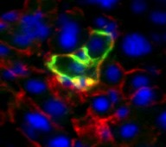
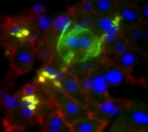
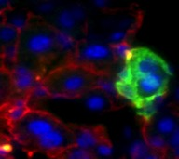
My Role in the Project
20 µm
20 µm
20 µm
200 µm
WT - ABCC6
WT - ABCC6
WT - ABCC6
20 µm
20 µm
20 µm
20 µm
Green: human ABCC6 protein
Red: plasma membrane marker (cadherin)
Blue: nuclei
Q1347H
Q1347H
Q1347H
20 µm
20 µm
20 µm
Q1347H + 4-PBA
Q1347H + 4-PBA
Q1347H + 4-PBA

Slide 12
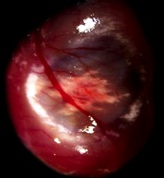
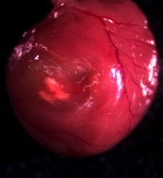
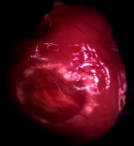
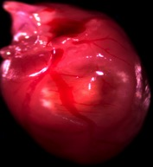
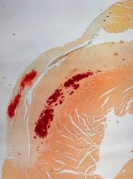
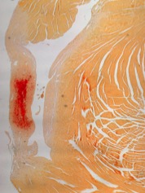
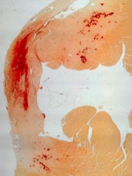
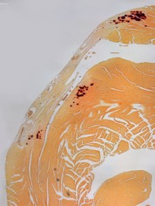
My Role in the Project
Abcc6 -/-
Abcc6 -/- WT
Q1347H
Q1347H + 4-PBA
200 µm
200 µm
200 µm
200 µm

Slide 13
Conclusion
4-PBA is effective for certain mutants (R1314W, Q1347H, S1121W)
Can stop and prevent calcification, but cannot reverse existing calcification
4-PBA can be used to treat some PXE patients
The manuscript was resubmitted
(V. Pomozi, C. Brampton, F. Szeri, D. Dedinszki, E. Kozak, K. van de Wetering,
H. Hopkins, L. Martin, A. Varadi, and O. Le Saux)
Notes:
Clinical trial in France

Slide 14
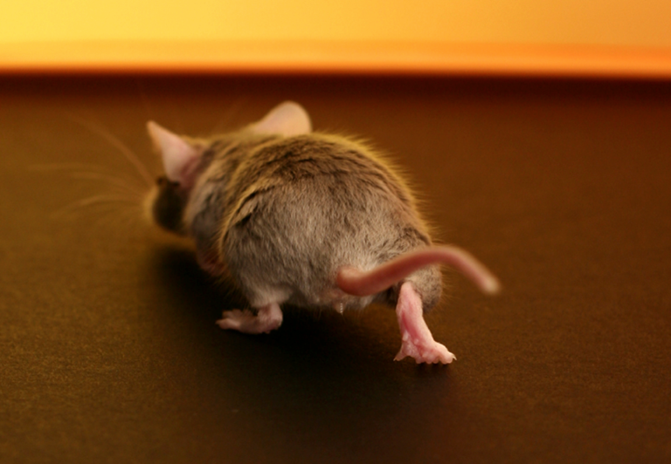
Acknowledgments
Olivier Le Saux, PhD
Viola Pomozi, PhD
Janna Zoll, MS
STEP-UP Program
George Hui, PhD
Fiona Brown
NIH Grant: HL108249

