Slide 1
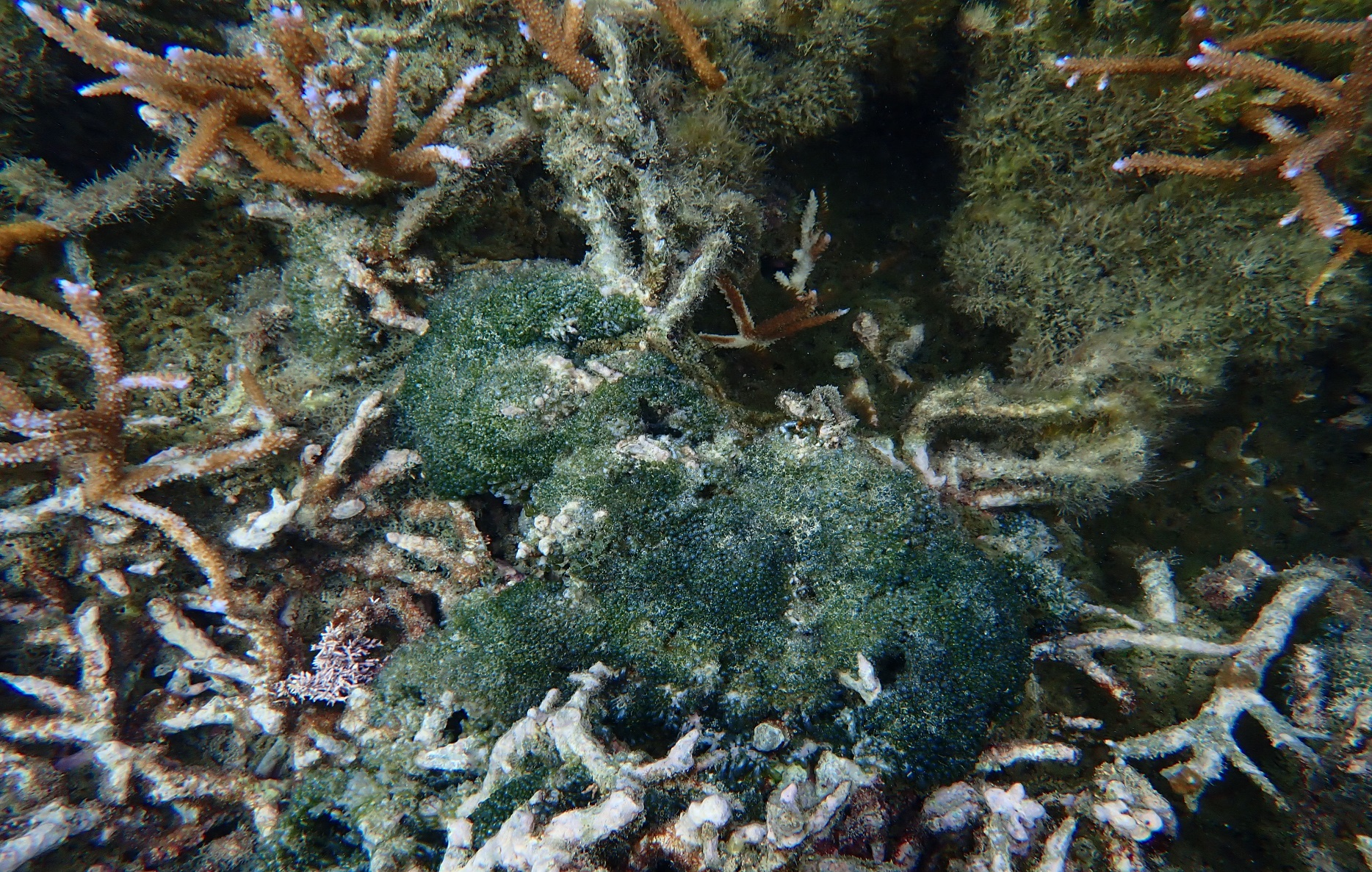
Determining the Impact of Nutrient Enrichment on Algal Growth
Myron Faimalo
Tafuna High School
Mentor: Eric Brown, Ph.D.
Marine Ecologist
National Park of American Samoa

Slide 2
INTRODUCTION
Algae: photosynthetic organisms, primary producers in ecosystems
Algae use nutrients such as nitrogen and phosphorus to grow
Nutrient enrichment leads to algal blooms that are harmful to aquatic life. Can overgrow corals
The purpose of this research is to determine how different species of algae react to varying levels of nutrients in water
Results can inform resource managers about problematic nutrient levels

Slide 3
HYPOTHESES
An increase in nutrients will cause an increase in biomass for all algal species
Valonia fastigata will have the greatest increase in biomass

Slide 4
Hawaii
Philippines
Marshall Islands
Papua New Guinea
Tutuila
Samoa
American Samoa
Fiji
French Polynesia
Tonga
Australia
New Zealand

Slide 5
Sites
Pago Pago
Gataivai
Nuuuli
Fagaalu

Slide 6
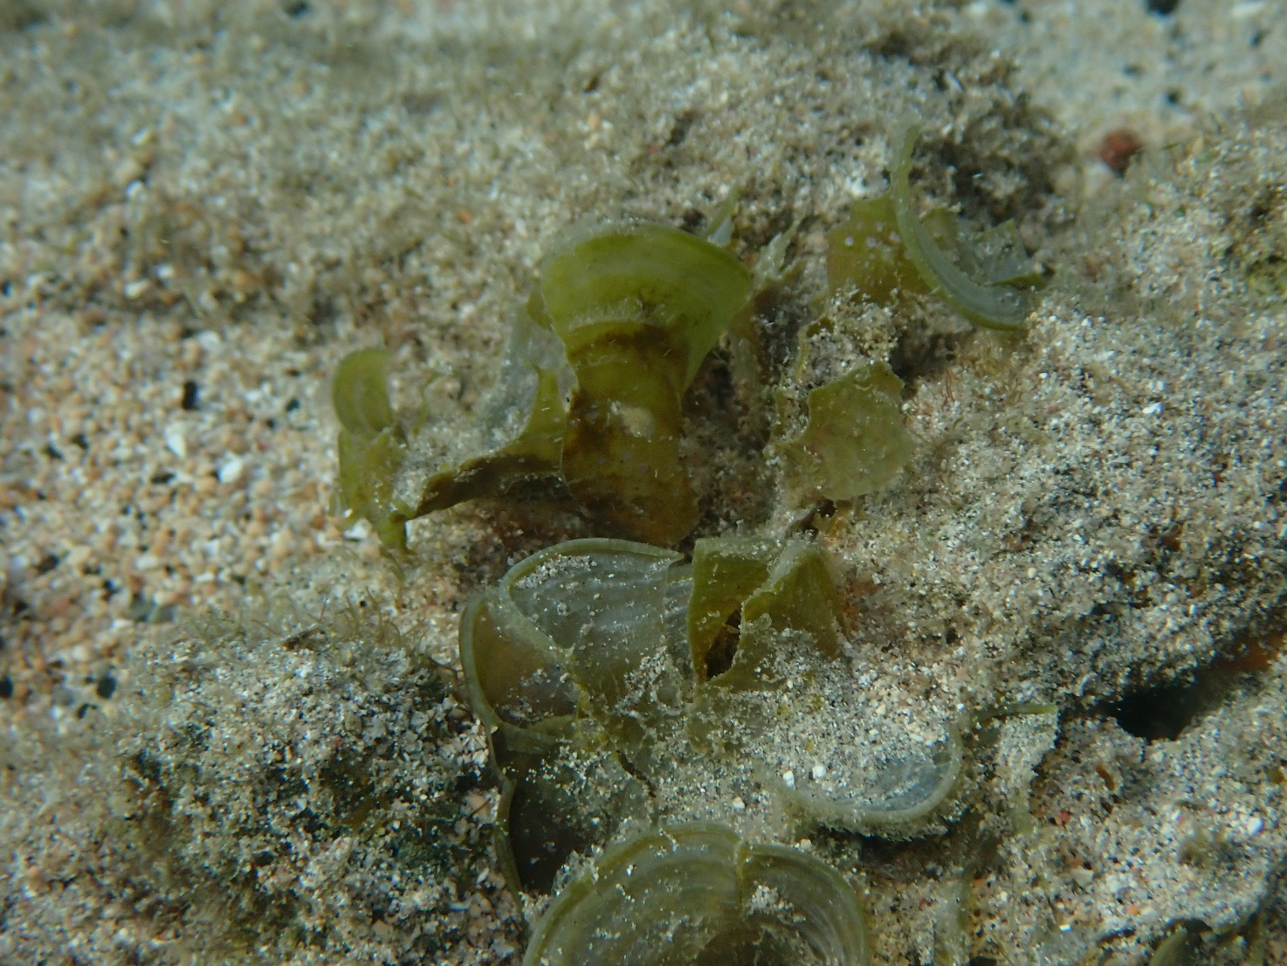
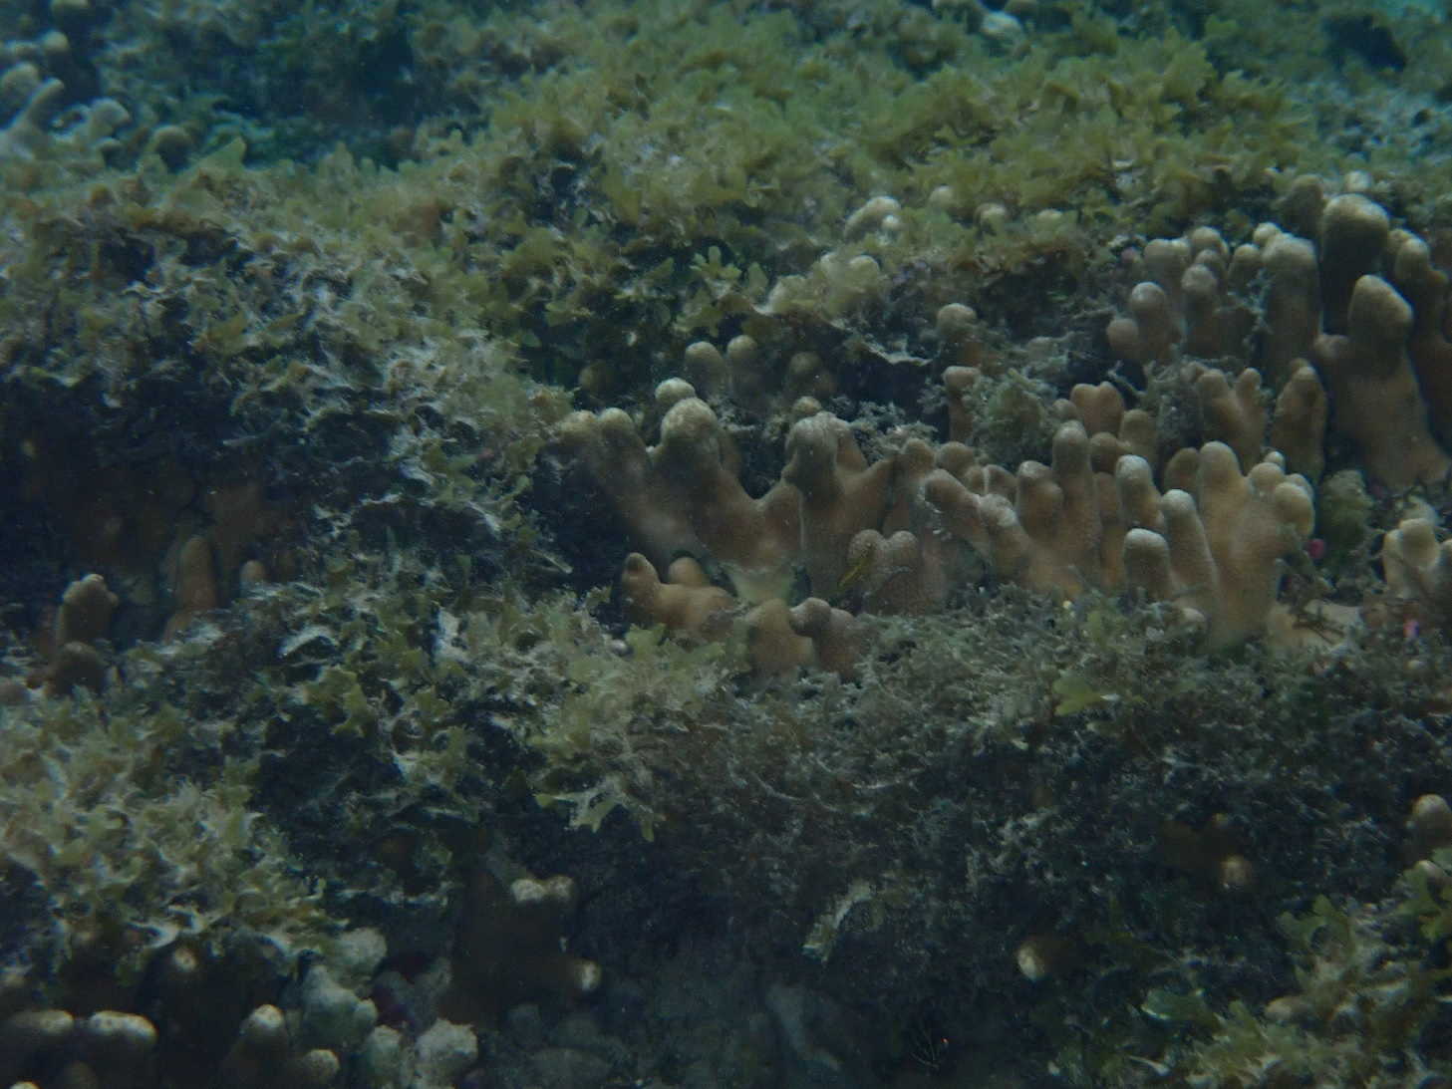
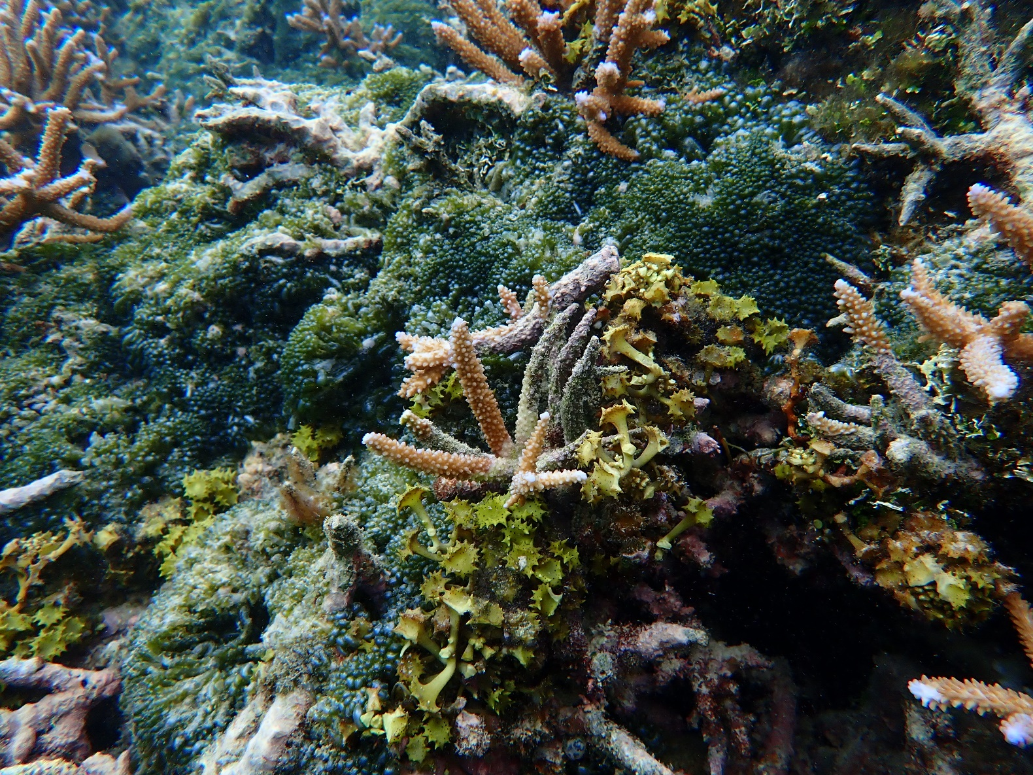
Padina boryana
Dictyota bartyresiana
Valonia fastigiata
Turbinaria ornata

Slide 7
Methodology-Experimental Design
Control
Nutrient
Round 1: 6/18-6/25
0 mg/l NO₃
26 mg/l NO₃
Round 2: 6/28-7/5
0 mg/l NO₃
53mg/l NO₃
Round 3: 7/9-7/16
0 mg/l NO₃
105 mg/l NO₃

Slide 9
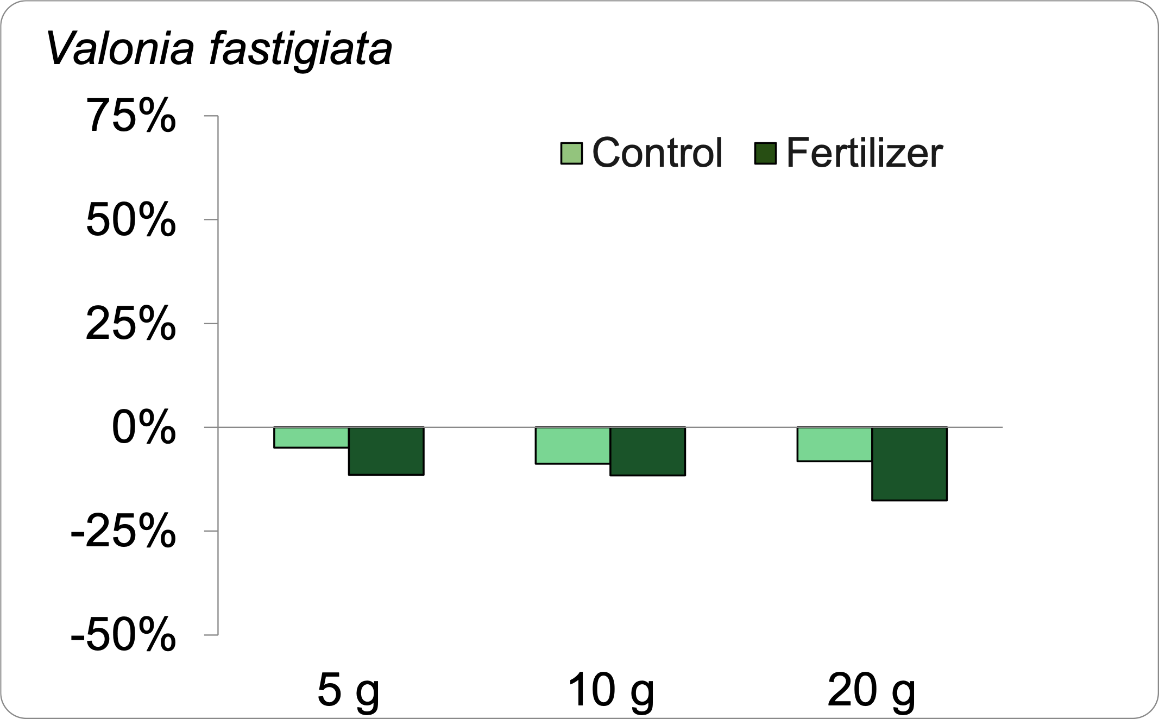
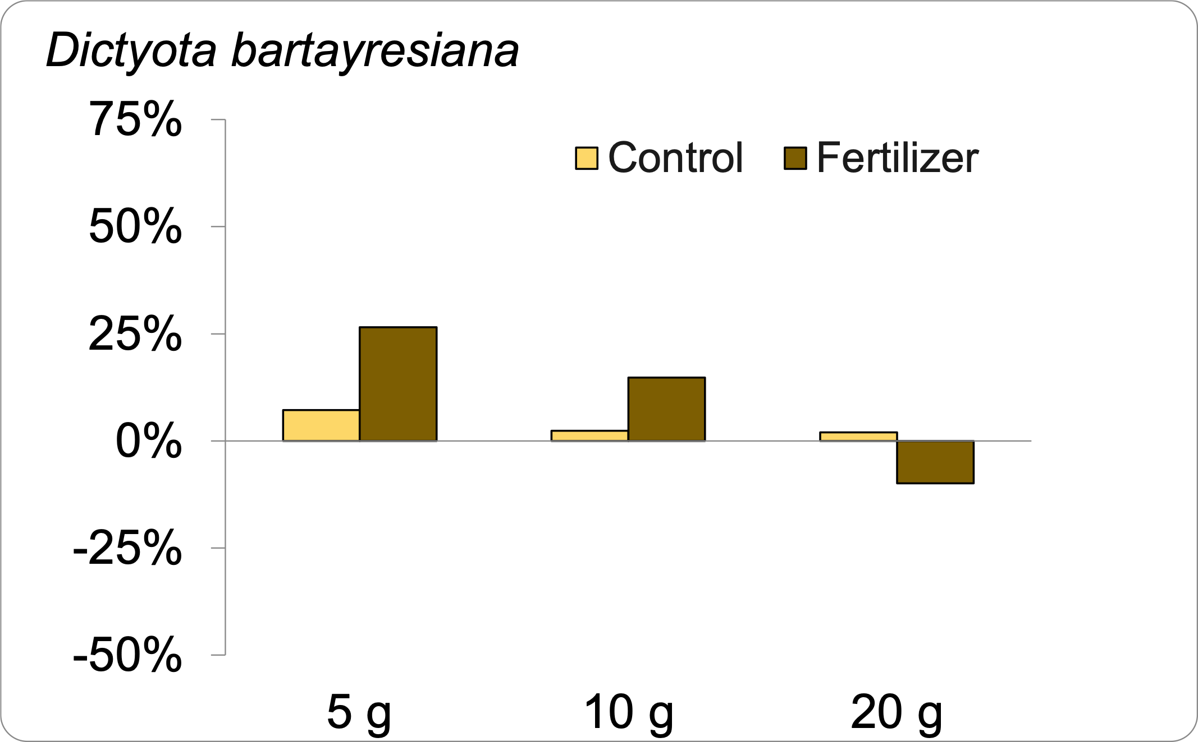
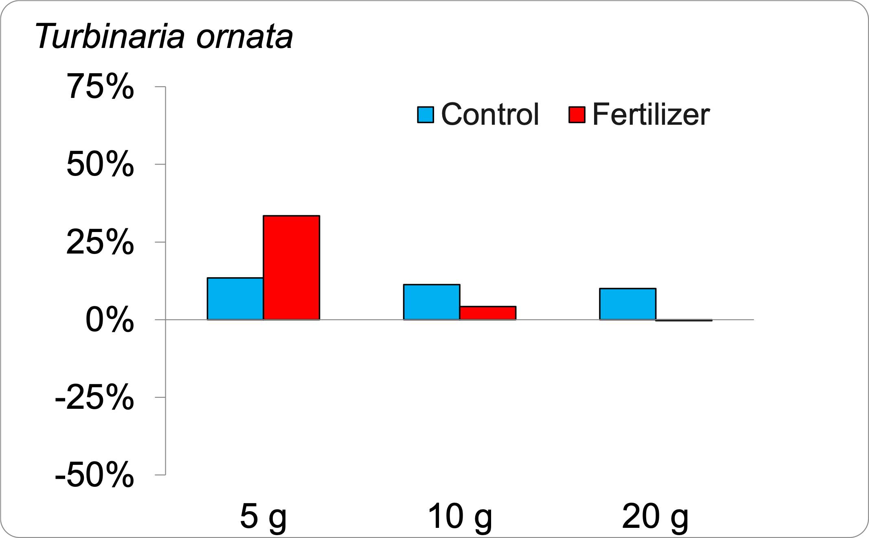
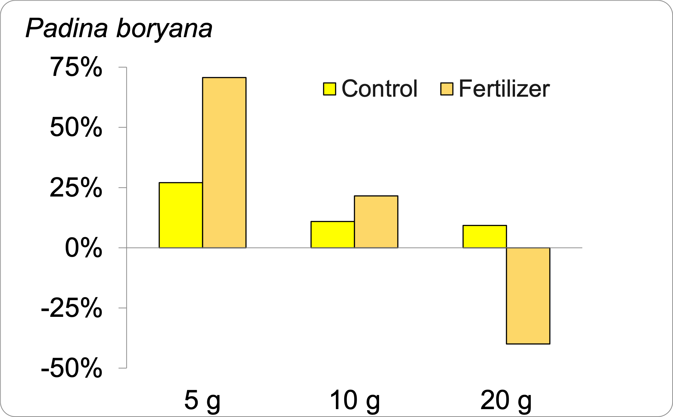
Results-Growth

Slide 10
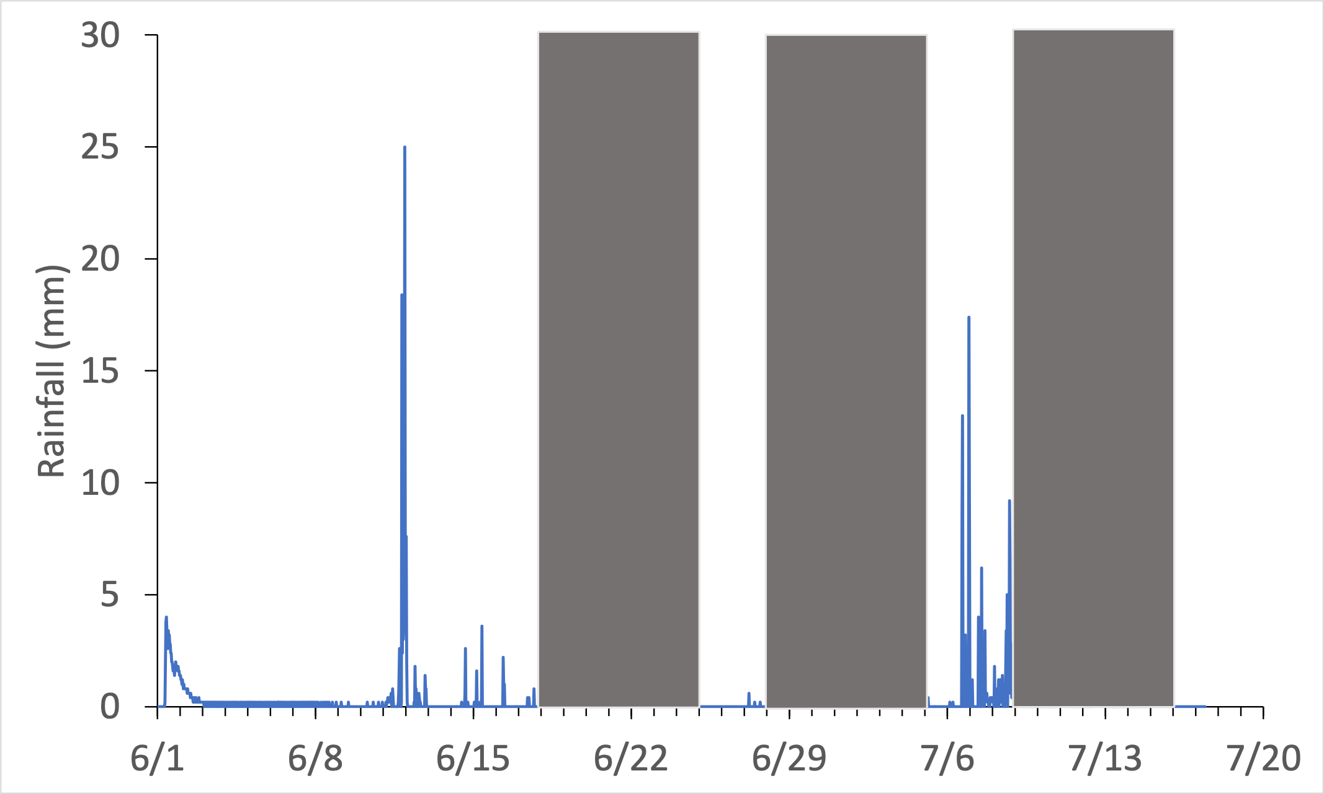
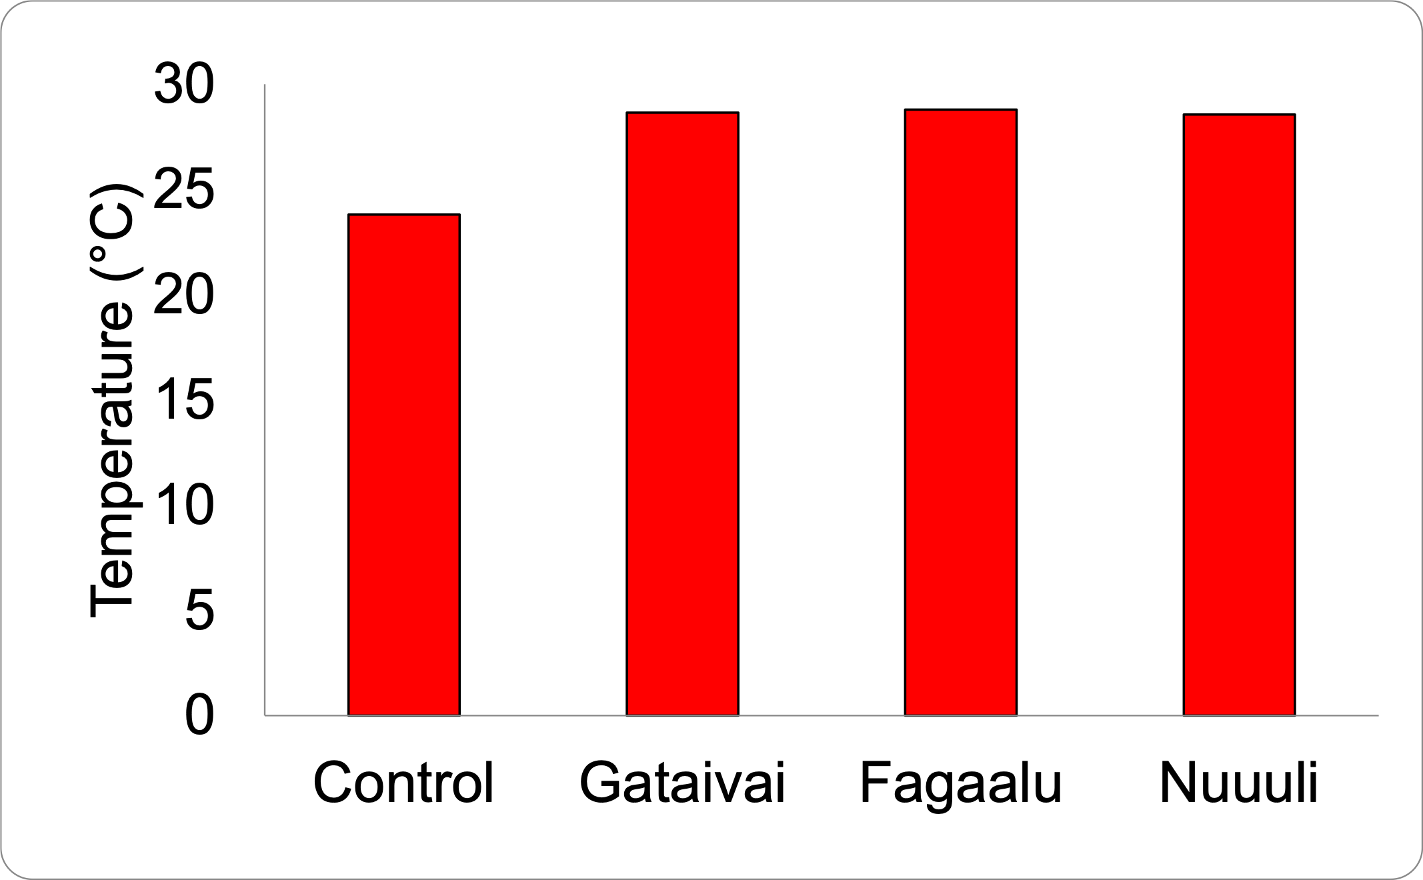
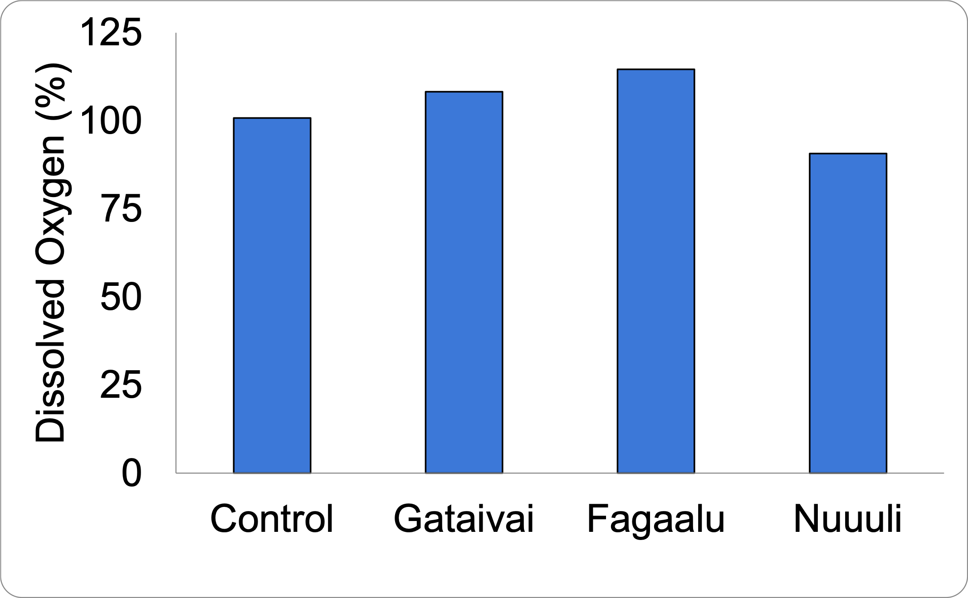
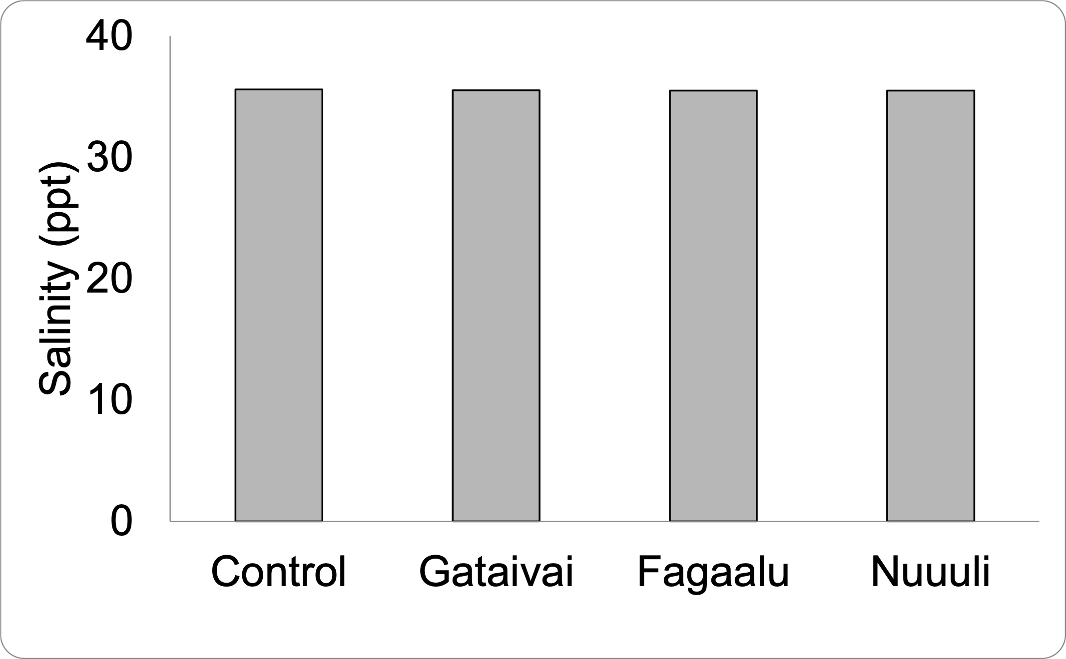
Results-Environmental
Rainfall
Temperature
Dissolved Oxygen
Salinity

Slide 11
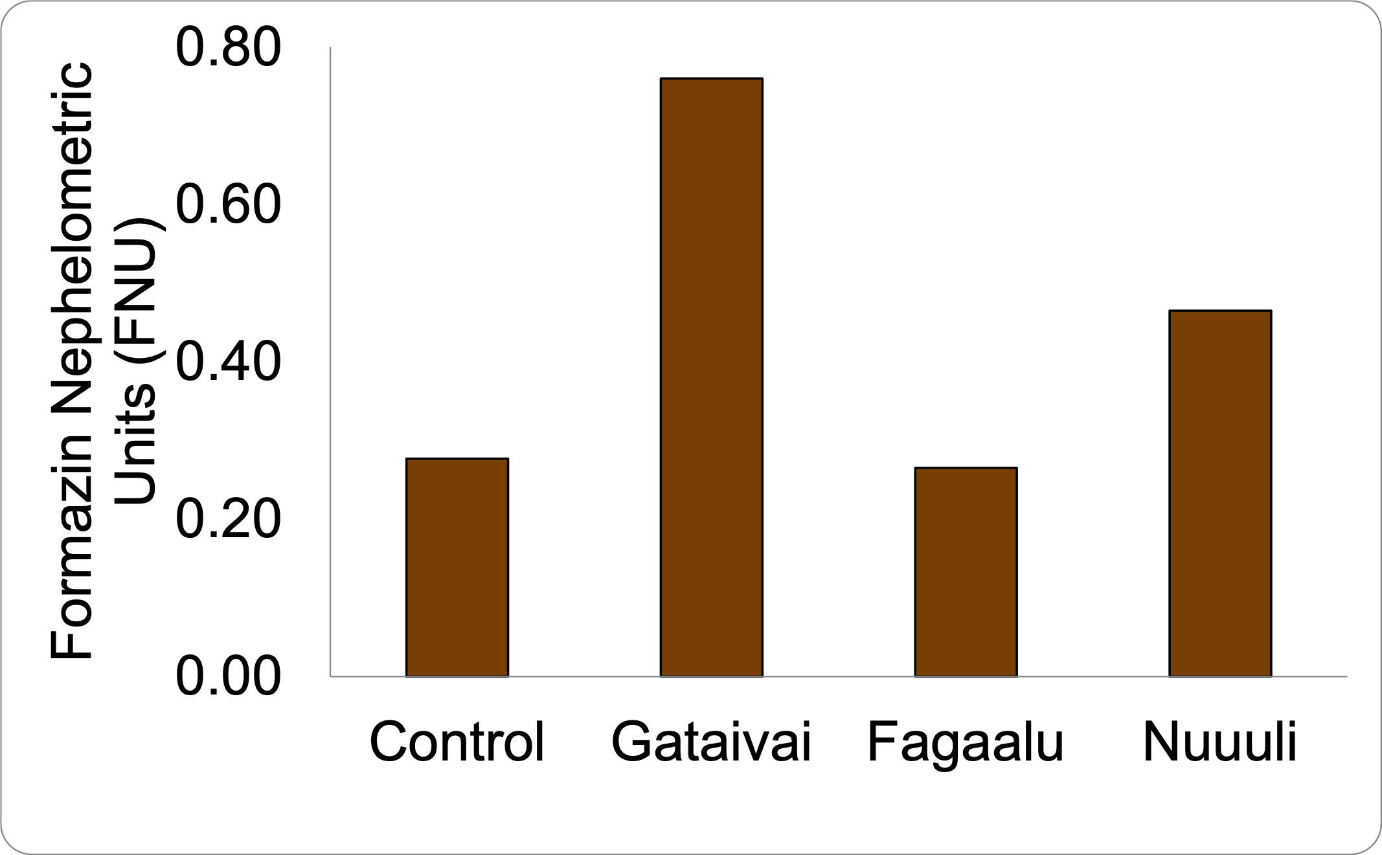
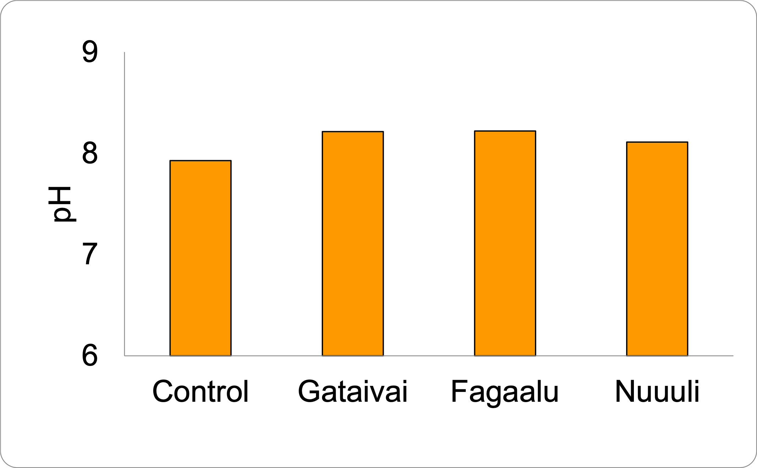
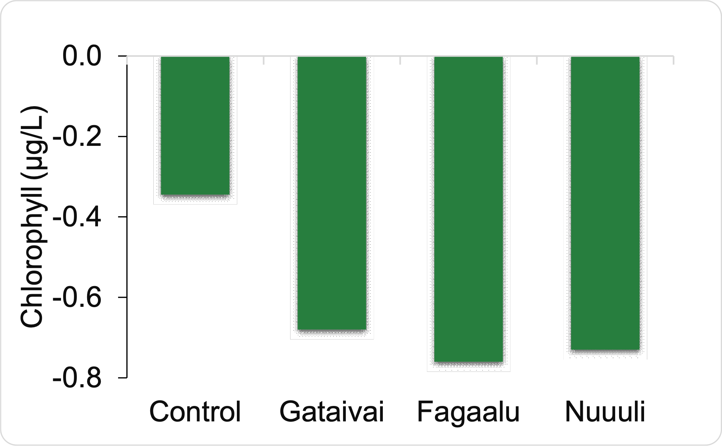
Results-Environmental
Turbidity
pH
Chlorophyll

Slide 12
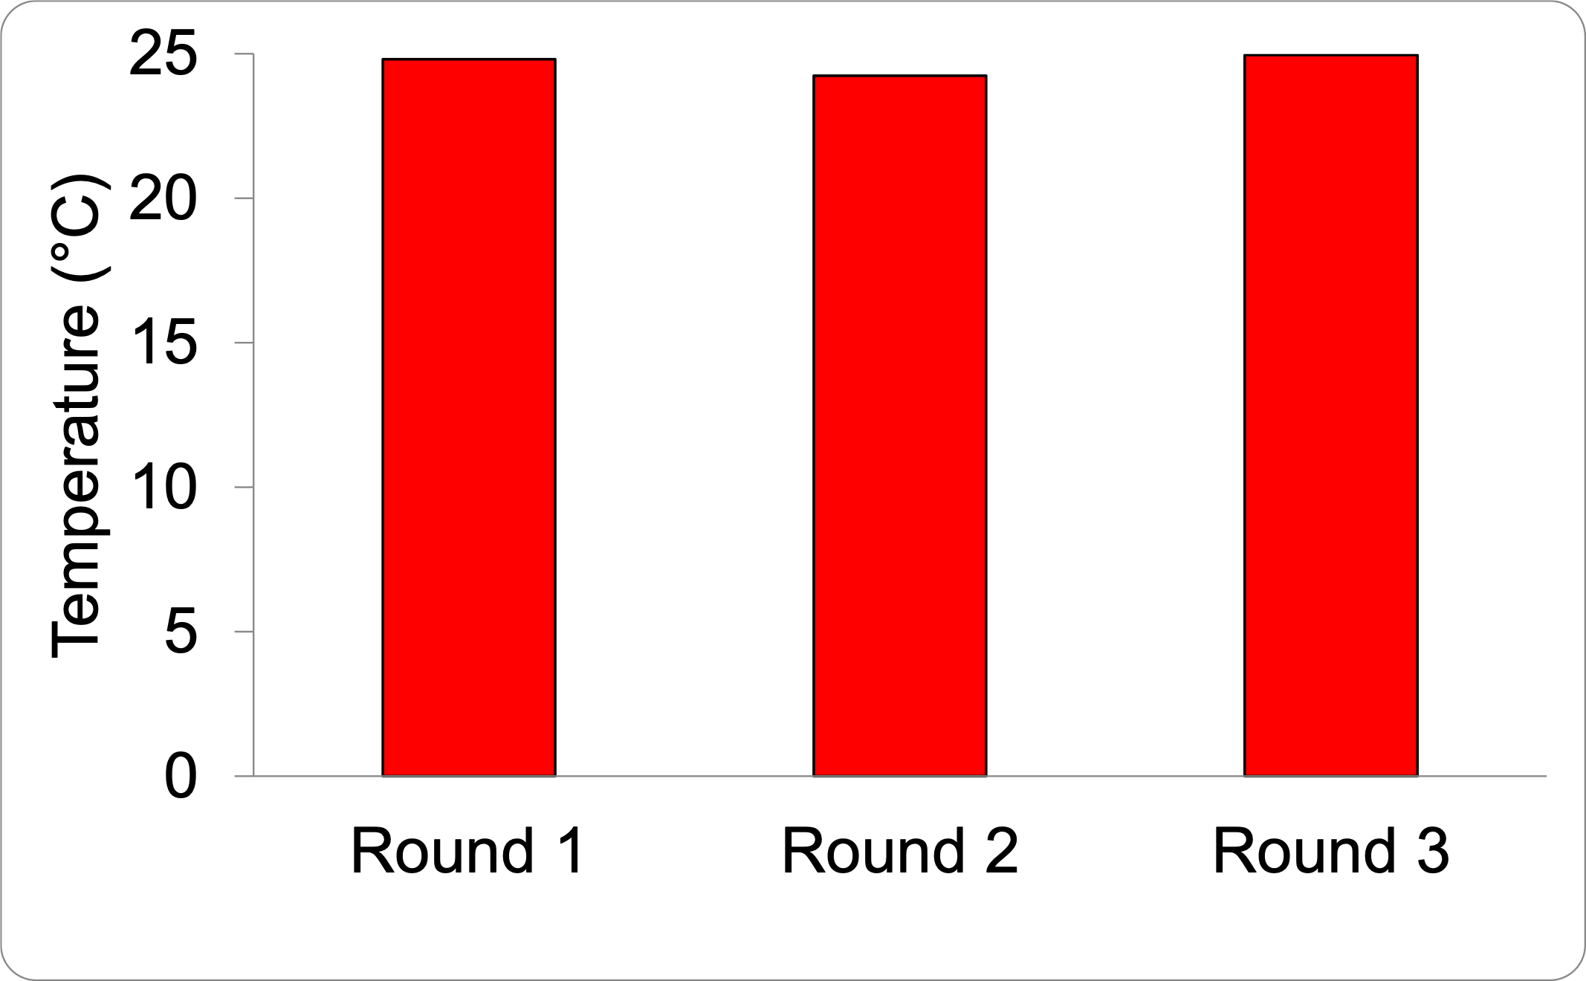
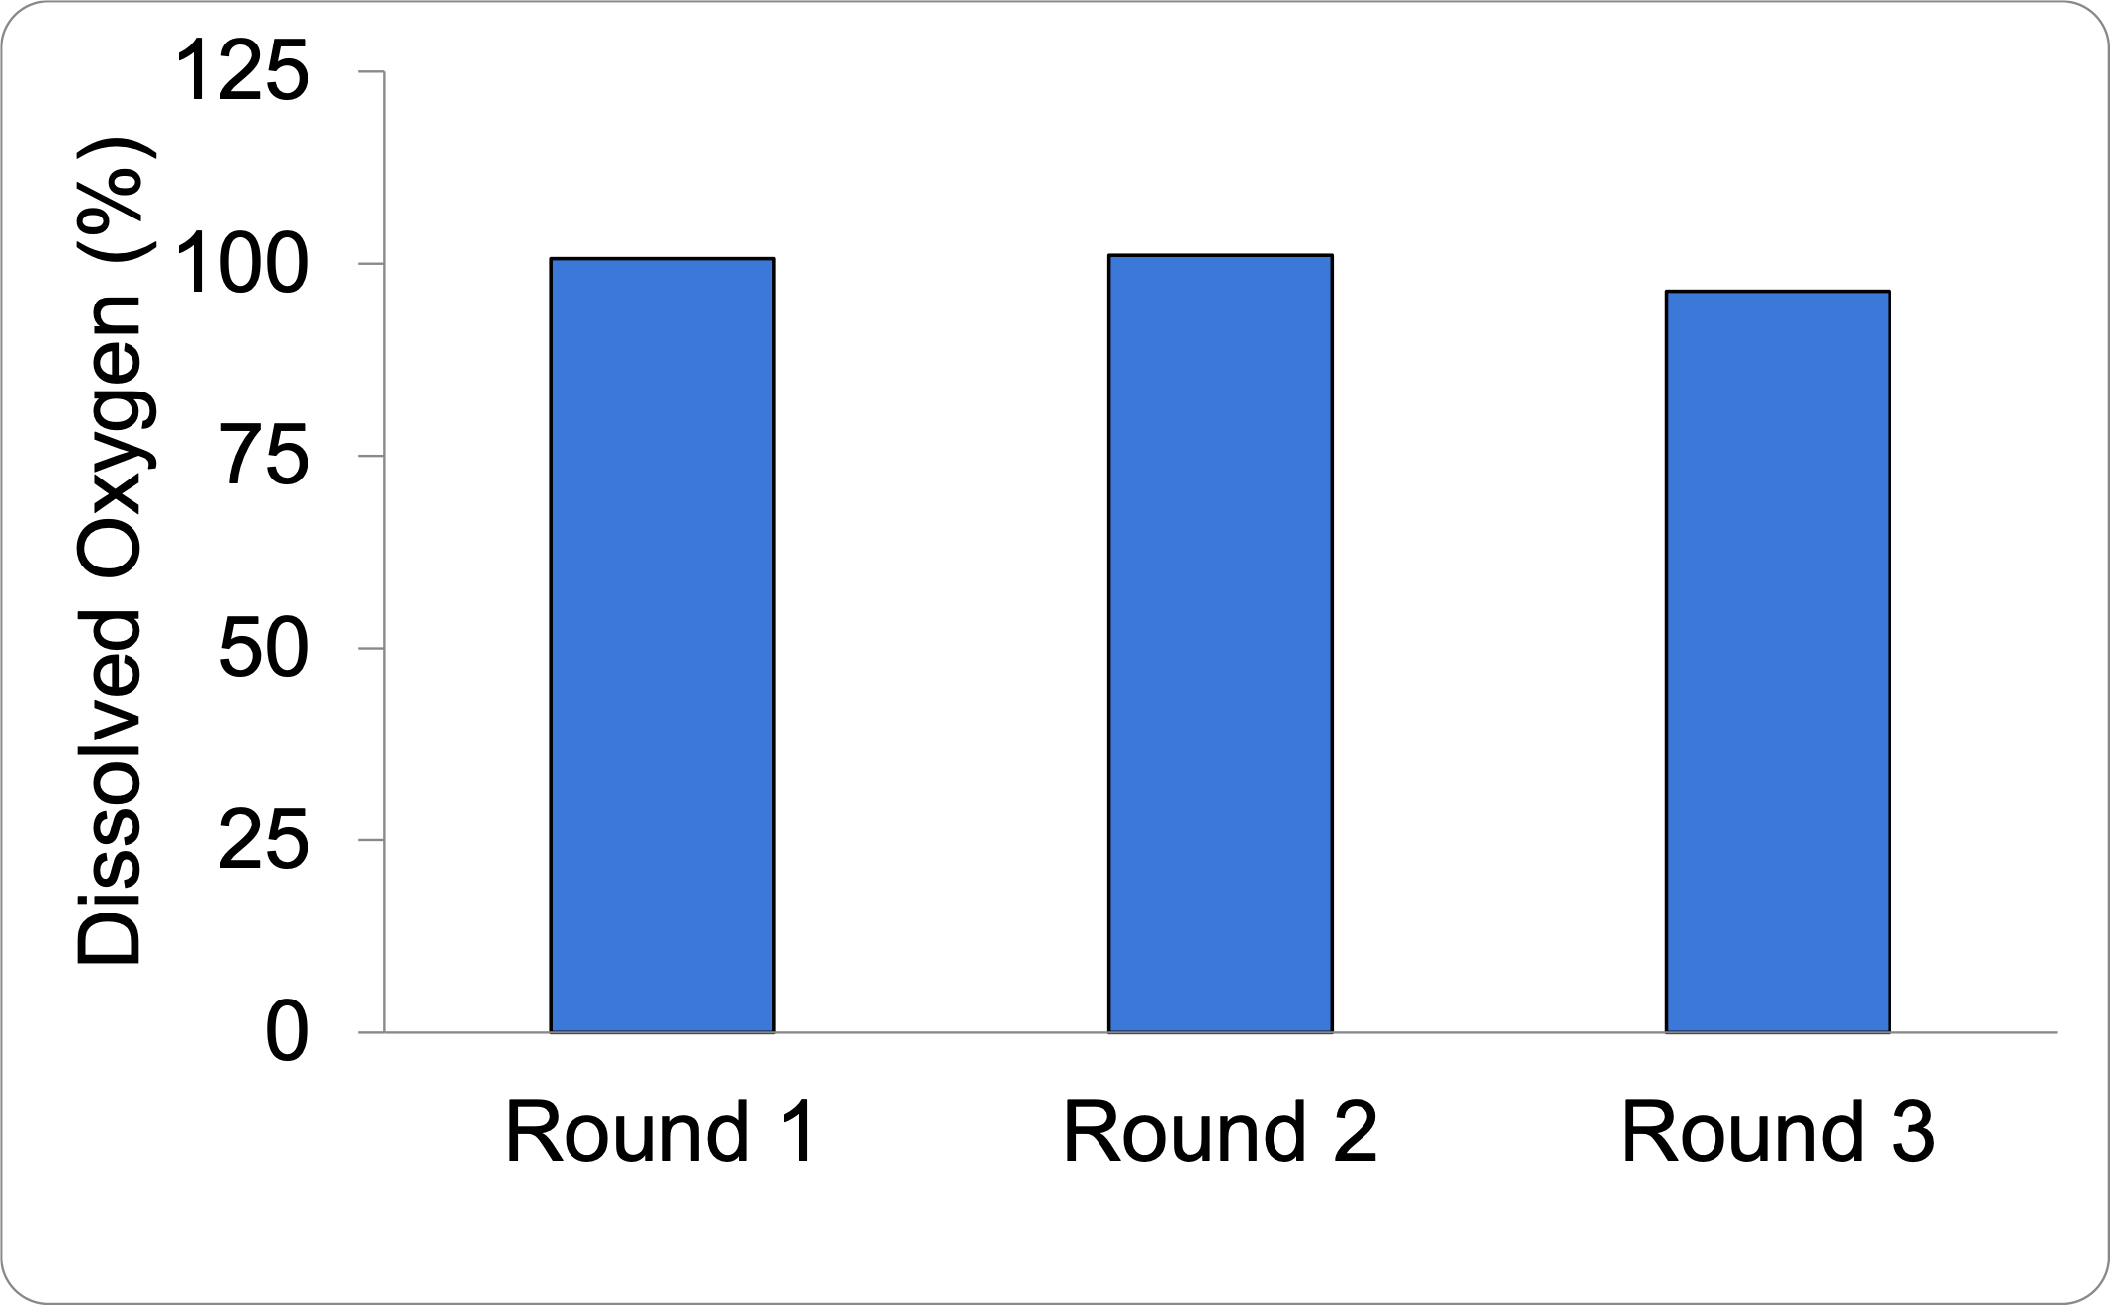
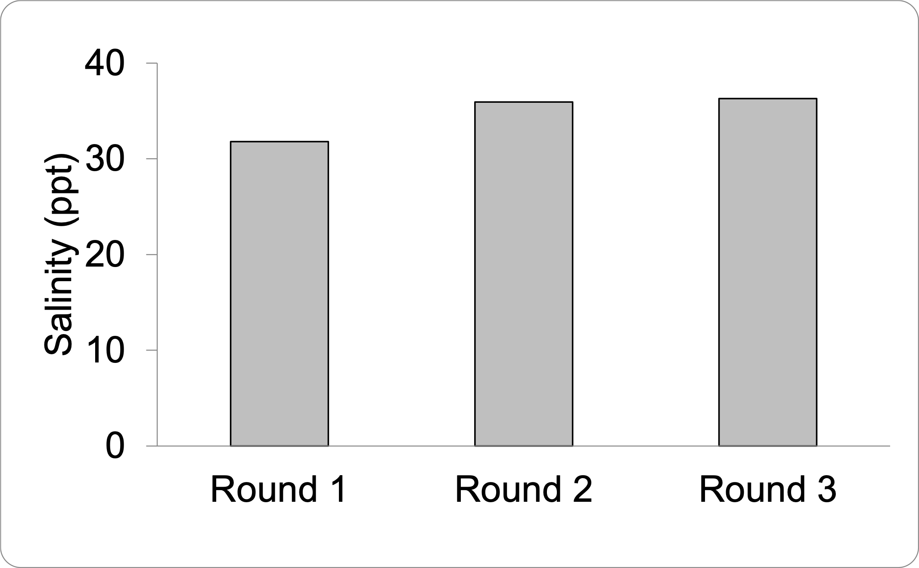
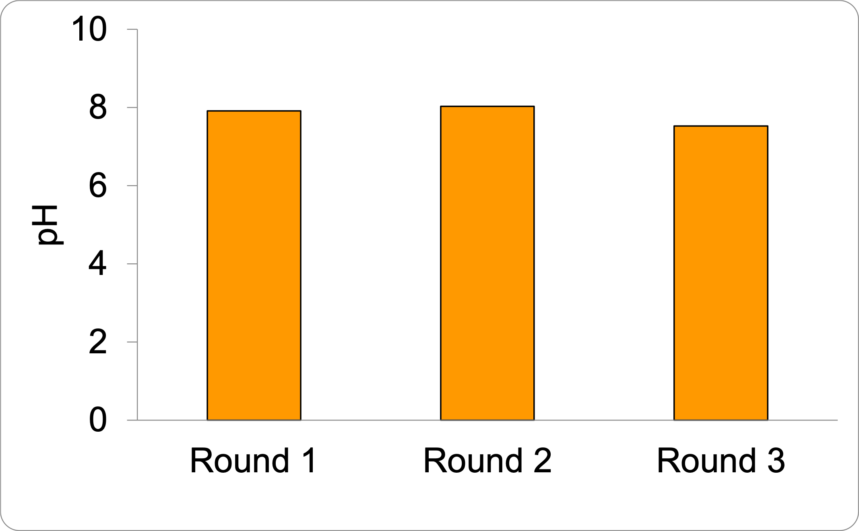
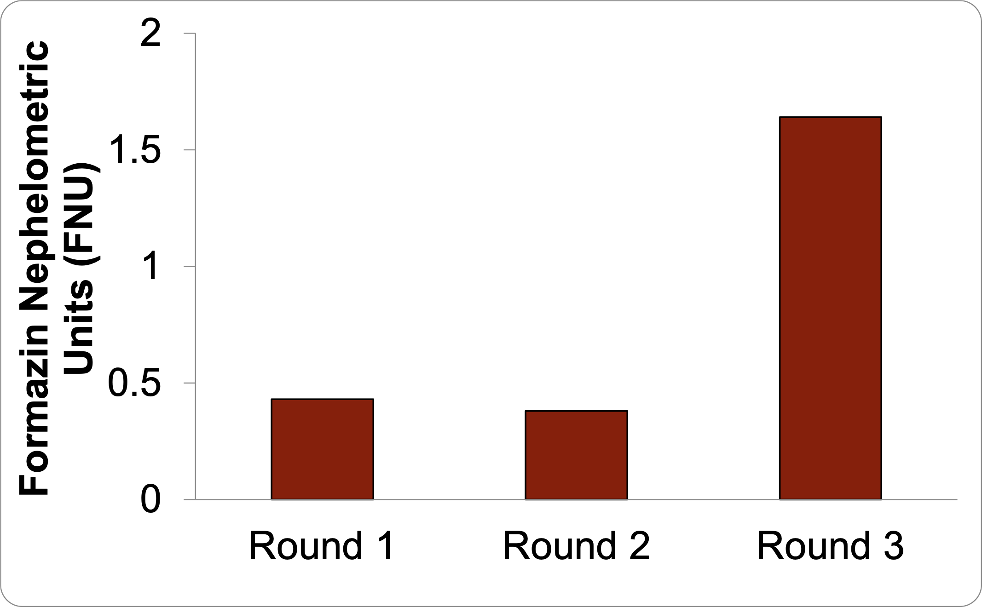
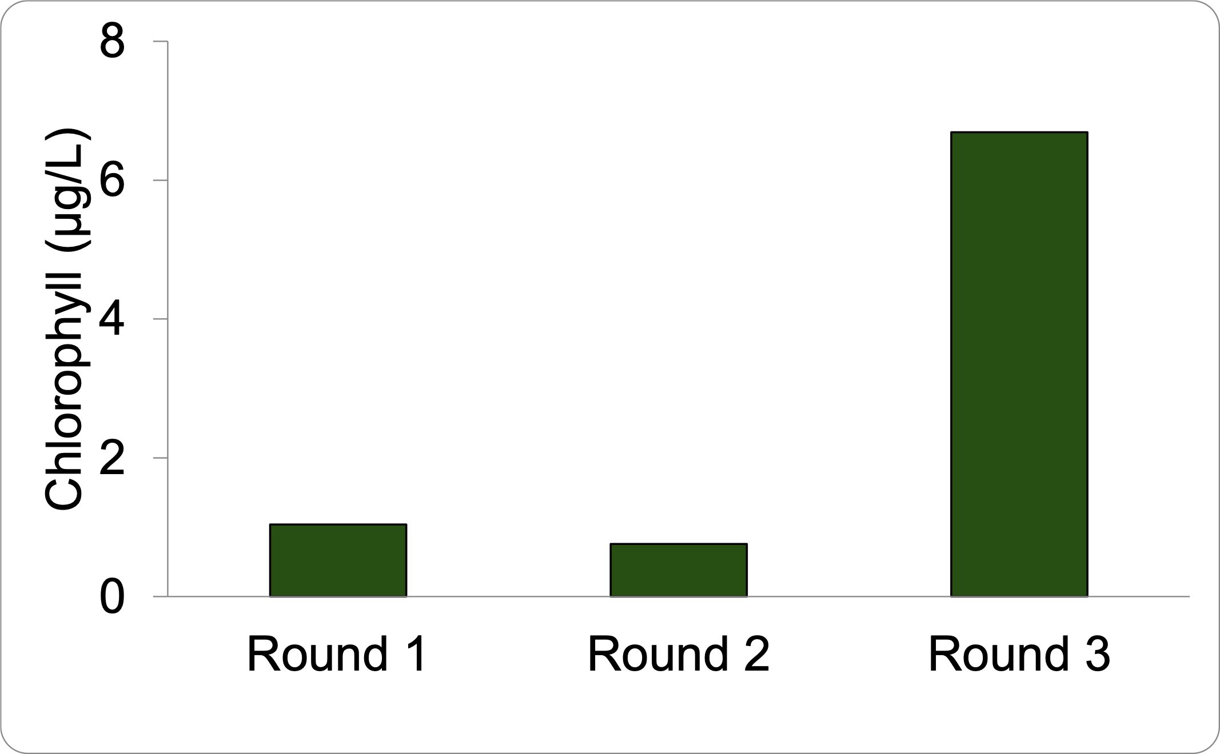
Results - Nutrient environmental
Temperature (°C)
Dissolved Oxygen (%)
Salinity (ppt)
pH
Turbidity (FNU)
Chlorophyll (µg/L)

Slide 13
References
Lapointe, B. E. (1997). "Nutrient thresholds for bottom-up control of macroalgal blooms on coral reefs in Jamaica and southeast Florida." Limnology and Oceanography, 42(5), 1119-1131.
Smith, J. E., Smith, C. M., & Hunter, C. L. (2001). "An experimental analysis of the effects of herbivory and nutrient enrichment on benthic community dynamics on a Hawaiian reef." Coral Reefs, 19(4), 332-342.
Littler, M. M., & Littler, D. S. (1984). "Models of tropical reef biogenesis: The contribution of algae." Progress in Phycological Research, 3, 323-364.
McCook, L. J. (1999). "Macroalgae, nutrients and phase shifts on coral reefs: Scientific issues and management consequences for the Great Barrier Reef." Coral Reefs, 18(4), 357-367.
Smith, S. V., & Marsh, J. A. Jr. (1973). "Organic carbon production on the windward reef flat of Eniwetok Atoll." Limnology and Oceanography, 18(6), 953-961.
Boyer, K. E., & Fong, P. (2005). "Co-occurrence of habitat-modifying invertebrates: Effects on structural and functional properties of a created salt marsh." Oecologia, 143(4), 619-628.
Fabricius, K. E. (2005). "Effects of terrestrial runoff on the ecology of corals and coral reefs: Review and synthesis." Marine Pollution Bulletin, 50(2), 125-146.
Lapointe, B. E., Barile, P. J., Littler, M. M., & Littler, D. S. (2005). "Macroalgal blooms on southeast Florida coral reefs II. Cross-shelf discrimination of nitrogen sources indicates widespread assimilation of sewage nitrogen." Harmful Algae, 4(6), 1106-1122.
Vermeij, M. J. A., & Smith, T. B. (2009). "Coral macroalgal competition: Macroalgae with different properties have different effects on corals." Marine Ecology Progress Series, 394, 275-283.

Slide 14
Conclusions
Hypothesis was partially correct. Nutrient levels initially increased growth levels
Excess nutrients however decreased growth levels (E.g., dead zone)
Padina boryana exhibited the highest increase in biomass among species
Valonia fastigiata had a significant decrease in biomass
Turbinaria ornata and Dictyota bartayresiana both decreased in biomass as nutrient levels increased
Future changes/ modifications
This research showed that some species of algae are more sensitive to fertilizer and could serve as sentinel species to indicate high nutrients
Understanding the ecological impact of high nutrient levels is crucial to prevent algal overgrowth and protect the resilience and biodiversity of coral reef ecosystems

Slide 15
Acknowledgements
NIH Grant: 525DK078386-18
STEP-UP Program
Mark Schmaedick, PhD (American Samoa Community College)
Eric Brown, PhD (National Park Service)
Valentine Vaeoso (National Park Service)
Tilali Scanlan (Student Conservation Association)

Slide 16
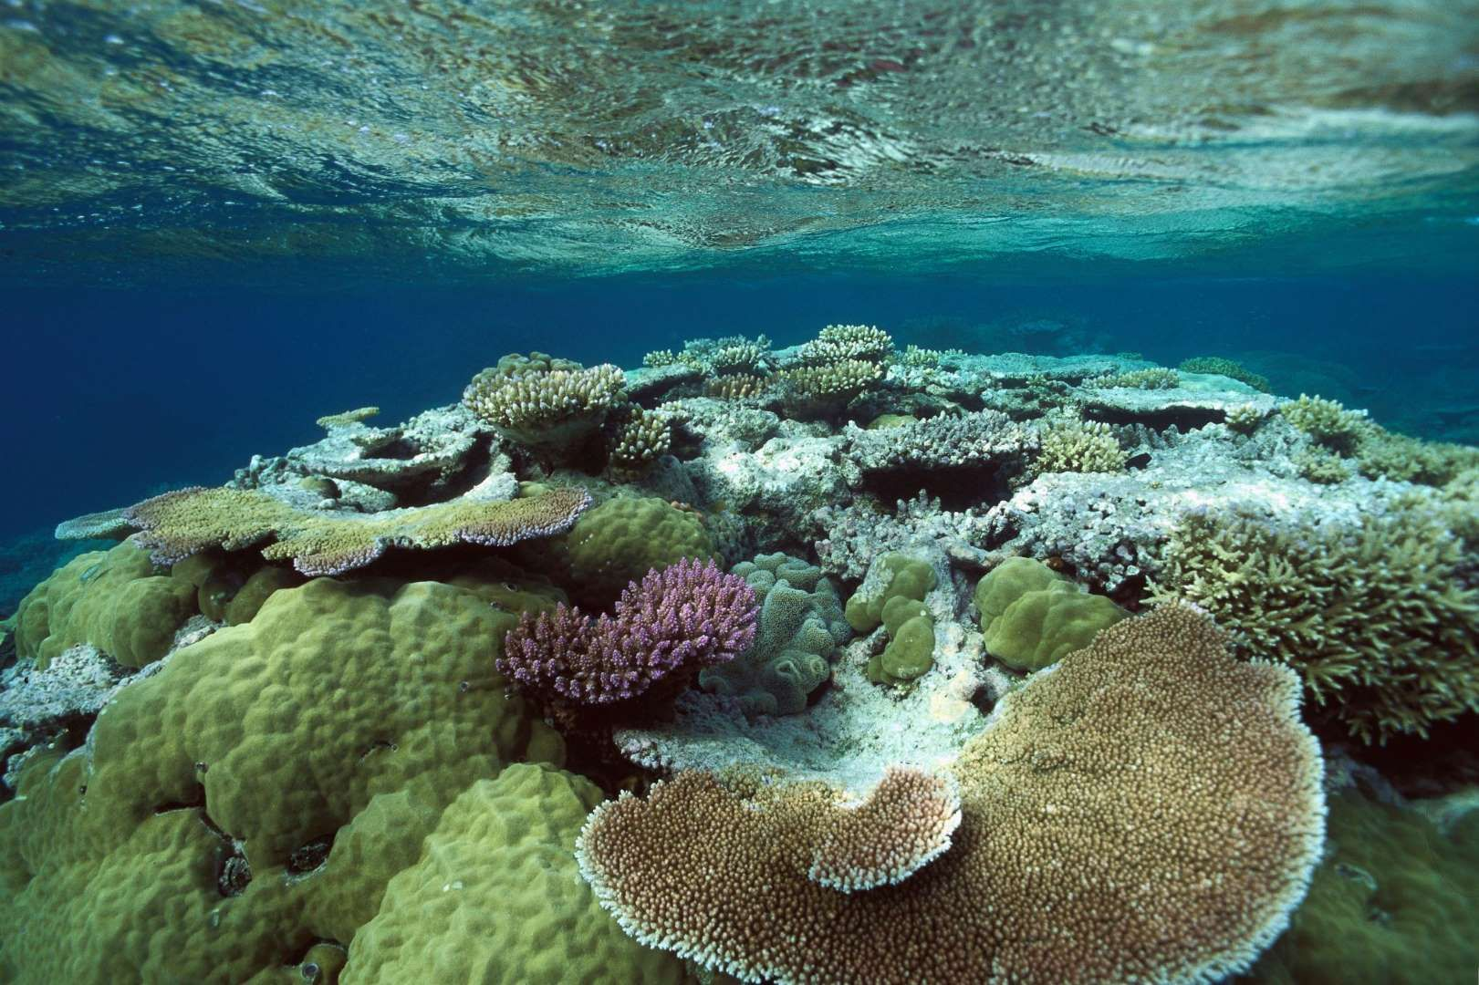
Questions?

