Slide 1
Species Richness of Native Plants within the National Park of American Samoa
Presentation By: Alycia Tausaga
Mentored By: Visa Vaivai-Tapusoa
Notes:
Touch briefly on the photograph. View of a healthy native rainforest protectd in the National Park. All the trees here are native plants. This is an Ieie vine our people in Manu’a used the roots of the ieie vine to weave fish traps to catch i’a sina. In the background is the Asi Toa tree which provides food for fruit bats and native birds. In the Asi wood it is used by people to build Samoan geust house.

Slide 2
Environmental Impact of Non-Native Plants (Invasive Species)
Alter fundamental ecological functions of Samoan forest
Adversely impacts island biodiversity
Increase levels of Nutrient (NO₃) in the soil
Out-compete Samoan rainforest tree species
Native habitat degradation
High cost to manage for invasive species control projects
Major cause of Native species extinction on islands

Slide 3
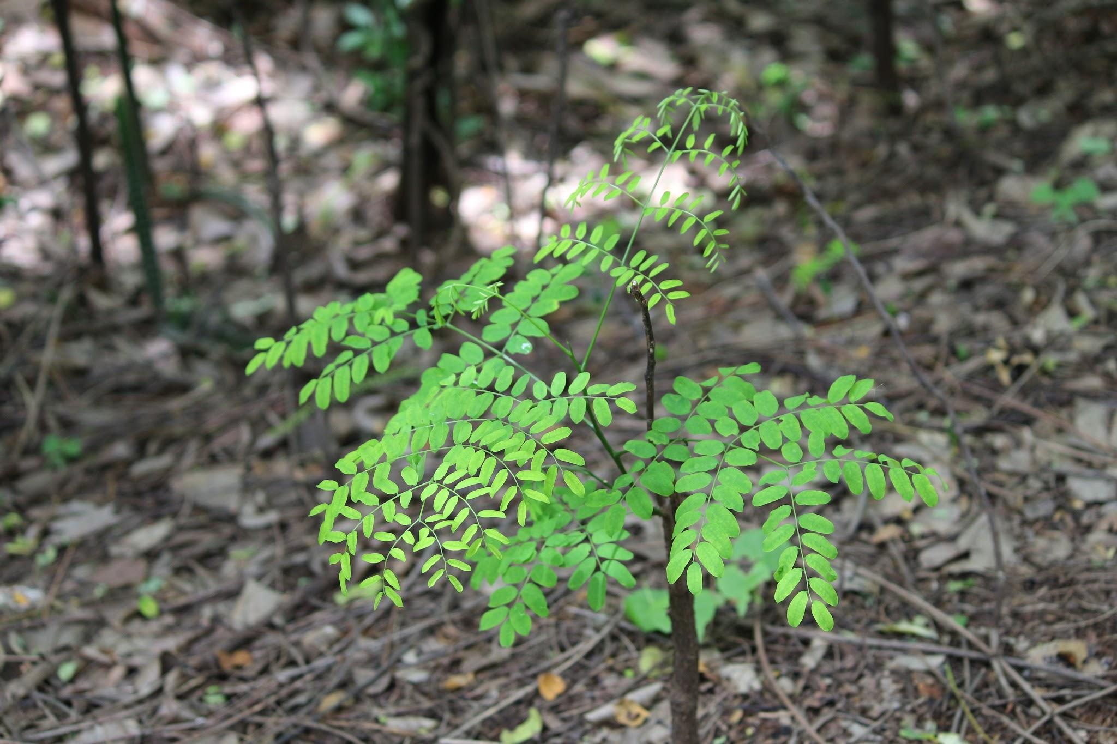
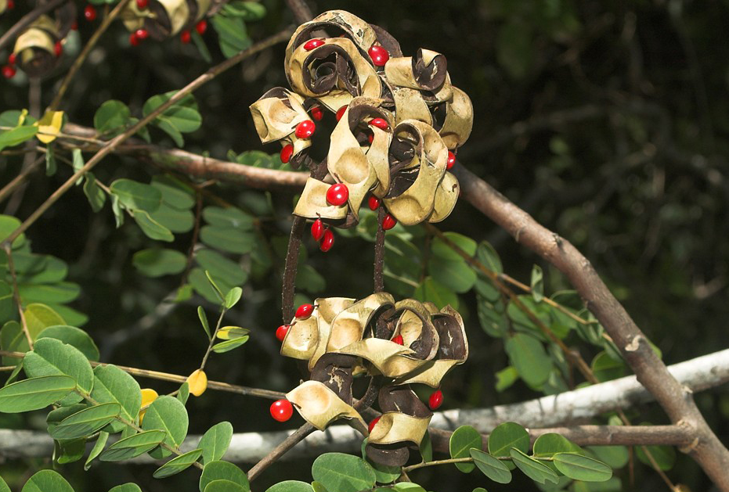
Adenanthera pavonina
COMMON NAME: Lopa
TAXONOMIC FAMILY: Fabaceae
THREATS: Grows tall and shades out native plants from sunlight. It also produces high levels of nitrates in the soil, causing unhealthy growth of native plants

Slide 4
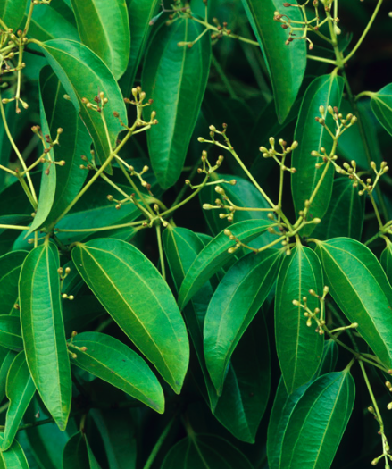
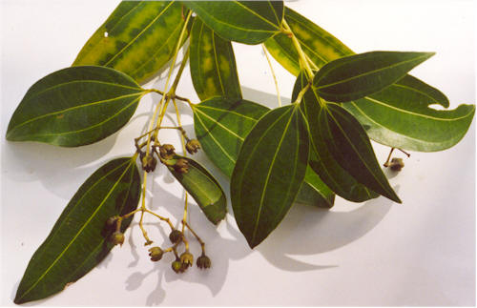
Cinnamomum verum
COMMON NAME: Tinamoni
TAXONOMIC FAMILY: Lauraceae
THREAT: Grows a thick carpet of seedlings which cover the space needed by native plants to grow

Slide 5
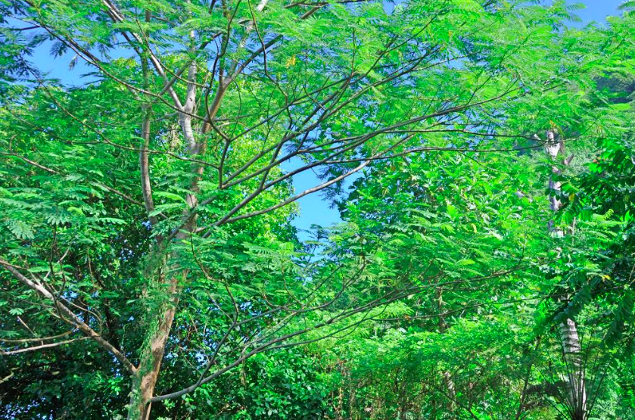
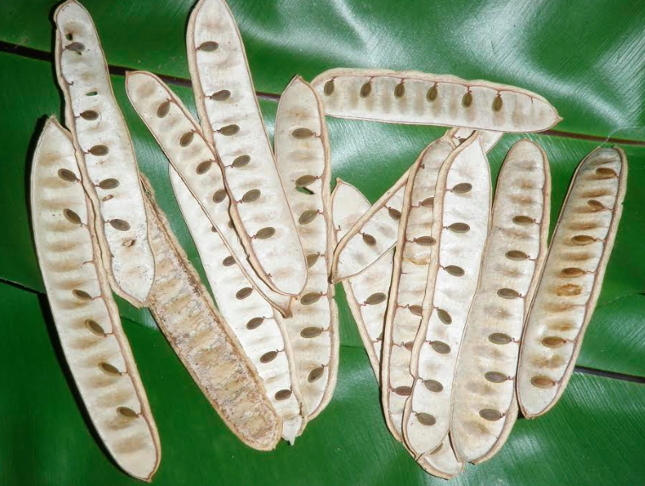
Falcataria moluccana
COMMON NAME: Tamaligi
TAXONOMIC FAMILY: Fabaceae
THREATS: Tamaligi is a nitrogen fixing tree which increases high levels of nitrogen in the form of nitrates in the soil changing the soil chemistry which is unfavorable for native plants to grow.

Slide 6
Purpose
●To measure the species richness of native plants within the National Park of American Samoa

Slide 7
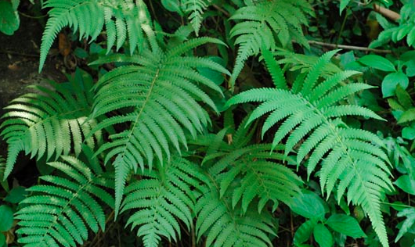
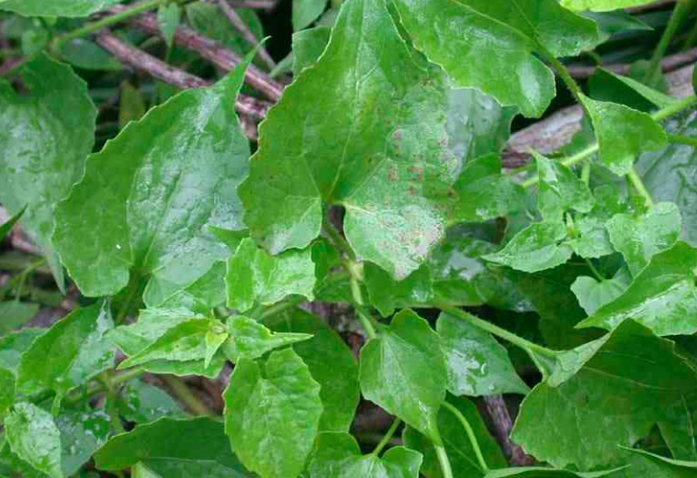
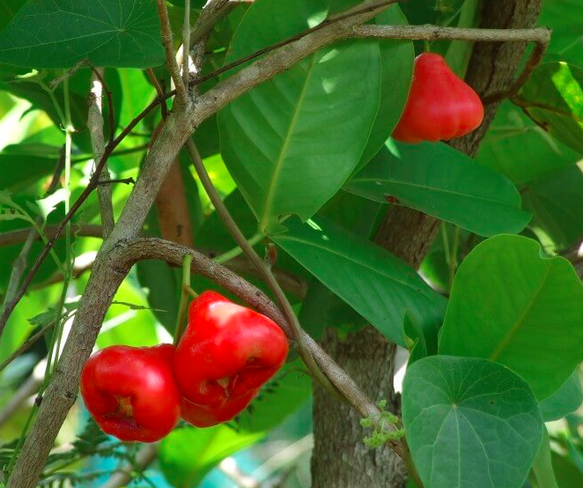
Hypothesis
We hypothesise that because humans (via logging, farming, grazing, etc.) have not heavily altered the wet forest plant community within the National Park of American Samoa (NPSA) we expect native species to exceed non-native species richness on average across the sampling area
Notes:
We are fortunate that we do not have some of world worst invasive plants such as Miconia.
Syzygium samarangense
Cyclosorus parasiticus

Slide 8
Ta’u, Manu’a

Slide 9
Sampling Plots
Only Fixed Plot 1-4, 6-11 and Rotational Plot 16 and 19 were sampled in 2013
Plots
Fixed Plots: are Inventoried and Monitored every five years
Rotational Plots: changes every five years

Slide 10
Vatia, Tutuila

Slide 11
Sampling Plots
All Fixed Plots 1-15 and Rotational 16 thru 28 and 30 were sampled in 2013

Slide 12
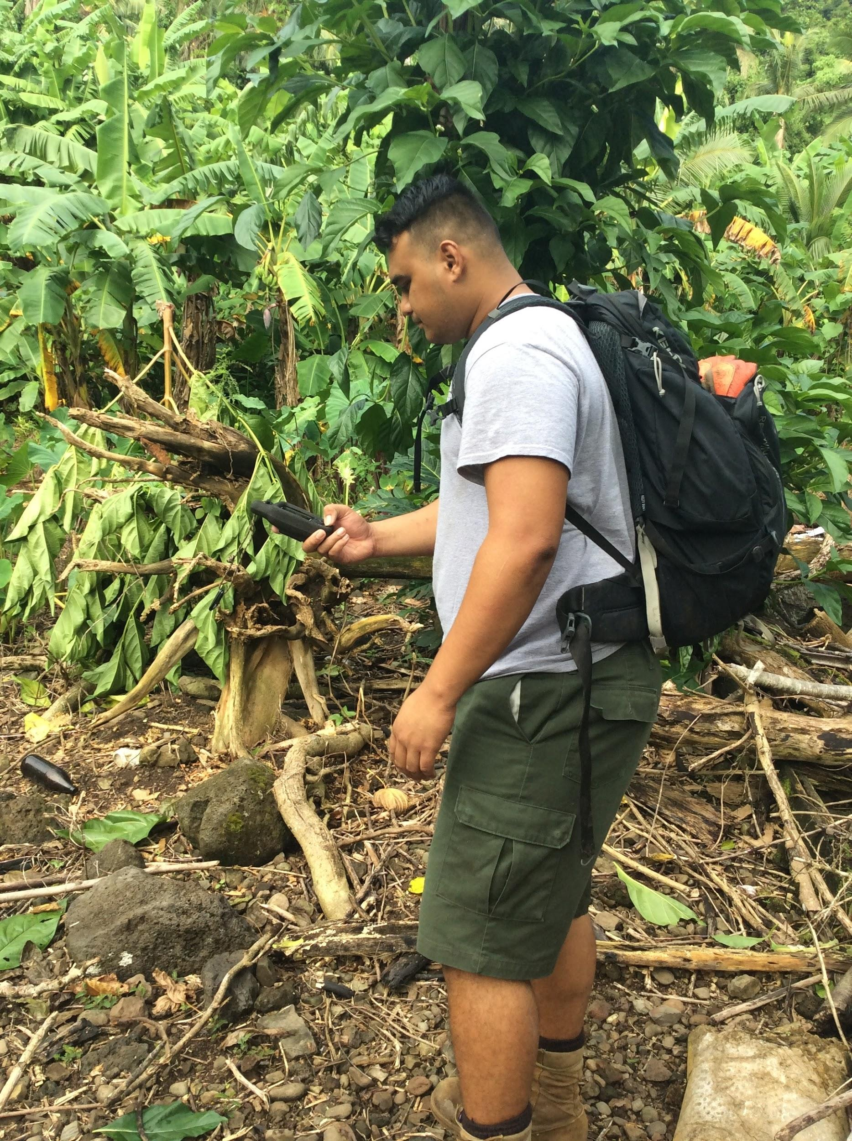
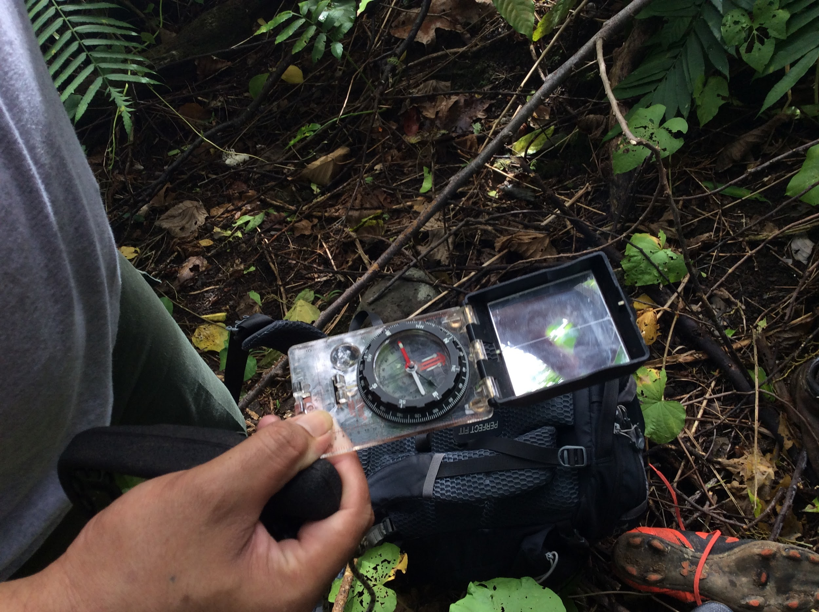
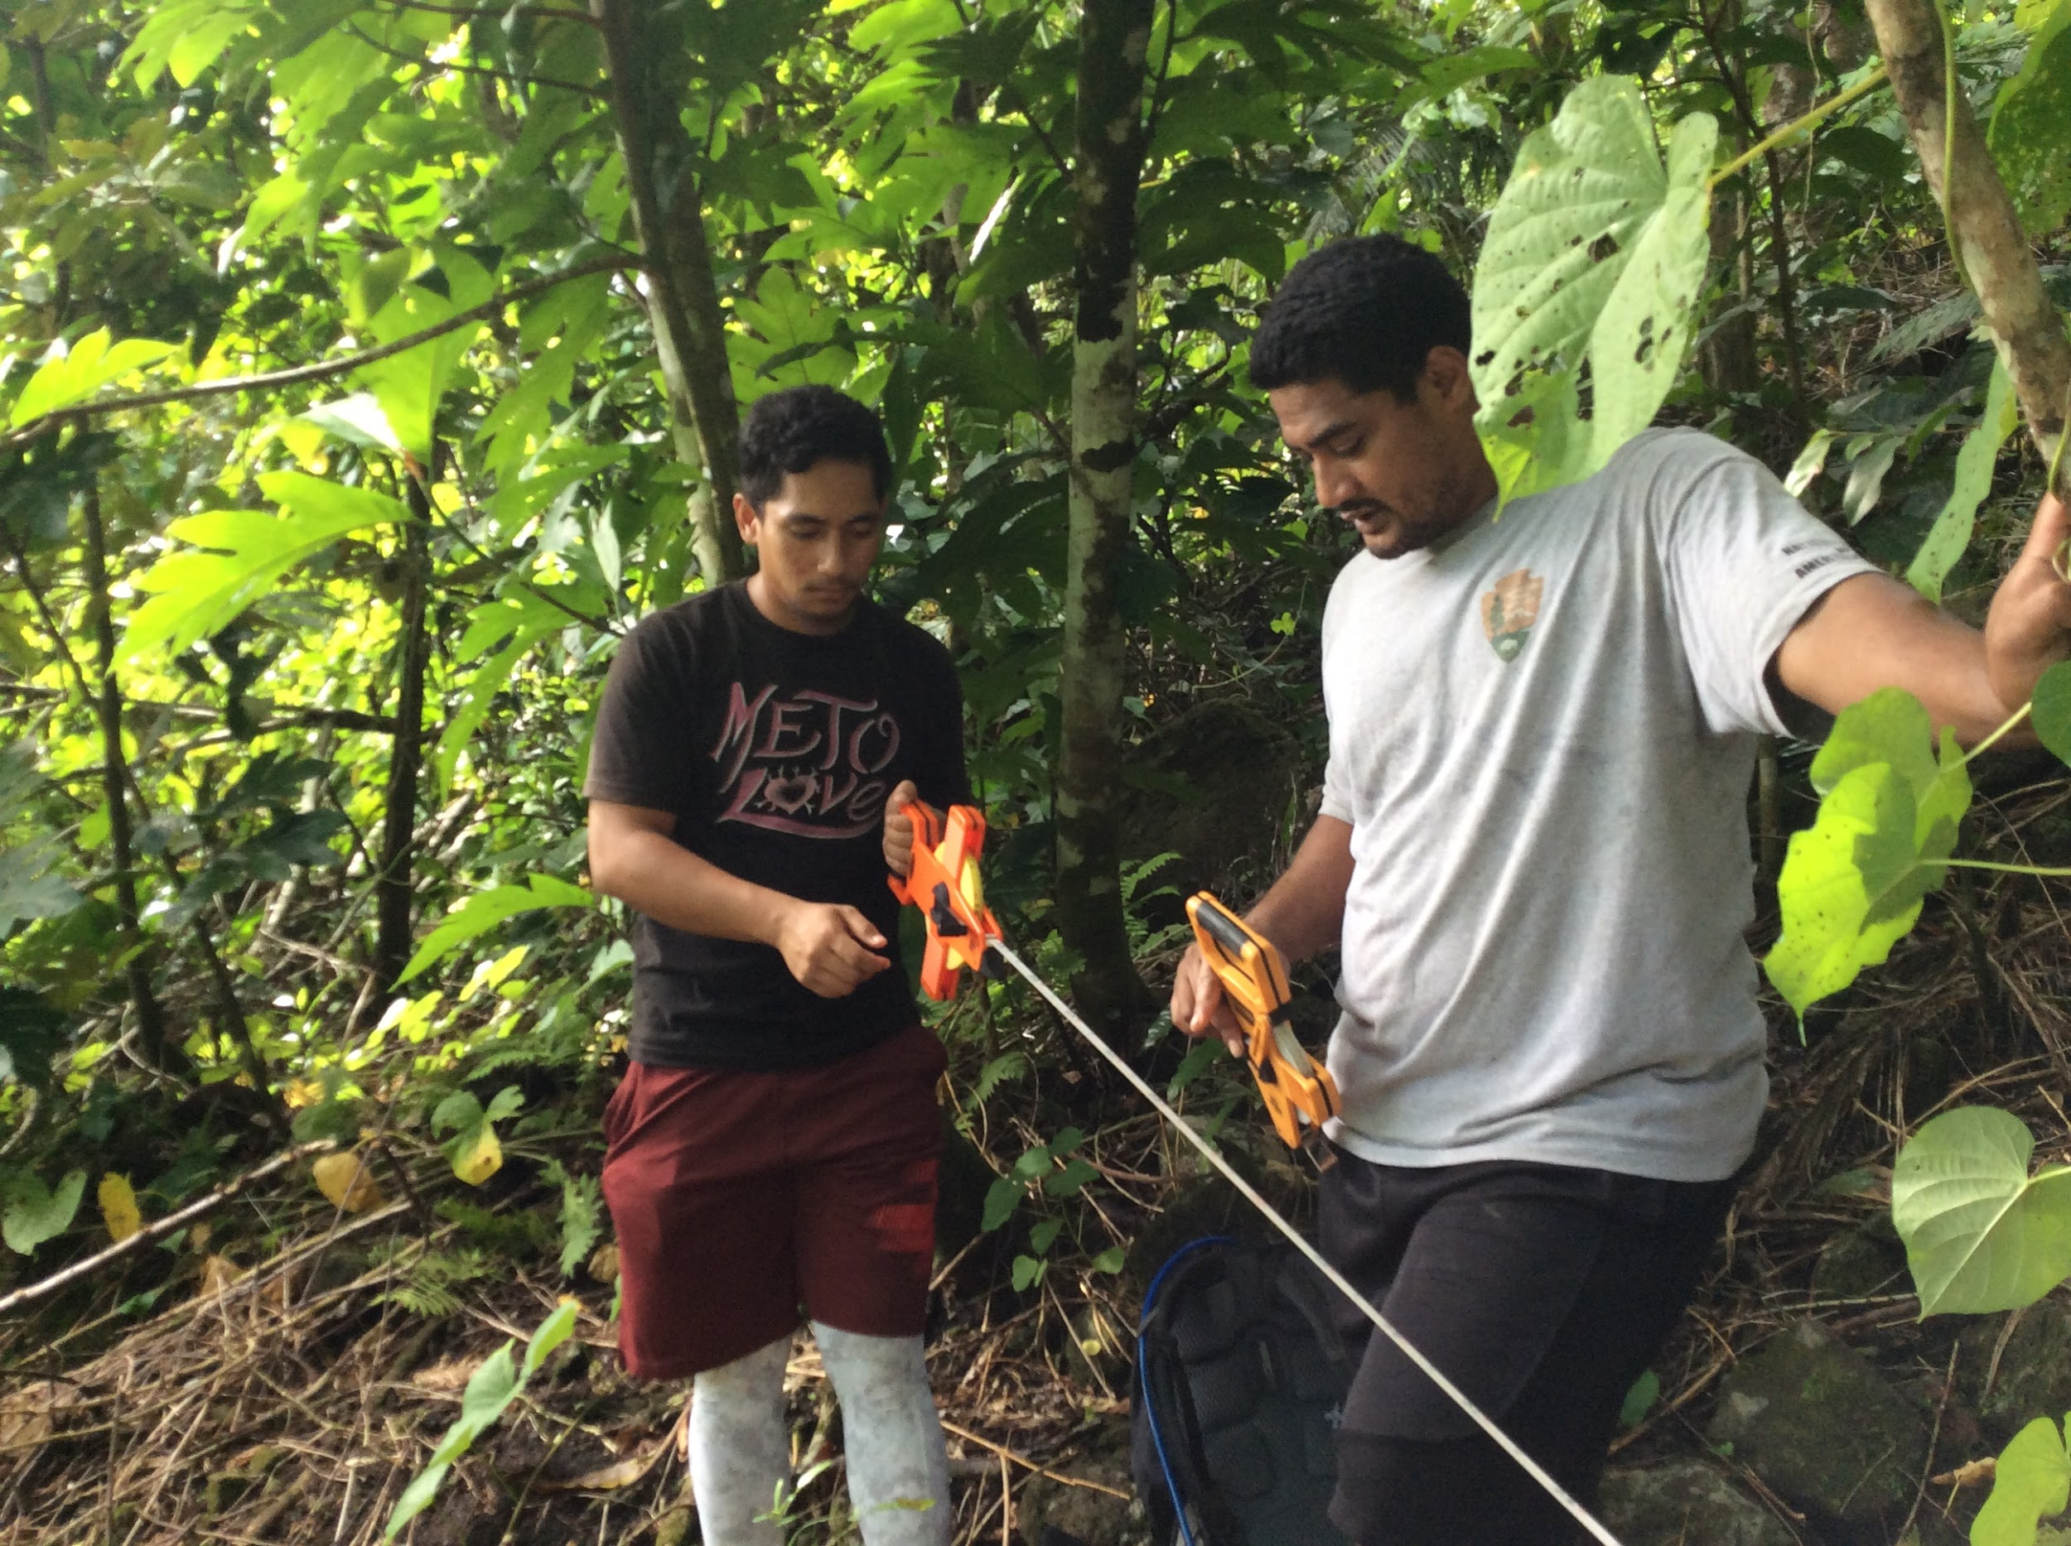
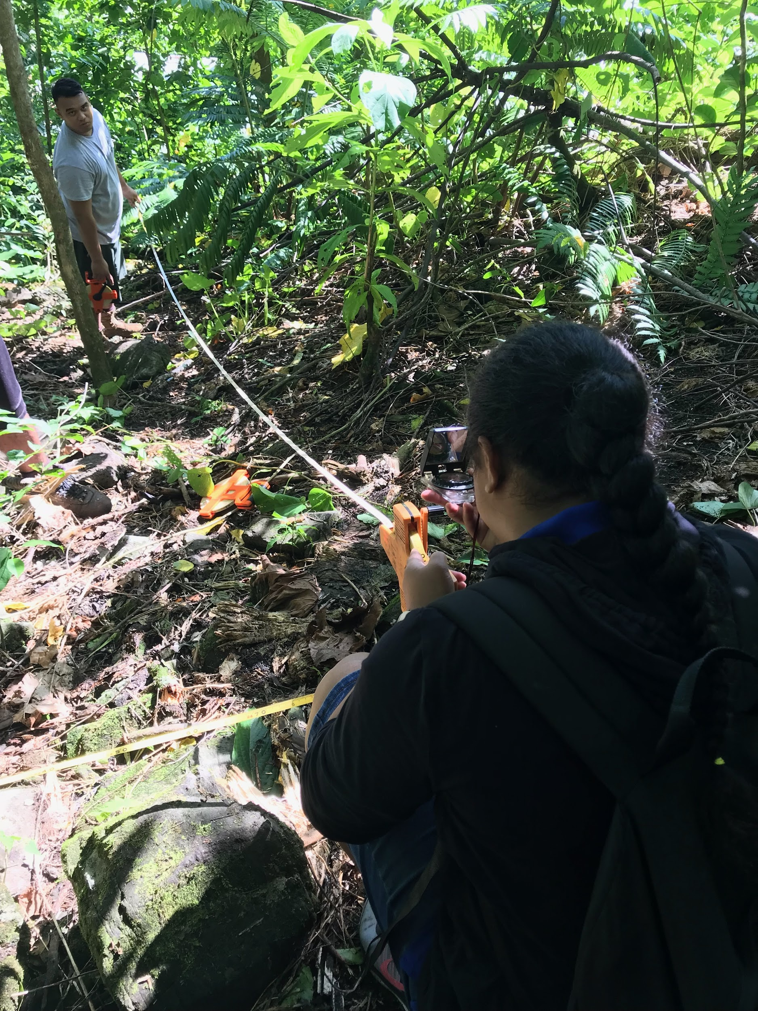
METHOD: Plot Design
1.) Locate center of plot by using GPS to find it
2.) Use compass to find direction of azimuth (which is Horizontal Axis) and set up 50m tape which 25m is the center, one would go from 25 to zero and the other end from 25 to 50m
3.) A 20 meter tape will also be set vertically from the same center at a 90 degree from the 50m tape
4.) Pull three 20m vertical lines using 30 meter transect tapes; plot set out as a quadrant

Slide 13
PLOT 20 x 50 m
PLOT EXAMPLE
TR 1
3 - 50 m transects (TR 1-3)
Q1
Q2
TR 4
20 m
Origin
TR 2
End
TR 6
Subplot 10 x 25 m
3- 20 m transects (TR 4-6)
Q4
Q3
TR 5
TR 3
Subplot 2 X 50 m
50 m

Slide 14
METHOD: Data Survey
•Understory plant cover data are surveyed in TR 1, 2, and 3
•Large trees are measured for its DBH (Diameter at Breast Height [frequently used to calculate biomass]) in all 4 quads.
•Four canopy tree height will be measured and recorded ( one tree from each quadrant [ choosing the highest tree in the quad and selecting different trees from each quadrant])
•Large tree ferns (caudex diameter > or = to 10 cm) and Small trees ( DBH greater than 1 and ,< 10) are surveyed and recorded in Q4
•Small tree ferns are surveyed in the 2 x 50 m subplot
•Coarse woody debris are recorded along TR 2, 4, and 6
•The plot slope is measures using a clinometer along TR 2, TR 4,and TR 6) from the start ( 0 meter mark ) to the end of each transect

Slide 15
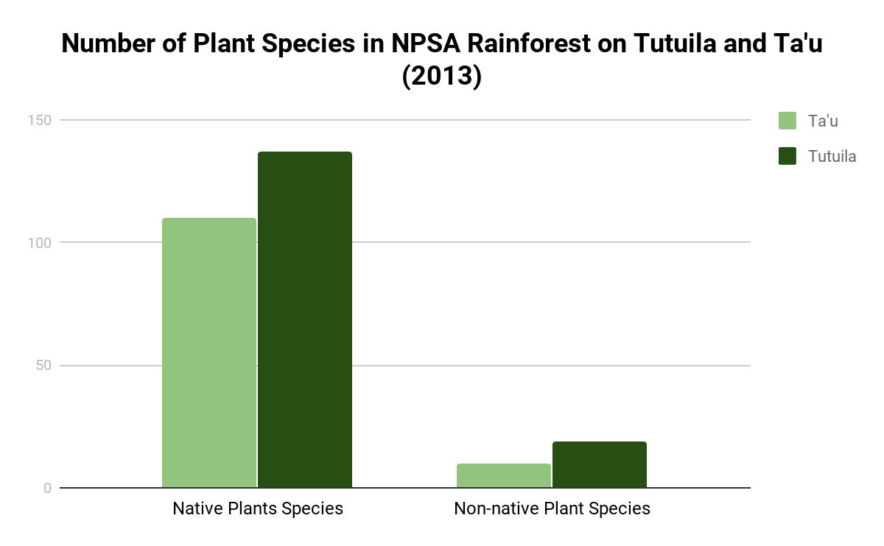
RESULTS
Number of Species
Pacific Island Network Inventory and Monitoring Focal Terrestrial Community Data
Nativity of Species
Notes:
Number of Plant Species found the Tutuila and Ta’u unit of NPSA rainforest

Slide 16
RESULTS: TA’U
Species Type | Total | Presence
Native | 110 | 91.67%
Non-Native | 10 | 8.34%
RESULTS: TUTUILA
Species Type | Total | Presence
Native | 137 | 87.82%
Non-Native | 19 | 12.18%

Slide 17
CONCLUSION
●The data supports the hypothesis
●Ta’u may have minimal number of the different types species of non-native plants because of less interaction with air cargo and shipping vessels
●Invasive Species were found in the National Parks

Slide 18
Importance of Species Richness in Native Plants
Sustainability of the richness of native plants provides:
Habitat for native birds and fruit bats
Protect Wetlands and Coastal Marine Ecosystem
Proper functions of ecosystem
Economic Services for our communities
Notes:
Last slide emphasize importance of sustaining and improving the high number and diversity of native species found in our rainforests
Very Important for forest sustainability, ecologically- not only it will
When we have a high number of native plants our ecosystem function very well, providing habitat for aquatic animals in the streams, providing habitat for native birds and fruit bats, and protect our wetlands and coastal marine ecosystem.
When have a healthy rainforest means a healthy ocean that will provide ecological services, economic services for our community and the environment.

Slide 19
REFERENCE
Whistler, W. Arthur. Rainforest Trees of Samoa: a Guide to the Common Lowland and Foothill Forest Trees of the Archipelago. Isle Botanica, 2004
Mack, Richard N., et al. “Biotic invasions: causes, epidemiology, global consequences, and control.” Ecological applications 10.3 (2000): 689-710
Vitousek, Peter M., Lloyd L. Loope, and Randy Westbrooks. “Biological invasions as global environmental change.” (2017
Vilà, Montserrat, et al. "Ecological impacts of invasive alien plants: a meta‐analysis of their effects on species, communities and ecosystems." Ecology letters 14.7 (2011): 702-708.
D'antonio, C. A. R. L. A., and Laura A. Meyerson. "Exotic plant species as problems and solutions in ecological restoration: a synthesis." Restoration Ecology 10.4 (2002): 703-713.
Florens, FB Vincent, et al. "Invasive alien plants progress to dominate protected and best-preserved wet forests of an oceanic island." Journal for nature conservation 34 (2016): 93-100.

Slide 20
ACKNOWLEDGEMENT
Our Heavenly Father
Family and Friends
Visa Vaivai-Tapusoa, NPSA
Inventory and Monitoring Crew, NPSA
Tavita Terrestrial Crew, NPSA
National Park of American Samoa
Mark Schmaedick, ASCC Land Grant
Claudia Thompson, UH PIPES Intern
Pacific STEP-UP

