Slide 1
Body mass index (BMI) during pregnancy and gestational diabetes (GDM) in American Samoa
Rosa Mareko
July 20, 2019
2019 NIDDK STEP-UP High School Symposium
Research mentors: Mata’uitafa Faiai, MPH & Aifili Tufa, MPH

Slide 2
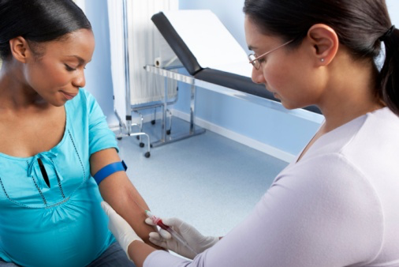
Background
GDM is a type of diabetes which only occurs during pregnancy.
Hormonal change during pregnancy and insulin resistance
Optimal GDM screening time frame (2nd trimester, 24 to 28 weeks gestation)
Oral glucose tolerance test (OGTT): routine GDM screening test
2 hour duration
Notes:
Briefly explain what occurs when a woman has GDM (what happens to the body during diabetes?): high blood sugar levels
GDM screening: Briefly explain optimal time frame and OGTT (2 hour glucose test)
Pacific Islanders are known to be at increased risk for GDM and this is compounded by high levels of pregnancy obesity.
GDM risk factors: mention list, but highlight that our project will focus on BMI (obesity) and GDM.

Slide 3
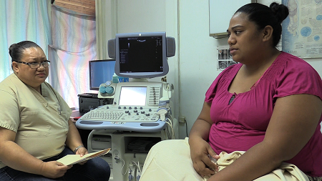
Background (cont.)
Pacific Islanders (AS): increased risk for GDM, high levels of pregnancy obesity (Hawley et.al, 2019)
GDM risk factors: Age (35 years or older), overweight/obesity, excessive gestational weight gain and family history of diabetes.
Notes:
*Explain why PIs like Samoans are at risk of developing GDM (risk factors: older age women, overweight/obesity, family history of diabetes)
* This specific study we will look at high BMI as a risk factor for GDM.
*Picture on the right is from a GDM knowledge intervention video shown at the LBJ OBGYN clinic (collaboration between Yale University, LBJ OBGYN Dept, ASCC and UNC.

Slide 4
Objectives and Hypotheses
Objective: To determine if high BMI (≥30 kg/m2) during first trimester of pregnancy is associated with GDM.
Hypothesis: High first trimester BMI (≥30 kg/m2) is associated with GDM
Null hypothesis: High first trimester BMI is not associated with GDM (Independent factors)
Alternative hypothesis: High first trimester BMI is associated with GDM
Notes:
Briefly explain objective and hypothesis (Null and alternative hypotheses based on chi square test of independence)
BMI >= 30 obesity

Slide 5
Methods
Descriptive statistics
Count or percentages
Demographics : Age and marital status
Health indicators: weight and BMI
Analytical Statistics
Chi-square test (Chi-square statistic, p-value (< 0.05 vs. >0.05)
Test association between BMI and GDM.
Microsoft Excel chi-square functions
GDM Dataset
Electronic Health Record (EHR) Review, 2017
GDM prevalence study in AS
Collaboration: LBJ OBGYN Dept., DOH MCH Division, PIHOA
Sample size: 147 pregnant women (2016)
Notes:
Epidemiology (2 main statistics)
What is descriptive statistics? (What did we do?)
What is analytical statistics? (What tests did we do?)
GDM dataset: EHR review of women who gave birth in 2016.

Slide 6
Results (Table 1: Demographics)
Variable | Range | Count | Percent
Demographics
Age | 15-43 years
 | <30 years | 90 | 61.2
 | ≥30 years | 57 | 38.8
 | Total | 147
Marital status | Married | 89 | 60.5
 | Never married | 56 | 38.1
 | Divorced | 2 | 1.4
 | Total | 147
Notes:
*Describe your descriptive statistic table
1)Demographics: Age and marital status (age range 15-43 years, about 60% of women who gave birth were <30 years of age; for marital status about 60% of women who gave birth were married and about 38% were not married.

Slide 7
Results (Table 2: Health Indicators)
Variable | Range | Count | Percent
Health indicators
First trimester weight | 41-216 kg
 | <100 kg | 107 | 72.8
 | ≥100 kg | 40 | 27.2
 | Total | 147
First trimester BMI | 14-71 (kg/m2)
 | <30 (kg/m2) | 71 | 48.3
 | ≥30 (kg/m2) | 76 | 51.7
 | Total | 147
GDM Diagnosis | Not GDM Diagnosed | 134 | 91.2
 | GDM Diagnosed | 13 | 8.8
 | Total | 147
Notes:
2) Health indicators: 1st trimester weight, range is from 41-216 kg, more than 70% of women weighed less than 100kg and about 30% weighed more than 100kg, looking at 1st trimester BMI range is from 14-71 kg/m2, more than 50% of pregnant women had a BMI of 30 or higher. Finally when looking at GDM Diagnosis, about 9% of the pregnant women were diagnosed with GDM.

Slide 8
Results (Analytical Statistics)
Chi-square test of independence (High BMI and GDM diagnosis)
Chi square statistic: 4.7935
p-value: 0.028566
p<0.05: statistically significant, reject the null hypothesis (2 factors: BMI and GDM are independent or not associated)

Slide 9
Discussion
Hypothesis
Reject null hypothesis: No association between high 1st trimester BMI and GDM diagnosis
Conclude: Alternative hypothesis (There is an association between high 1st trimester BMI (≥30kg/m2) and GDM
Limitations
Small sample size (n=147 women)
Data availability (gestational weight for each trimester not available in dataset)
Short project timeline (5-6 weeks)
Future plans
Gestational weight gain (1st, 2nd, 3rd trimester of pregnancy) and GDM diagnosis

Slide 10
References
Hawley, N.L., Johnson, W., Hart, C.N., Triche, E.W., Ah Ching, J., Muasau-Howard, B., McGarvey, T.S. (2015). Gestational weight gain among American Samoa women and its impact on delivery and infant outcomes.
Hawley, N.L., Rosen, R.K., Ashton Strait, E., Raffucci, G. Holmdahl, I., Freeman, J.R., Muasau-Howard, B.T., McGarvey, S.T. (2015). Mothers’ attitudes and beliefs about infant feeding highlight barriers to exclusive breastfeeding in American Samoa.
Kocher, E.L., Sternberg Lamb, J.M., McGarvey, S.T., Faiai, M., Muasau-Howard, B.T., Hawley, N.L. (2018). Conceptions of pregnancy health and motivations for healthful behavior change among women in American Samoa.
Notes:
Cite the articles you read here in APA format (I forwarded you the link)

Slide 11
Acknowledgements
Mentors: Mata’uitafa Faiai & Aifili Tufa
NIDDK High School STEP-UP (Dr. Mark Schmaedick)
Brittany Meyer (GDM prevalence dataset)
Maternal Child Health Division, Department of Health
Family & Friends
Staff of Fagaitua High School

Slide 12
Questions

