Slide 1
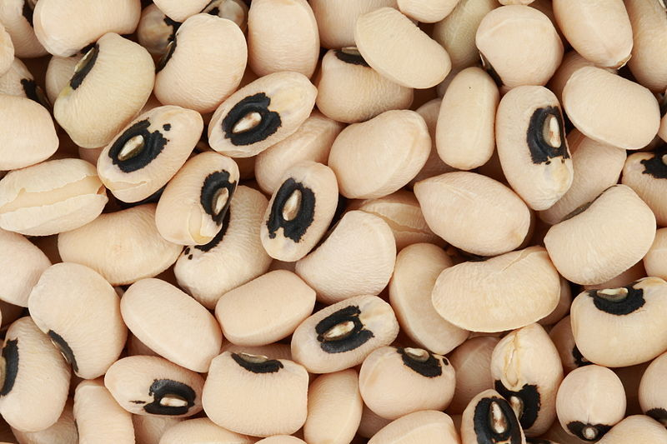
Demonstrating the “Ratio Problem” Using A Cotyledon Experiment
College of Natural and Applied Sciences
Mentor: Dr. Timothy Righetti
Funding Agency: NIH/NIDDK STEP-UP
Johann Rei Castro

Slide 2
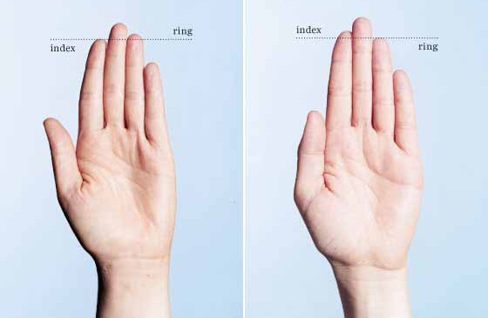
Introduction
Scientists regularly use ratios, however, ratios can produce misleading interpretations.
Local importance: Ratios are extensively used for both terrestrial and marine research at University of Guam
Ratio problems have been well-known for over a hundred years.
Scientists often ignore the issue and use inappropriate statistics.
Sources:

Slide 3
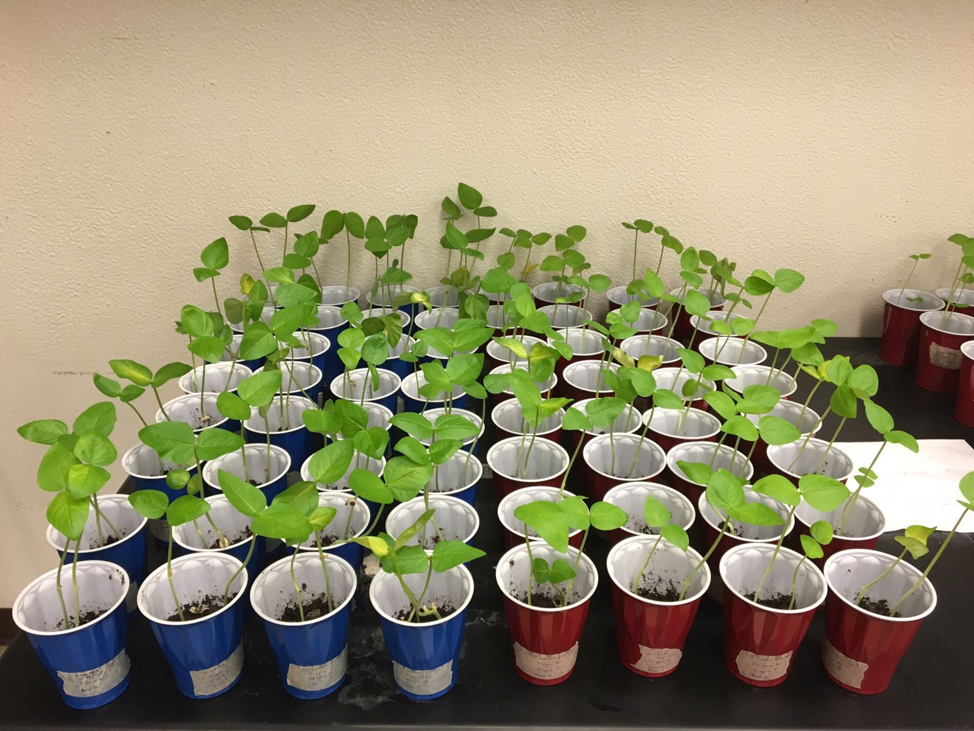
Objectives
To develop a laboratory experiment, using cowpea (Vigna unguiculata) plants, that would demonstrate the “ratio problem”
To analyze the leaf darkness and shoot-root ratio of the plants
Hypothesis
After making a very simple analysis (leaf pigmentation), students will misinterpret results, if unaware of ratio difficulties while analyzing shoot-root ratios.

Slide 4
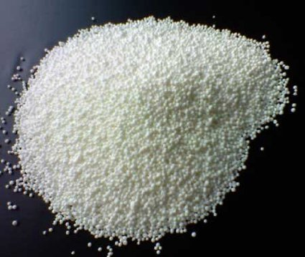
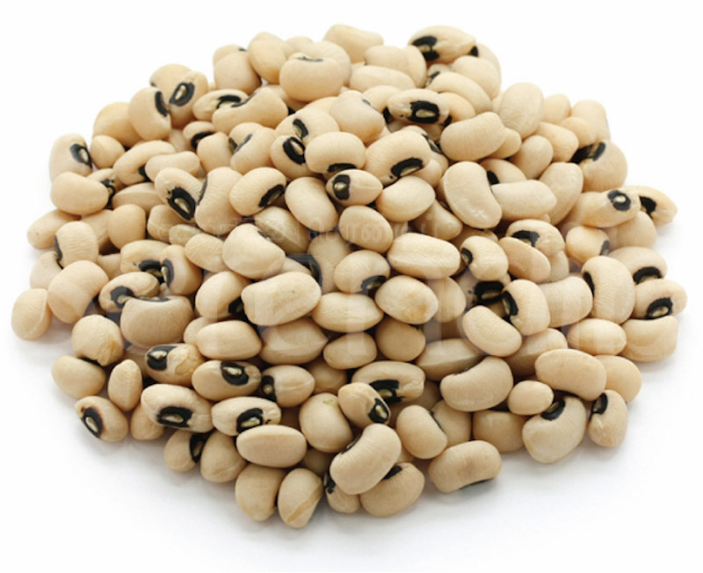
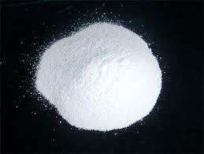
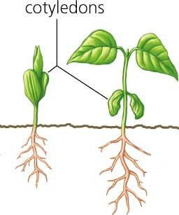
Materials & Methods
Planted 480 cowpeas (Vigna unguiculata) with various nitrogen and phosphorus treatments
Removed cotyledons after a week
Harvested 160 plants a week after the cotyledons were removed
Measured the leaves’ green pigment
of two and four-week old plants
(photographically using ImageJ)
shoot
root

Slide 5
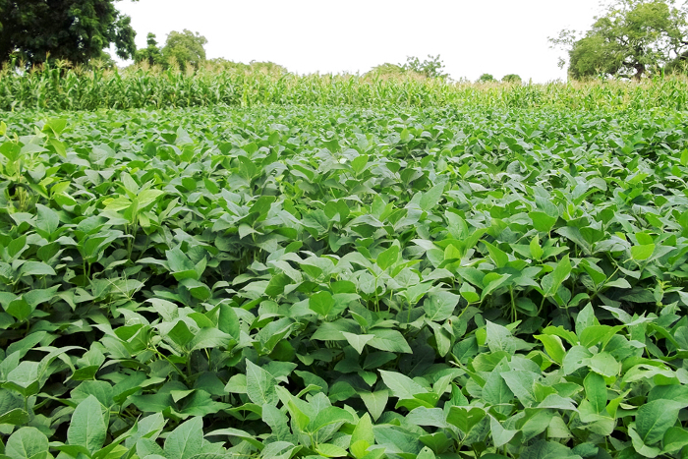
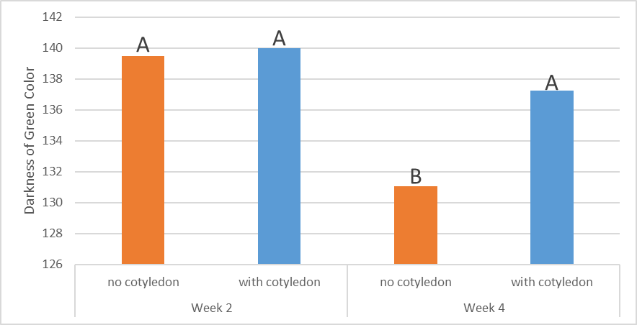
Time
Cotyledon
Time x Cotyledon
0.038
0.001
0.078

Slide 6
Finger Ratio
Finger ratios have been associated with gender, testosterone, homosexuality and mouse behavior (an NIH-funded project).
Two scientists presented evidence that the whole finger story is an artifact.
Dr. Righetti’s Jasmine’s
Finger Ratio:
2nd digit (index):4th digit (ring)

Slide 7
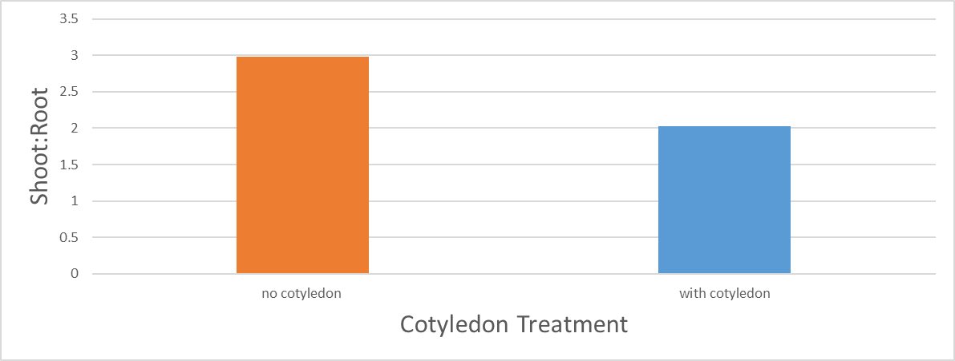
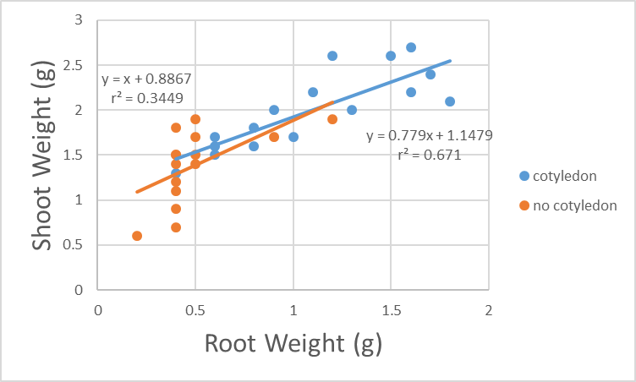
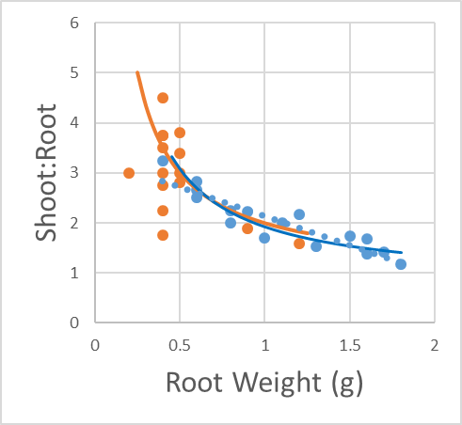
Data
no cotyledon
with cotyledon
The effect of cotyledon removal upon emergence (week 1) on shoot-root ratio for two-week old cowpea (Vigna unguiculata) seedlings. The cotyledon removal effect approaches statistical significance (p=0.065).

Slide 8
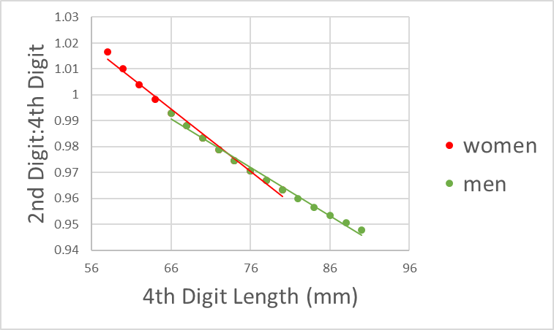
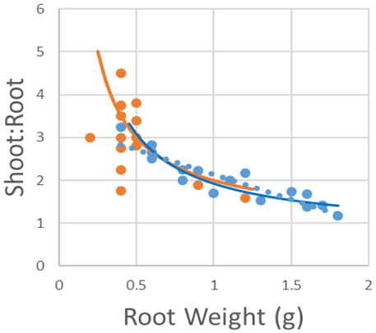
women
men
no cotyledon with cotyledon
Lukas Kratochvil and Jaroslav Flegr, 2009
Ratio = 0.823 x 4th digit length + 11.223

Slide 9
Conclusions
Color Analysis
Results are straight-forward and easy to interpret. Removing cotyledons produces leaves that are lighter in green color after four weeks.
Shoot-Root Ratio
The effect of the cotyledon removal on the shoot-root ratios of plants is indirect.
Regression results produce a different conclusion than a traditional analysis of anatomical ratios.
We make two different conclusions depending on how we analyze the data.

Slide 10
Always be careful when analyzing ratios!

Slide 12
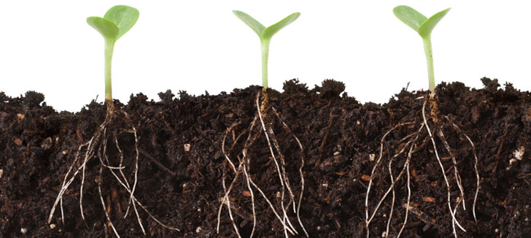
References
Pearson, K. 1897. On a form of spurious correlation which may arise when indices are used in the measurement of organs. Proc. R. Doc. London. 60: 489-502.
Tanner, J.M. 1949. Fallacy of per-weight and per-surface are standards and their relation to spurious correlation. J. Appl. Physiology.
Kratochvil, L. and Flegr, J. 2009. Differences in the 2nd to 4th digit ratios in humans reflect shifts along the common allometric line. Biology Letters 5: 643-646.
I would like to acknowledge:
Maegan Delfin for taking the photographs presented here.
Cathy and Tina Nguyen, and the rest of the crew who are working in Dr. Righetti’s lab, for helping me set up my experiment. ☺

Slide 13
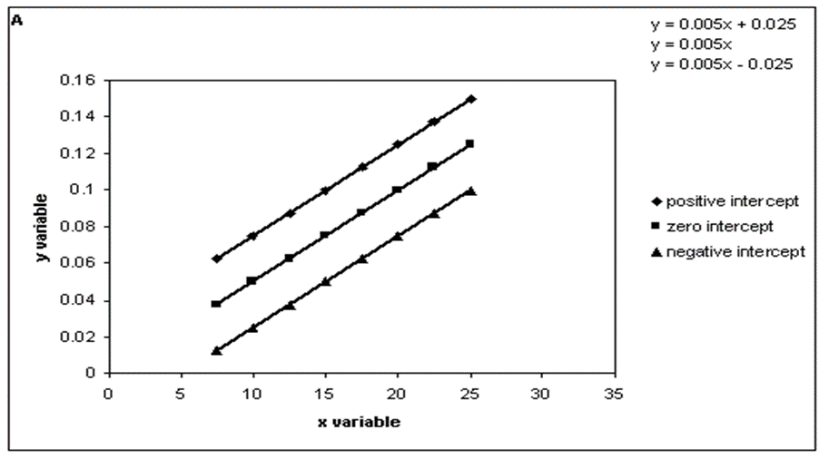
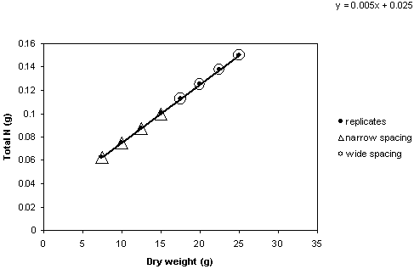
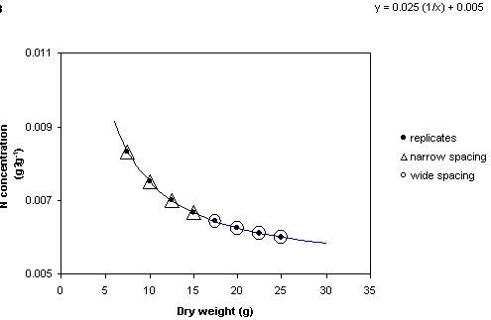
Math
y = mx + b
y/x = b (1/x) + m
y = mx + b
y/x = b (1/x) + m

